Slide 1
Categorization of EEG-Data by type of Motor Movement
Joshua El-Samalouti, Puliyampatta Anil sasikumar menon, Abidur rahman

Slide 2
Literature Review
Preprocessing:
Limit to 17 channels associated with movement (Yimin Hou et al (2020))
Use of Bandpass function (Yimin Hou et al (2020))
Use of Morlet wavelet transformation (Yimin Hou et al (2020))
Model:
CNN (A. Schirrmeister et al. (2017), Yann LeCun et al. (2015))
LSTM (Alaa M. M. Anwar et al. (2018))
RNN (Rajesh Kumar et al. (2018))
DBN (Wei Yang et al. (2015), Kun-Hsing Yu et al. (2018))

Slide 3
Dataset Characteristics
64 Channels
14 Recordings of Time Series per Patient
109 Patients
1-2 Minutes per Recording
160 Samples per Second
First derivative of tension in microvolt
Notes:
Found on Physionet.org, patients 1 each for baslines, 3 each for 4 tasks

Slide 4
Dataset Characteristics
Eyes Open
Eyes Closed
Opening and closing left or right fist
Imagining opening and closing left or right fist
Opening and closing both fists or both feet
Imagining opening and closing both fists or both feet
Notes:
Found on Physionet.org

Slide 5
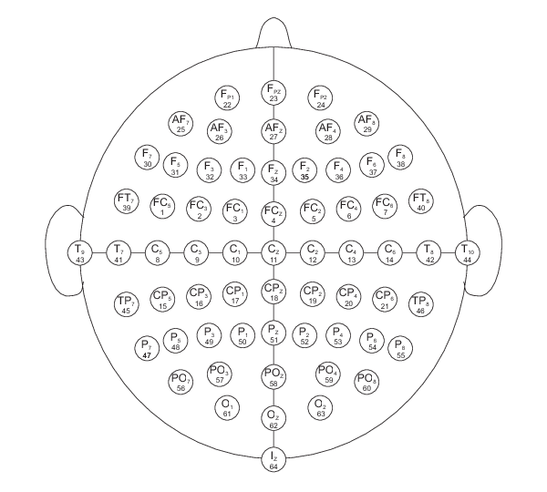
Dataset Characteristics
Notes:
Unusual montage

Slide 6
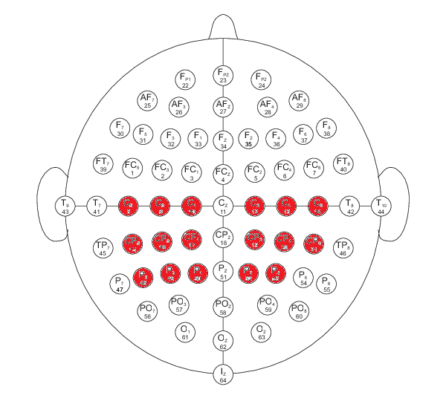
Dataset Characteristics
Notes:
Unusual montage

Slide 7
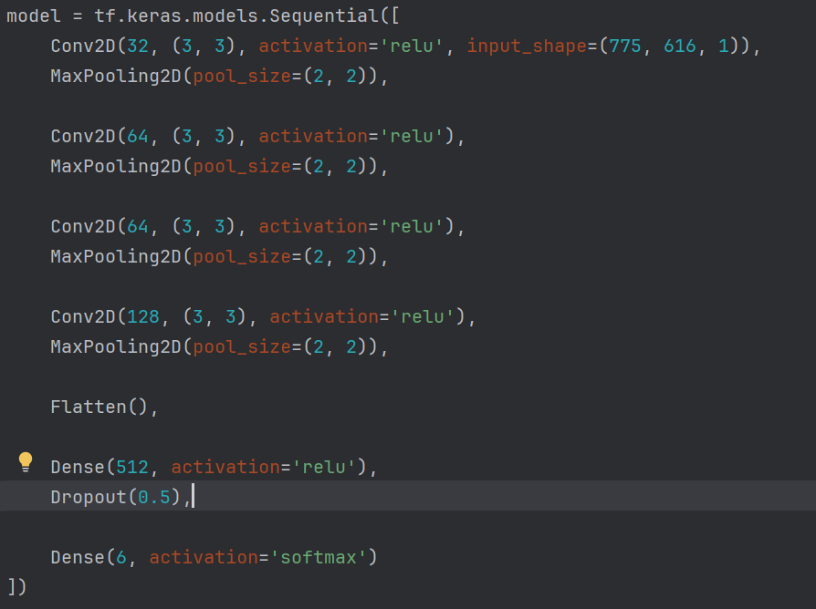

Baseline Model
Implementation of bandpass function

Slide 8
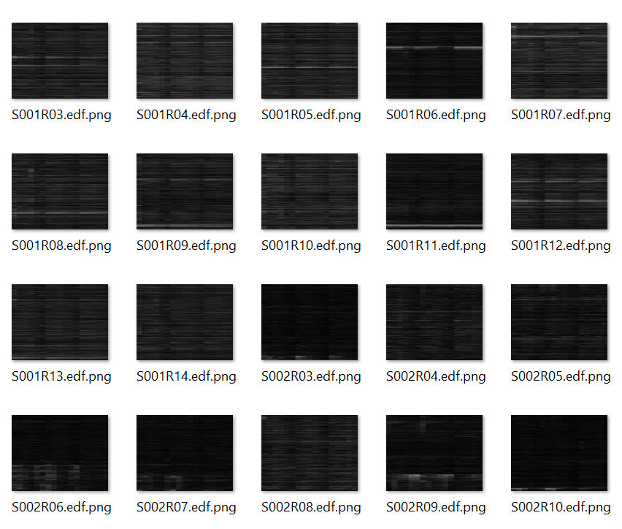
Model Definition and Evaluation
Use of absolute values
Export of data as heatmap images
Import of data with ImageDataGenerator
Change to binary classification
Removal of bandpass function

Slide 9
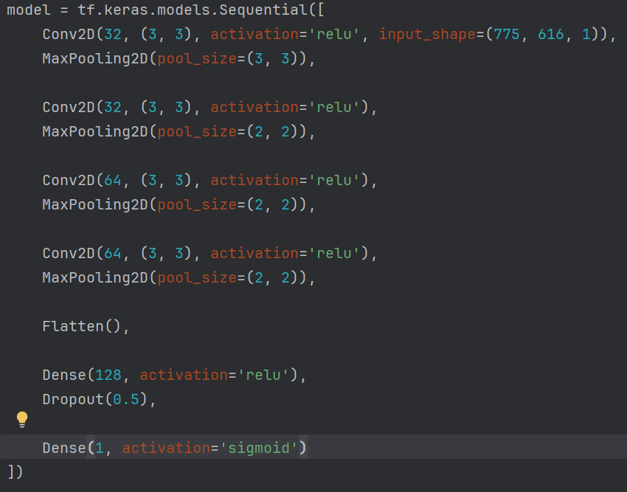
Model Definition and Evaluation
Increased pool size
Reduced convolution filters
Reduced Dense layer units
Sigmoid activation function

Slide 10
Challenges
Recording length varied slightly
Model performance
Positive and negative values without a clear maximum or minimum
Large filesizes
Small amount of available data

Slide 11
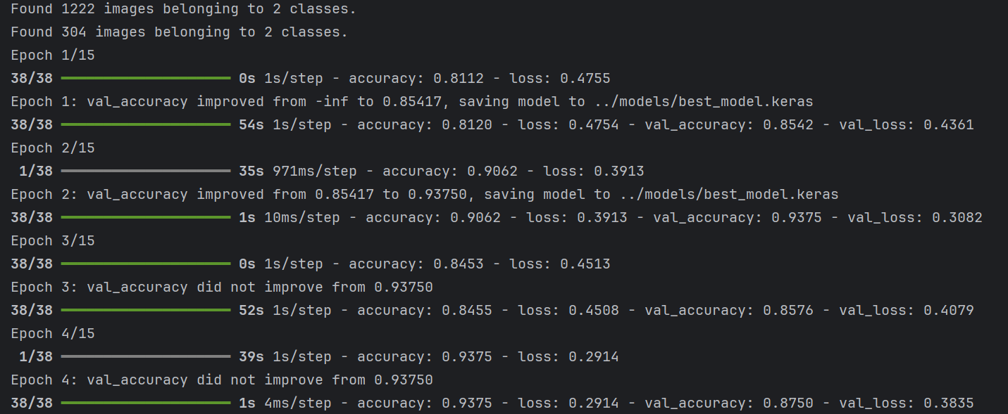
Results

Slide 12
References
"Deep Learning with Convolutional Neural Networks for EEG Decoding and Visualization" by Yann LeCun et al. (2015)
"Deep learning with convolutional neural networks applied to EEG decoding and visualization" by A. Schirrmeister et al. (2017)
"A Recurrent Neural Network Approach for Classification of EEG Based Motor Imagery Signals" by Alaa M. M. Anwar et al. (2018)
"Classification of EEG signals using LSTM network" by Rajesh Kumar et al. (2018)
"EEG-based intention recognition from unstructured thoughts via deep belief network" by Wei Yang et al. (2015)
"Sparse autoencoder-based feature learning for EEG classification" by Kun-Hsing Yu et al. (2018)
"A novel approach of decoding EEG four-class motor imagery tasks via scout ESI and CNN" by Yimin Hou et al. (2020)

