Slide 1


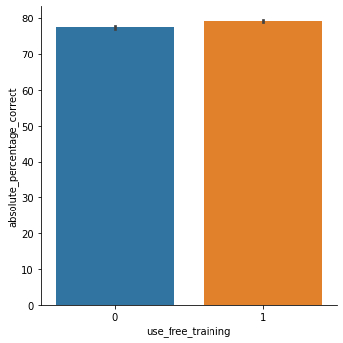
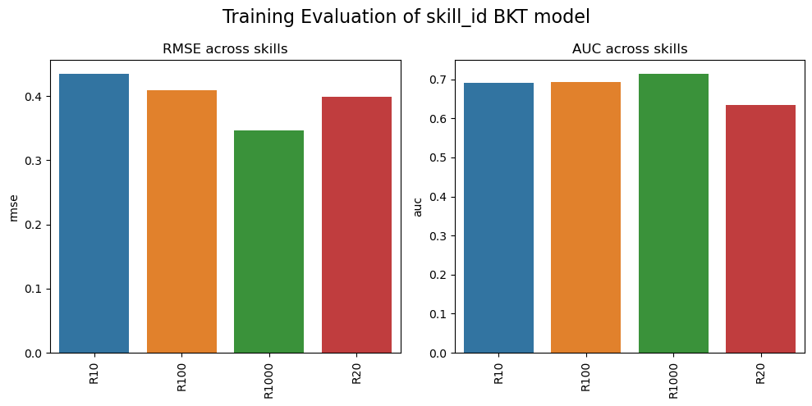
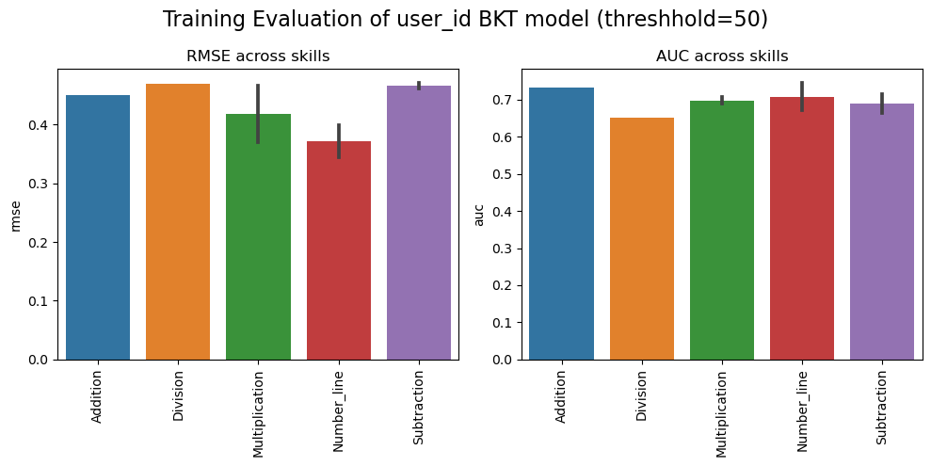
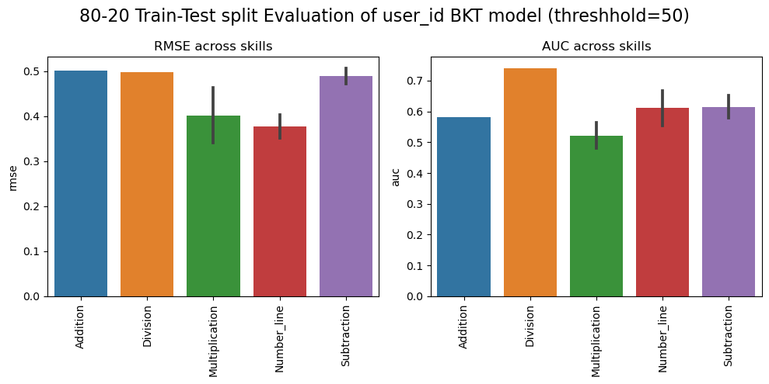
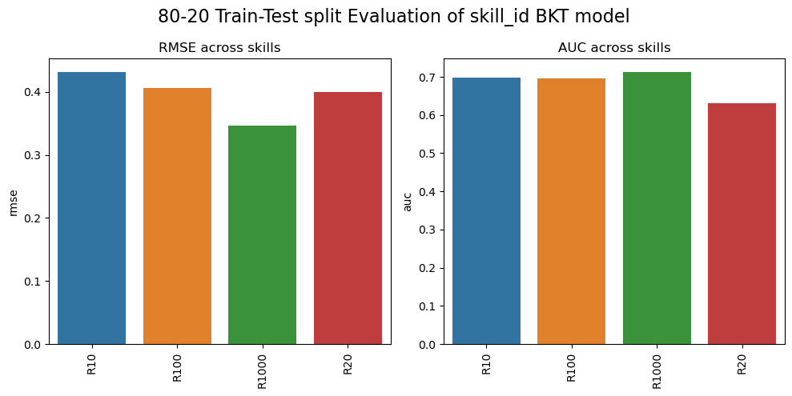
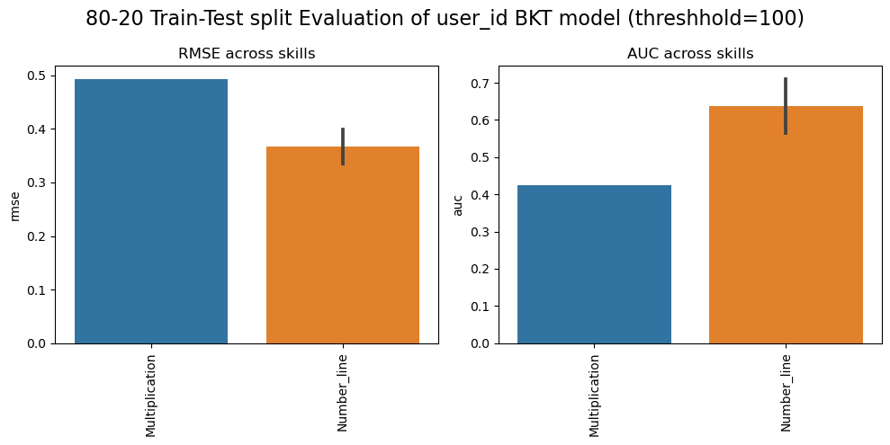
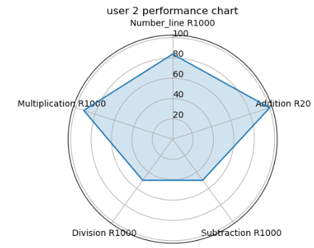
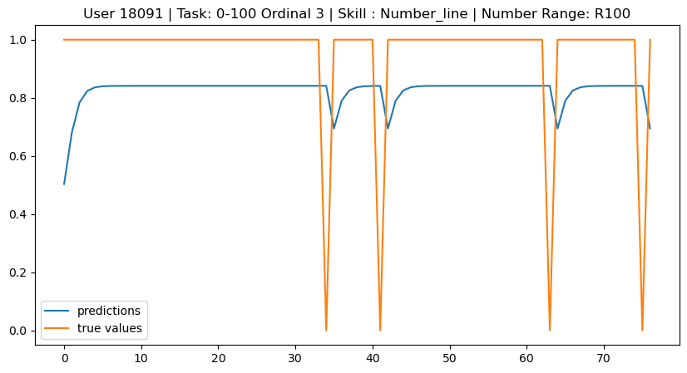
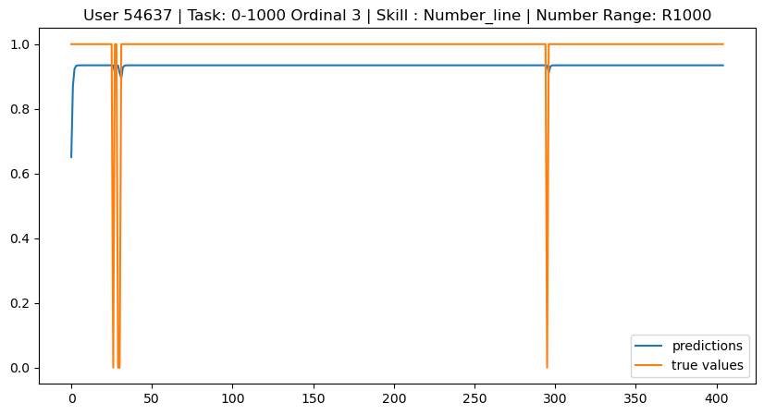
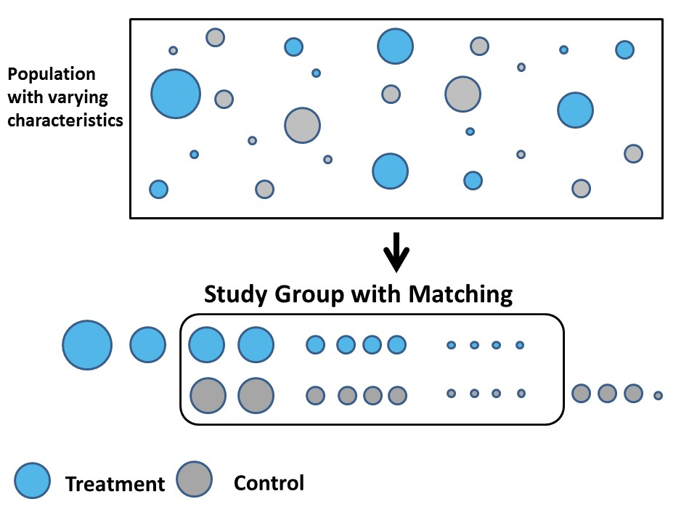
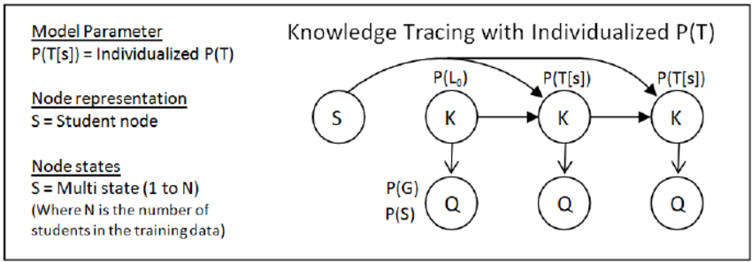
Calcularis user performance analysis
  ^{Authors : LeuRah}
  Aouame Mohamed Yassine – Youssef El Ouazzani - Mohamed Badr Taddist
  Machine Learning for Behavioral Data (MLBD) Course, EPFL, 2022
1 INTRODUCTION + RESEARCH QUESTION
3 RESULTS
This report provides a comprehensive analysis of the calcularis dataset, aiming to gain insights into the effectiveness of the calcularis program and explore predictive models for user performance. The analysis addresses two research questions: performance prediction and performance comparison. The first question focuses on developing predictive models to forecast user performance across various skills, allowing for personalized recommendations. The second question investigates the impact of free training on student performance through propensity score matching, comparing outcomes between users who utilize free training and those who do not. These analyses provide valuable insights into the effectiveness of the free training feature and its influence on student achievement.
A:Observational Study :
Skill | Scores
Addition | 0 : 44.08 – 1 : 46.77
Subtraction | 0 : 42.99 – 1 : 46.60
Division | 0 : 15.20 – 1 : 16.87
Multiplication | 0 : 59.42 – 1 : 65.10
Number_line | 0 : 74.50 – 1 : 73.63
Figure 3. Weighted scores for matched groups
B: Student performance prediction
P-Value = 0.0 implies statistical significance of the differences between the 2 groups
Figure 5 : Mean training and testing accuracies across different skills for 2 trained models with different hyperparameter
Figure 4. Mean absolute percentage of correct answers for matched groups
2 METHODOLOGY
Dataset
Model Architecture
A: Predictive modeling: Used a multi-learn user_id Bayesian knowledge tracing model to predict user performance on different skills.
B: Inferential analysis: Enhancing data with free_training_time, we used logistic regression and K-nearest neighbors to perform fair propensity score matching on similar users and compare their performance.
Tables | 3 main tables : events (which can include many subtasks), subtasks and users | Subtasks_weeks : time series of users' performance over weeks
Skills | Using K-means, we clustered skill_ids into 5 main skills: Number_line, Addition, Subtraction, Division, Multiplication | Each skill has 4 difficulty levels, increasingly : R10, R20, R100 and R1000
Metrics | Absolute percentage of correct answers | Weighted score computed for each skill as a sum over the following mapping of difficulties : {'R10': 1, 'R20': 2, 'R100': 10, 'R1000': 100}
Visualization: Included a visualization of user strengths and skill levels.
User Id BKT model
Skill Id BKT model
Figure 6 : Prediction on test data for a sample of 2 users
4 CONCLUSION
In conclusion, the analysis of the Calcularis dataset provided valuable insights into user performance and the impact of free training. The Bayesian Knowledge Tracing (BKT) models effectively predicted user performance, enabling personalized recommendations for students. Users who utilized free training showed significantly higher performance, emphasizing its effectiveness in enhancing student achievement. These findings have implications for personalized learning and highlight the importance of additional resources. Continuous analysis and improvement can further enhance the Calcularis program and provide a more impactful learning experience for students.
REFERENCES
Figure 1. Observational Study model using propensity score to match comparable students
Figure 2. Multi-learn Student Bayesian knowledge tracing model
[1] https://github.com/CAHLR/pyBKT-examples
[2] https://school.alemira.com/de/calcularis/

