Slide 1

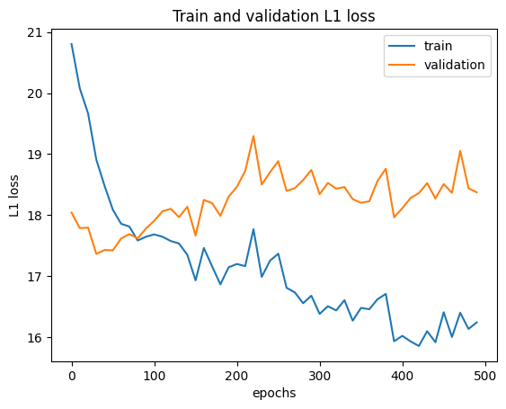
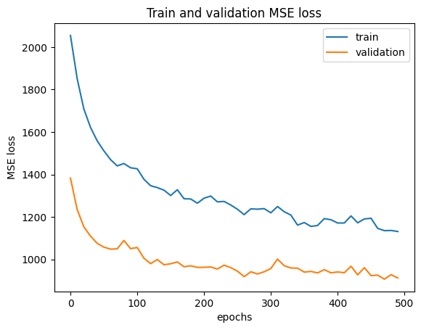
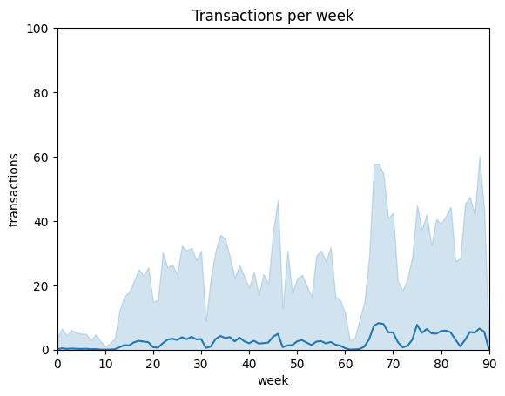
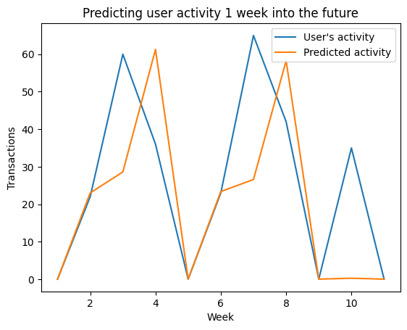
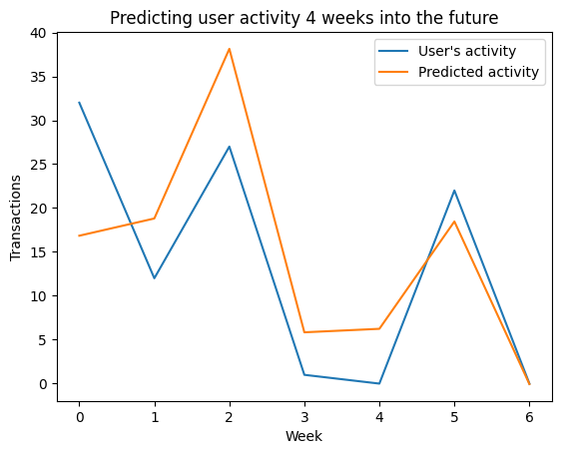

LSTM TO PREDICT STUDENT ENGAGEMENT
A study conducted on Lennarvi, an educational web application
Dragos Albastroiu, Nathan Chettrit, Hongyi Shi
Machine Learning for Behavioral Data (MLBD) Course, EPFL, 2023
1 INTRODUCTION + RESEARCH QUESTION
3 RESULTS
It is well known that a major issue that slows down students in their learning is not their understanding of the topics or exercises difficulty, but their consistency in their learning curve and thus their engagement toward their study.
Here, we decided to focus on predicting user engagement on Learnnavi as it can result in meaningful data that can help the web application in providing more resources and support for users who may reduce their activity in the near future.
We trained using two different loss functions: L1 loss function and MSE. The training were done for different type of model depending on the loss, we used the L1 loss function for training a 1 week ahead predictor, and MSE loss function for training a 4 week ahead predictor.
1 week ahead using L1 loss
Results stabilize after 50-100 Epochs.
Validation loss increases after the ~25 first Epochs.
Significant overfitting
4 week ahead using MSE
Promising improvement compared to L1 loss.
Results stabilize after 200-300 Epochs.
Validation loss much more stable compared to L1 loss.
No visible overfitting so far; validation loss decreases along with the training loss.
Despite difference in the loss curve, while predicting a single user engagement from our test set, both models were able to show satisfying results.
2 METHODOLOGY
Model Architecture
Stacked LSTM:
3 LSTM layers
2 dropout layers with a probability of 0.1
1 Linear layer
Adam optimizer
L1 loss function (1 week ahead) and MSE (4 week ahead)
LSTM is an RNN deep learning model. Thus, features selection is less crucial as it aims to predict itself which features are the most meaningful through the training process. We however still had to select some from the provided dataset in order to reduce the dataset size.
Dataset
113 features
3 categorical features, one-hot encoded
22201 users
Label: engagement - number of transactions per week
Time serie: data spread on several weeks
Figure 2. Training and validation loss for both models
4 CONCLUSION
LSTM is an effective model for predicting user engagement.
MSE loss shows more satisfying loss curve compared to the L1 loss function, however both prediction accuracies are similar.
LSTM does not require 500 Epoch to show a satisfying accuracy.
Figure 1. Mean transaction per week
Figure 3. Prediction sample for both models

Slide 2
LSTM TO PREDICT STUDENT ENGAGEMENT
A study conducted on Lennarvi, an educational web application
Dragos Albastroiu, Nathan Chettrit, Hongyi Shi
Machine Learning for Behavioral Data (MLBD) Course, EPFL, 2022
1 INTRODUCTION + RESEARCH QUESTION
3 RESULTS
It is well known that a major issue that slows down students in their learning is not their understanding of the topics or exercises difficulty, but their consistency in their learning curve and thus their engagement toward their study.
Here, we decided to focus on predicting user engagement on Learnnavi as it can result in meaningful data that can help the web application in providing more resources and support for users who may reduce their activity in the near future.
We trained using two different loss functions: L1 loss function and MSE. The training were done for different type of model depending on the loss, we used the L1 loss function for training a 1 week ahead predictor, and MSE loss function for training a 4 week ahead predictor.
1 week ahead using L1 loss
Results stabilize after 50-100 Epochs.
Validation loss increases after the ~25 first Epochs.
Significant overfitting
4 week ahead using MSE
Promising improvement compared to L1 loss.
Results stabilize after 200-300 Epochs.
Validation loss much more stable compared to L1 loss.
No visible overfitting so far; validation loss decreases along with the training loss.
Despite difference in the loss curve, while predicting a single user engagement from our test set, both models were able to show satisfying results.
2 METHODOLOGY
Model Architecture
Stacked LSTM:
3 LSTM layers
2 dropout layers with a probability of 0.1
1 Linear layer
Adam optimizer
L1 loss function (1 week ahead) and MSE (4 week ahead)
LSTM is an RNN deep learning model. Thus, features selection is less crucial as it aims to predict itself which features are the most meaningful through the training process. We however still had to select some from the provided dataset in order to reduce the dataset size.
Dataset
113 features
3 categorical features, one-hot encoded
xxx users (TBD)
Label: engagement - number of transactions per week
Time serie: data spread on several weeks
Figure 2. Training and validation loss for both models
4 CONCLUSION
LSTM has shown being an effective model for predicting user engagement on a time serie dataset.
MSE loss shows more satisfying loss curve compared to the L1 loss function, however both prediction accuracies are similar.
LSTM is an efficient model that does not require 500 Epoch to show a satisfying accuracy.
REFERENCES
Figure 1. Mean transaction per week
[1]
[2]
[3]

