Slide 1

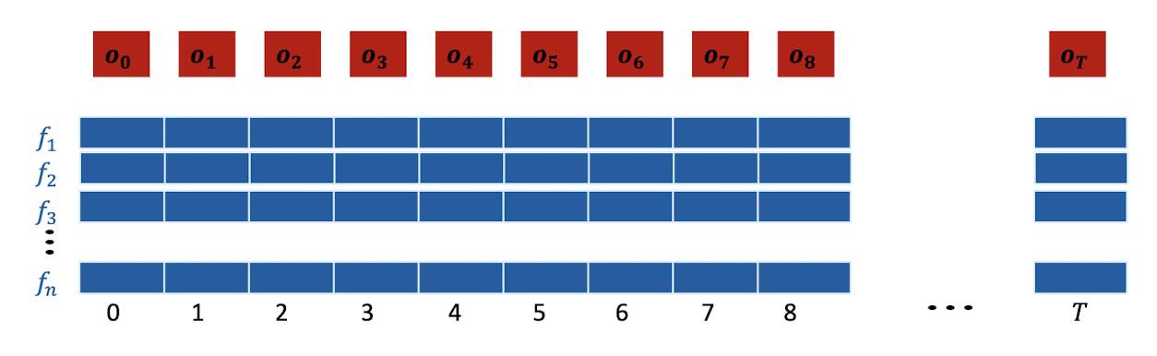
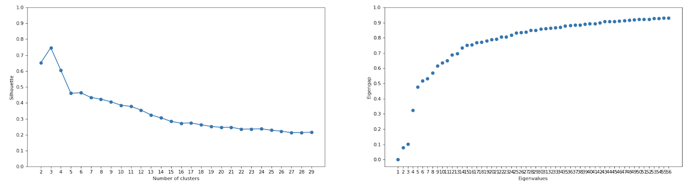
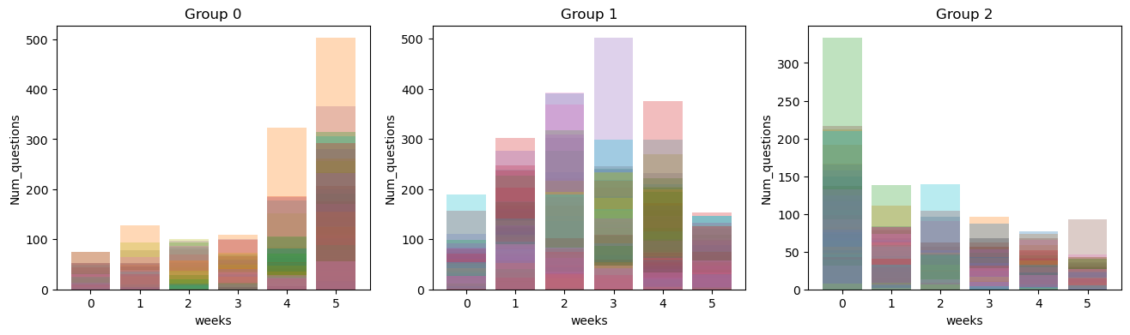
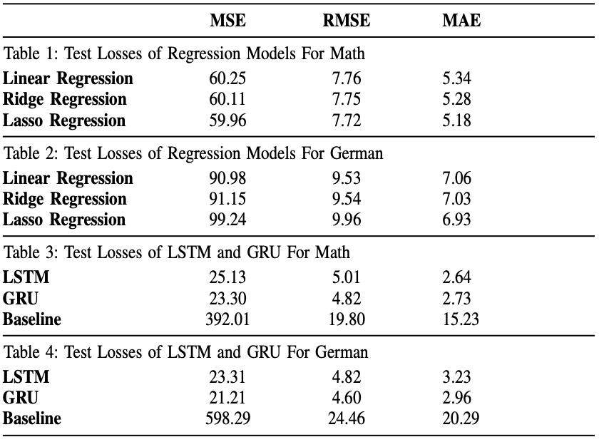
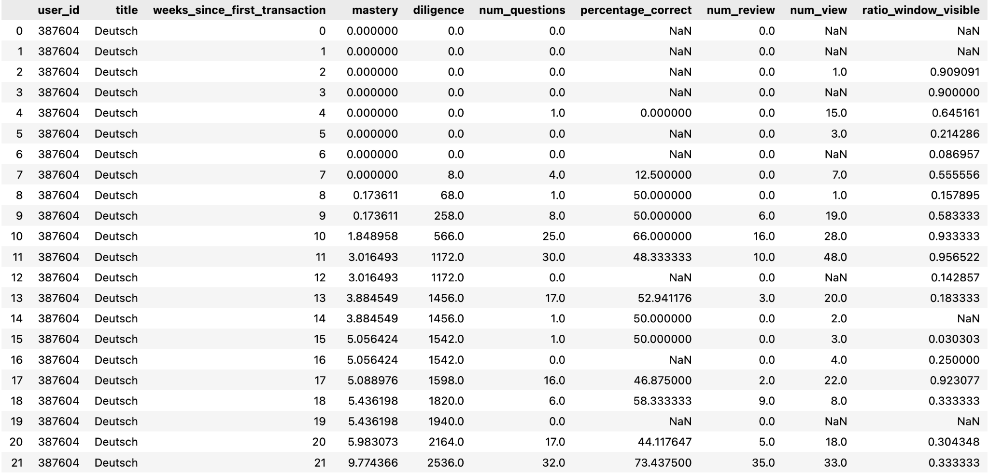
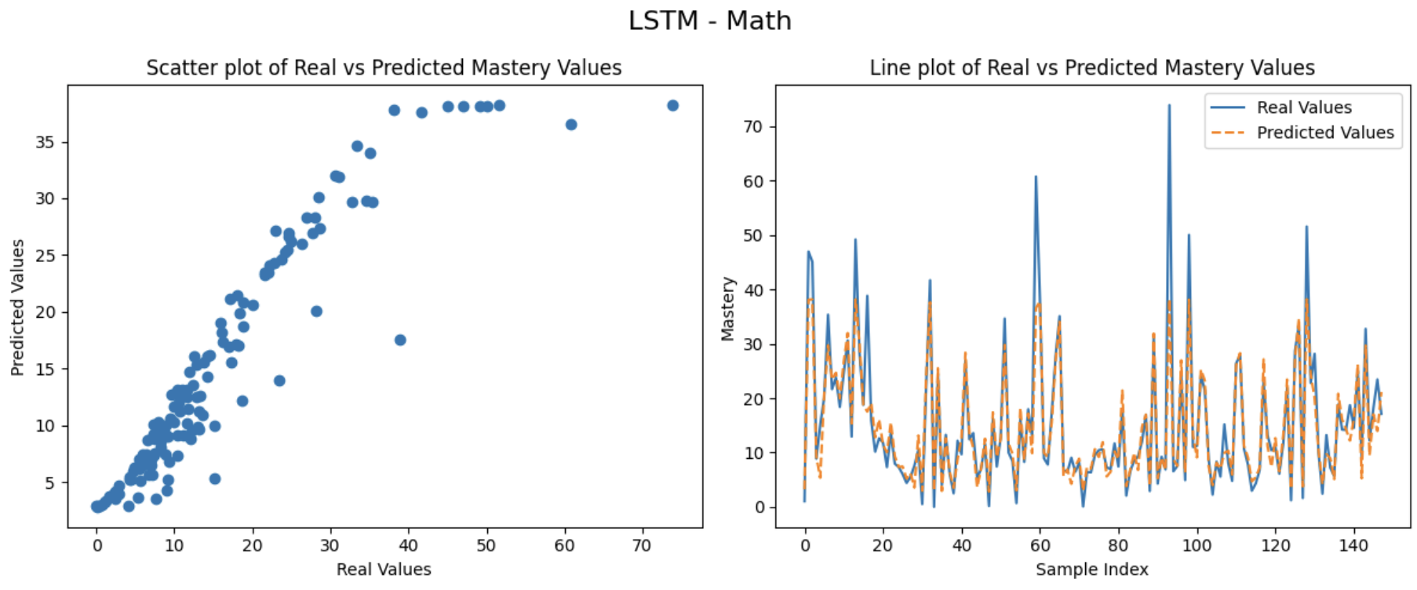
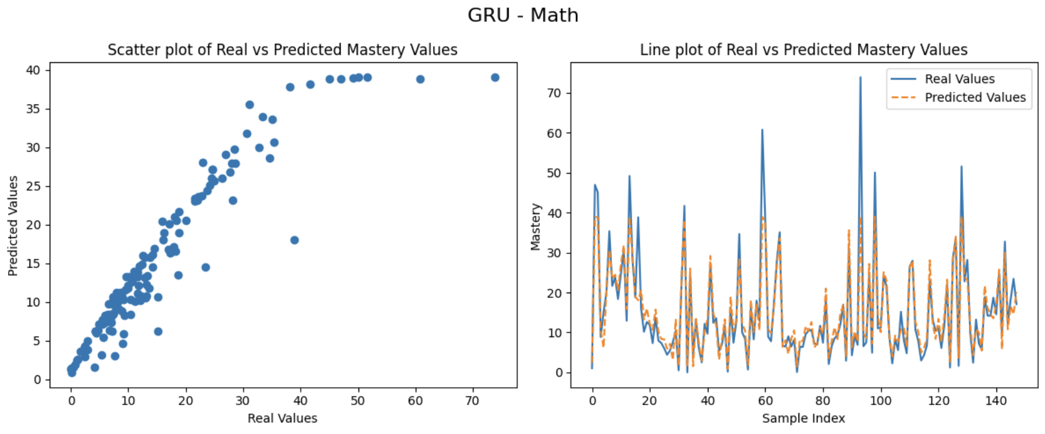
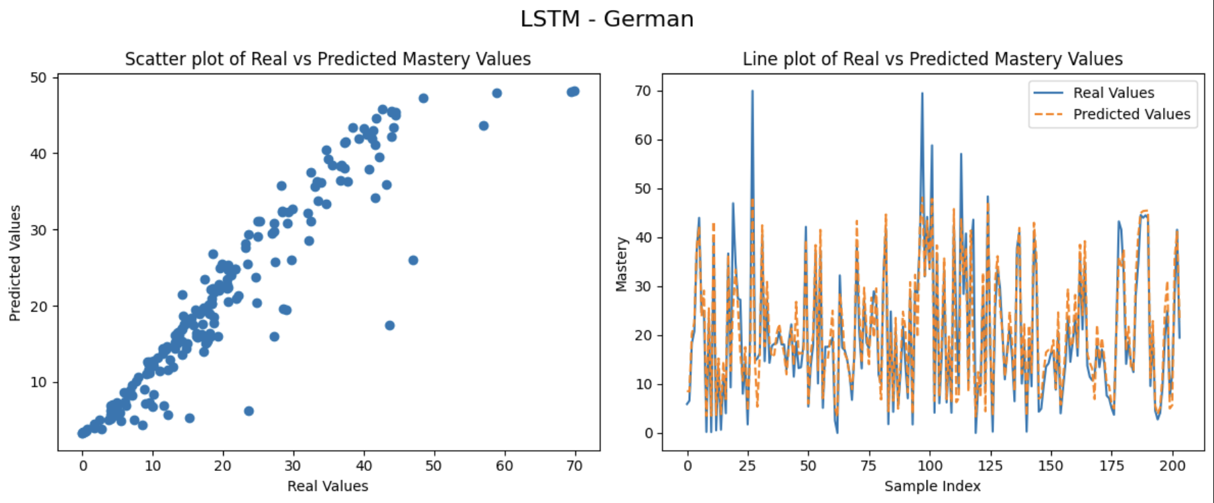
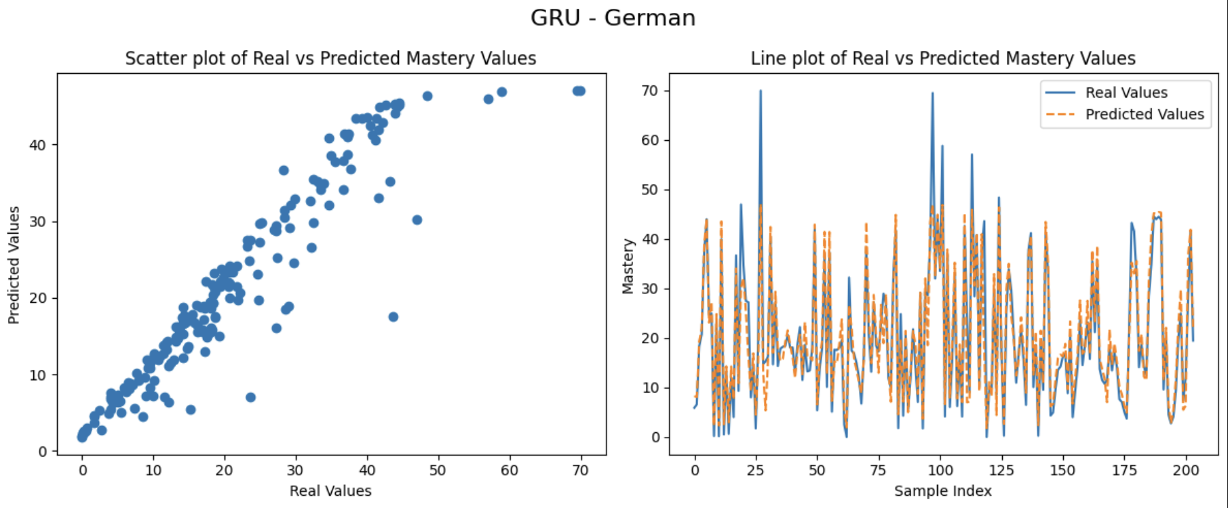
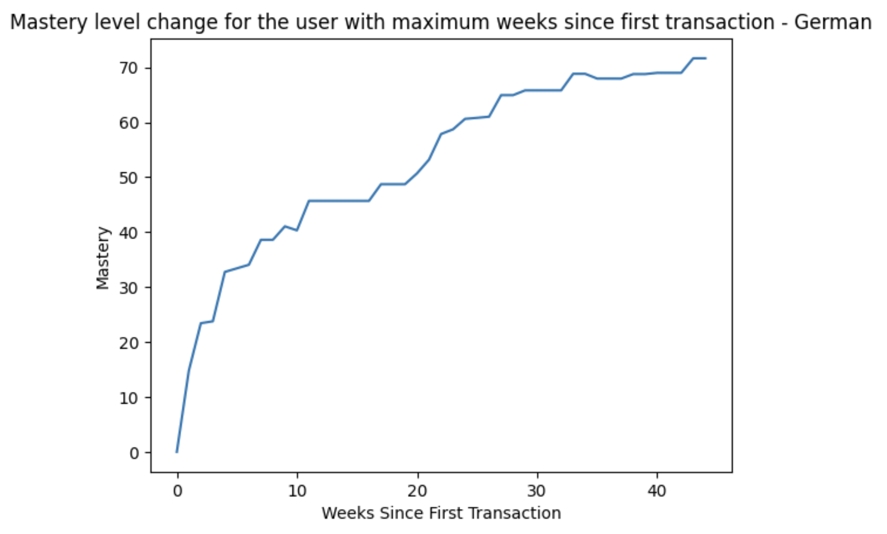
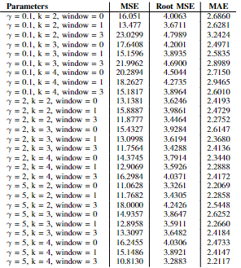
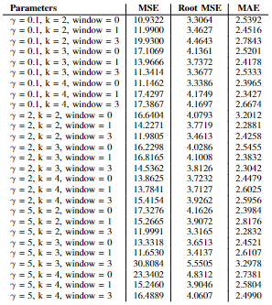
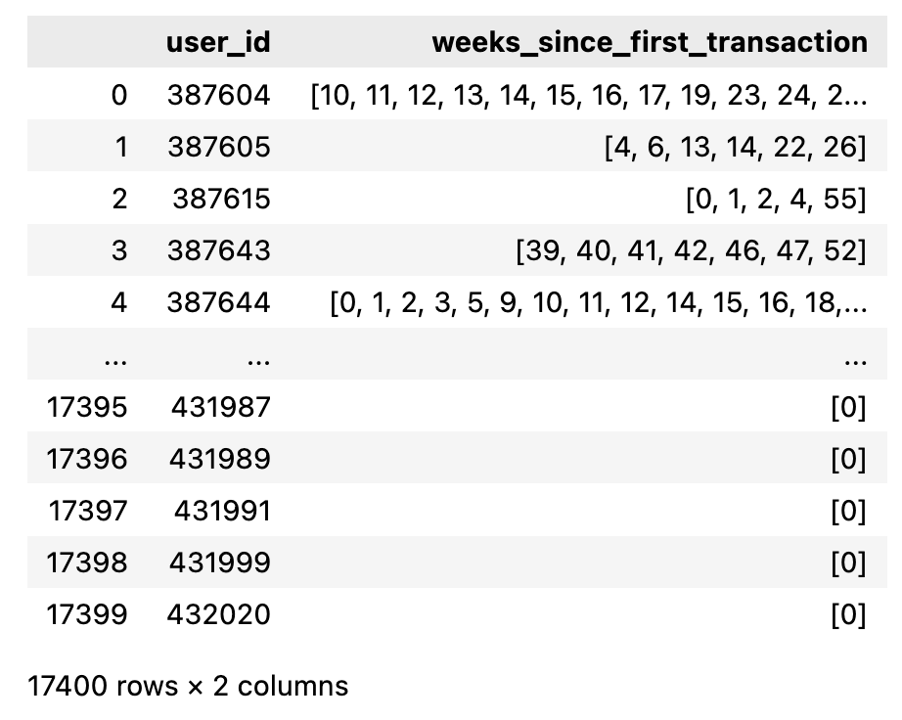

TIME-SERIES MASTERY LEVEL PREDICTION
Lernnavi
Team UcluMasa - Gul Ilker, Kirimca Can, Yazici Aybars
Machine Learning for Behavioral Data (MLBD) Course, EPFL, 2023
1 INTRODUCTION + RESEARCH QUESTION
→ Eigenvalue and Silhouette scores of k values for γ=5, window size=1:
Can we apply time series forecasting to the multidimensional lernnavi data from weeks 1...N − 1, enriched with additional data features, to
more accurately predict a user’s mastery level in week N? And which predictive model will provide the most reliable results?
→ Then we cluster the students and add a cluster label to each student.
→ Visualization of clusters using k=3 γ=5, window size=1:
2 METHODOLOGY
Model Architecture
3 Regression variants: Linear, Lasso and Ridge. Grid search for Ridge and Lasso regression to find the optimal alpha.
2 RNN variants: LSTM and GRU. Two additional linear layers after LSTM and GRU layers to increase model complexity.
Training and Testing: Different approaches for Regression and RNN variants.
→ Regression: Training on the first five weeks of user data and testing on the sixth week prediction.
→ LSTM and GRU: User based train-test split to prevent data leakage between train-test sets.
3 RESULTS
We evaluated our models' performances using the following metrics:
→ Mean Squared Error (MSE)
→ Root Mean Squared Error (RMSE)
→ Mean Absolute Error (MAE)
Dataset
We notice that most of the users only focus on one of the topics, either German or Mathematics:
→ We treat these topics independently,
→ Split our features by topic, ex: # of German questions solved, # of Math questions solved
→ We create 2 DataFrames, one for German - one for Mathematics
→ In the Math dataset, Lasso Regression outperformed other models
→For the German dataset, Linear Regression outshined among others
→LSTM and GRU notably outdid Linear Regression variants on our data, with GRU slightly leading LSTM, mainly due to their ability to capture our data's temporal patterns.
→ Clustering does not improve the overall performance of the models
→ Only improvement is on the Math dataset
LSTM Scores for Math: GRU Scores for Math:
→ We gathered all subtopics under our two major topics.
→ Mastery level = sum of all sub topic mastery levels
→ Users’ activity patterns are erratic.
→ Inactivity for several weeks before coming back to use the platform
→ First interaction not in the 0th week
(Due to splitting the DFs into two topics)
Hence, our consideration of active weeks.
4 CONCLUSION
Our analysis reveals:
LSTM and GRU models show promising performance in predicting mastery levels, yet there's scope for enhancement.
To improve these models, we propose:
Data augmentation, given that LSTM and GRU models typically perform better with larger datasets.
Extraction of additional features for deeper insights into the dataset.
Investigation based on specific topics inside Math and German
Clustering the students
We perform clustering to further extend our data
→ We plot Eigenvalue and Silhouette scores based on different k (number of clusters), gamma (γ) and window size (used for Dynamic Time Warping) values to determine their optimal values.

