Slide 1
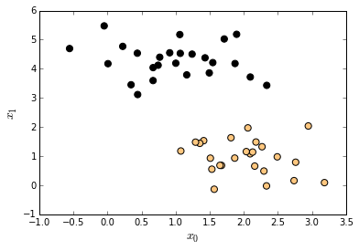
w^{T}x - b = 1
w^{T}x - b = -1
x₁ - x₂

