Slide 1



Topic Modeling
Vanessa Gómez Verdejo
Jesús Cid Sueiro
ML4DS: Machine Learning 4 Data Science
Universidad Carlos III de Madrid

Slide 2
Content
1. Topic Models
2. Latent Semantic Indexing
3. Latent Dirichlet Allocation

Slide 3
1. Topic Models
Corpus Acquisition
Corpus Processing
Text processing tools:
Natural Language Toolkit (NLTK)
Semantic Analysis
Topic Models: PLSI, LDA

Slide 4
Semantic Analysis
Corpus Acquisition
Corpus Processing
Text processing tools:
Natural Language Toolkit (NLTK)
Semantic Analysis
Topic Models: PLSI, LDA

Slide 5
Topic models
Topic Models attempt to uncover the underlying semantic structure of a document corpus by identifying recurring patterns of terms (topics).
Topic models are models for bags-of-words:
do not parse sentences
do not care about word order, and
do not “understand” grammar or syntax
Topic models are useful on their own to build visualizations and explore data. They are also very useful as an intermediate step in many other tasks.

Slide 6
Topic modelling tools
Gensim
Developed by Radim Řehůřek.
Topics and transformations: Gensim includes
BOW
TF-IDF
Latent Semantic Indexing, LSA/LSI
Latent Dirichlet Allocation, LDA

Slide 7
Gensim
Instalation:
Data Structures
Corpus: list of documents
Document: list of words
pip install gensim
easy_install gensim

Slide 8
Working with Gensim
Import tools.
Represent the words by ids (integer) → create a dictionary
Vectorize the documents: create bow.
Gensim has efficient implementations for long corpus (work document to document): http://radimrehurek.com/gensim/tut1.html
from gensim import corpora
D = corpora.Dictionary(docs)
bow = [D.doc2bow(doc) for doc in docs]

Slide 9
Working with Gensim
Compute tf-idf values.
From now on, tfidf can be used to convert any vector from the old representation (bow integer counts) to the new one (TfIdf real-valued weights):
Or to apply a transformation to a whole corpus:
from gensim import models
# 1-- initialize a model
tfidf = models.TfidfModel(corpus_bow)
doc_bow = [(0, 1), (1, 1)]
# 2-- transform a new vector
tfidf[doc_bow]
corpus_tfidf = tfidf[corpus_bow]

Slide 10
2. Latent Semantic Indexing
It transforms documents from either
bag-of-words, or
(preferably) TfIdf-weighted space
into a latent space of a lower dimensionality.
LSI is able to correlate semantically related terms that are latent in a collection of text
LSI uses example documents to establish the conceptual basis for each category.
LSI overcomes two of the most problematic constraints of Boolean keyword queries: multiple words that have similar meanings (synonymy) and words that have more than one meaning (polysemy).

Slide 11
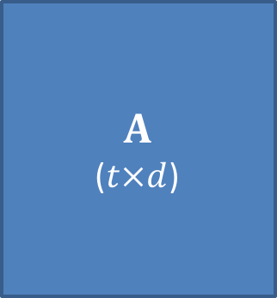
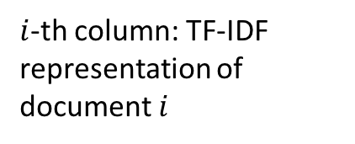
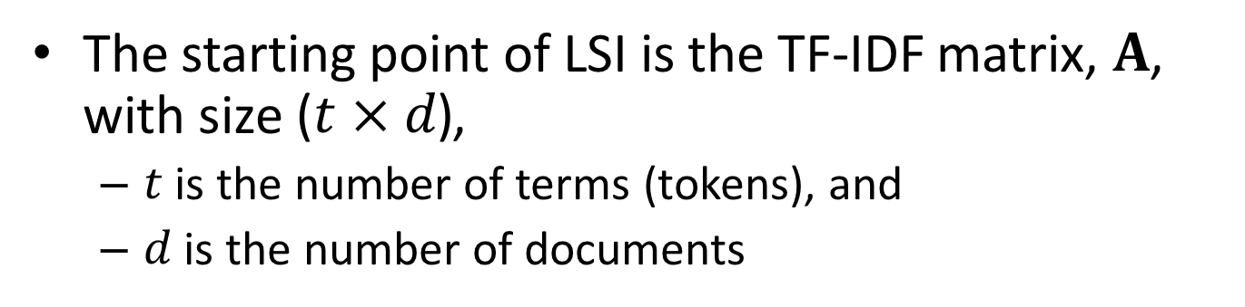
Latent Semantic Analysis/Indexing
The starting point of LSI is the TF-IDF matrix, $A$, with size $\text{(}t × d\text{)}$,
$t$ is the number of terms (tokens), and
$d$ is the number of documents
$$A$$
($t×d$)
$i$-th column: TF-IDF representation of document $i$

Slide 12
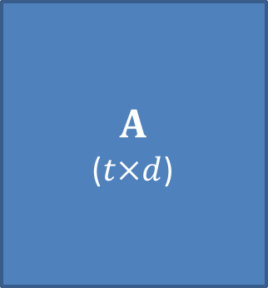


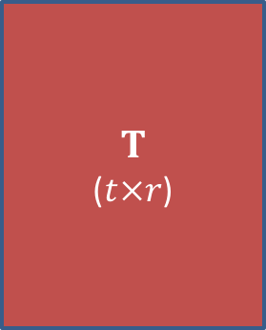
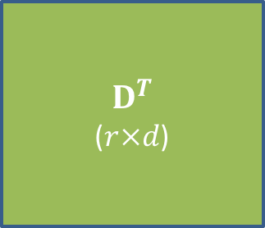
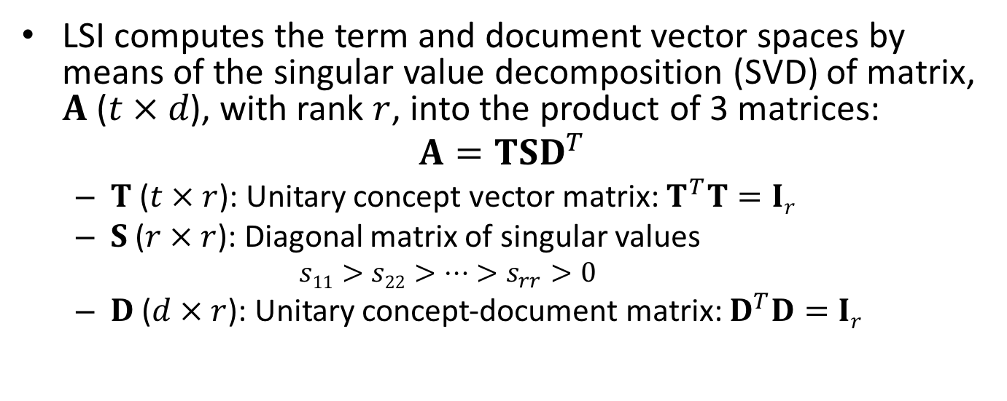
Latent Semantic Analysis/Indexing
LSI computes the term and document vector spaces by means of the singular value decomposition (SVD) of matrix, $A \text{(}t × d\text{)}$, with rank $r$, into the product of 3 matrices:
$$A=TSD^{T}$$
$T$ ($t × r$): Unitary concept vector matrix: $T^{T}T=Ir$
$S$ ($r × r$): Diagonal matrix of singular values
$$s11>s22>…>s_{rr}>0$$
$D$ ($d × r$): Unitary concept-document matrix: $D^{T}D=Ir$
$$A$$
($t×d$)
$$T$$
($t×r$)
$$D^{T}$$
($r×d$)
=
$$×$$
$$×$$

Slide 13
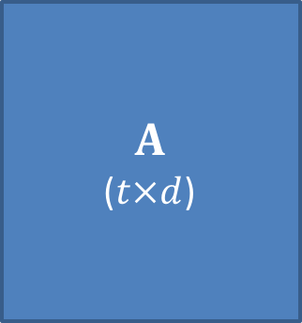




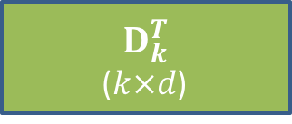
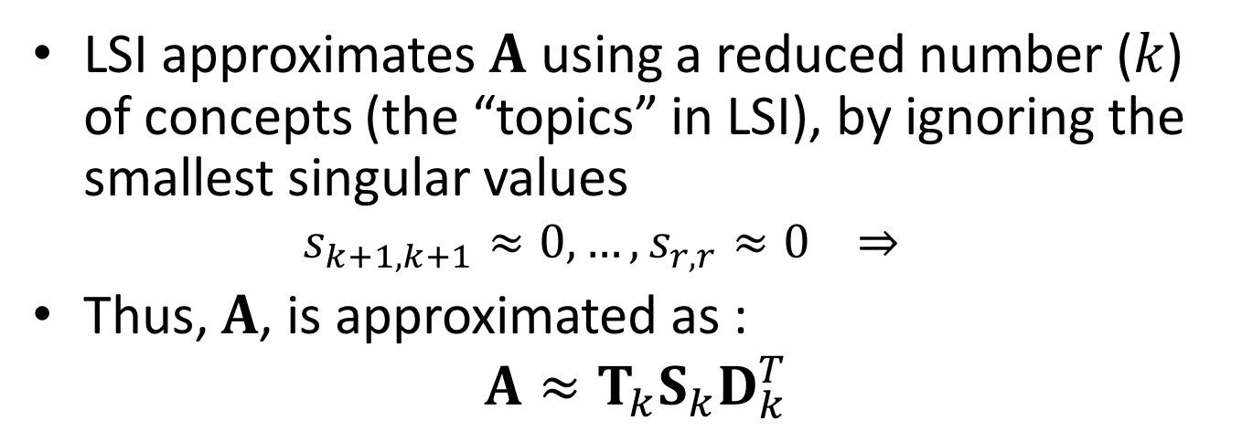
Latent Semantic Analysis/Indexing
LSI approximates $A$ using a reduced number ($k$) of concepts (the “topics” in LSI), by ignoring the smallest singular values
$$s_{k+1,k+1}≈0, …,s_{r,r}≈0 ⇒$$
Thus, $A$, is approximated as :
$$A≈T_{k}S_{k}D_{k}^{T}$$
$$A$$
($t×d$)
$$T_{k}$$
($t×k$)
$$D_{k}^{T}$$
($k×d$)
$$≈$$
$$×$$
$$×$$

Slide 14
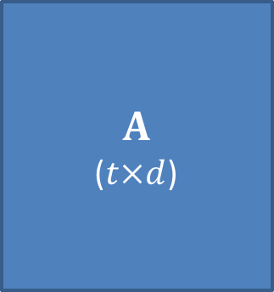



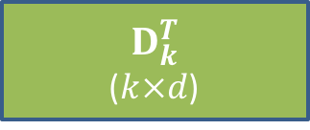
Latent Semantic Analysis/Indexing
LSI approximates $A$ using a reduced number ($k$) of concepts (the “topics” in LSI), by ignoring the smallest singular values
$$s_{k+1,k+1}≈0, …,s_{r,r}≈0 ⇒$$
Thus, $A$, is approximated as :
$$A≈T_{k}S_{k}D_{k}^{T}$$
$$A$$
($t×d$)
$$T_{k}$$
($t×k$)
$$≈$$
$$×$$
$$×$$
$$D_{k}^{T}$$
($k×d$)

Slide 15


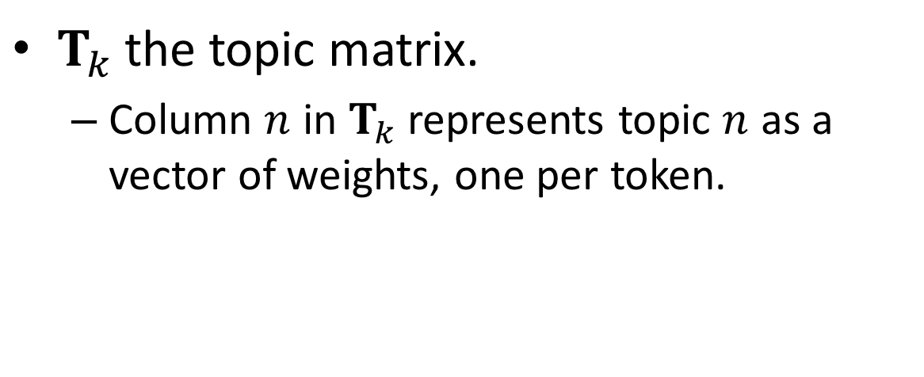
Latent Semantic Analysis/Indexing
$T_{k}$ the topic matrix.
Column $n$ in $T_{k}$ represents topic $n$ as a vector of weights, one per token.
$$T_{k}$$
$i$-th topic vector

Slide 16


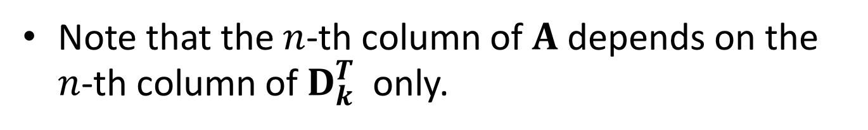
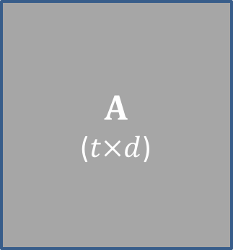




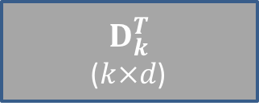
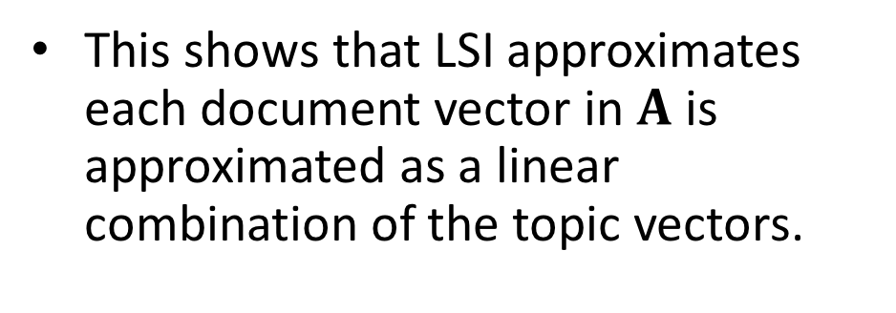

Latent Semantic Analysis/Indexing
Note that the $n$-th column of $A$depends on the $n$-th column of $D_{k}^{T}$ only.
$$A$$
($t×d$)
$$T_{k}$$
($t×k$)
$$≈$$
$$×$$
$$×$$
$$D_{k}^{T}$$
($k×d$)
This shows that LSI approximates each document vector in $A$ is approximated as a linear combination of the topic vectors.
$$T_{k}$$
($t×k$)
$$≈$$
$$×$$

Slide 17
LSA-LSI in Gensim
Steps to transform our Tf-Idf corpus via LSI into a latent 2-D space
It allows incremental updates:
# Initialize an LSI transformation
lsi = models.LsiModel(corpus_tfidf,
id2word=dictionary, num_topics=2)
# On real corpora, target dimensionality of
# 200–500 is recommended as a “golden standard”
# Create a double wrapper over the original
# corpus bow → tfidf → fold-in-lsi
corpus_lsi = lsi[corpus_tfidf]
lsi.add_documents(another_tfidf_corpus)

Slide 18
LSA-LSI
Analyzing the topics:
“trees”, “graph” and “minors” are all related words (and contribute the most to the direction of the first topic)
# both bow → tfidf and tfidf → lsi
# transformations are actually executed here,
# on the fly
>> lsi.print_topics(2)
topic #0(1.594): -0.703*"trees" + -0.538*"graph" + -0.402*"minors" +…
topic #1(1.476): -0.460*"system" + -0.373*"user" + -0.332*"eps" +….

Slide 19
LSA-LSI
Analyzing document representation over the topics:
>> for doc in corpus_lsi:
print(doc)
# "The intersection graph of paths in trees"
[(0, -0.877), (1, -0.168)]
# "System and human system engineering testing of
# EPS”
[(0, -0.076), (1, 0.632)]

Slide 20
3. Latent Dirichlet Allocation (LDA)
LDA is another transformation from bag-of-words counts into a topic space of lower dimensionality.
LDA is a probabilistic extension of LSA, so LDA’s topics can be interpreted as probability distributions over words.
These distributions are inferred automatically from a training corpus.
Documents are in turn interpreted as a (soft) mixture of these topics (again, just like LSA).

Slide 21
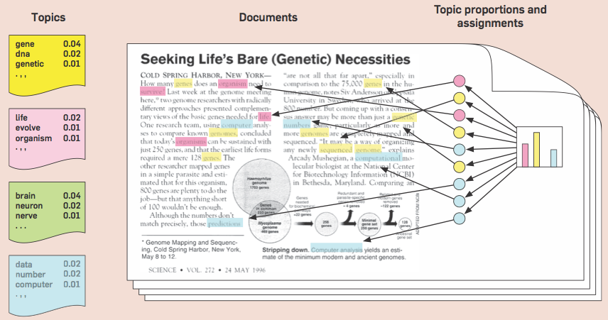
Latent Dirichlet Allocation

Slide 22
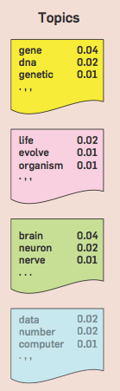
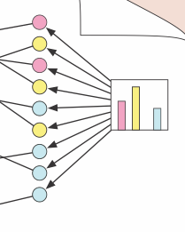

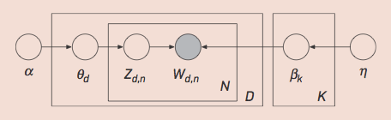


Understanding LDA
LDA is a generative probabilistic model:
it assumes that documents have been generated according to some probability model with some unknown parameters an certain hidden variables
The corpus data is used to inferring the topic structure (hidden variables) from the words of documents (observed variables)
Topic distribution
over the vocabulary
Topic proportions of d-th document
Topic assignment of n-th word in document d-th

Slide 23
A naïve corpus generator:
Corpus
model
Random
token generator
Vocabulary
Doc.
Token
Token
Token
Token
…
Doc.
Token
Token
Token
Doc.
Token
Token
Token
Token
Token
Doc.
Token
Token
Inference:
Given the corpus, obtain the vocabulary.
Limitations:
In real documents, token proportions are far from uniform.

Slide 24
An homogeneous corpus generator:
Corpus
model
Token distribution
Token generator
Vocabulary
Doc.
Token
Token
Token
Token
…
Advantages:
Differentiated token proportions.
Inference (for a given corpus):
Compute the vocabulary and estimate the token distribution.
The token distribution can be easily estimated from token frequencies measured over the whole corpus.
Limitations:
Real corpora are heterogeneous: each document use to obey a different token distribution.

Slide 25
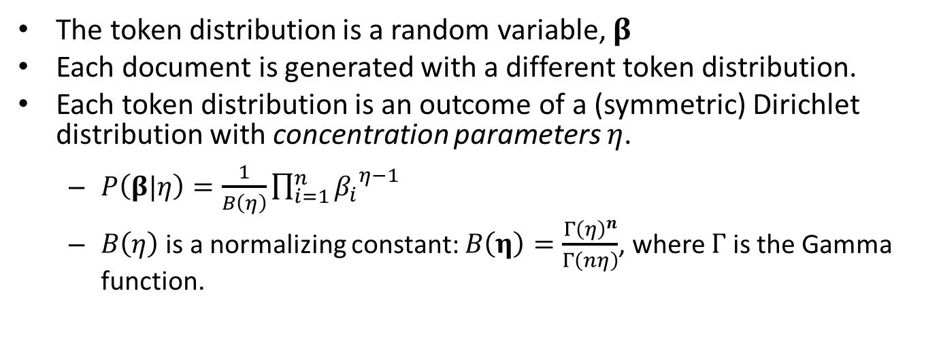
An heterogeneous corpus generator:
Corpus
model
Doc. model
Token
distribution
generator
Token generator
η
Vocabulary
Token
Token
Token
…
The token distribution is a random variable, $β$
Each document is generated with a different token distribution.
Each token distribution is an outcome of a (symmetric) Dirichlet distribution with concentration parameters $η$.
$P\left(β|η\right)=\frac{1}{B\left(η\right)}\prod_{i=1}^{n}{{β_{i}}^{η−1}}$
$B\left(η\right)$ is a normalizing constant: $B\left(η\right)=\frac{{Γ\left(η\right)}^{n}}{Γ\left(nη\right)}$, where $Γ$ is the Gamma function.

Slide 26
An heterogeneous corpus generator:
Corpus
model
Doc. model
Token
distribution
generator
Token generator
η
Vocabulary
Token
Token
Token
…
Example: Dirichlet distributions for a vocabulary of size 3.
For large η, probabilities concentrate in a few terms.
Image taken from http://www.cnblogs.com/huashiyiqike/articles/3232082.html

Slide 27
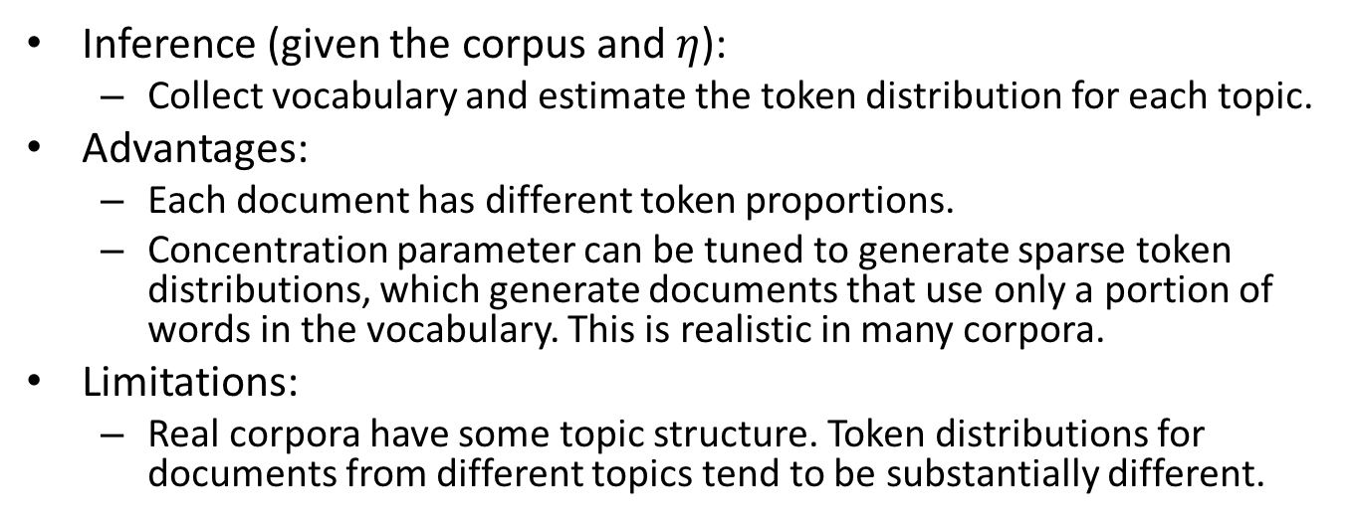
An heterogeneous corpus generator:
Corpus
model
Doc. model
Token
distribution
generator
Token generator
η
Vocabulary
Token
Token
Token
…
Inference (given the corpus and $η$):
Collect vocabulary and estimate the token distribution for each topic.
Advantages:
Each document has different token proportions.
Concentration parameter can be tuned to generate sparse token distributions, which generate documents that use only a portion of words in the vocabulary. This is realistic in many corpora.
Limitations:
Real corpora have some topic structure. Token distributions for documents from different topics tend to be substantially different.

Slide 28
The LDA corpus generator:
Corpus model
η
Topic
generator
Vocabulary
Topic β₁
Topic β₂
Topic β₃
Topic β₄
Document model
Token
model
Topic
distribution
generator
α
θ_{d}
Topic Selector
T1
T2
T3
T4
Topic β*
Token generator
Token
Token
Token
Token

Slide 29
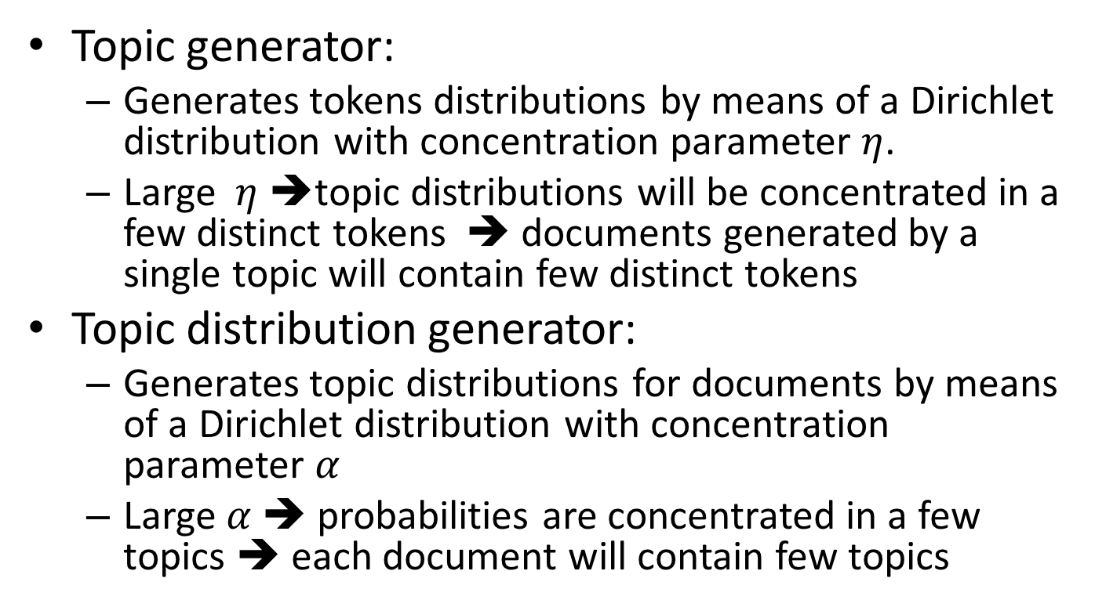
The LDA corpus generator:
Topic generator:
Generates tokens distributions by means of a Dirichlet distribution with concentration parameter $η$.
Large $η$ ➔topic distributions will be concentrated in a few distinct tokens ➔ documents generated by a single topic will contain few distinct tokens
Topic distribution generator:
Generates topic distributions for documents by means of a Dirichlet distribution with concentration parameter $α$
Large $α$ ➔ probabilities are concentrated in a few topics ➔ each document will contain few topics

Slide 30



LDA
The generative process for LDA corresponds to the following joint distribution of the hidden and observed variables
Goal: computing the conditional distribution of the topic structure given the observed documents

Slide 31
LDA
The denominator is the probability of seeing the observed corpus under any topic model.
It can be computed by summing the joint distribution over every possible hidden topic structure.
The number of possible topic structures is exponentially large; this sum is intractable to compute.
Two LDA families
Sampling-based algorithms
Variational algorithms

Slide 32
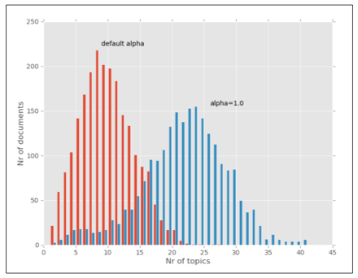
LDA in Gensim
Steps:
# Create an LDA transformation
lda = gensim.models.LdaModel(corpus_bow,
id2word=dictionary, alpha='auto', num_topics=20)
It automatically updates the alpha value
Bigger values for alpha will result in more topics per document

Slide 33
LDA in Gensim
>> # Analize topics
>> # (the top 5 words associated with 5 topics)
>> lda.print_topics(topics=5, topn=5)
['0.047*link + 0.027*ui + 0.018*main + 0.017*level + 0.016*locale',
'0.107*tap + 0.047*popup + 0.045*appears + 0.031*request + 0.029*tab',
'0.120*play + 0.096*ics + 0.084*music + 0.049*bug + 0.030*android',
'0.106*device + 0.078*google + 0.060*talk + 0.057*voice + 0.044*icon’,
'0.191*screen + 0.055*button + 0.034*change + 0.032*page + 0.032*lock’]
Weights indicate the relevance of a word for a given topic

Slide 34
LDA in Gensim
More things to do….
# training document representation
for doc in lda:
print(doc)
# get topic probability distribution for a document
print(lda[doc_bow])
# update the LDA model with additional documents
lda.update(corpus2)
print(lda[doc_bow])

