Slide 1
Which parts of the previous QAE result
survive one-factor changes?
A quantum autoencoder (QAE) robustness study — a follow-up to last meeting's architecture-search result
Baseline finding: physics-informed language-model proposals beat random and greedy circuit search by a wide margin; a closed feedback loop added a small extra gain.
Four factors, one at a time: evaluation budget · qubit count · Hamiltonian · language model.
This is a tested one-factor-slice study, not a complete factorial grid.
Tomoya Hatanaka
ML4SCI / Google Summer of Code 2026 · September 4, 2026

Slide 2
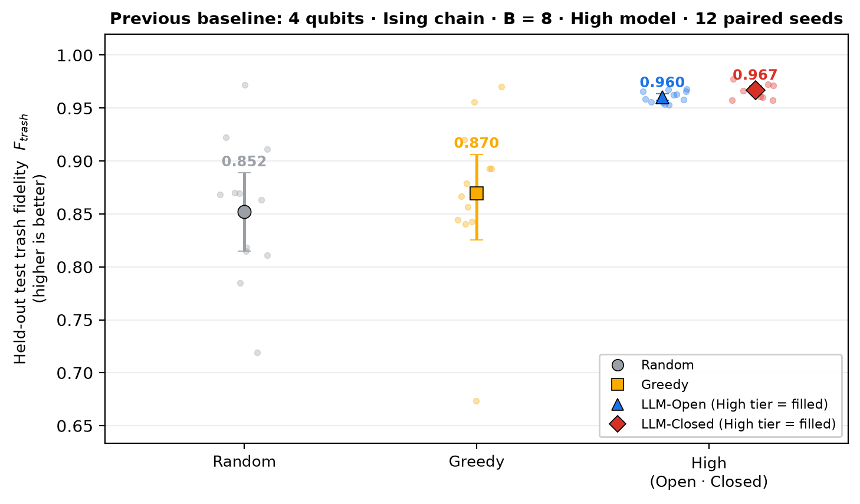
1 · PREVIOUS BASELINE
Where we left off: the previous baseline result
Quantum autoencoder (QAE): compress ground states into fewer qubits · 4 qubits · Ising chain · B = 8 · High model tier · 12 paired seeds
Input |ψ(h)⟩
ground state of the 4-qubit Ising chain
H = −Σ Zᵢ Zᵢ₊₁ − h Σ Xᵢ, h ∈ [0.2, 2.0]
→
Encoder Uθ
the circuit we search
(16 gates, angles trained)
→
Latent qubits q0, q1
the 2 qubits we keep
→
Trash qubits q2, q3
should end in |00⟩ for every input
Trash fidelity F_trash = P(trash qubits q2 q3 = 00) — higher is better · measured on a held-out test set of 64 unseen h values, read once after selection
Four search methods (budget B = candidate circuits trained and evaluated per seed)
Random B uniformly sampled circuits
Greedy B/2 random starts + B/2 single-change refinements of the best
LLM-Open open-loop: all semantic proposals before any score is seen
LLM-Closed closed-loop: semantic starts + free redesigns of the current best, guided by validation scores
Two claims to stress-test
1 Semantic proposals beat non-semantic search: Open − Random +0.108 (11/12, p < 0.001)
2 Closed-loop redesign adds a small extra gain: Closed − Open +0.007 (11/12, p = 0.012)
Next: do these two claims survive when exactly one condition changes?
Dots = the 12 paired seeds (12 independent draws of training/validation data shared by all methods); marker = mean; bar = bootstrap 95% confidence interval (CI); p = exact paired Wilcoxon test. High tier = gpt-5.4-mini.

Slide 3
2 · CONTROLLED ROBUSTNESS DESIGN
One factor changes; everything else remains fixed
Four controlled changes leave the baseline; each moves exactly one declared factor and holds the other three
Evaluation budget B
FROZEN in every condition
• prompt wording and output schema
• the four search methods
• circuit rule: 3 rotations + 1 CNOT (controlled-NOT) per qubit
• trainer, optimizer, data splits
• the same 12 paired seeds
• validation-only selection; held-out test read once
• statistical analysis
4
8
16
BASELINE
4 qubits · Ising · B = 8
High model tier
12 paired seeds
Qubit count
4
6
8
Hamiltonian
Ising
XXZ
Language-model tier
Low
High
dark chip = baseline level · Low = gpt-4.1-mini · High = gpt-5.4-mini
No interaction condition was tested. Each change returns to the baseline before the next factor moves — e.g. a large budget at 8 qubits was never run. XXZ = the second Hamiltonian family, an XXZ Heisenberg chain H = Σ (Xᵢ Xᵢ₊₁ + Yᵢ Yᵢ₊₁ + Δ Zᵢ Zᵢ₊₁), Δ ∈ [0.2, 2.0], declared before the run.
Next: because only one factor moves at a time, read the results as four tested slices, not as a full grid.
An automated check refuses any condition whose frozen components differ from the baseline's or that moves more than one factor; the baseline cell is reused, not re-run.

Slide 4
3 · WHAT WAS ACTUALLY TESTED, AND HOW TO READ IT
Four tested slices, one baseline, no empty panels
Every result slide shows one of these four rows; untested combinations are omitted rather than displayed as empty panels
Budget slice
B = 4
→
B = 8
→
B = 16
4 qubits · Ising · High fixed
Model tiers (defined here once)
Low = gpt-4.1-mini High = gpt-5.4-mini
Fixed capability-tier labels, not the observed score. Open / Closed name the search workflow; Low / High name the model.
Qubit slice
4 qubits
→
6 qubits
→
8 qubits
B = 8 · Ising · High fixed
Hamiltonian slice
Ising
→
XXZ
4 qubits · B = 8 · High fixed
Reading every result figure
• dots = 12 paired seeds · marker = mean · bar = 95% CI
• higher trash fidelity is better
• groups always: Random → Greedy → Low → High
• LLM-Open = blue triangle, LLM-Closed = red diamond
• High = filled marker, Low = hollow marker
• thick frame / shaded band = the baseline
Model slice
Low
→
High
4 qubits · Ising · B = 8 fixed
dark chip = the baseline level, present in every slice.
Low was run only in the model slice. The other slices show Random, Greedy and High only; no Low value is invented.
Untested combinations are omitted rather than displayed as empty panels.
Next: the first slice changes the amount of search — the evaluation budget B.
Random and Greedy do not depend on the language model, so each is one result per condition; Low and High each hold an Open and a Closed result.

Slide 5
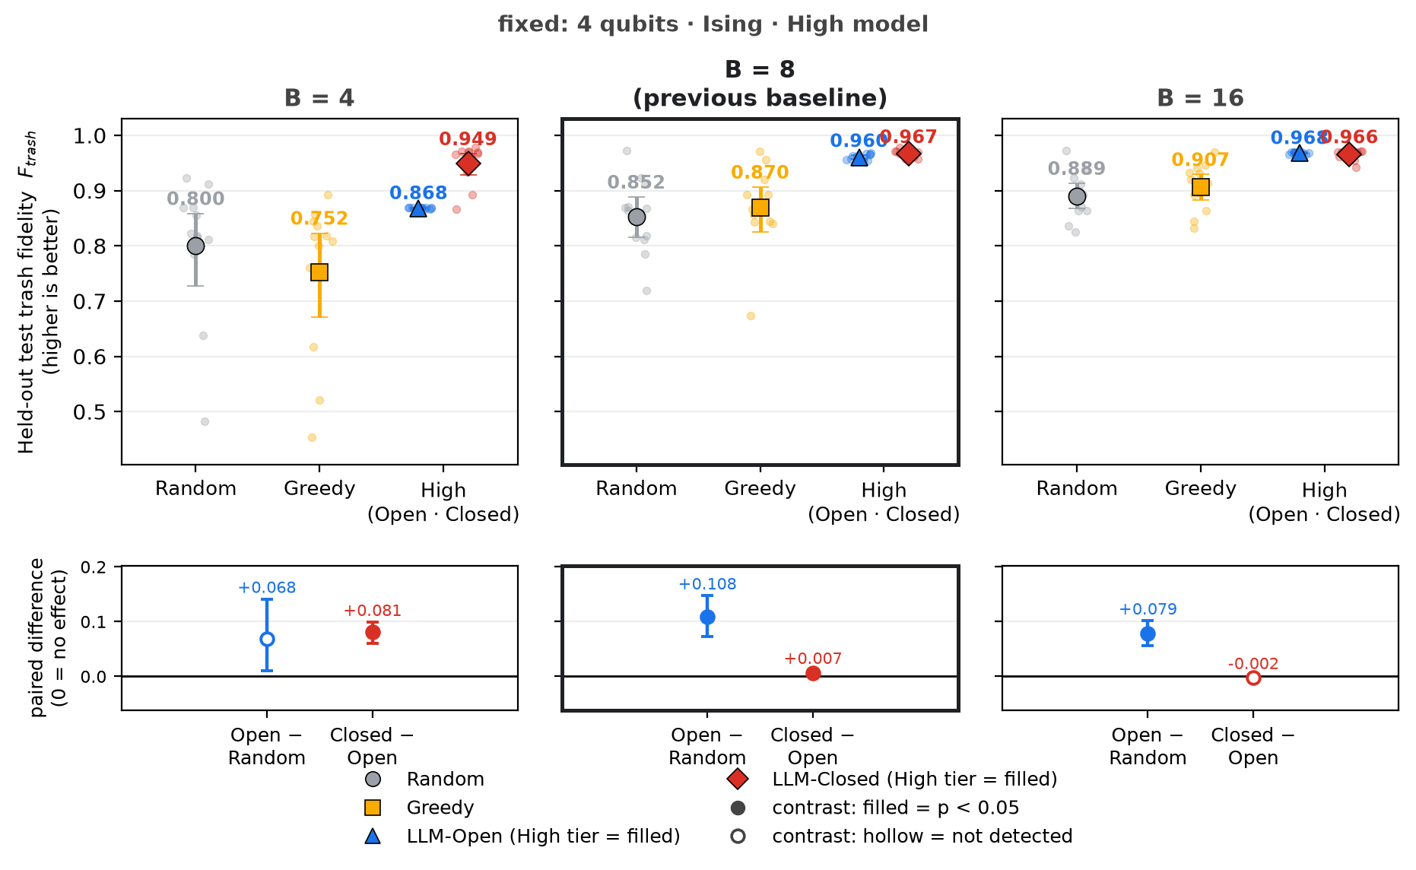
4 · BUDGET SLICE
Budget changes the value of feedback
B = 4 → 8 → 16 with 4 qubits, Ising chain and High tier fixed; B = 8 (thick frame) is the previous baseline
Semantic proposals stay above non-semantic search at every budget.
Open − Random is positive at all three budgets; at B = 4 it is not detected (+0.068 (8/12, p = 0.064)).
The Closed − Open advantage shrinks as the budget grows:
+0.081 at B = 4 → +0.007 at B = 8 → -0.002 at B = 16 (not detected).
Free redesign pays most when the open batch is thinnest; a wide open batch buys the same breadth without feedback.
Next: budget changes the amount of search; next we ask whether register width changes the conclusion.
Same trainer, prompts, seeds and selection rule at every budget; adaptive methods always split B as B/2 exploration + B/2 refinement (2+2, 4+4, 8+8).

Slide 6
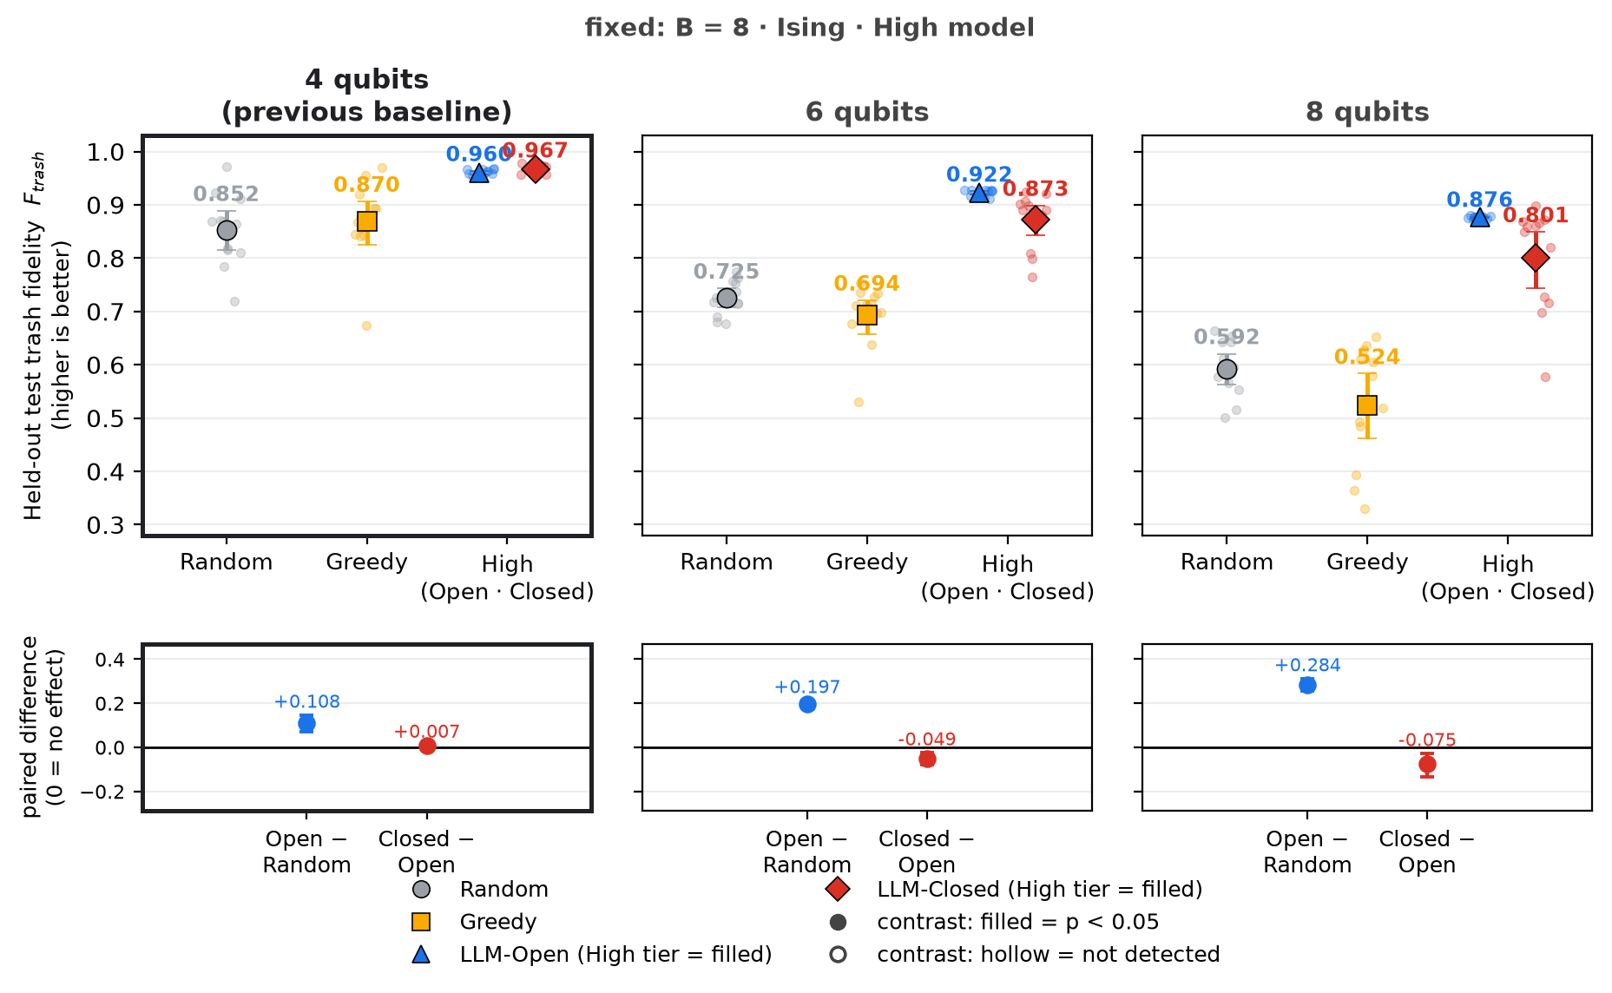
5 · QUBIT-COUNT SLICE
The semantic advantage grows as the register widens
4 → 6 → 8 qubits with B = 8, Ising chain and High tier fixed; 4 qubits (thick frame) is the previous baseline
1 Absolute fidelity falls as the task widens
Random 0.85 → 0.59; LLM-Open 0.96 → 0.88.
2 Open stays strong; Closed falls below Open
Open − Random +0.108 → +0.197 → +0.284, significant at every width.
Closed − Open +0.007 → -0.049 → -0.075, reversed at 6 and 8 qubits.
Caveat: closed-loop proposals meeting the gate-count contract (the required 3 rotations + 1 CNOT per qubit) fell 92% → 70% → 77%; invalid proposals become random draws.
Tested for the Ising chain and the High tier only.
Next: width changes task difficulty; next we change the physical state family at the baseline width.
Same B = 8, prompts (qubit count substituted), trainer and seeds at every width; latent and trash registers are always half and half.

Slide 7
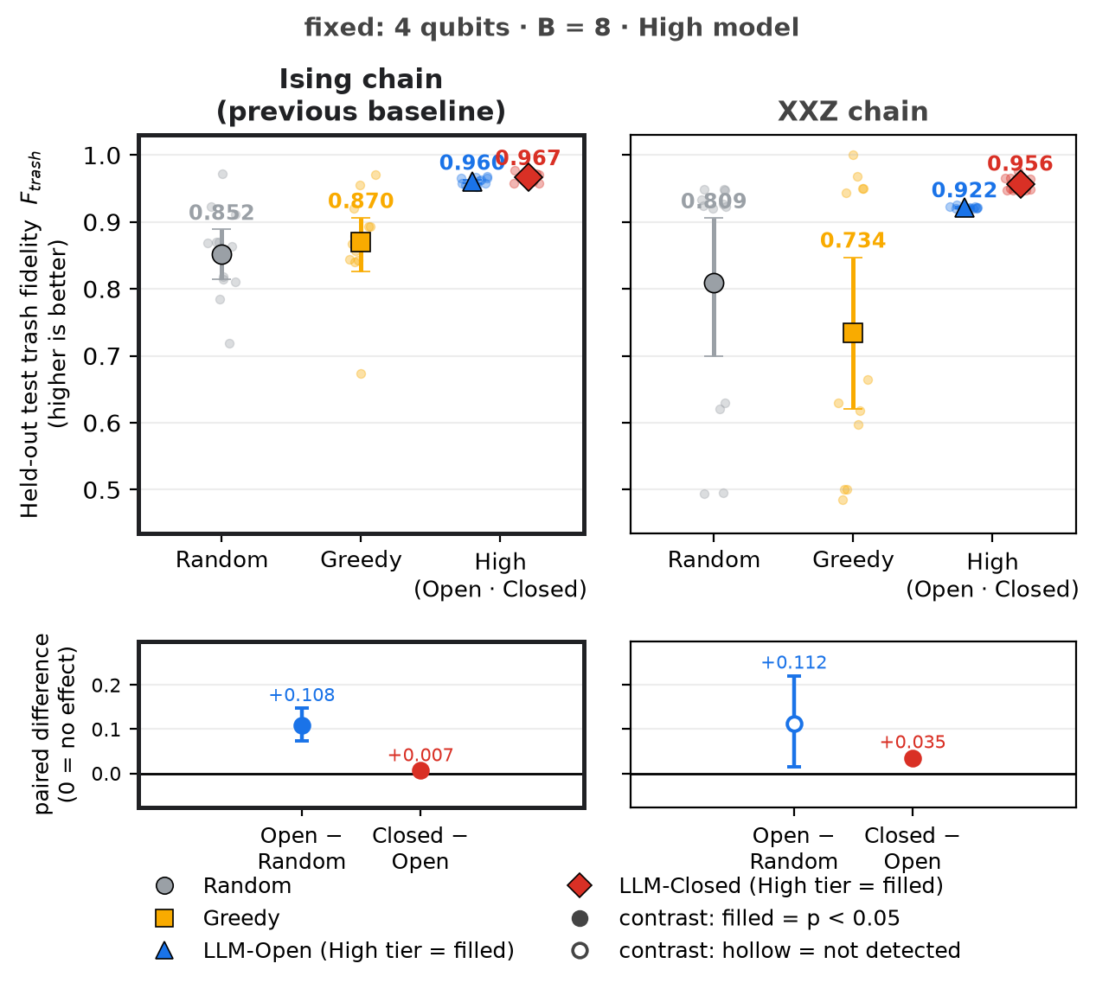
6 · HAMILTONIAN SLICE
The broad ordering survives at the tested XXZ anchor
Ising → XXZ with 4 qubits, B = 8 and High tier fixed; the Ising chain (thick frame) is the previous baseline
The same broad semantic advantage
Both LLM methods have higher means than Random on XXZ (Open 0.92, Closed 0.96 vs Random 0.81).
Per seed: Closed − Random +0.147 (11/12, p < 0.001); Open − Random +0.112 (5/12, p = 0.791) — Random's seeds spread widely, so that mean gain is not detected per seed.
Closed exceeds Open at this anchor
Closed − Open +0.035 (12/12, p < 0.001), larger than at the Ising baseline.
One XXZ point is not the XXZ landscape: budget, width and model tier were not varied for XXZ.
Next: the physics anchor gives one second-family result; the final controlled change is the model itself.
Only the stated Hamiltonian facts change in the prompt (name, formula, parameter range, interaction type); circuit space, trainer and seeds are identical.

Slide 8
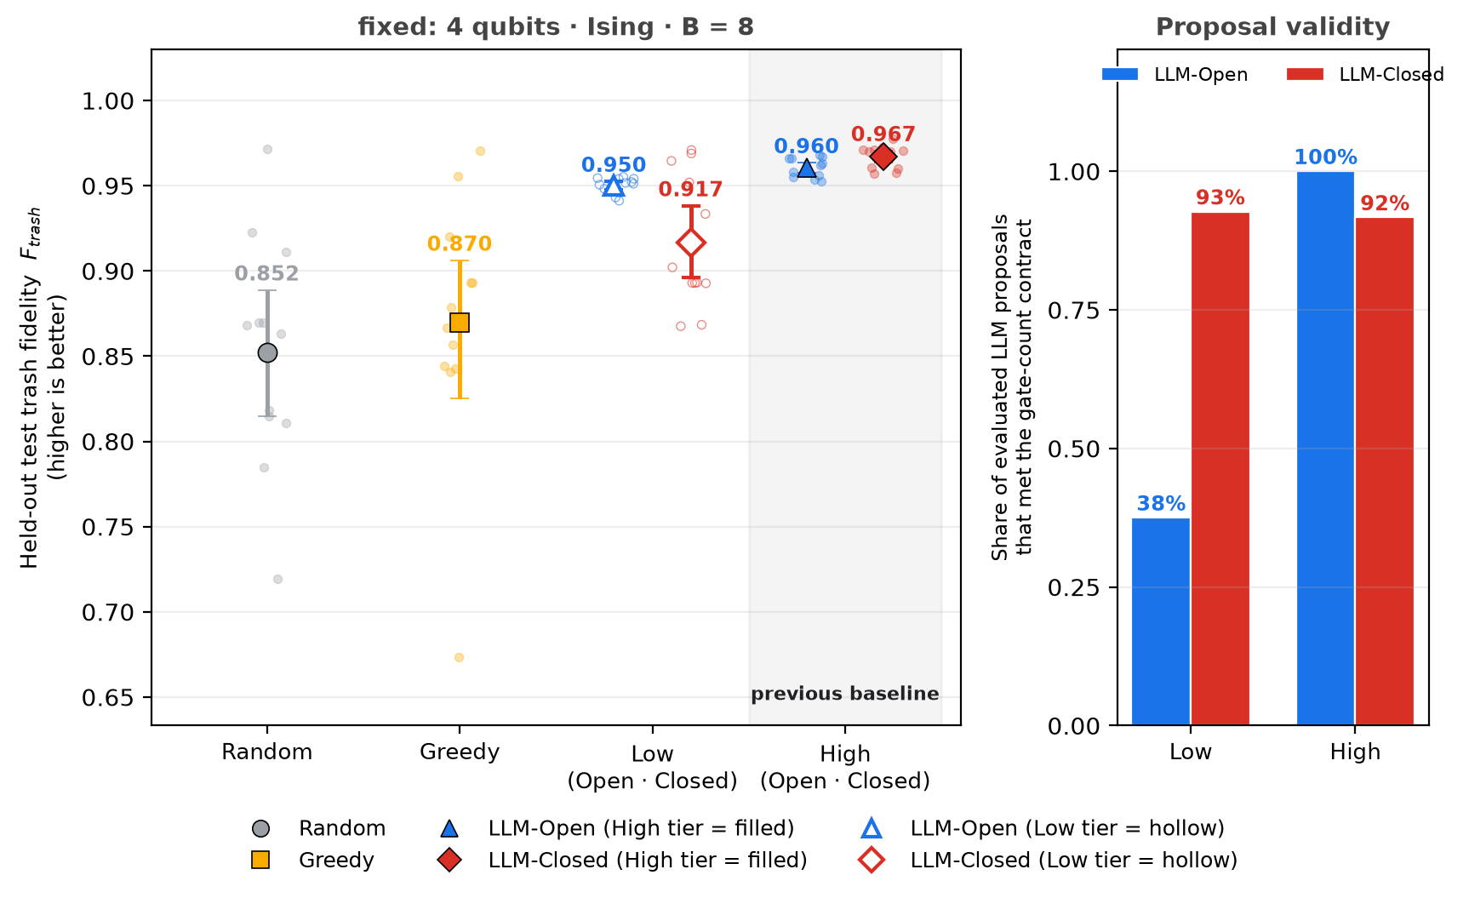
7 · MODEL SLICE
Model tier changes reliability more than the Open advantage
Low → High with 4 qubits, Ising chain and B = 8 fixed; High (shaded band) is the previous baseline; groups Random → Greedy → Low → High
The Open advantage is similar for both tiers
Open − Random +0.098 (11/12, p < 0.001) for Low, +0.108 (11/12, p < 0.001) for High.
The Closed − Open relationship differs
-0.034 (4/12, p = 0.052) for Low vs +0.007 (11/12, p = 0.012) for High — the baseline's small closed-loop gain is not present for Low.
Proposal validity is a separate failure mode
Only 38% of Low's open-batch proposals met the gate-count contract (Low closed 93%; High 100% / 92%). Invalid proposals become random draws, so validity and architecture quality are entangled in the score.
Low and High are fixed tier labels, not a ranking by score.
Next: the four slices can now be combined to separate robust effects from fragile ones.
Identical prompt bytes, temperature, retry policy and token limit for both tiers; only the model name changes. Random and Greedy are the same runs in both groups.

Slide 9
8 · CROSS-SLICE SYNTHESIS AND LIMITATIONS
What survived across the tested slices?
Closed − Open sorted by what the paired test detected; the Open − Random advantage kept its sign in every slice
Closed beats Open
No difference detected
Open beats Closed
Baseline: B = 8 +0.007 11/12 seeds
B = 16 -0.002 9/12 seeds
6 qubits -0.049 0/12 seeds
B = 4 +0.081 11/12 seeds
Low tier -0.034 4/12 seeds
8 qubits -0.075 1/12 seeds
XXZ anchor +0.035 12/12 seeds
a wide open batch, or the Low tier
wider registers; closed-loop validity 92% → 70%, 77%
small budget, the XXZ anchor, and the baseline (slight)
Across the tested one-factor slices, the Open − Random advantage is the robust finding: positive in all 7 tested conditions, significant in 5. The closed-loop advantage is budget-, width-, Hamiltonian- and model-dependent — not a general result.
Proposal validity can confound method differences
An invalid proposal is replaced by a random draw. Closed-loop validity fell to 70% at 6 qubits; Low's open batch was only 38% valid. Part of what looks like a method effect is a generation-validity effect.
Limitations
no interactions · one XXZ anchor · Low only at the baseline condition · 12 paired seeds · noiseless simulation · qubit count and circuit size scale together · not tested: everything else
Next: ranking methods at a fixed budget is the wrong question for practice — how much budget is actually required?
"beats" = p < 0.05 in the exact paired Wilcoxon test over 12 seeds; "not detected" = p ≥ 0.05, which is not evidence of no effect. Values = mean paired difference in trash fidelity.

Slide 10
9 · CONCLUSION AND NEXT ACTION
Next: how much budget is actually required?
Three statements from the tested slices, then a targeted boundary-finding experiment rather than a factorial sweep
Robust
Physics-informed Open proposals beat non-semantic search across the tested one-factor slices.
Next experiment: the minimum budget for a target fidelity
Before running, fix a target validation fidelity F_target (candidates 0.95 and 0.99). B_min = the smallest budget reaching F_target in at least 10 of the 12 paired seeds — chosen on validation; the held-out test is read only after B_min is selected.
API-minimising procedure
1 Reanalyse the existing logs first — no new calls.
2 Build best-so-far validation curves versus candidate count from those logs.
3 Check whether each target is already reached by B = 4, 8 or 16.
4 Keep only the conditions whose B_min is unresolved.
5 Run new LLM calls only at the nearest bracketing budget for those.
6 Preserve the same 12 paired seeds for any confirmatory run.
7 Report an interval for B_min where the exact minimum would cost too much.
Not a blind full sweep — targeted boundary-finding, not factorial completion.
Fragile
The closed-loop advantage is not general: it changes with budget, width, Hamiltonian and model tier.
Operational bottleneck
Valid circuit generation must be separated from architecture quality.
Why: every comparison so far ranks methods at a fixed B; what decides practical use is the budget needed to reach the required accuracy.
All figures and statistics come from the committed result tables via the committed build scripts; no new experiment or model call was made for this deck.

