Slide 1
How much search budget a target fidelity actually needs
Answering last checkpoint's action item: two boundary runs, decided on validation only.
Background: the previous checkpoint showed semantic proposals beat random and greedy search, but ranked methods at one fixed budget.
Question: what is the smallest candidate budget that reaches a target validation fidelity in 10 of 12 seeds?
Method: re-analysed 7 earlier conditions with no model calls, then ran 2 pre-registered boundary cells; judged on validation only.
Result: the open loop passes at budget 6 (12/12) where the closed loop fails (8/12); more budget did not rescue the XXZ cell (9/12 to 5/12).
Not claimed: no single minimum budget and no interval - the counts are not monotone; the test set was never evaluated.
Tomoya Hatanaka
Project: llm-vqc · Previous checkpoint: one-factor robustness stress test · New model calls: 138 · candidate circuits trained: 408 · Measured cost at list price: USD 0.29 (hard cap USD 2.00, authorised in advance)
llm-vqc
Notes:
The previous checkpoint ended on an action item rather than a result. This run executes it and reports two outcomes that are not flattering to the closed loop.

Slide 2
1 · WHY THIS, AND WHAT IS BEING VERIFIED
What budget a required accuracy needs, not who wins
Every earlier comparison ranked methods at one fixed budget; that is not the operational question.
For a target validation trash fidelity, what is the smallest candidate budget that reaches it in at least 10 of the same 12 paired seeds?
• Claim under test (EXPERIMENT_CHECK_REQUIRED before this run): a budget below 8 suffices on the Ising chain, and the XXZ cell that fell one seed short at budget 8 is rescued by more budget.
• Alternative that fits the same evidence (MODEL_INFERENCE): attainment counts near a threshold are dominated by run-to-run variation, so a budget change moves the count without moving the underlying fidelity distribution much.
• Both were separable in advance, because each budget is run as its own independent policy rather than as a prefix of a larger run.
• A result could exist under a false claim only if the counts were monotone in budget by construction. They are not: the runs are independent, so this was a genuine test.
The endpoint is a count of seeds over a fixed threshold, not a mean fidelity.
Next: What was already settled, and what this adds.
llm-vqc · Checkpoint: minimum budget to a target validation fidelity · 2026-09-08
2 / 10
Notes:
Stating the alternative first matters here, because the measured result turned out to favour it.

Slide 3
2 · BACKGROUND: WHAT WAS ALREADY KNOWN
Settled: semantics helps. Open: how much search
Position relative to the immediately preceding checkpoint of this project.
Settled (measured)
Shown fragile (measured)
The gap this run addresses
Novelty: recombined
• Beat non-semantic search in all seven tested conditions.
• Survives changes of budget, width, Hamiltonian and model.
• Methods, prompts, trainer and seeds unchanged; only the budget moves.
• Closest prior work: our own last checkpoint, reused as controls.
• The closed-loop bonus is not general; it moves with every factor tested.
• Invalid proposals become random draws.
• No budget between 4 and 8 had ever been run.
• One cell sat one seed short and was never retried at a larger budget.
Next: Every term the rest of the deck uses.
llm-vqc · Checkpoint: minimum budget to a target validation fidelity · 2026-09-08
3 / 10
Notes:
Nothing here is new physics; the contribution is a decision procedure and two executed boundary cells.

Slide 4
3 · WHAT THE TERMS MEAN
From a ground state to a single pass-or-fail count
Each arrow is a fixed rule, written down before the runs; nothing below was chosen after seeing a result.
Budget B candidate circuits trained and evaluated per seed - not tokens, not model calls, not wall-clock time
Input state
→
Encoder circuit
→
Validation fidelity
→
Best so far
→
Pass or fail
ground state of a 4-qubit chain
Ising or XXZ, parameter in [0.2, 2.0]
16 gates: 12 rotations + 4 CNOTs
structure searched, angles trained
highest F among the first k candidates
of a run configured at budget B
count seeds with F >= target
pass iff at least 10 of 12
F = P(trash qubits end in |00>)
on 12 held-out validation states
A mean above the target is not a pass, and equality with the target counts as a hit.
Next: The judging rules, and the one that was deliberately changed.
llm-vqc · Checkpoint: minimum budget to a target validation fidelity · 2026-09-08
4 / 10
Notes:
The metric is validation fidelity throughout — not reconstruction fidelity, and not test fidelity.

Slide 5
4 · METHOD: HOW THE EVIDENCE IS JUDGED
The judging rules were frozen before any run
Fixed in the repository before the first new candidate circuit was generated.
Rule | Fixed as
Endpoint | Validation trash fidelity; never test
Targets | 0.95 and 0.99, both reported, neither revisable
Seeds | The same 12 paired seeds, 0-11, all reported
Pass rule | At least 10 of 12; equality counts
Admissible budgets | Even budgets 4, 6, 8, 10, 16 only
Budget split | Half exploration, half refinement, always
Inherited unchanged | Model, prompts, schema, repair policy, gates, trainer, splits, selection
Cost | Refuses to call without an explicit cap; USD 2.00
Reported as | Verified pass / verified fail / unverified
• One deliberate change from the action item: no interval for the minimum is reported.
• An interval would assume attainment never disappears as the budget grows. That assumption is testable, and slide 7 shows it failing, so the three-way report replaces it.
Does not show: The table does not show effect sizes or significance tests; the endpoint here is a count, and no paired statistic is claimed from it.
Next: What was actually executed, and what was reused.
llm-vqc · Checkpoint: minimum budget to a target validation fidelity · 2026-09-08
5 / 10
Notes:
The rules matter more than usual here because the measured result is close to the threshold.

Slide 6
5 · METHOD: WHAT WAS ACTUALLY RUN
Two new runs, seven reused, no test evaluation
Existing logs were re-analysed first; new calls were made only at the two unresolved boundaries.
Reused (no model calls)
Run now
Checks that passed
Not verified
• Ising chain at budget 6, all four methods, same seeds.
• XXZ chain at budget 10, closed loop only, same seeds.
• 408 candidate circuits trained and evaluated.
• Seed completeness, candidate order, finite fidelity.
• A machine check refuses any two-factor cell.
• 603 automated tests pass, 46 of them new.
• No confirmatory evaluation on any held-out set exists, by design.
• One run was interrupted; the resume paid nothing for stored seeds.
• Seven earlier conditions, 2,880 candidate records.
• Reproduces the earlier audit byte for byte (CONFIRMED).
Next: The main evidence.
Runner, analysis, figures, report and this deck are generated by checked-in scripts; the reproduction commands are in the report.
llm-vqc · Checkpoint: minimum budget to a target validation fidelity · 2026-09-08
6 / 10
Notes:
Reuse-only regeneration was demonstrated with no API key and no cost cap configured, and reproduced the tables byte for byte.

Slide 7
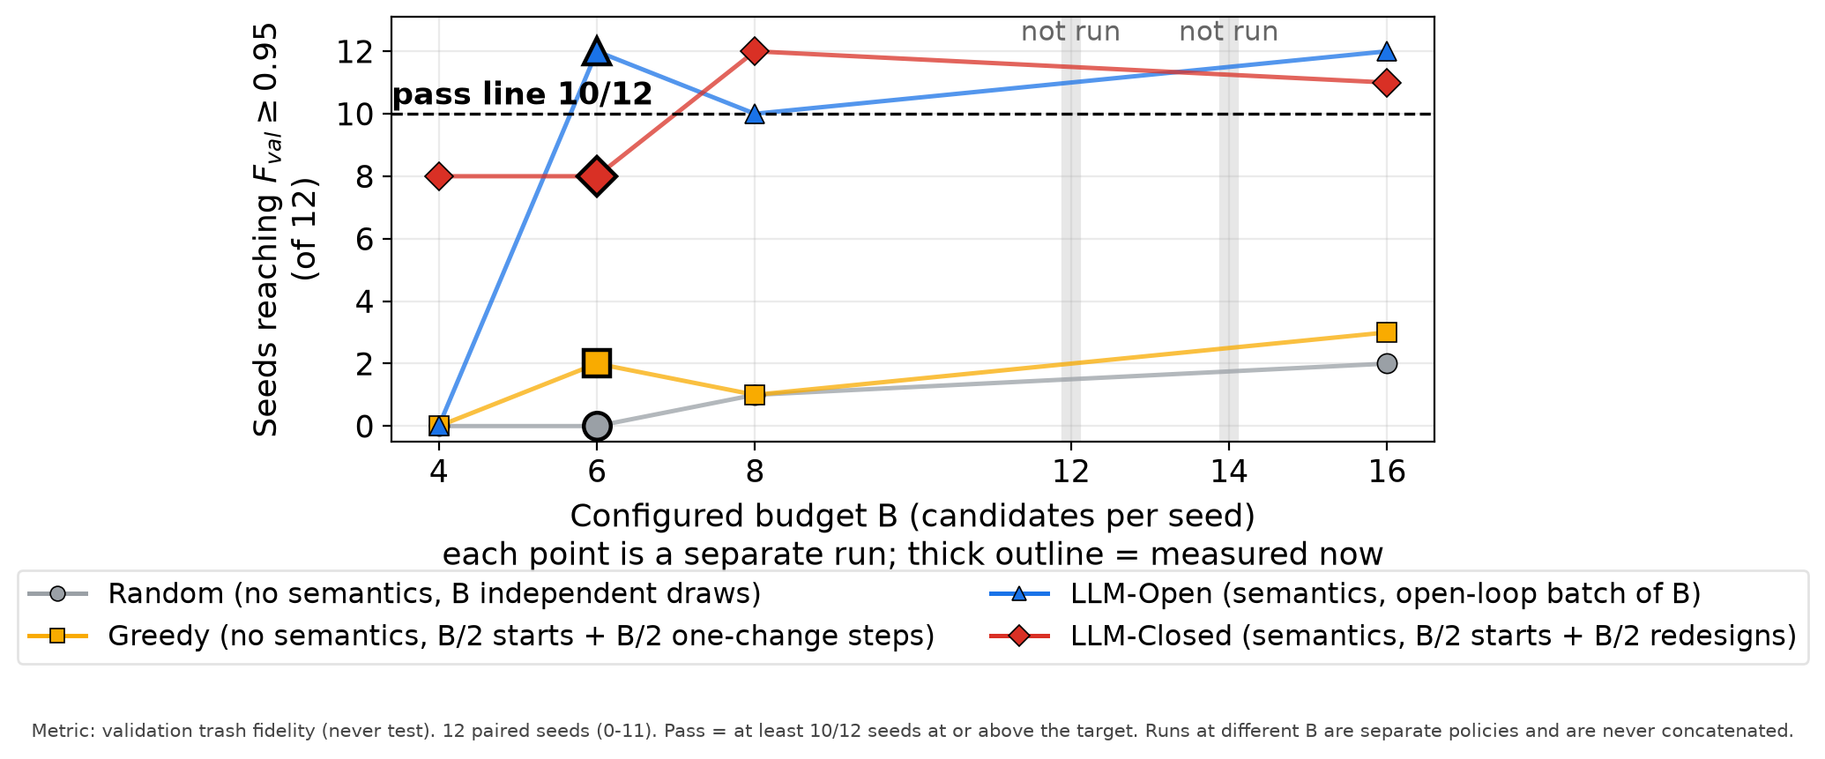
6 · RESULT
Open clears the bar at a budget closed cannot
Ising chain, target 0.95, four independently executed budgets, the same 12 paired seeds.
Measured
• Open 12/12 passes, closed 8/12 fails.
• Random 0/12, greedy 2/12, same seeds.
Counts are not monotone
• Open at B=4,6,8,16: 0, 12, 10, 12.
• Closed: 8, 8, 12, 11.
x: budget B. y: seeds (of 12) reaching validation fidelity 0.95. Dashed: the 10-of-12 rule. Thick outline: measured here; grey band: not run.
Does not show: A count, not an average, so no error bars. Nothing about budgets 12 or 14, other widths, or the test set.
Next: What this does and does not mean.
Generated from the committed validation-only result tables by the checked-in figure script.
llm-vqc · Checkpoint: minimum budget to a target validation fidelity · 2026-09-08
7 / 10
Notes:
The non-monotone counts are the reason the interval was dropped from the reporting format.

Slide 8
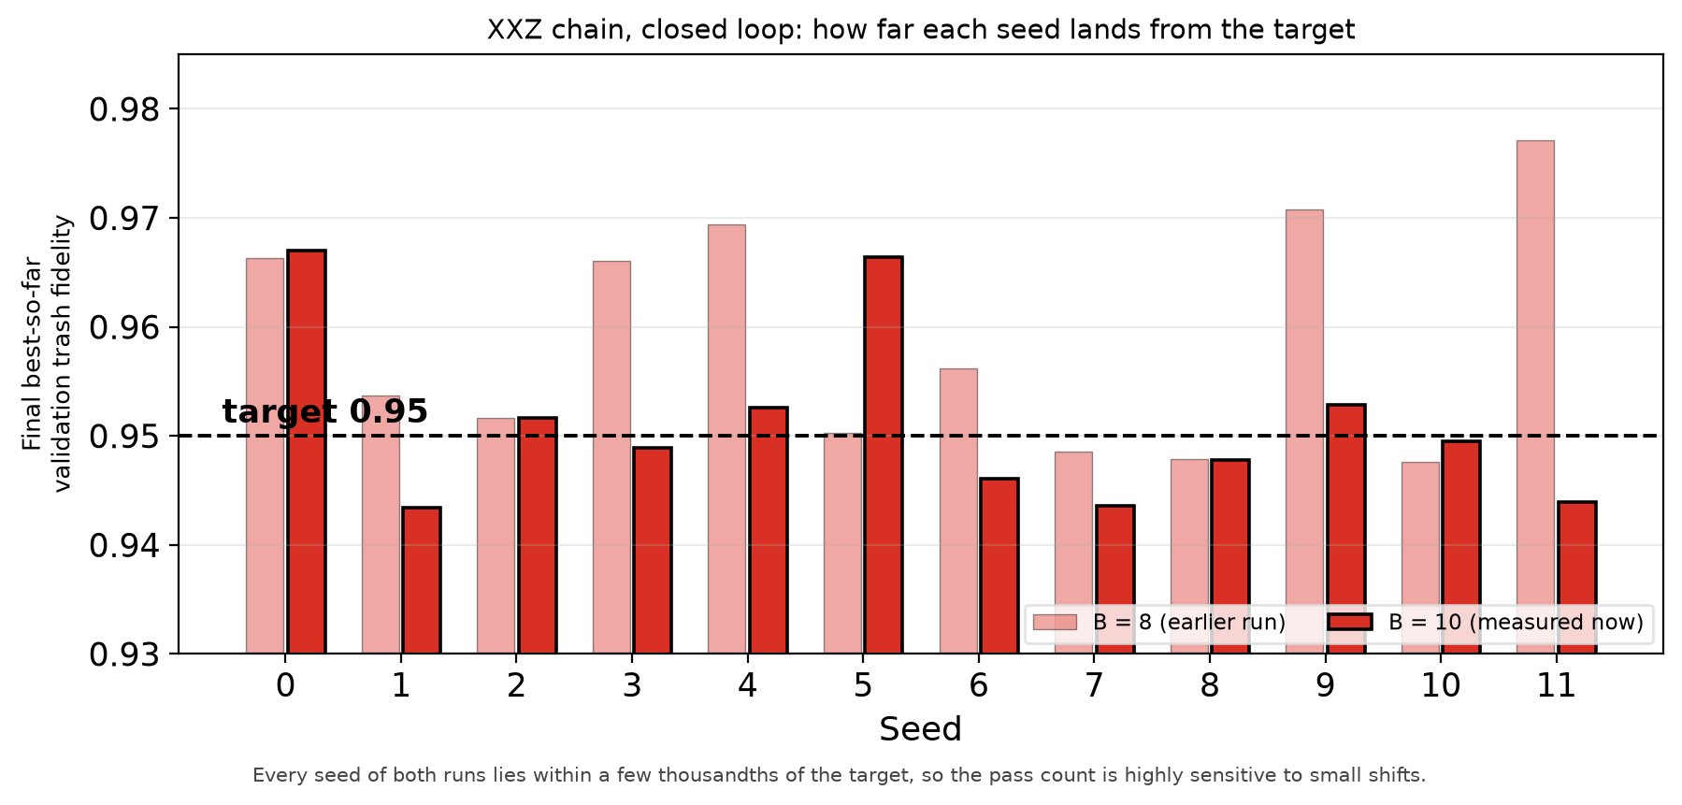
7 · WHAT THE RESULT MEANS
The XXZ count halved while the fidelities barely moved
Closed loop at the XXZ anchor, budget 8 against budget 10, per seed, same 12 paired seeds.
Observed (measured)
• Seeds at target: 9 to 5 of 12.
• Mean moved only -0.0076; 17 of 24 within 0.01.
Interpretation (inferred)
• A threshold inside the distribution makes the count knife-edge.
• Only the budget varied: no cause isolated.
x: seed. y: that seed's final best validation fidelity - pale for budget 8, solid for the budget 10 measured here. Dashed line: the 0.95 target. Single values, not averages.
Does not show: Not the path within a run, the rejected candidates, or whether a third run lands the same way.
Supports: the budget boundary is real and the count is threshold-sensitive. Does not support: any causal story about feedback.
Next: What would have to be true for this to be wrong.
llm-vqc · Checkpoint: minimum budget to a target validation fidelity · 2026-09-08
8 / 10
Notes:
Reporting the count faithfully matters more than explaining it; the mean shift is given so the reader can see the count is not a fidelity collapse.

Slide 9
8 · LIMITS AND OPEN QUESTIONS
What bounds this, and what stays unresolved
Stated before any of it is used to argue for a next step.
What would overturn it
Validity range
Negative results kept
Left open on purpose
• 4 qubits, noiseless, one capacity rule, one model, one XXZ anchor.
• One open-loop pool shared across the 12 seeds, not 12 generations.
• The closed loop fails the rule at budget 6.
• The XXZ boundary probe did not rescue the cell.
• Target 0.99: 0 of 12 everywhere, unresolved.
• 6 and 8 qubits and the other model: every method sits at 0-3 of 12.
• A blind sweep cannot separate the causes.
• Random fallbacks stay in the score: 12 of 408 evaluated candidates.
• A repeat landing the other side of the line - margins are thousandths.
• A different target, which would reshuffle every count.
Open question: Attainment counts are not monotone in budget, so no statement of the form 'the minimum lies between X and Y' is supported by these runs.
Next: What needs deciding.
llm-vqc · Checkpoint: minimum budget to a target validation fidelity · 2026-09-08
9 / 10
Notes:
The limits are deliberately stated before the recommendation.

Slide 10
9 · DECISIONS AND NEXT STEP
Sharpen the boundary, or diagnose the 0.99 ceiling
Both new cells are complete; the next move needs a decision, not more of the same.
What the evidence supports
Decisions needed from you
Proposed next step
• Ising chain, target 0.95: smallest verified passing budget is 6 for the open loop, 8 for the closed loop; budget 4 fails for both.
• XXZ chain, closed loop: no verified passing budget; 8 and 10 are both verified failures (measured).
• Target 0.99 unresolved everywhere, both new cells included (null result).
• New work: 138 model calls, USD 0.29 at list prices, under a USD 2.00 cap.
• D1 Sharpen the budget boundary?
– (a) repeat both cells with fresh generation seeds
– (b) accept budget 6 open-loop as the answer
– Recommend (a), Ising only; moderate.
• D2 What to do about 0.99
– (a) diagnose capacity and training length
– (b) record 0.99 as out of scope
– Recommend (a); a sweep cannot separate the causes.
• D3 Read held-out data yet? Recommend not yet; high confidence.
• On D1(a): repeat the Ising budget-6 cell with fresh generation seeds.
• On D2(a): write the capacity-versus-search protocol and its cap, then stop.
• Either yes commits to a new protocol and cap before anything runs.
• Already committed: report, hashed logs, reproduction commands.
Recommendation and decision are recorded separately in the research log; nothing above is approved.
llm-vqc · Checkpoint: minimum budget to a target validation fidelity · 2026-09-08
10 / 10
Notes:
The recommendation and the decision are recorded separately in the research log; nothing above is treated as approved.

