Slide 1
SPINN Circular Trap
PINN hyperparameter study vs. DEVSIM ground truth
Keynote-friendly discussion deck with graph-by-graph interpretation
RUNS COMPLETED
BEST VARIANT
BEST PHI MSE
VS BASELINE
19
bc_weight_1000
0.619
95x
Main Readout
Best DEVSIM agreement came from bc_weight_1000: Phi MSE 0.619, Psi MSE 0.0388.
That is about 95x lower RF-potential MSE than the baseline.
ReLU is the cautionary case: near-zero training loss, but the worst DEVSIM field error.
Among optimizer-only variants, RMSprop had the lowest DEVSIM error: Phi MSE 14.5.
SPINN Circular Trap PINN Hyperparameter Study

Slide 2
Study Setup
Circular Trap DEVSIM ground truth and Vanilla PINN sweep
What Was Run
How To Read The Deck
Ground truth: Circular Trap DEVSIM RF solve with East/West electrodes at 300 V.
PINN target: solve Laplace equation for Phi_RF; compute RF pseudopotential from autograd gradients.
Comparison: evaluate trained PINN at DEVSIM mesh nodes and compute common-point MSE/error maps.
Sweeps: width, depth, activation, boundary-condition weight, optimizer, and learning rate.
Convergence plots explain training behavior.
Phi/Psi MSE plots explain agreement with DEVSIM.
Appendix slides show raw PINN minus DEVSIM maps for each variant.
SPINN Circular Trap PINN Hyperparameter Study

Slide 3
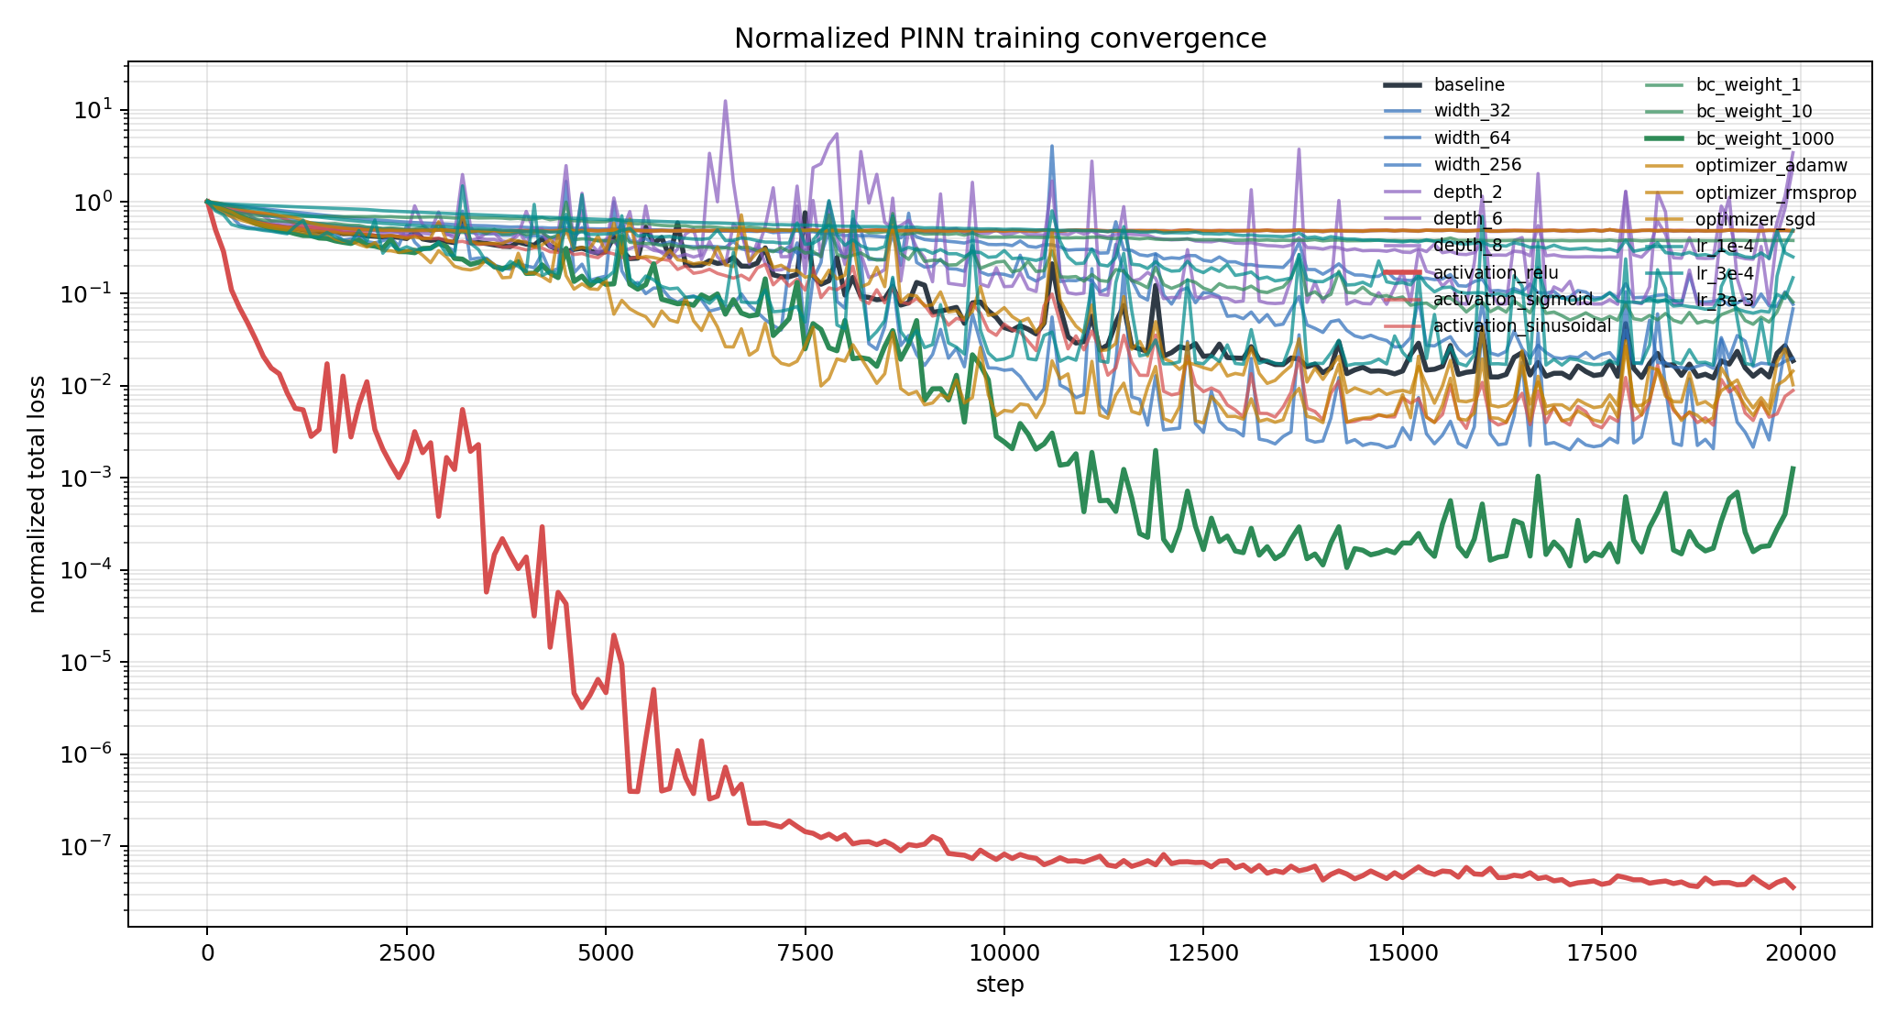
Normalized Convergence
Each curve is total loss divided by that run's initial total loss.
Graph Analysis
Normalized loss lets runs with different starting losses be compared on the same scale.
Fast normalized convergence did not always mean physical accuracy.
ReLU ended at 3.58e-08 normalized loss but failed the DEVSIM comparison.
BC weight 1000 also converged strongly and was physically accurate: Phi MSE 0.619.
SPINN Circular Trap PINN Hyperparameter Study

Slide 4
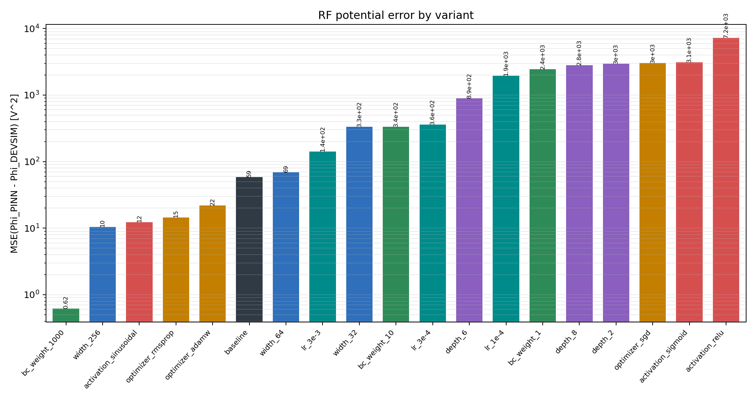
RF Potential Error
MSE of Phi_PINN minus Phi_DEVSIM on common DEVSIM mesh nodes.
Graph Analysis
Lowest RF-potential error: bc_weight_1000 at Phi MSE 0.619.
Largest RF-potential error: activation_relu at Phi MSE 7.2e+03.
Boundary-condition weighting dominated field accuracy in this first sweep.
Wider networks and sinusoidal activations were the strongest architecture-side options.
SPINN Circular Trap PINN Hyperparameter Study

Slide 5
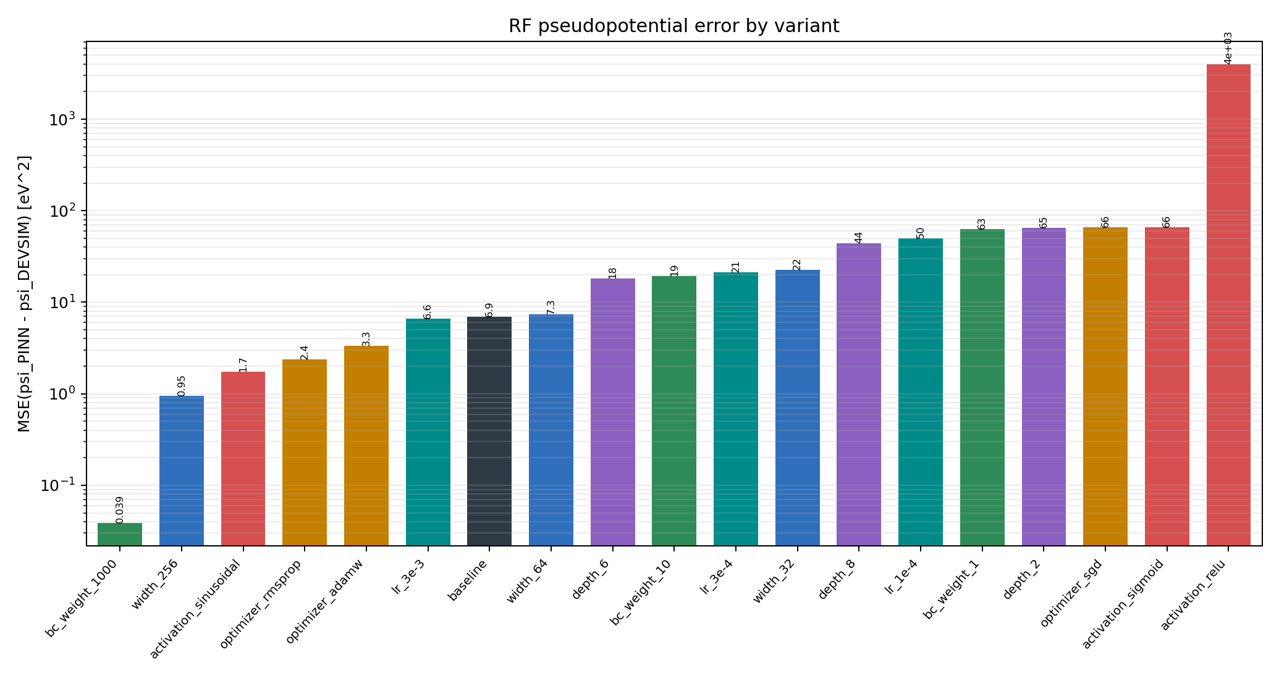
RF Pseudopotential Error
MSE of gradient-derived RF pseudopotential in eV.
Graph Analysis
Lowest pseudopotential error: bc_weight_1000 at Psi MSE 0.0388.
Pseudopotential depends on gradients, so it punishes field-shape errors more than voltage MSE alone.
The same variants that improved Phi generally improved Psi, but high-frequency instability can still appear in gradients.
SPINN Circular Trap PINN Hyperparameter Study

Slide 6
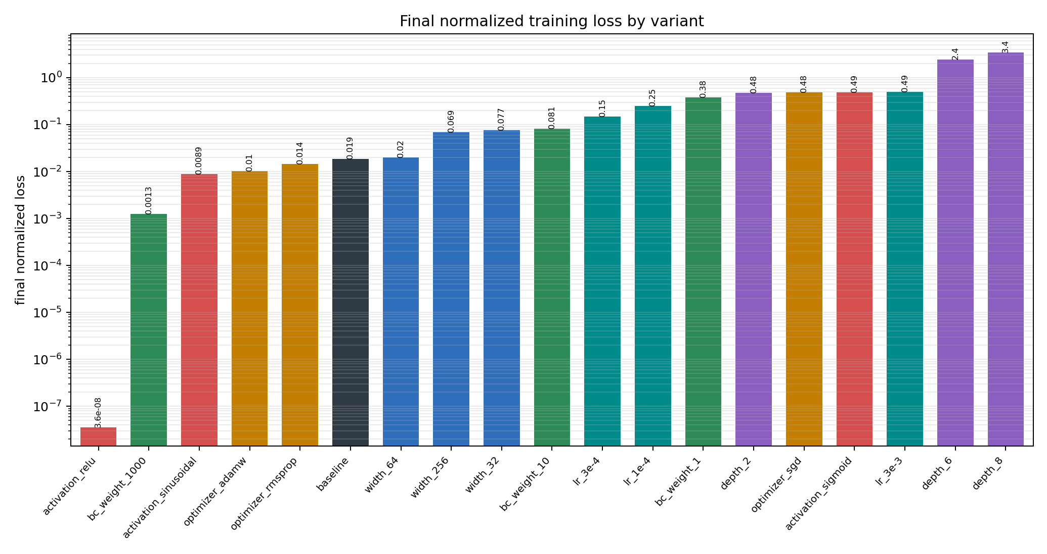
Final Normalized Loss
Final training loss normalized by each run's initial total loss.
Graph Analysis
Final training loss alone is not a reliable model-selection criterion here.
ReLU is artificially favored because the second derivative of ReLU is zero almost everywhere.
The best physical run, bc_weight_1000, also had a low final normalized loss, so it is the most credible winner.
SPINN Circular Trap PINN Hyperparameter Study

Slide 7
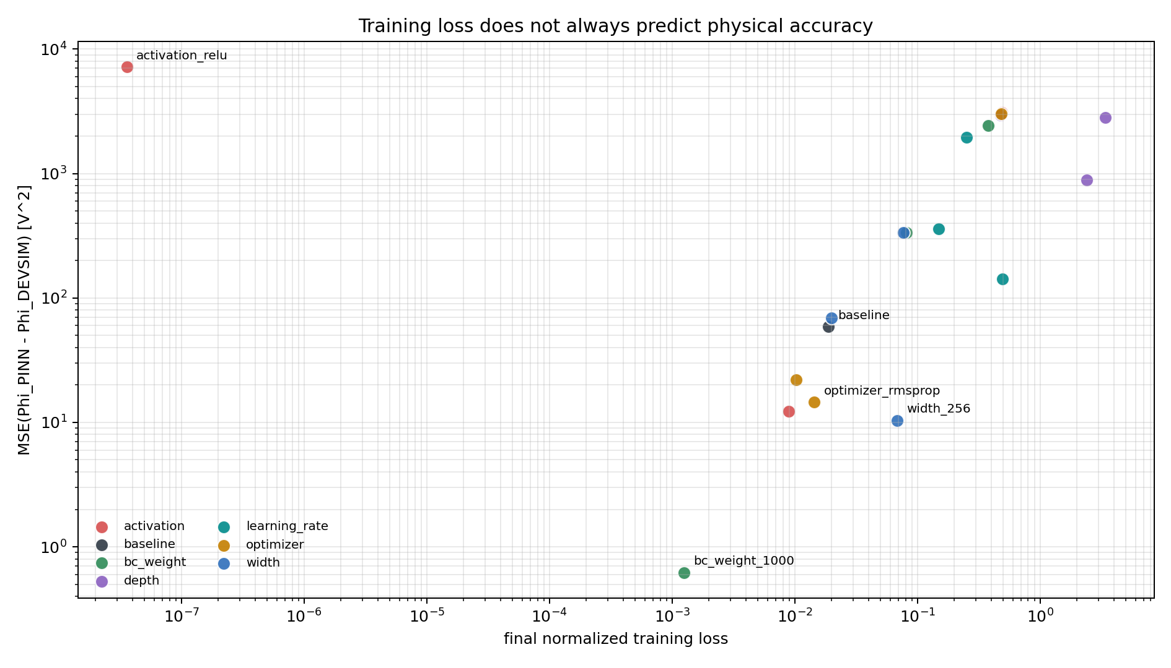
Training Loss vs. Field Error
Log-log comparison of final normalized loss against DEVSIM RF-potential MSE.
Graph Analysis
Ideal runs sit toward the lower-left: low training loss and low DEVSIM error.
ReLU sits far from the physical winner despite its tiny training loss, exposing a residual-definition failure.
BC weight 1000 is the cleanest point because it pairs low loss with the lowest field error.
Use this graph as the model-selection warning slide: optimization metrics need ground-truth validation.
SPINN Circular Trap PINN Hyperparameter Study

Slide 8
Best Runs By DEVSIM Error
Ranked by RF-potential MSE at DEVSIM mesh points
Variant
Act.
Opt.
Width
Depth
BC wt.
Phi MSE
Psi MSE
bc_weight_1000
tanh
adam
128
4
1e+03
0.619
0.0388
width_256
tanh
adam
256
4
100
10.4
0.955
activation_sinusoidal
sinusoidal
adam
128
4
100
12.3
1.75
optimizer_rmsprop
tanh
rmsprop
128
4
100
14.5
2.38
optimizer_adamw
tanh
adamw
128
4
100
21.9
3.33
baseline
tanh
adam
128
4
100
58.9
6.89
width_64
tanh
adam
64
4
100
69.2
7.33
lr_3e-3
tanh
adam
128
4
100
142
6.57
Interpretation
The best run is not just a lower-loss run; it also wins on both Phi and gradient-derived Psi.
The top group includes one BC-weight setting, one width setting, one activation setting, and two optimizer settings.
SPINN Circular Trap PINN Hyperparameter Study

Slide 9
Baseline Sweep
Ranked by DEVSIM RF-potential MSE
BEST
BEST PHI MSE
BEST PSI MSE
WORST PHI MSE
baseline
58.9
6.89
58.9
Variant
Final Norm. Loss
AUC Norm. Loss
Phi MSE
Psi MSE
baseline
0.0188
3.48e+03
58.9
6.89
Analysis
Baseline gives a useful reference: Phi MSE 58.9, Psi MSE 6.89.
Several variants beat the baseline decisively, so the PINN is hyperparameter-sensitive.
SPINN Circular Trap PINN Hyperparameter Study

Slide 10
Width Sweep
Ranked by DEVSIM RF-potential MSE
BEST
BEST PHI MSE
BEST PSI MSE
WORST PHI MSE
width_256
10.4
0.955
334
Variant
Final Norm. Loss
AUC Norm. Loss
Phi MSE
Psi MSE
width_256
0.0685
2.78e+03
10.4
0.955
width_64
0.02
5.37e+03
69.2
7.33
width_32
0.0767
7.27e+03
334
22.5
Analysis
Increasing width helped the physical field much more than it helped final training loss.
Width 256 was best: Phi MSE 10.4, compared with 334 for the worst width run.
SPINN Circular Trap PINN Hyperparameter Study

Slide 11
Depth Sweep
Ranked by DEVSIM RF-potential MSE
BEST
BEST PHI MSE
BEST PSI MSE
WORST PHI MSE
depth_6
886
18.3
2.95e+03
Variant
Final Norm. Loss
AUC Norm. Loss
Phi MSE
Psi MSE
depth_6
2.4
7.87e+03
886
18.3
depth_8
3.41
1.26e+04
2.81e+03
44.4
depth_2
0.478
9.79e+03
2.95e+03
65.4
Analysis
Depth variants were unstable in this setup; deeper did not mean better.
The best depth-only run was depth_6, but it still lagged the baseline by DEVSIM error.
SPINN Circular Trap PINN Hyperparameter Study

Slide 12
Activation Sweep
Ranked by DEVSIM RF-potential MSE
BEST
BEST PHI MSE
BEST PSI MSE
WORST PHI MSE
activation_sinusoidal
12.3
1.75
7.2e+03
Variant
Final Norm. Loss
AUC Norm. Loss
Phi MSE
Psi MSE
activation_sinusoidal
0.0089
3.03e+03
12.3
1.75
activation_sigmoid
0.486
1.01e+04
3.1e+03
65.6
activation_relu
3.58e-08
170
7.2e+03
3.97e+03
Analysis
Sinusoidal activation was the best activation-only variant for field accuracy.
ReLU produced misleadingly tiny loss because the Laplace residual becomes degenerate under second derivatives.
SPINN Circular Trap PINN Hyperparameter Study

Slide 13
BC Weight Sweep
Ranked by DEVSIM RF-potential MSE
BEST
BEST PHI MSE
BEST PSI MSE
WORST PHI MSE
bc_weight_1000
0.619
0.0388
2.44e+03
Variant
Final Norm. Loss
AUC Norm. Loss
Phi MSE
Psi MSE
bc_weight_1000
0.00126
2.09e+03
0.619
0.0388
bc_weight_10
0.0814
5.28e+03
335
19.3
bc_weight_1
0.379
9.75e+03
2.44e+03
63.1
Analysis
Boundary-condition weight was the strongest lever in this sweep.
Too little BC weight let boundary mismatch dominate; 1000 gave the cleanest DEVSIM match.
SPINN Circular Trap PINN Hyperparameter Study

Slide 14
Optimizer Sweep
Ranked by DEVSIM RF-potential MSE
BEST
BEST PHI MSE
BEST PSI MSE
WORST PHI MSE
optimizer_rmsprop
14.5
2.38
3.02e+03
Variant
Final Norm. Loss
AUC Norm. Loss
Phi MSE
Psi MSE
optimizer_rmsprop
0.0145
1.94e+03
14.5
2.38
optimizer_adamw
0.0103
3.63e+03
21.9
3.33
optimizer_sgd
0.481
1.01e+04
3.02e+03
65.5
Analysis
Optimizer choice changed both convergence and physical accuracy.
RMSprop had the best optimizer-only DEVSIM error; SGD plateaued with large boundary error.
SPINN Circular Trap PINN Hyperparameter Study

Slide 15
Learning Rate Sweep
Ranked by DEVSIM RF-potential MSE
BEST
BEST PHI MSE
BEST PSI MSE
WORST PHI MSE
lr_3e-3
142
6.57
1.95e+03
Variant
Final Norm. Loss
AUC Norm. Loss
Phi MSE
Psi MSE
lr_3e-3
0.493
3.43e+03
142
6.57
lr_3e-4
0.149
6.49e+03
358
21.3
lr_1e-4
0.251
1.05e+04
1.95e+03
50.2
Analysis
Lower learning rates were smoother but too slow for this fixed training budget.
The high-rate run moved fastest but had large PDE spikes; it still beat the lower-rate runs by DEVSIM error.
SPINN Circular Trap PINN Hyperparameter Study

Slide 16
Discussion Points
Questions to bring to the group
Interpretation
Next Sweep
Do we trust BC-weight 1000 as physically better, or should we test robustness across seeds?
Should ReLU be excluded for second-derivative PINNs, or retained only as a negative control?
Is RMSprop genuinely better here, or should it be followed by LBFGS refinement like many PINN workflows?
Repeat top variants with multiple random seeds.
Add Adam to LBFGS and RMSprop to LBFGS two-stage optimizer runs.
Try adaptive loss balancing between PDE and boundary losses.
SPINN Circular Trap PINN Hyperparameter Study

Slide 17
Error Map Appendix
Each slide shows raw PINN minus DEVSIM error maps and a one-line interpretation.
SPINN Circular Trap PINN Hyperparameter Study

Slide 18
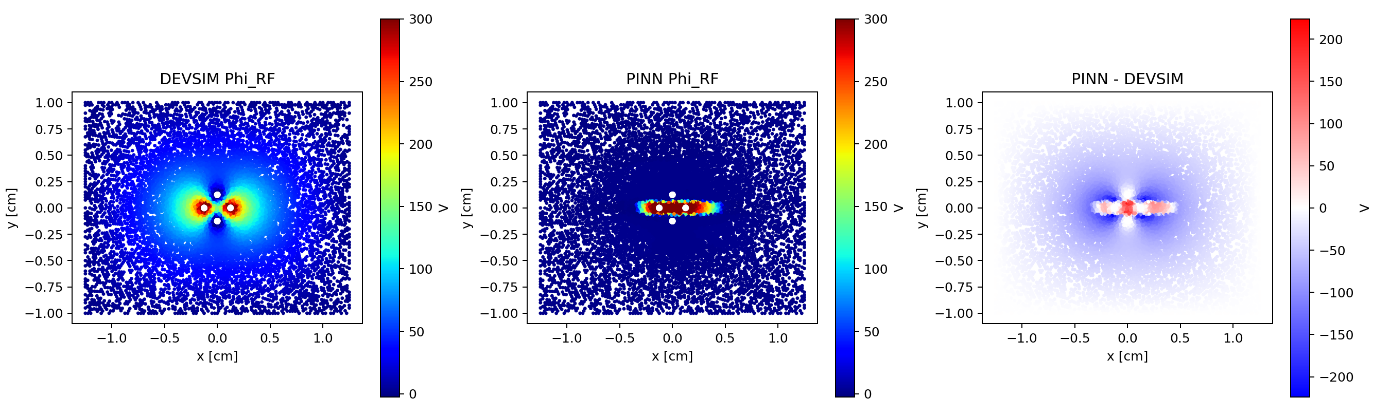
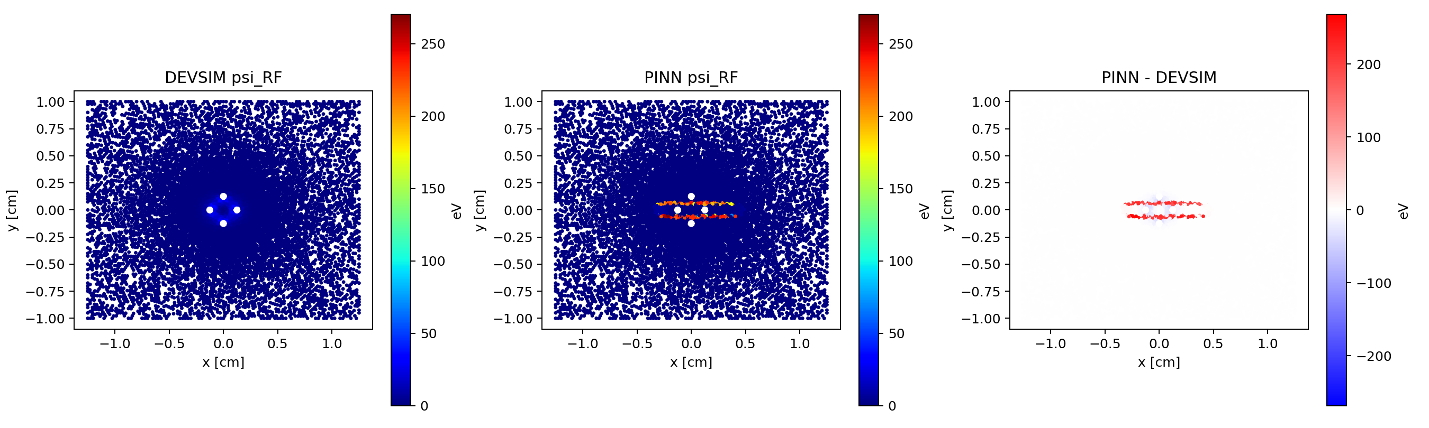
activation_relu
Raw error maps: PINN minus DEVSIM
PHI MSE
PSI MSE
NORM. LOSS
Misleading loss case: the training objective collapses, but the field error is the worst in the sweep.
7.2e+03
3.97e+03
3.58e-08
SPINN Circular Trap PINN Hyperparameter Study

Slide 19
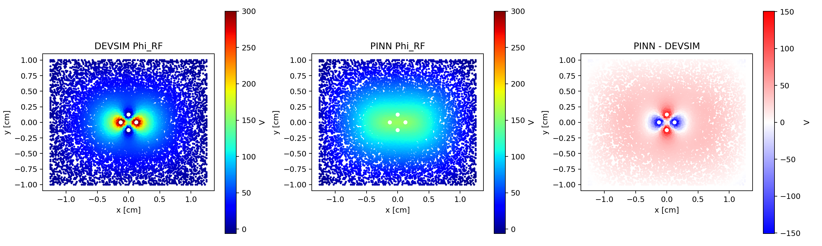
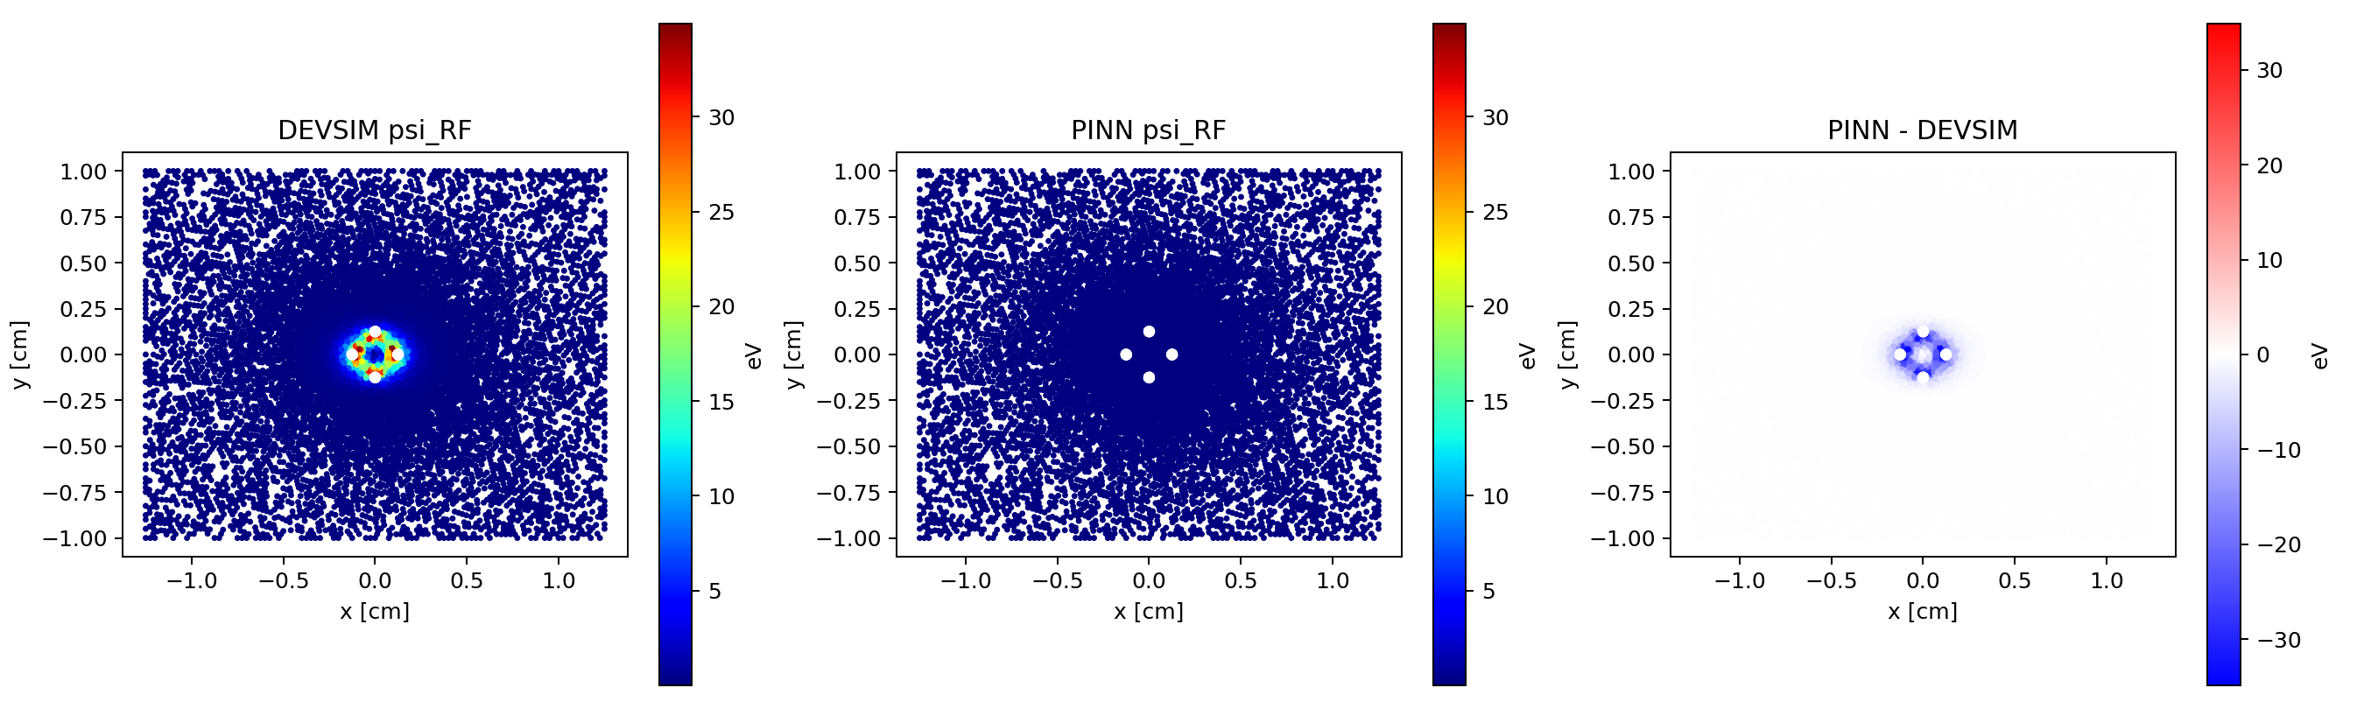
activation_sigmoid
Raw error maps: PINN minus DEVSIM
PHI MSE
PSI MSE
NORM. LOSS
Final norm. loss 0.486; Phi MSE 3.1e+03; Psi MSE 65.6. Use error maps to locate where residual field error concentrates.
3.1e+03
65.6
0.486
SPINN Circular Trap PINN Hyperparameter Study

Slide 20
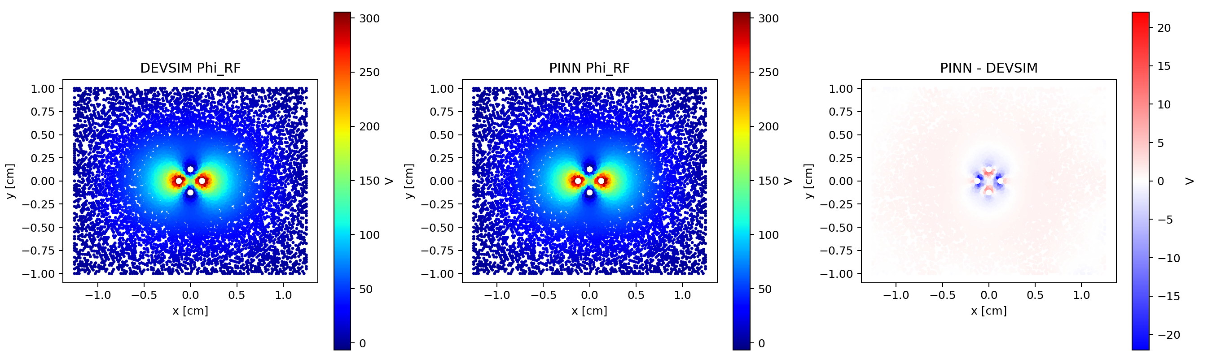
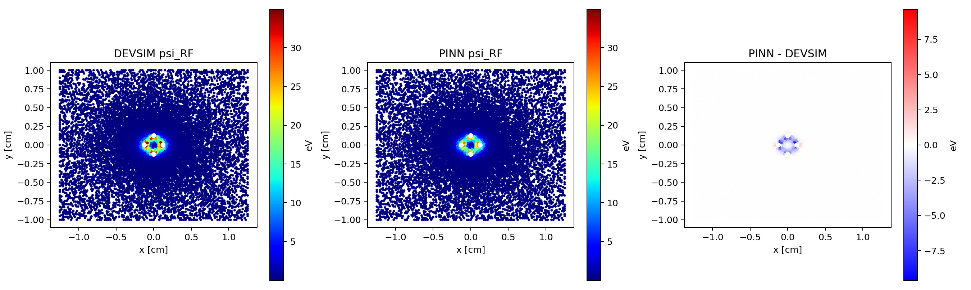
activation_sinusoidal
Raw error maps: PINN minus DEVSIM
PHI MSE
PSI MSE
NORM. LOSS
Best activation-only result; smooth derivatives help the PDE residual and gradient-derived pseudopotential.
12.3
1.75
0.0089
SPINN Circular Trap PINN Hyperparameter Study

Slide 21
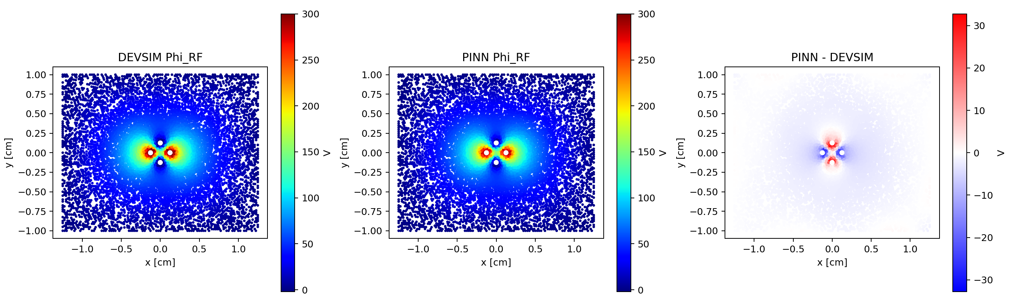

baseline
Raw error maps: PINN minus DEVSIM
PHI MSE
PSI MSE
NORM. LOSS
Reference run for interpreting all variants; several choices beat it by large margins.
58.9
6.89
0.0188
SPINN Circular Trap PINN Hyperparameter Study

Slide 22
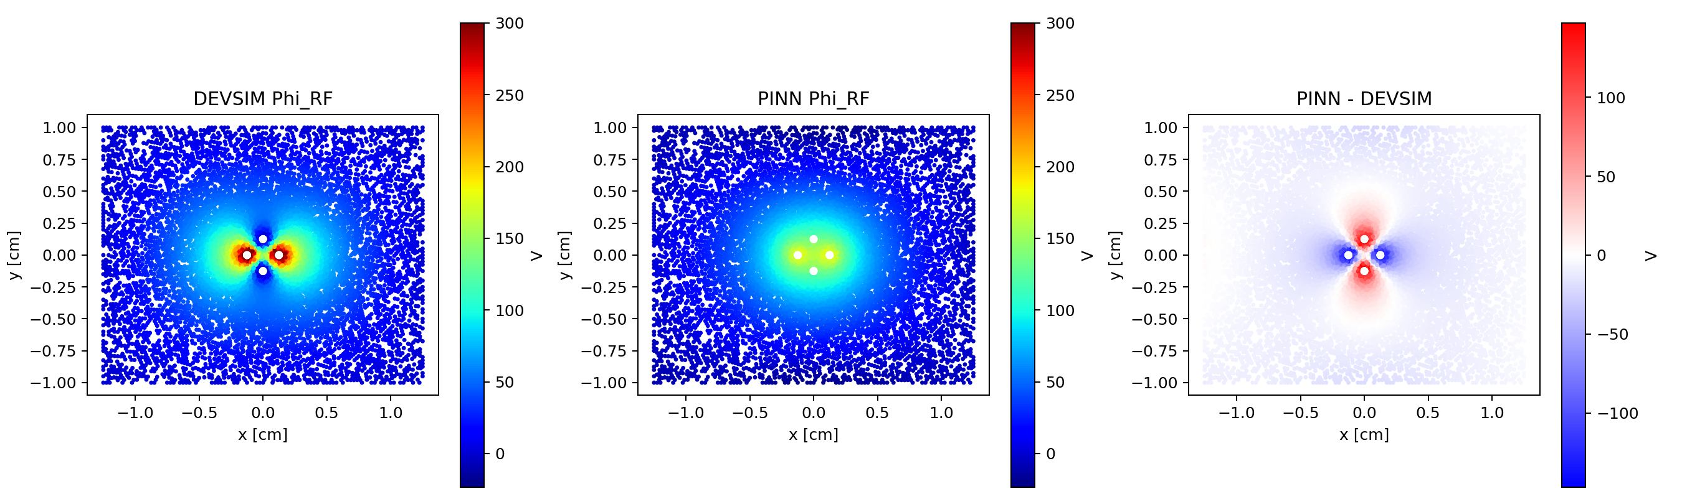

bc_weight_1
Raw error maps: PINN minus DEVSIM
PHI MSE
PSI MSE
NORM. LOSS
Final norm. loss 0.379; Phi MSE 2.44e+03; Psi MSE 63.1. Use error maps to locate where residual field error concentrates.
2.44e+03
63.1
0.379
SPINN Circular Trap PINN Hyperparameter Study

Slide 23
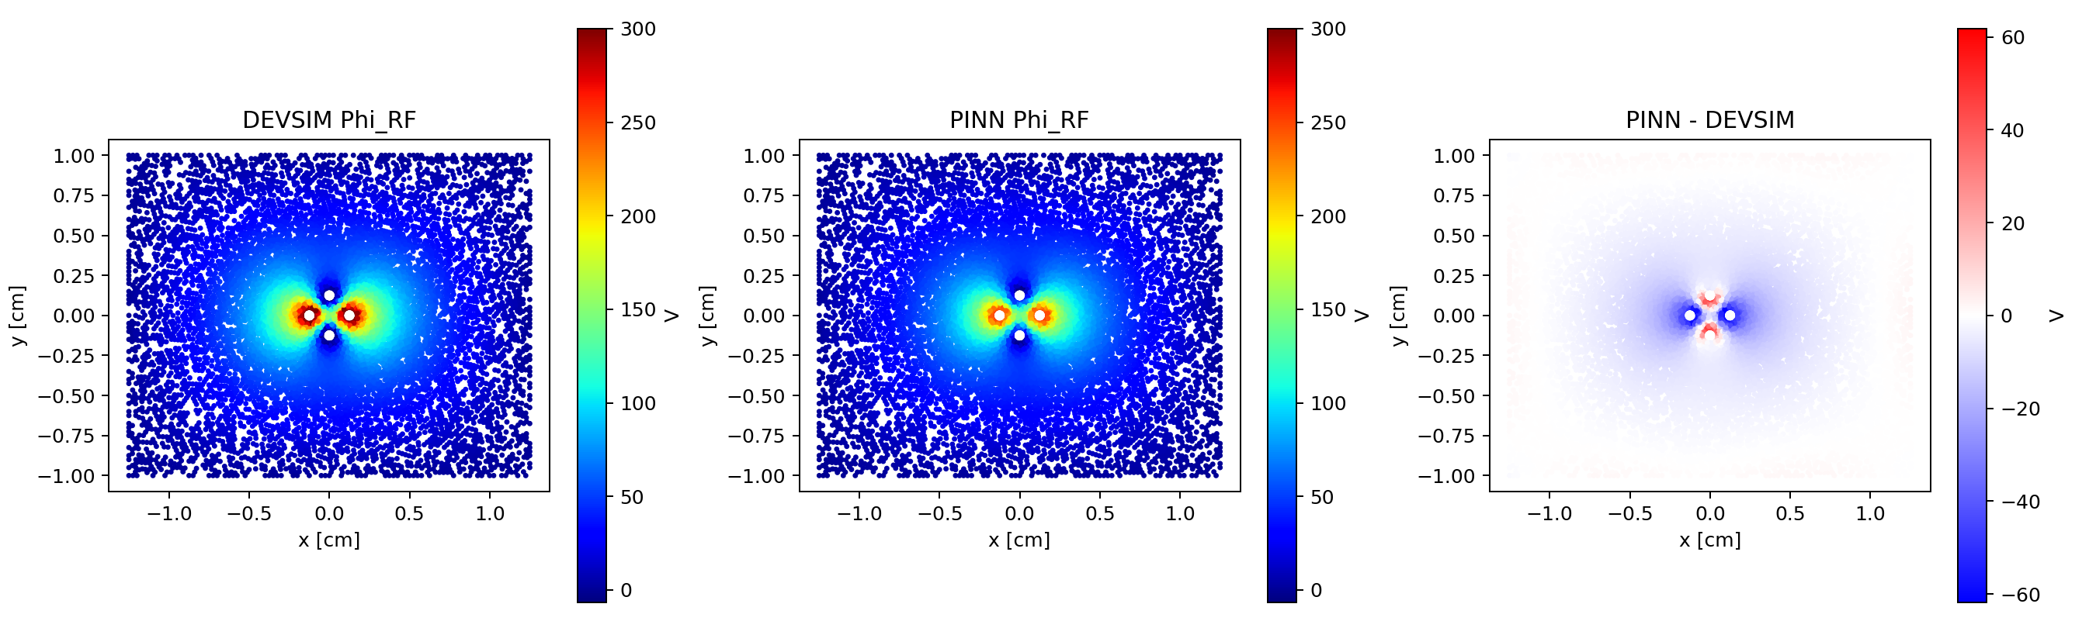

bc_weight_10
Raw error maps: PINN minus DEVSIM
PHI MSE
PSI MSE
NORM. LOSS
Final norm. loss 0.0814; Phi MSE 335; Psi MSE 19.3. Use error maps to locate where residual field error concentrates.
335
19.3
0.0814
SPINN Circular Trap PINN Hyperparameter Study

Slide 24
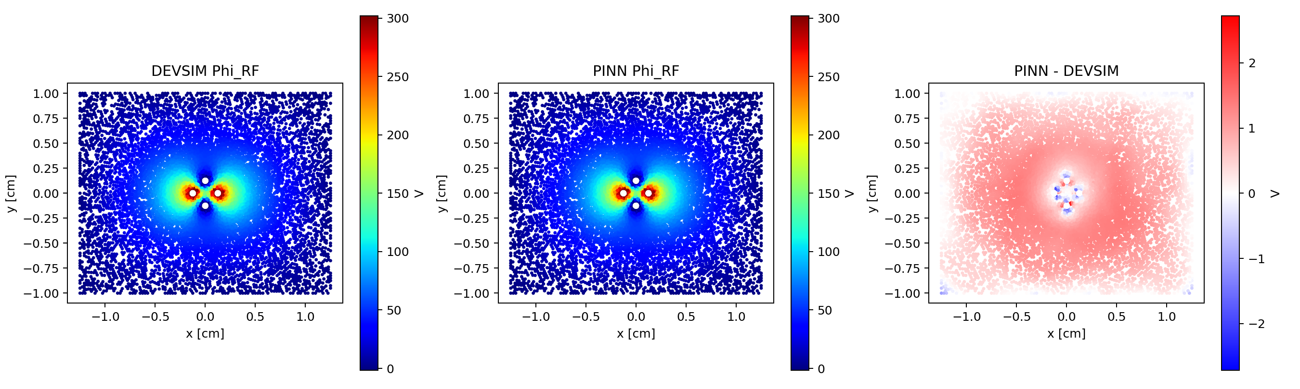
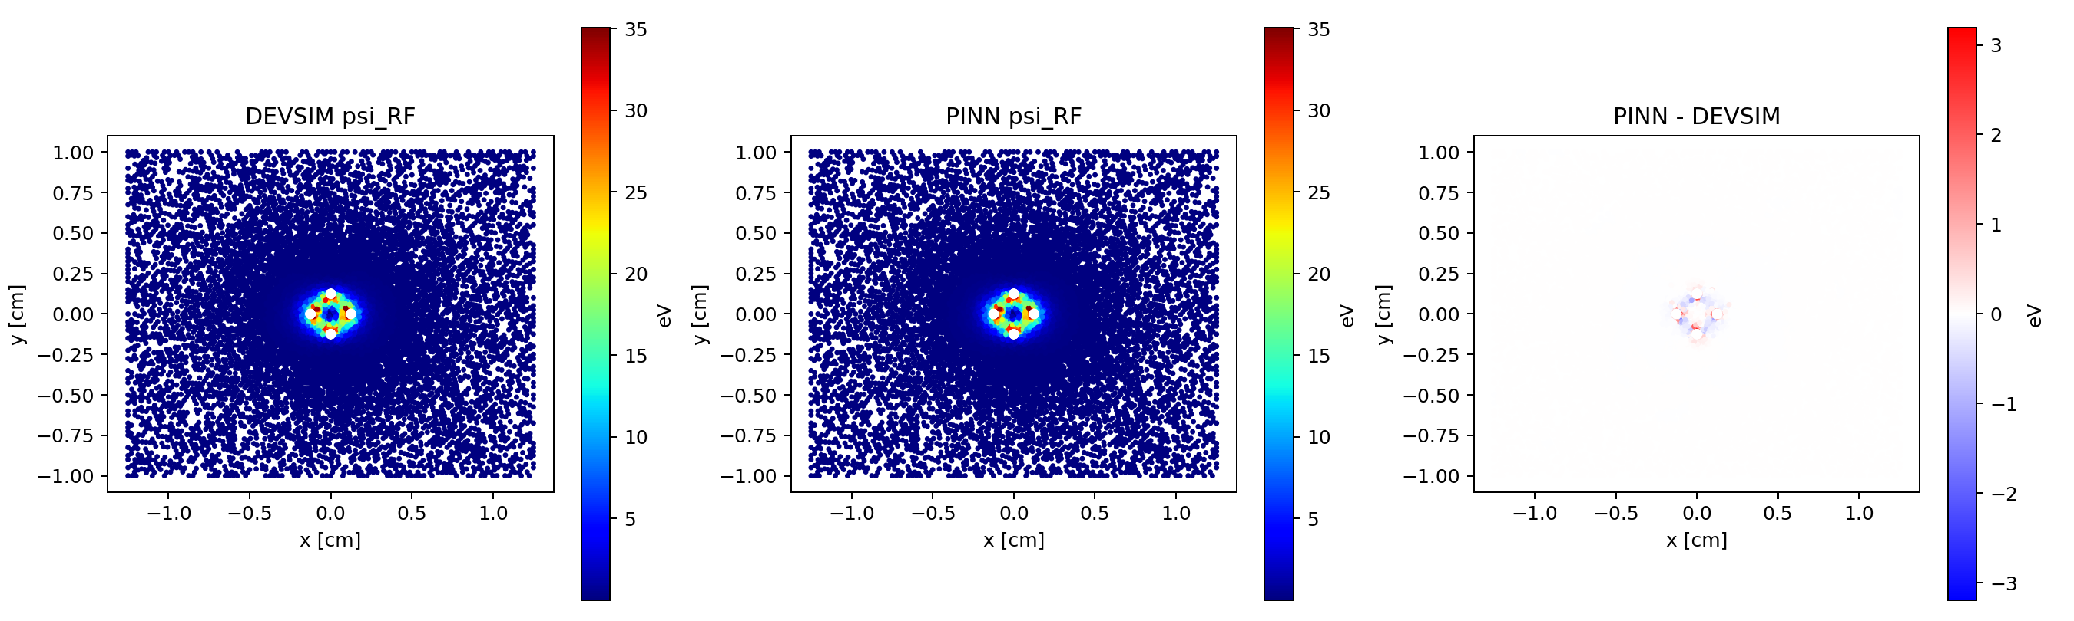
bc_weight_1000
Raw error maps: PINN minus DEVSIM
PHI MSE
PSI MSE
NORM. LOSS
Best overall DEVSIM match; boundary enforcement was strong without destroying the learned field.
0.619
0.0388
0.00126
SPINN Circular Trap PINN Hyperparameter Study

Slide 25
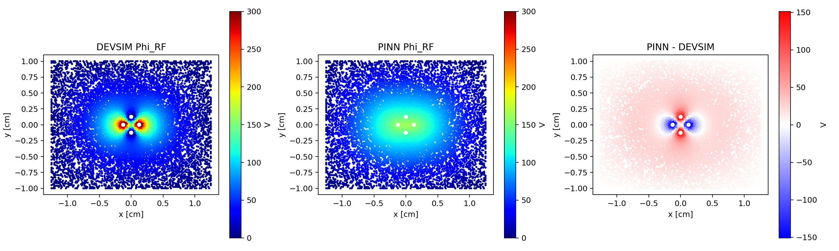

depth_2
Raw error maps: PINN minus DEVSIM
PHI MSE
PSI MSE
NORM. LOSS
Final norm. loss 0.478; Phi MSE 2.95e+03; Psi MSE 65.4. Use error maps to locate where residual field error concentrates.
2.95e+03
65.4
0.478
SPINN Circular Trap PINN Hyperparameter Study

Slide 26
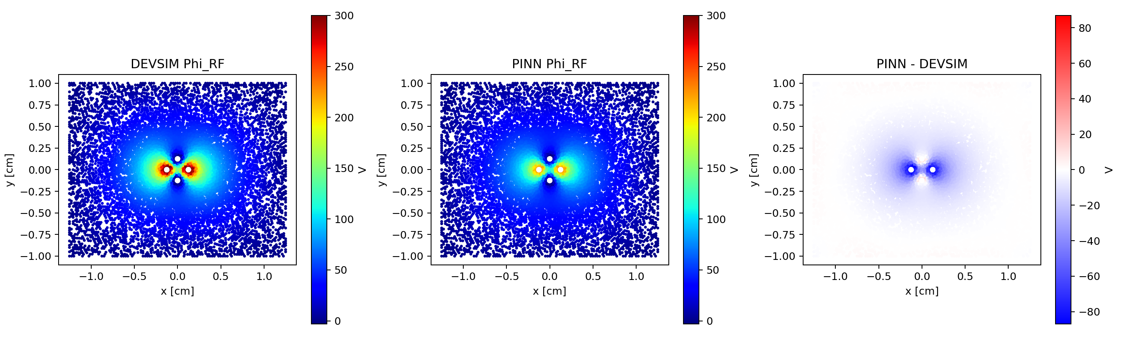

depth_6
Raw error maps: PINN minus DEVSIM
PHI MSE
PSI MSE
NORM. LOSS
Final norm. loss 2.4; Phi MSE 886; Psi MSE 18.3. Use error maps to locate where residual field error concentrates.
886
18.3
2.4
SPINN Circular Trap PINN Hyperparameter Study

Slide 27
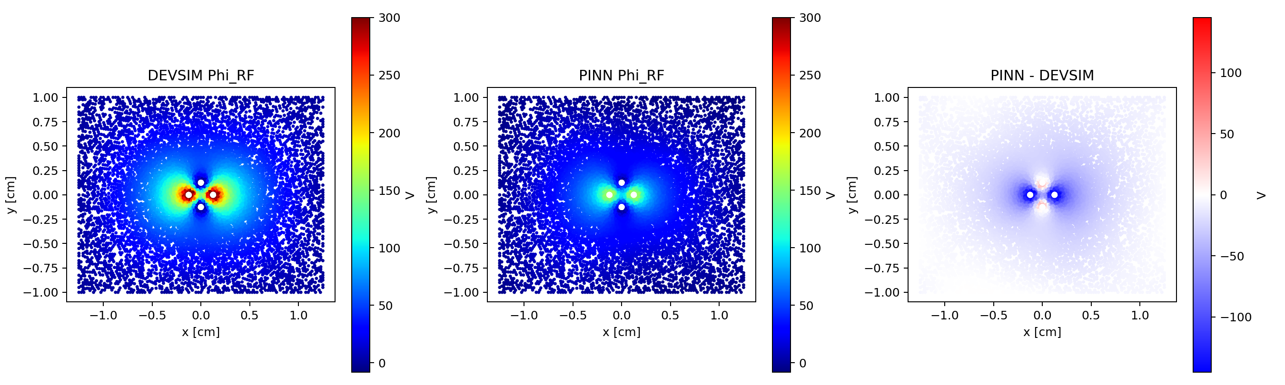

depth_8
Raw error maps: PINN minus DEVSIM
PHI MSE
PSI MSE
NORM. LOSS
Final norm. loss 3.41; Phi MSE 2.81e+03; Psi MSE 44.4. Use error maps to locate where residual field error concentrates.
2.81e+03
44.4
3.41
SPINN Circular Trap PINN Hyperparameter Study

Slide 28

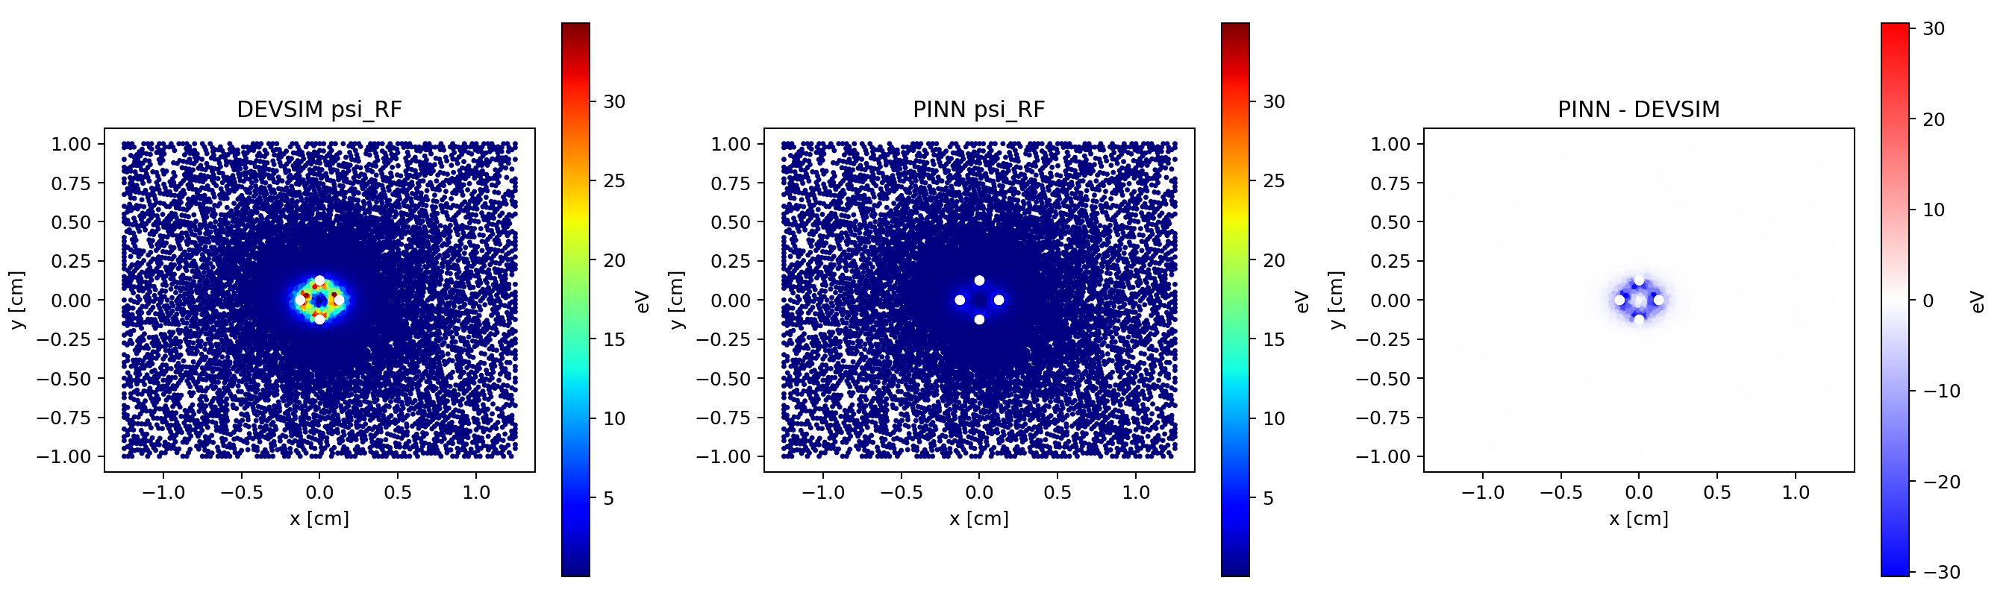
lr_1e-4
Raw error maps: PINN minus DEVSIM
PHI MSE
PSI MSE
NORM. LOSS
Final norm. loss 0.251; Phi MSE 1.95e+03; Psi MSE 50.2. Use error maps to locate where residual field error concentrates.
1.95e+03
50.2
0.251
SPINN Circular Trap PINN Hyperparameter Study

Slide 29
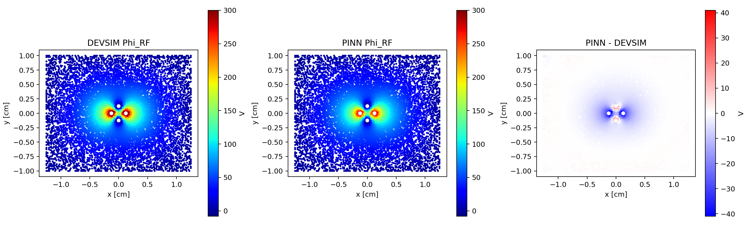

lr_3e-3
Raw error maps: PINN minus DEVSIM
PHI MSE
PSI MSE
NORM. LOSS
Final norm. loss 0.493; Phi MSE 142; Psi MSE 6.57. Use error maps to locate where residual field error concentrates.
142
6.57
0.493
SPINN Circular Trap PINN Hyperparameter Study

Slide 30
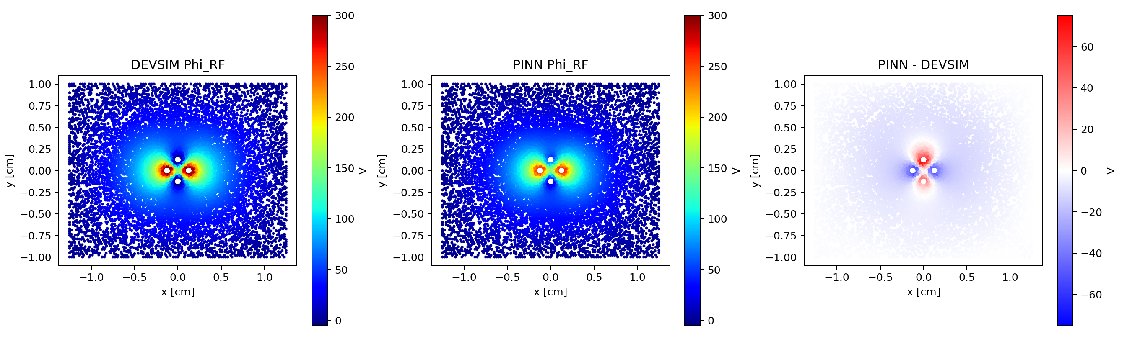

lr_3e-4
Raw error maps: PINN minus DEVSIM
PHI MSE
PSI MSE
NORM. LOSS
Final norm. loss 0.149; Phi MSE 358; Psi MSE 21.3. Use error maps to locate where residual field error concentrates.
358
21.3
0.149
SPINN Circular Trap PINN Hyperparameter Study

Slide 31
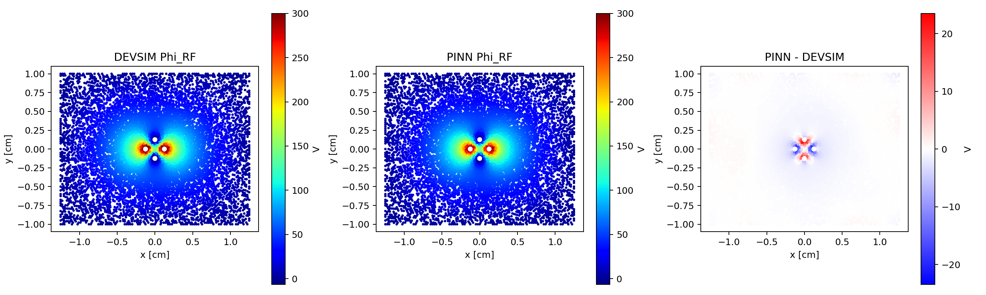

optimizer_adamw
Raw error maps: PINN minus DEVSIM
PHI MSE
PSI MSE
NORM. LOSS
Final norm. loss 0.0103; Phi MSE 21.9; Psi MSE 3.33. Use error maps to locate where residual field error concentrates.
21.9
3.33
0.0103
SPINN Circular Trap PINN Hyperparameter Study

Slide 32


optimizer_rmsprop
Raw error maps: PINN minus DEVSIM
PHI MSE
PSI MSE
NORM. LOSS
Final norm. loss 0.0145; Phi MSE 14.5; Psi MSE 2.38. Use error maps to locate where residual field error concentrates.
14.5
2.38
0.0145
SPINN Circular Trap PINN Hyperparameter Study

Slide 33
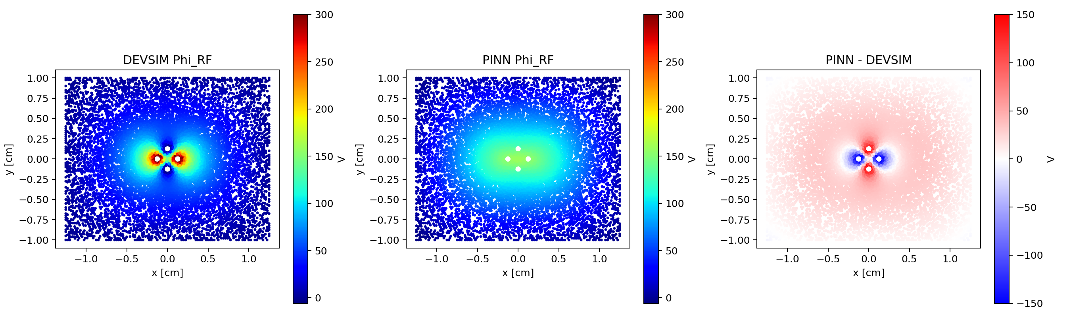

optimizer_sgd
Raw error maps: PINN minus DEVSIM
PHI MSE
PSI MSE
NORM. LOSS
SGD plateaued; comparison confirms poor field accuracy despite completing the same training budget.
3.02e+03
65.5
0.481
SPINN Circular Trap PINN Hyperparameter Study

Slide 34

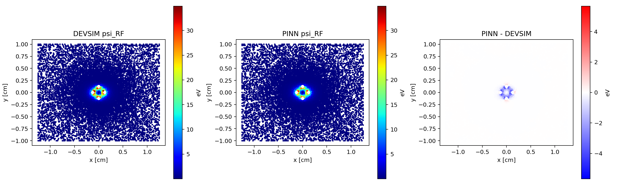
width_256
Raw error maps: PINN minus DEVSIM
PHI MSE
PSI MSE
NORM. LOSS
Best architecture-width result; wider representation improved field shape despite a higher final loss.
10.4
0.955
0.0685
SPINN Circular Trap PINN Hyperparameter Study

Slide 35
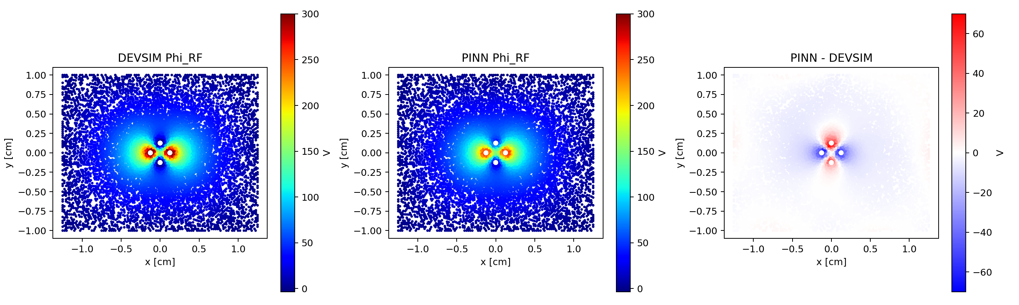

width_32
Raw error maps: PINN minus DEVSIM
PHI MSE
PSI MSE
NORM. LOSS
Final norm. loss 0.0767; Phi MSE 334; Psi MSE 22.5. Use error maps to locate where residual field error concentrates.
334
22.5
0.0767
SPINN Circular Trap PINN Hyperparameter Study

Slide 36
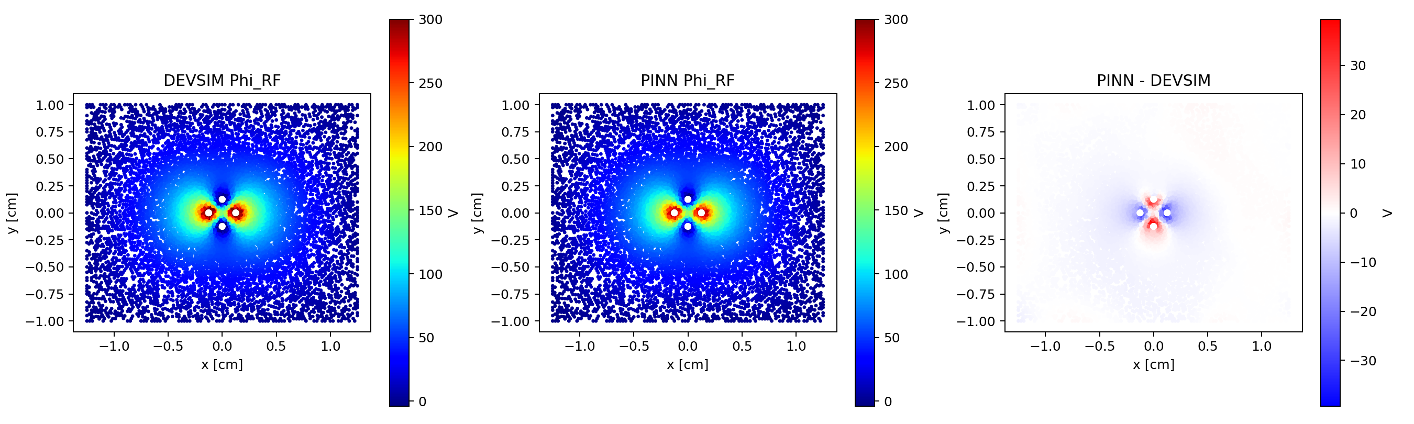

width_64
Raw error maps: PINN minus DEVSIM
PHI MSE
PSI MSE
NORM. LOSS
Final norm. loss 0.02; Phi MSE 69.2; Psi MSE 7.33. Use error maps to locate where residual field error concentrates.
69.2
7.33
0.02
SPINN Circular Trap PINN Hyperparameter Study

