Slide 1

Deep Assortment of Molecular Property (DAMP)
Venkata Sai Sreyas Adury and Arnab Mukherjee

Slide 2
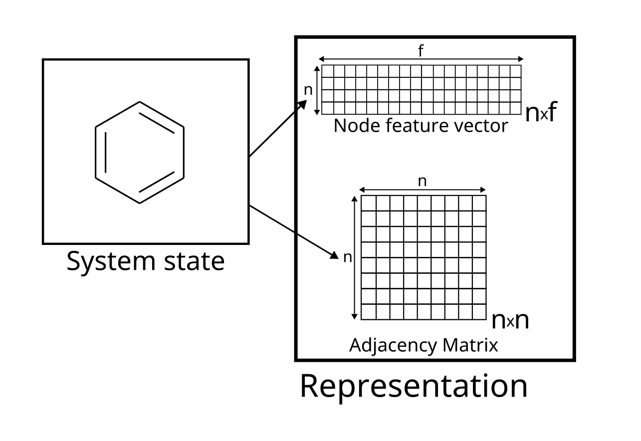
Molecules as graphs
All molecules can be represented as graphs
The atoms form the nodes
The bonds form the edges
The node features can store information about a node (i.e. atom)

Slide 3
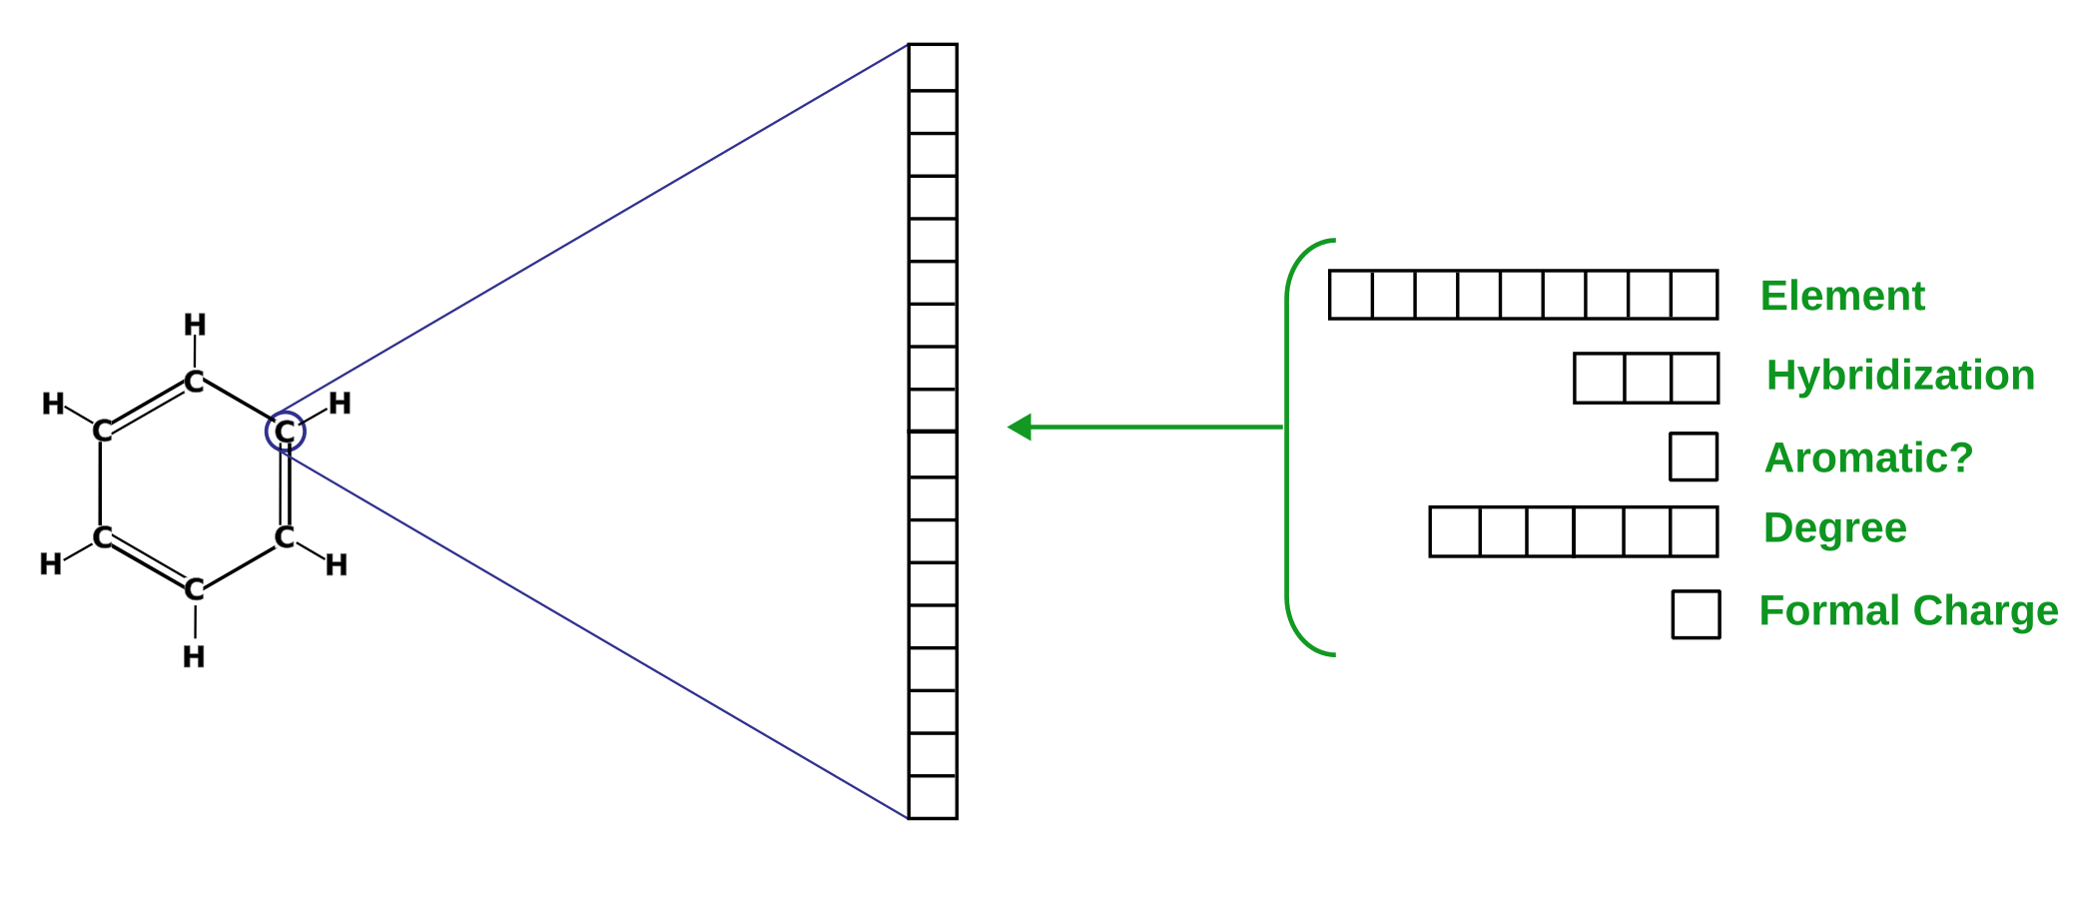
Node featurization
We use DeepChem’s featurization (feature-size=30)

Slide 4
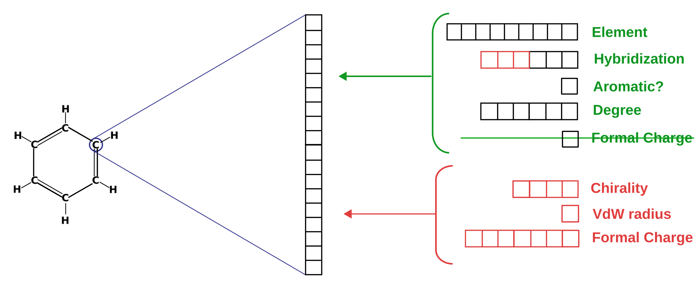
More features
For some properties, we added more features (final feature size = 79)

Slide 5
Changes to the features
Expanded the number of elements possible
Used one-hot encoding (-3, -2, -1, 0, 1, 2, 3) for formal charge instead of a single integer
Added potentially important chemical parameters such as Vdw radius and covalent radius

Slide 6
Graph Convolution and our model
Convolution lets us enrich the information available at each node by incorporating it from its nearest neighbours
Multiple iterations of GCN can thus incorporate information from farther and farther neighbours
In out models, we used 8 iterations of Graph Convolution and trained with the Adam optimizer after taking an 80-20 split of the provided data for training and validation respectively

Slide 7
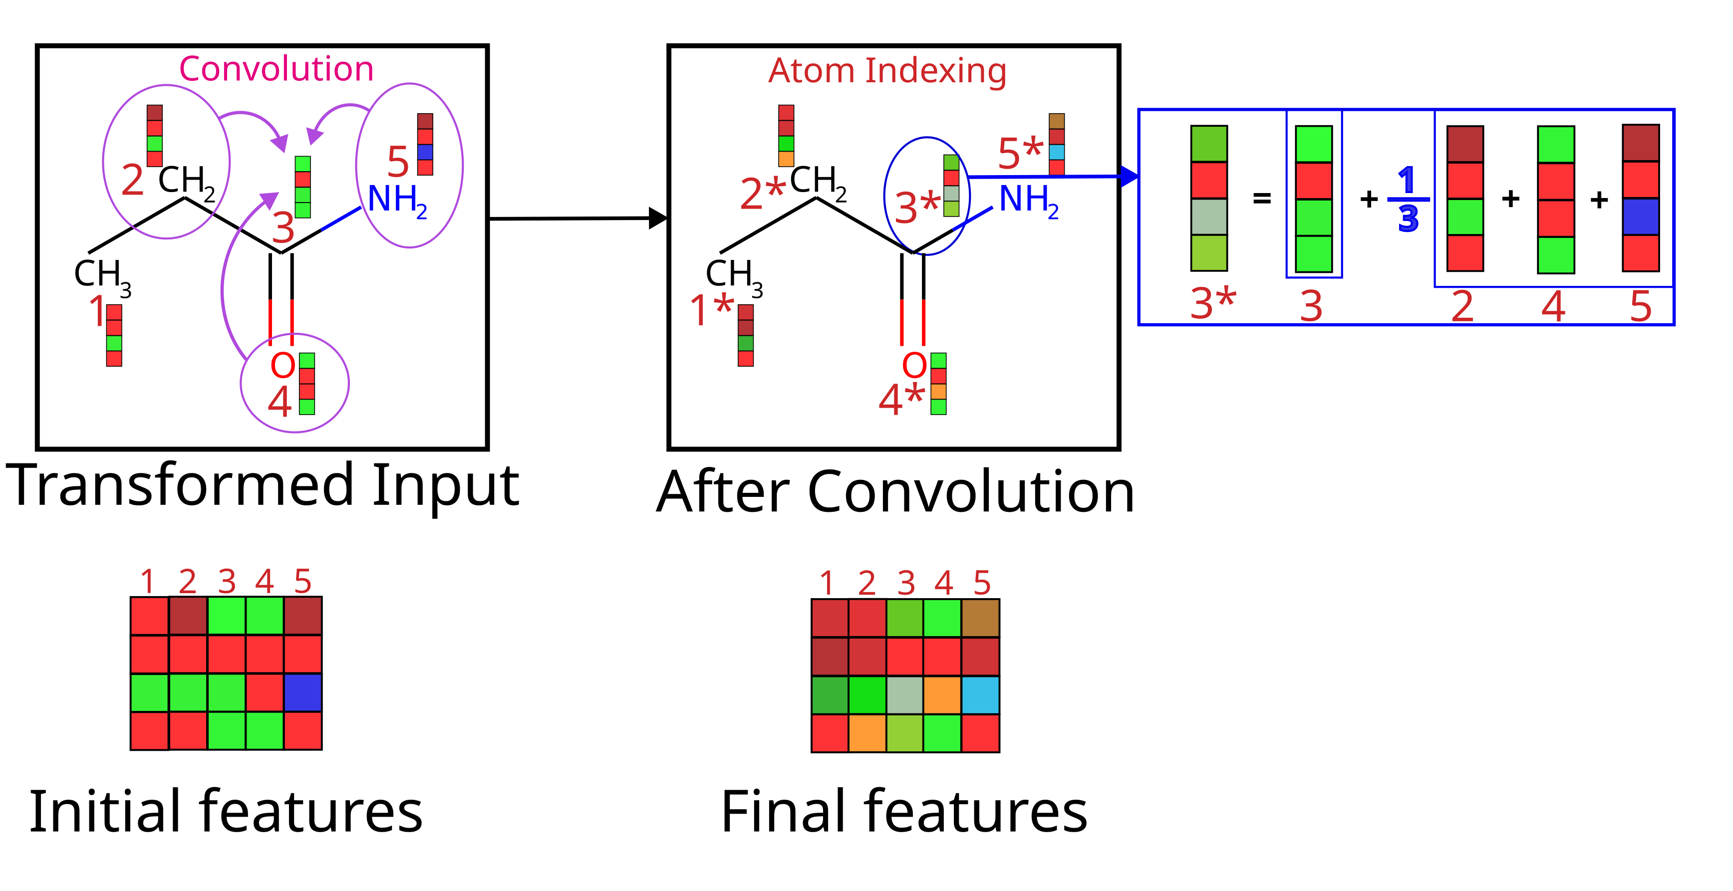
Graph Convolution

Slide 8
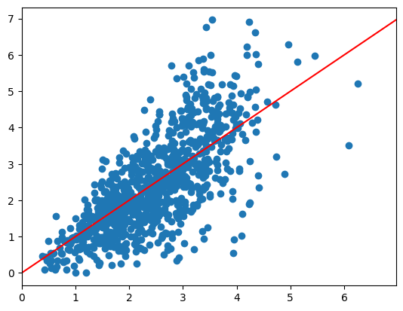
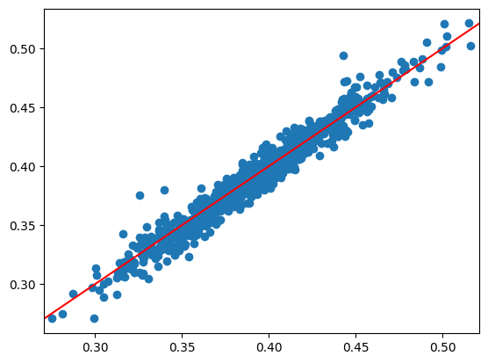
Results (Validation set)
R² = 0.54
R² = 0.951
Property 1
Property 2

Slide 9
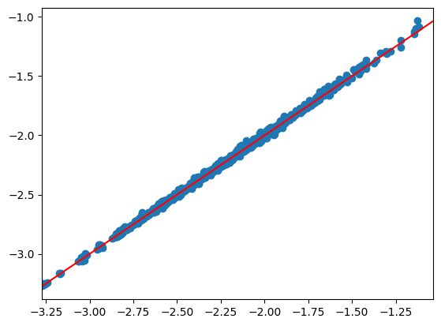
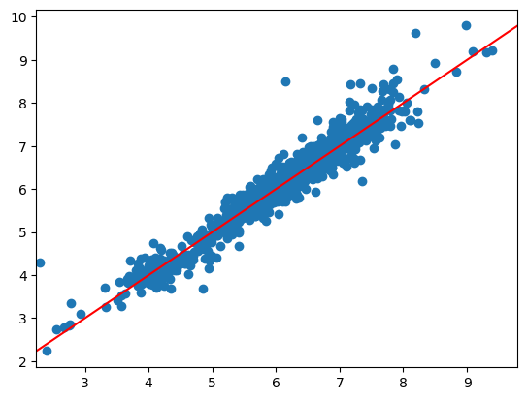
Results (Validation set)
R² = 0.99
R² = 0.936
Property 3
Property 4

