Slide 1
An investigation into effects of optimizations on the adversary search algorithm Minimax
Michael Li

Slide 2


Research question
How does search depth affect the extent to which optimizations on the Minimax search algorithm make the search more efficient, as applied to chess?

Slide 3
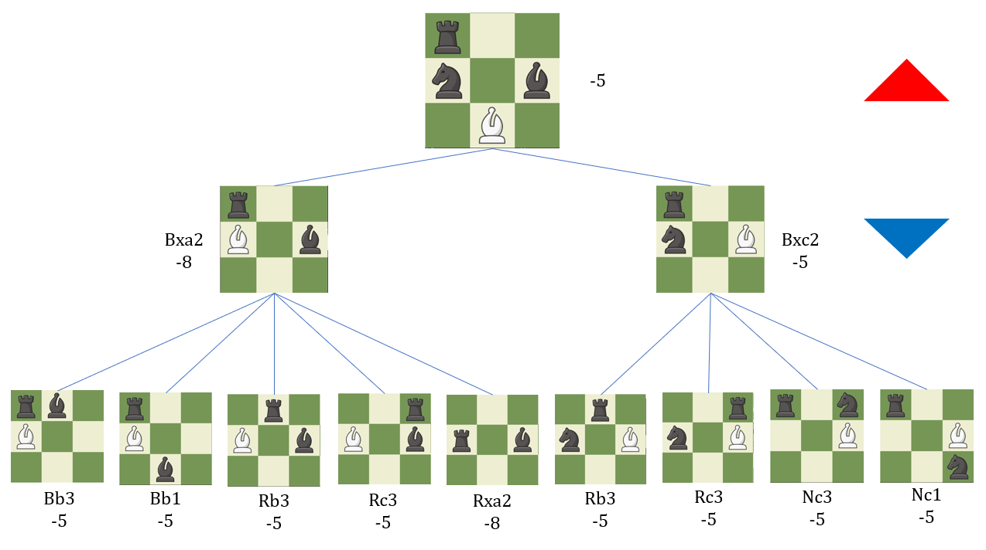
Why this topic?
I like chess…
Have played on Interlake chess team since freshman year
I play on chess.com in my spare time; my blitz rating has gone from 900 to 2000
I like coding…
Have been coding Java since middle school
The Minimax adversary search algorithm is fun
Why not combine these two passions…
… and write about coding chess engines?

Slide 4
Methodology
Write a chess engine with search enhancements
Make it play games with itself at different search depths & collect data
Compare optimizations’ effect on efficiency at different depths

Slide 5
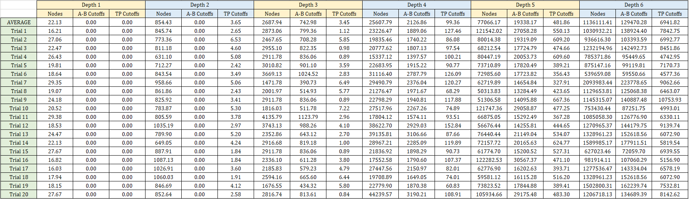
Research and data
120 games were played over 6 different search depths
My chess engine code can be found here: https://github.com/ML72/JavaChess/

Slide 6
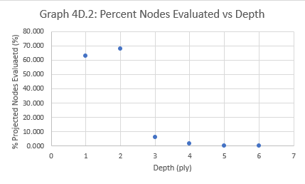
Conclusion
“Search depth increases the extent to which optimizations on the Minimax search algorithm make the search more efficient, as applied to chess”
No comment on the precise mathematical relationship – the data tends to be quasi-inconclusive

Slide 7
Why does this matter?
Minimax is at core of adversarial networks (idea of choosing best move given optimal opponent play)
Can be applied to other adversarial settings (ex. Economics)

Slide 8
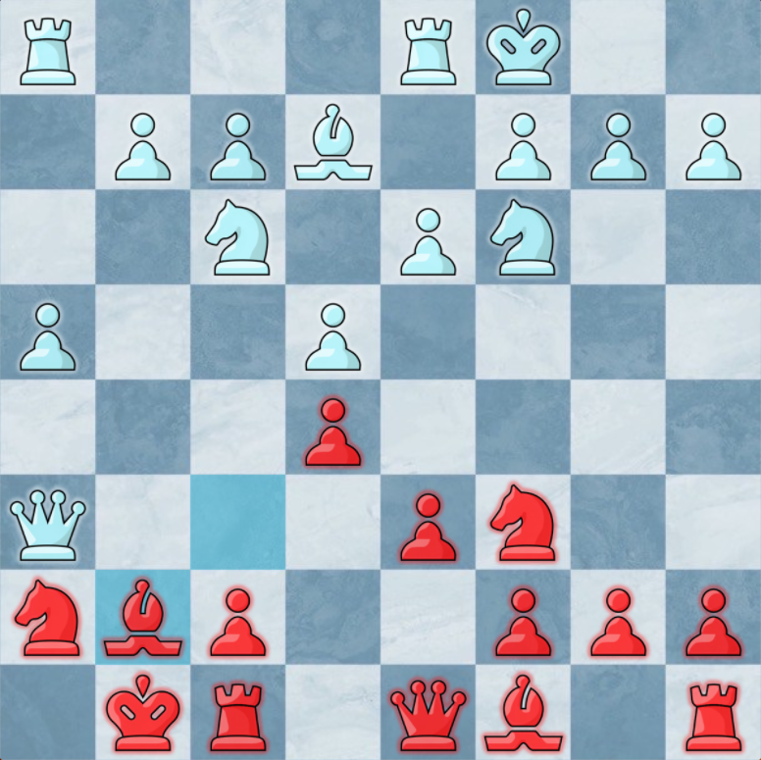
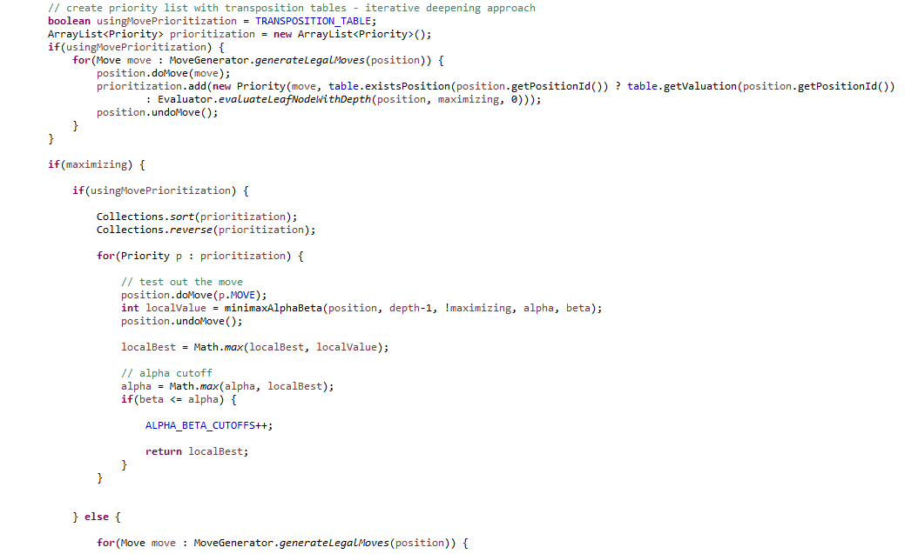
Highlights
Got to write my own chess engine in Java! It has been one of my most fun coding endeavors recently
Learned more about search algorithms
Improved my chess by learning how “good moves” are evaluated by computers
Got to play more chess!

Slide 9
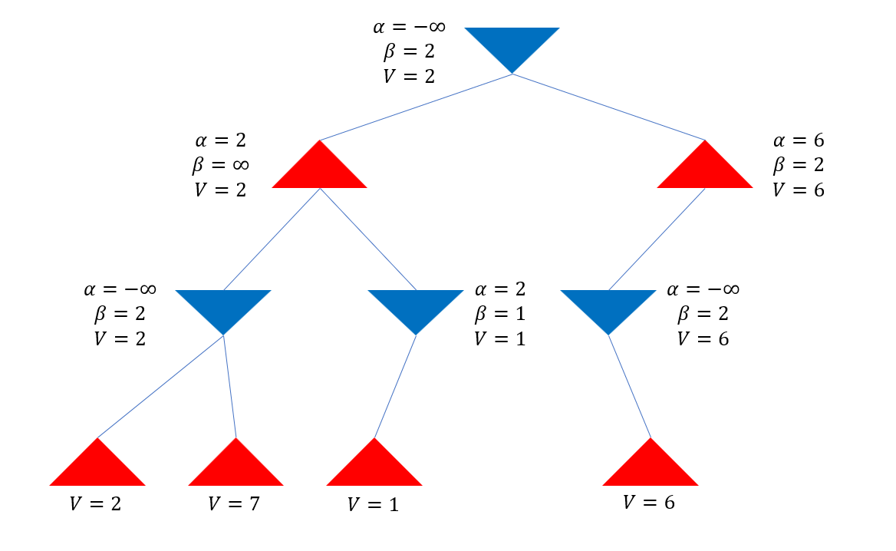

What I’ve learned
Coding is hard, writing essays is hard, getting data that makes sense is hard ☹
If I could do this again, I would…
Debug the code! I think might be a bug that caused my first data to not make sense
Add more optimizations so its computationally feasible to collect more data points
Deduce projected nodes without optimizations experimentally, rather than with this formula (derived from a book value): $N(d)=\sum_{n=1}^{d}{{35}^{n}}$

Slide 10
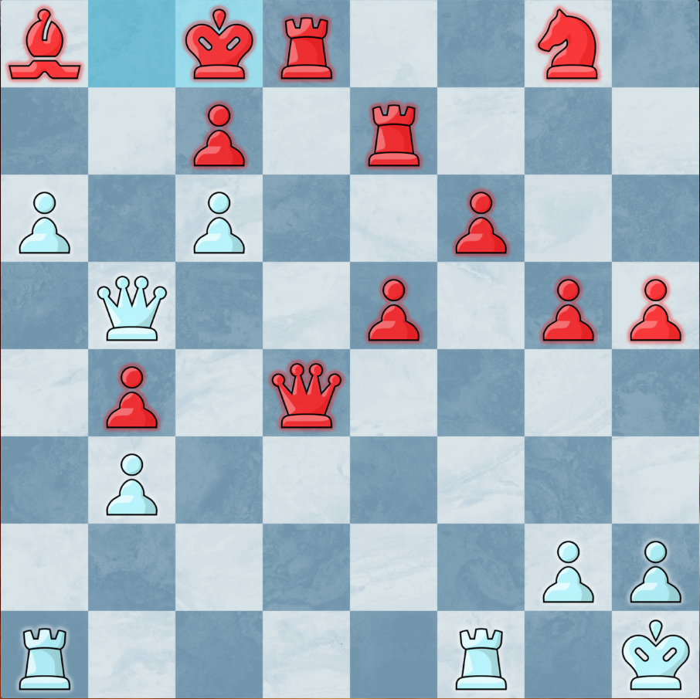
Thank you!
While we’re at it, here’s a simple chess puzzle: White to play and mate in 3

