Slide 1


Conflicts between Fields Seeking Knowledge
Ishan Bansal and Michael Li
Notes:
Michael says title, Ishan continues

Slide 2

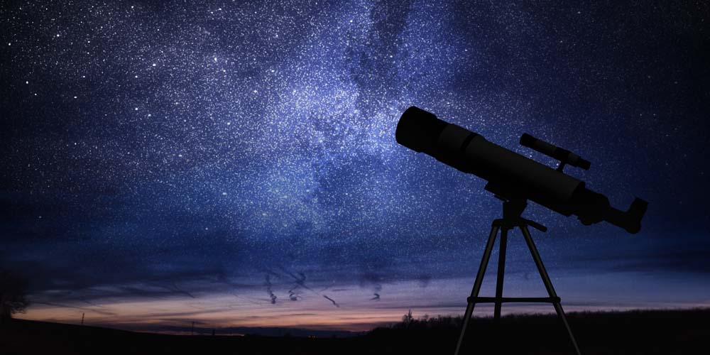
Starlink vs. Astronomers
Notes:
Ishan
Introduce the RLS
So diving right into our real life situation, we examined the conflict between starlink and astronomers. The Starlink program first started in 2018, designed to bring free global internet and improve communications with an array of satellites across the globe. Today, there are over 700 starlink satellites in space, among the countless others from differing companies. However, with the new design of the technology, and the growing number of arrays, astronomers have begun to raise serious concerns of light pollution. This conflict, although fairly recent, is escalating quickly, and the threat of a lawsuit against spacex makes it all the more important to solve. The satellites, while aiding our pursuit of knowledge for physics and technology, are inhibiting our astronomical inquiries. In this circumstance, there are two conflicting lines of inquiry that are conflicting in their pursuit of knowledge.

Slide 3
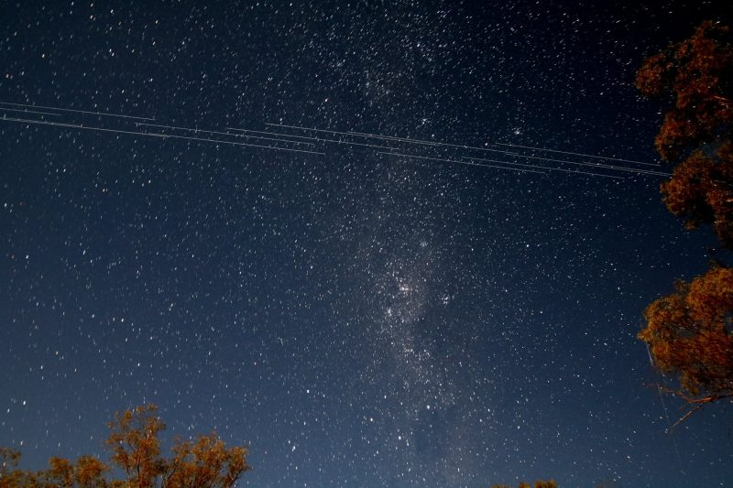
The Conflict
Natural Sciences (Astronomy) => The purity of the sky is important for the use of understanding our universe
Natural Sciences (Astrodynamics/Physics) => The purity of the sky is irrelevant in the face of the knowledge a satellite system provides
Notes:
Ishan
Discuss the RLS
There are two fundamental sides to this argument: the astronomers and SpaceX (who represent a new era in an expanding field of space technology). Both have legitimate knowledge claims that stand to expand scientific knowledge. Made difficult through the following: Both are natural science and have no clear-cut answer: both benefit society. The argument is between two fundamental fields: astronomy and space technology which explore similar frontiers -> conflict over resource and not principle

Slide 4
How do we know which methodology is most appropriate in resolving conflicts between different fields seeking knowledge?
AOK: Natural science
WOKs: Sense perception, reason, imagination
Notes:
Ishan
Methodology: steps taken to achieve a resolution
Appropriate: most appropriate = maximizes societal benefit and minimizes conflict and its consequences
Conflicts: any difference in methodology or perception caused by differences in the known field knowledge of the two fields
Fields: different branches of study - does not have to be different AOKs

Slide 5


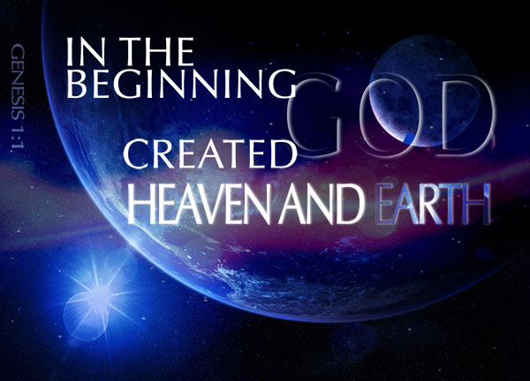
First Example: Origin of the Universe
Notes:
Michael
In this presentation, we’ll discuss two similar real life examples / which can help answer the knowledge question. The first regards controversy / over the creation of the universe.
The origin of the universe / and the very fabric of the world around us / has been a fundamental question of humanity since the very beginning. However, the disagreement over the answer to this question / has resulted in a conflict that has left us at a halt / over what we accept as the societal truth, preventing us from expanding our knowledge further beyond this fundamental question.

Slide 6


The Conflict
Christianity => The origin of the universe is the creation of a divine agent (God)
Physics => The origin of the universe is from a phenomena known as the “Big Bang”
Accepting Christianity = closing case, accepting Big Bang = asking more questions
Notes:
Michael
There is a conflict between the areas of knowledge / of religious knowledge systems and natural sciences, which each have differing takes / on the origin of the universe
The field of physics, in natural science, currently accepts the Big Bang hypothesis, a theory that the universe exploded into existence. However, while becoming widely adopted and opening new frontiers / for the development of science, the Big Bang theory lacks many definitive answers regarding the very composition and nature of our universe.
On the other hand, religious knowledge systems view this differently. For example, the current biggest religion in the world, Christianity, tells a different story. In the book of Genesis from the Old Testament, it says “In the beginning God created the heavens and the earth.” Historical facts of the entire religion support this theory of creationism.
Thus, there is debate between physics and Christianity / regarding the origin of the universe. I would also like to draw your attention / to a deeper implication of this conflict – accepting Genesis would entail closing the case for creation / and practically accepting the Bible’s story, while accepting the Big Bang hypothesis opens more possibilities for inquiries because the hypothesis leaves many things unanswered. A lot of those new possibilities bring up new questions that question our knowledge and understanding even further. Hence, is accepting the Big Bang actually furthering our knowledge? This is a knowledge dilemma implied in the conflict, of whether we want to keep questioning and searching for more knowledge, or whether we want to say that we “know” everything.

Slide 7
How do we know what area of knowledge is accurate in determining the origins of the universe?
AOKs: Religious knowledge systems, natural science
WOKs: Sense perception, faith, reason, imagination
Notes:
Michael
In confronting this conflict, we are answering the following, more specific, knowledge question: How do we know what area of knowledge is accurate in determining the origins of the universe?
AOK: Religious knowledge systems, Natural Science (different sides of conflict)
WOK: Sense perception, faith, reason, imagination

Slide 8

Methodology
The impact on either field is large and siding with either will have major consequences for the other
Science opens a new field, religious knowledge closes the field completely
Notes:
Ishan
Methodology for answering
First, this is question of two fundamentally different answers to the same question and, as a result, which field is to proceed at the expense of the other. The impact of the fields as well is unquestionably large, siding with one side will have innumerable consequences on the other, to the point of even destroying the other field. However, it is important to consider that the Christian answer is absolute, God created the world, and thus is restrictive as it prevents any other further inquiries. In contrast the science answer opens a new realm of thought, from the world before the Big Bang to the implications of its discovery. Thus, while the impact on both sides is undeniably great, the implications for society dictate us choosing science as that opens more knowledge rather than an absolute answer

Slide 9

Limitations of Methodology
Difficult to apply to such fundamental conflicts
Tackling the implications of the decision is particularly difficult to measure as it relies on the field evaluations themselves of the issues at hand.
Adopts a too harsh metric for determining decisions
Need for a general effort to create a compromise is required.
Notes:
Ishan
Limitation of methodology
This methodology is difficult to apply to such fundamental conflicts and tackling the implications of the decision is particularly difficult to measure as it relies on the field evaluations themselves of the issues at hand. Also this methodology adopts a too harsh metric for determining decisions and the need for a general effort to create a compromise is required.

Slide 10
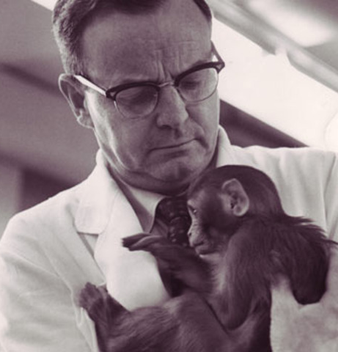


Second Example: Pit of Despair
Notes:
Michael
A second related example / that we will bring up to help answer the initial knowledge question regards controversy over the pit of despair, a psychological experiment

Slide 11
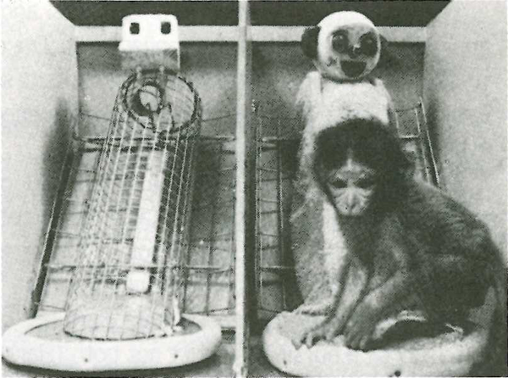
The Conflict
Human sciences => Psychologist Harry Harlow researched human clinical depression by isolating rhesus monkeys and observing their psychological changes
Ethics => Critiqued unethical treatment
Journalist Deborah Blum deemed the experiment “common sense results”
Notes:
Michael
In the 1900s, psychologist Harry Harlow became infamous for his pit of despair experiment. Attempting to provide an animal model for human clinical depression, Harlow designed an experiment relying upon isolation of monkeys to observe psychological changes. He put monkeys in metal containers with nothing more than a small opening for days, weeks, and months on end, observing whether they would become depressed.
While the study resulted in findings that confirmed the importance of social relations for emotional development, it drew heavy criticism for “unethical” treatments. Outspoken journalist Deborah Blum called the conclusion “common sense results”, alluding to the fact / that the results did not justify anything new in her eyes. Instead, the experiment solely violated fundamental ethical principles.
We thus have a conflict between the fields of ethics and human sciences. Continuing the experiment is detrimental to ethics, but stopping the experiment would be likely detrimental to human science.
Hence, choosing to side with one field in this scenario would impede development in the other field, resulting in a conflict

Slide 12
How do we know when an experiment is breaking ethical principles to the extent that we should stop it?
AOKs: Ethics, human science
WOKs: Reason, sense perception, emotion
Notes:
Michael
In approaching this conflict, we are answering the following, more specific, knowledge question: How do we know when an experiment is breaking ethical principles to the extent that we should stop it?
AOK: Ethics, Human Science (different sides of argument)
WOK: Reason, sense perception, emotion

Slide 13
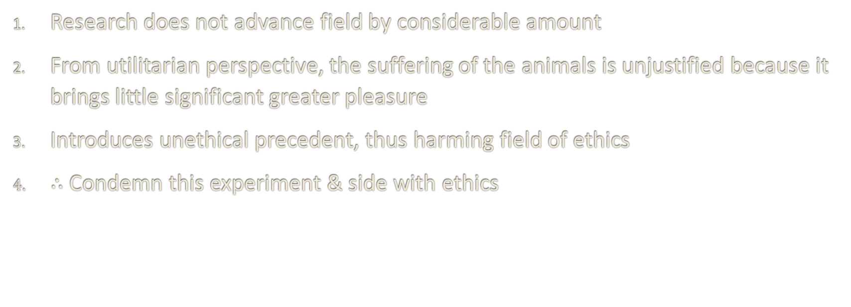
Methodology
Research does not advance field by considerable amount
From utilitarian perspective, the suffering of the animals is unjustified because it brings little significant greater pleasure
Introduces unethical precedent, thus harming field of ethics
$∴$ Condemn this experiment & side with ethics
Notes:
Ishan
Methodology for answering
In this example, most people already recognize the conclusion (more isolation = worse psychology), so this experiment will not have a great impact in advancing knowledge in human sciences. As Deborah Blum called it, a “common sense” result, this experiment did little to advance the field. It must be considered that subsequent experiments did have effects on advancing the field like discovering abuse cycles, however it was not entirely related to this experiment. However, if we choose to follow human science, a bad ethical precedent is set. In fact, prominent professors like Gene Sackett (of UW) even claim that there is significant evidence that the animal liberation movement was born as a consequence of these experiments, demonstrating the wide disapproval and significance of Harlow’s actions on ethical ground. The impact of ethics is huge - if we allow this, we are implicitly normalizing animal cruelty and setting a bad example for the future. The pain and suffering of the animals, from the utilitarian (the doctrine that actions are right if they are useful or for the benefit of a majority) perspective, is not justified by the results which do not bring any significantly greater pleasure. This can be noted by the huge protests in opposition to this. Also, this would cause irreparable harm to the field of ethics, introducing an unethical precedent. Thus, knowing that the impact upon ethics is greater, we must condemn this experiment and side with the ethical field. A possible compromise could be redesigning the experiment to be ethical with a desensitization program, however, as the experiment stands it should not be allowed. In fact, from this we can learn something to be applied to our general methodology, the precedent of ethics. Ethics is an extremely important field of knowledge that, as shown in this example, must dictate the others due to the implications on our ethical fields otherwise. Simply put, any conflict with ethics will almost always have to result in a victory for ethics as the precedent set and effects of breaking ethics is too great to ignore

Slide 14
Limitations of Methodology
Difficult to apply to fundamental conflicts
Relies on field evaluations of the issues at hand
Harsh metric for decision-making, general effort to compromise is required
Notes:
Ishan
Limitation of methodology
While we assert that the subsequent experiments are not as related to be concerning, the impact of halting this upon the others is unknown and the methodology lacks a concrete way to measure this
The deemed “common sense” conclusion is largely subjective and can result in incorrect conjectures thus justifying the need to validate even common sense knowledge. The methodology undervalues this.

Slide 15
Original Knowledge Question: How do we know which methodology is most appropriate in resolving conflicts between different fields seeking knowledge?
Notes:
Michael
We can now return to our initial knowledge question: How do we know which methodology is most appropriate in resolving conflicts between different fields seeking knowledge? By summing up our methodologies used in the previous examples of the universal origin and the pit of despair, we can piece together a more general methodology to answer this question.

Slide 16
General Methodology
Balance the impact of the pursuit of knowledge vs impact of ethics
Gauge impact
First look at effect on society, then impact on field knowledge
Impact is defined as what changes as a result of the decision
Understand the implications - will the conflict restrict societal future inquiries?
Is this knowledge inquiry and its effects inevitable/irreversible?
Search for a compromise that can maximize the positive impacts
Notes:
Michael
We can first balance the impact of research, or pursuit of knowledge, in each field vs impact of ethics (i.e. how ethical we think the action is)
Recall that everything should be balanced with ethics because ethics is of profound importance, as all of our morals that guide our actions are grounded on ethics
Next, we weigh the impacts of the courses of action proposed by the contesting fields. We first look at the impact on society, because society is more broad and more important. Then, we come back to gauge the impact on the field itself. Impact is defined as what is caused to change as a result of a development. We also estimate the impact such discoveries will have on society and the field in the future. We also need to understand the implications of siding with one side or another, answering questions such as will the conflict restrict future inquiries?
Then, we ask whether this knowledge inquiry and its effects are inevitable/irreversible. By this we mean, is there any alternative strategy to gain this knowledge that will not conflict or is there a possibility of irreparable harm to the field? And even if we don’t pursue a harmful course of action, will its negative effects eventually reach society one way or another anyways?
With the above three metrics, we can decide on which field is more important. However, we will still try to search for a compromise that can maximize the positive impacts on both fields in seeking knowledge. Such a compromise / should not significantly hinder the field deemed more important. Note that a compromise maximizes utility, making it in alignment with the ethics / that we value so much

Slide 17

Limitations of Methodology
There is discrepancy over how to compare “impacts” - subjective, based on perception
Gauging how these changes can better a field in the future is uncertain
“Irreparable harm” and “inevitable development” claims can only be evaluated in present context
In the future, the situation may change and make present decisions seem misguided
Notes:
Michael
We tried to refine our general methodology / as much as possible; however, we do recognize that there are problems with it
Firstly, there is discrepancy over how to compare “impacts” – it is highly subjective. The solution is to go by what most people in the affected fields think, because they are mostly likely / to know the situation well. However, they are likely to be biased towards their own field, making the evaluation of “impacts” highly based on perception
Additionally, part of our methodology is evaluation of impact, and that includes gauging how the proposed actions by a field can affect the field itself or all of society / in the future. Obviously, we can only speculate on this
Lastly, claims of irreparable harm or inevitable development can only be evaluated in present context; in the future the situation may shift and make present decisions seem misguided
As seen, our methodology is based heavily / on individual judgement and present context and situation, which may be subject to bias and inaccuracy. However, such a methodology / is sufficient for answering most real life situations, including our initial conflict of Starlink vs. astronomers

Slide 18
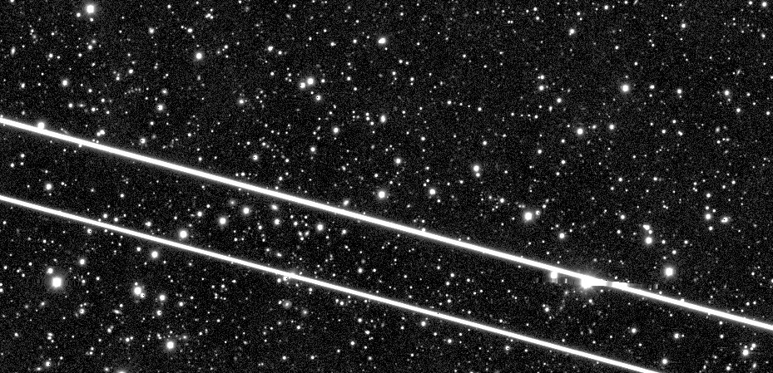
Answer Starlink vs. Astronomers
No ethical dilemma
Impact of Starlink upon space tech is hugely positive – aids practical applications, enhances global communications, etc.
Negative impact of Starlink upon astronomy is confined
Increase in space debris is inevitable
Compromise is possible
Ex. cover satellites in non-reflective substances
Aid astronomers in upgrading technology
Notes:
Ishan
First, in this conflict there is no real ethical dilemma, making the RLS slightly more complex to answer. The impact upon the field of space technology and the Earth is largely beneficial from the Starlink program. Without the program, not only would we lack a global communications infrastructure reliant on satellites (which are more secure as they are less susceptible to natural disasters) but it will also hamper our ability to translate theoretical physics into practical applications to augment society. However, its negative impact upon astronomy is not negligible; it will prevent the accurate study of the stars from earth's surface. This will heavily restrict the field of astronomy in the future, as astronomers will no longer be able to simply use a telescope and instead may have to use more advanced and complex technology. In impact, our methodology however favors Starlink as there is a greater impact upon all of society in comparison to simply one field of scientists. The third aspect of our methodology is regarding alternatives or inevitable. Here it is inevitable, in the expansion of space technology, for there to be a drastic increase in the space debris, hampering astronomers. This is just the inherent nature of our space exploration programs and the existing needs for satillites (government) making the cons of starlink unavoidable. Also there exist alternatives for astronomy, through space technology. Using telescopes like Hubble, the need for ground observation is diminishing. Finally, compromises are possible like covering Starlink satellites in non-reflective substances in order to reduce light pollution. Therefore, Starlink should continue, but work with astronomers to either compromise (non-reflective) or aid them (more hubbles)

Slide 19



Conclusion
Goal: Maximize positive benefits for society
Analyze => prioritize => compromise
We have these situations in our lives too!
Knowing this, we can maximize utility for ourselves and for others
Notes:
Ishan
In this presentation, we discussed how we can mediate conflicts between conflicting fields that are knowledge:
We first analyze the impacts and implications of each field (and whether they are inevitable/irreversible), and then use that to prioritize the conflicting pursuits. Next, we search for any possible compromise to see if the damage suffered by the conflicting fields in their pursuit of knowledge can be minimized. This whole methodology is in alignment with our overall goal of maximizing utility for society.
This discovery is important because in our lives, we are often confronted with different conflicts, a lot of which are between different pursuits of knowledge. Conflicts of the type and on the scale of Starlink vs. astronomers are fairly new, but fields like science and technology are developing at increasing rates, so it is inevitable that more and more such conflicts will emerge in the future. Hence, it is vital to know how to resolve these conflicts so that we can maximize utility for ourselves, for others, and for the pursuit of knowledge as a society as a whole.

Slide 20
Bibliography [Important]
Terrel Gallaway, Reed N. Olsen, David M. Mitchell, The economics of global light pollution, Ecological Economics, Volume 69, Issue 3, 2010, Pages 658-665, ISSN 0921-8009, https://doi.org/10.1016/j.ecolecon.2009.10.003.
John P. Gluck (1997) Harry F. Harlow and Animal Research: Reflection on the Ethical Paradox, Ethics & Behavior, 7:2, 149-161, DOI: 10.1207/s15327019eb0702_6
McDowell, Jonathan C. "The Low Earth Orbit Satellite Population And Impacts Of The Spacex Starlink Constellation". The Astrophysical Journal, vol 892, no. 2, 2020, p. L36. American Astronomical Society, doi:10.3847/2041-8213/ab8016. Accessed 6 Jan 2021.
Notes:
Michael
Evaluation of light pollution from perspective of astronomers – provides valuable insight from astronomy POV
Investigates ethical paradoxes in animal research, specifically Harry Harlow – really got us thinking about the implications of his experiment
Analyzes the starlink situation from a slightly astronomer-leaning, but mostly neutral perspective, gives insight into argument for SpaceX and Starlink from both sides

Slide 21
Bibliography cont.
Book of Genesis. The King James Bible 1:1
"Current Space Law Limitations And Its Implications On Outer Space Conflicts". E-International Relations, 2021, https://www.e-ir.info/2015/06/16/current-space-law-limitations-and-its-implications-on-outer-space-conflicts/.
Foust, Jeff. "Starlink Vs. The Astronomers - Spacenews". Spacenews, 2021, https://spacenews.com/starlink-vs-the-astronomers/.
"Dashed Hopes–“The Pit Of Despair”". Psychology Today, 2021, https://www.psychologytoday.com/us/blog/anxiety-another-name-pain/202001/dashed-hopes-the-pit-despair.
Howell, Elizabeth. "What Is The Big Bang Theory?". Space.Com, 2021, https://www.space.com/25126-big-bang-theory.html.
"Ethics In The Workplace-Making Them Work - Fmlink". Fmlink, 2021, https://fmlink.com/articles/the-importance-of-ethics-in-the-workplace/.
"The History Of Utilitarianism (Stanford Encyclopedia Of Philosophy)". Plato.Stanford.Edu, 2021, https://plato.stanford.edu/entries/utilitarianism-history/.

