Slide 1
Assignment 3
Latest findings on hate crimes
Notes:
ID=d924773e-9a16-4d6d-9803-8cb819e99682 Recipe=text_billboard Type=TextOnly Variant=0 FamilyID=AccentBoxWalbaum_Zero

Slide 2
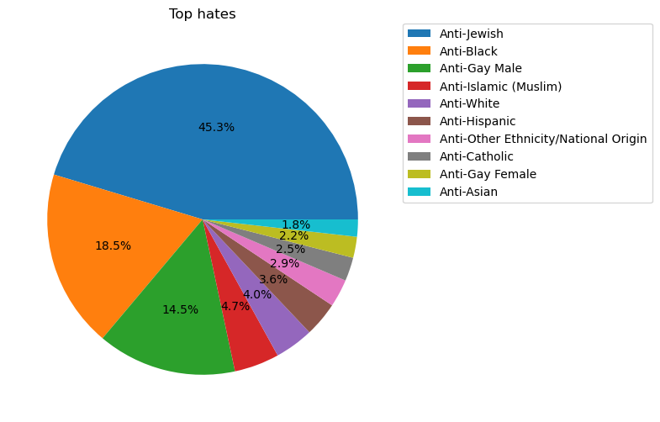
Top 10 hate crimes in total
The top 10 hate crimes from the given data are:
Anti-Jewish – 45.3% occurrences
Anti-Black – 18.3% occurrences
Anti-Gay Male – 14.5% occurrences
Anti-Islamic, Anti-White, Anti-Hispanic, Anti-Other Ethnicity/National Origin, Anti-Catholic, Anti-Gay Female, Anti-Asian about 20% in total

Slide 3
To view the interactive dashboard, run the attached ipynb script on Jupyter Notebook.

