Slide 1
Assignment 1
Findings on Injury/Death data
Notes:
ID=d924773e-9a16-4d6d-9803-8cb819e99682 Recipe=text_billboard Type=TextOnly Variant=0 FamilyID=AccentBoxWalbaum_Zero

Slide 2
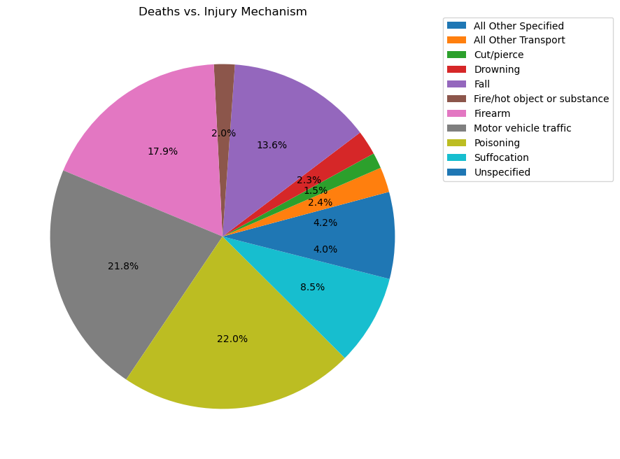
Leading causes of injury and deaths by mechanism
After processing the data provided, it is found that the top 5 causes of injuries and deaths are:
Poisoning – 22% occurrences
Motor vehicle traffic – 21.8% occurrences
Firearm – 17.9% occurrences
Fall – 13.6% occurrences
Suffocation – 8.5% occurrences

Slide 3
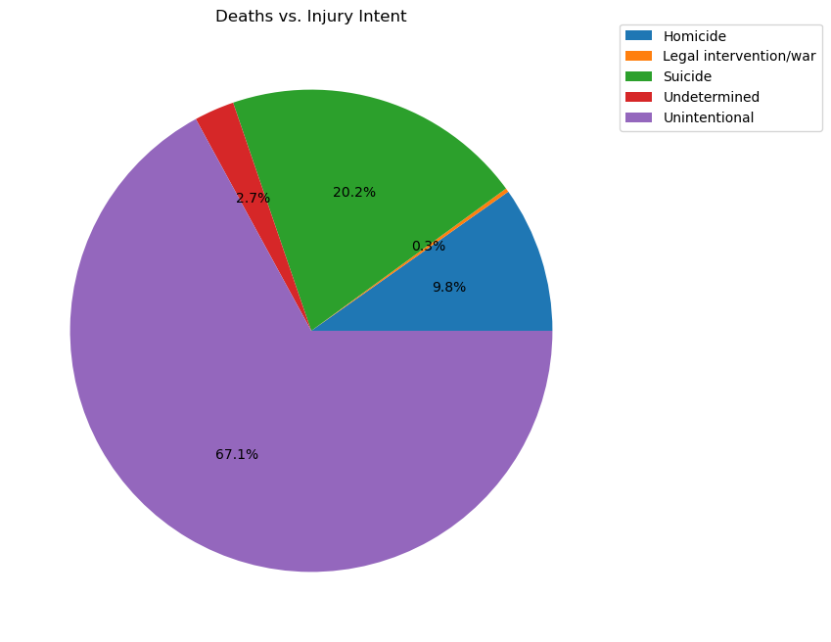
Leading causes of injury and deaths by intent
After processing the data provided, it is found that the causes of most injuries and deaths are:
Unintentional – 67.1% occurrences
Suicide – 20.2% occurrences
Homicide – 9.8% occurrences
Undetermined – 2.7% occurrences
Legal intervention/War – 0.3% occurrences

Slide 4
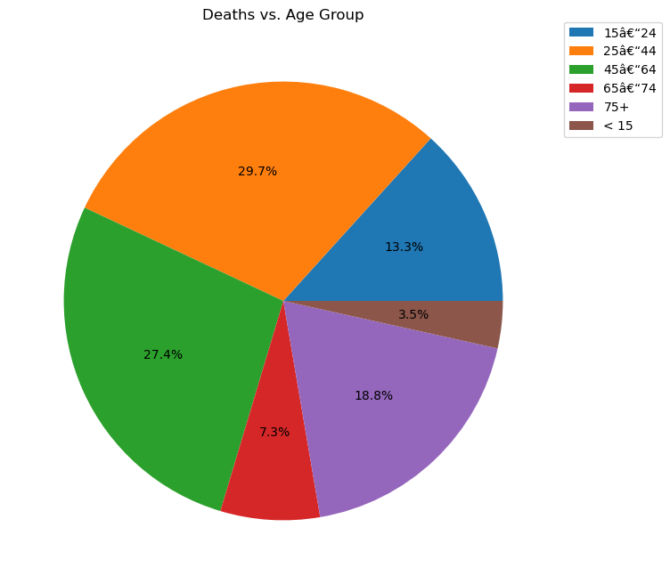
Trends in relation to age group
After processing the data provided, it is found that the age groups of most injuries and deaths are:
25 to 44 – 29.7% occurrences
45 to 64 – 27.4% occurrences
75+ – 18.8% occurrences
15 to 24 – 13.3% occurrences
65 to 74 – 7.3% occurrences
<15 – 3.5% occurrences

Slide 5
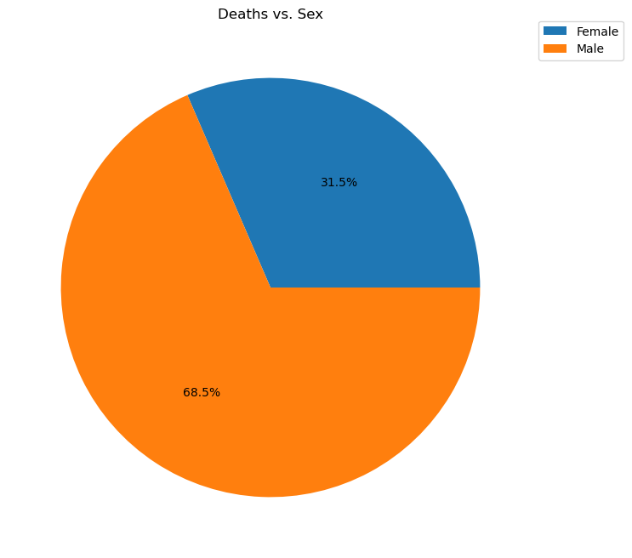
Trends in relation to sex
After processing the data provided, it is found that:
Male – 68.5% occurrences
Female – 31.5% occurrences

Slide 6
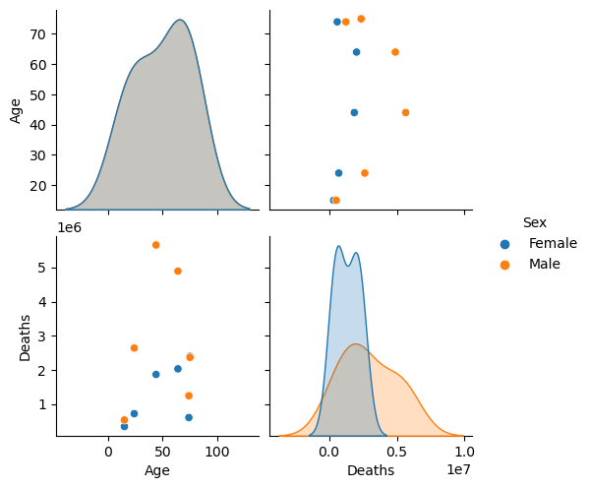
Trends in correlation between gender and age
It can be observed that, on average, injuries and deaths related to male are much more than those that are related to female.
It can also be observed that injuries and deaths related to both male and female have the same trend based on age, i.e. peaking at around age 50 and falling before and after 50.

Slide 7
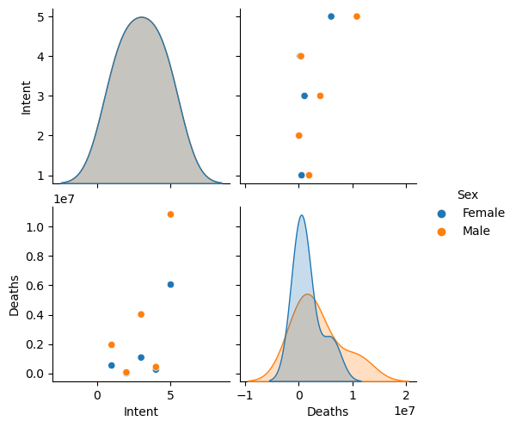
Trends in correlation between gender and intent
Similar to the previous analysis, it can be observed that, injuries and deaths related to male are much more than those that are related to female.
It can also be observed that both male and female follow the same trend intent-wise. The majority of injuries and deaths are unintentional, however, the numbers from legal intervention/war and undetermined are very close for both sexes.
For data processing, intents are represented by the following indices
1 - Homicide
2 - Legal intervention/war
3 - Suicide
4 - Undetermined
5 - Unintentional

Slide 8
To view the interactive dashboard, run the attached ipynb script on Jupyter Notebook.

