Slide 1


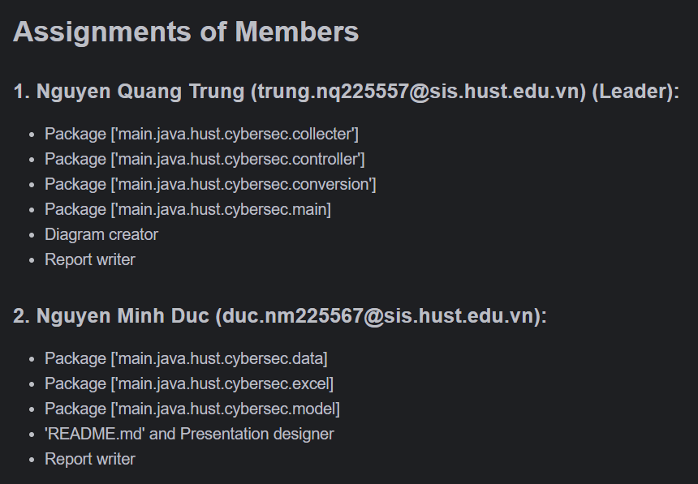
TOPIC 05
Assignment of members

Slide 2


TOPIC:
Atomic RedTeam Excel Export and MITRE ATT&CK Coverage Analysis
PROBLEM: Design a program to export Atomic RedTeam data into an excel file and view the chart of Mitre Attack coverage analysis.
REQUEST:
- GUI Design Summary:
Main Menu:
Title
Update data
Excel Export
View Chart
- Contents:
Download the data and update the latest data.
Export the Atomic RedTeam data into an excel file.
Get the chart of Mitre Attack coverage analysis with some different features.

Slide 3
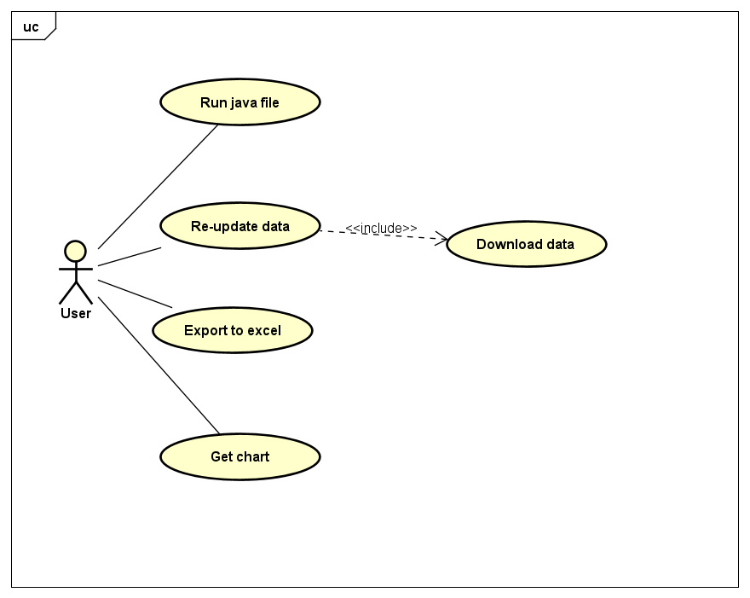
Use case diagram
- Run java file: Allow the user to enter the Main Menu.
- Re-update data : Allow the user to download the data and update the latest data.
- Export to Excel: Allow the user to get an excel file of Atomic RedTeam data.
- Get Chart: Show the user the Chart of Mitre Attack coverage analysis .

Slide 4
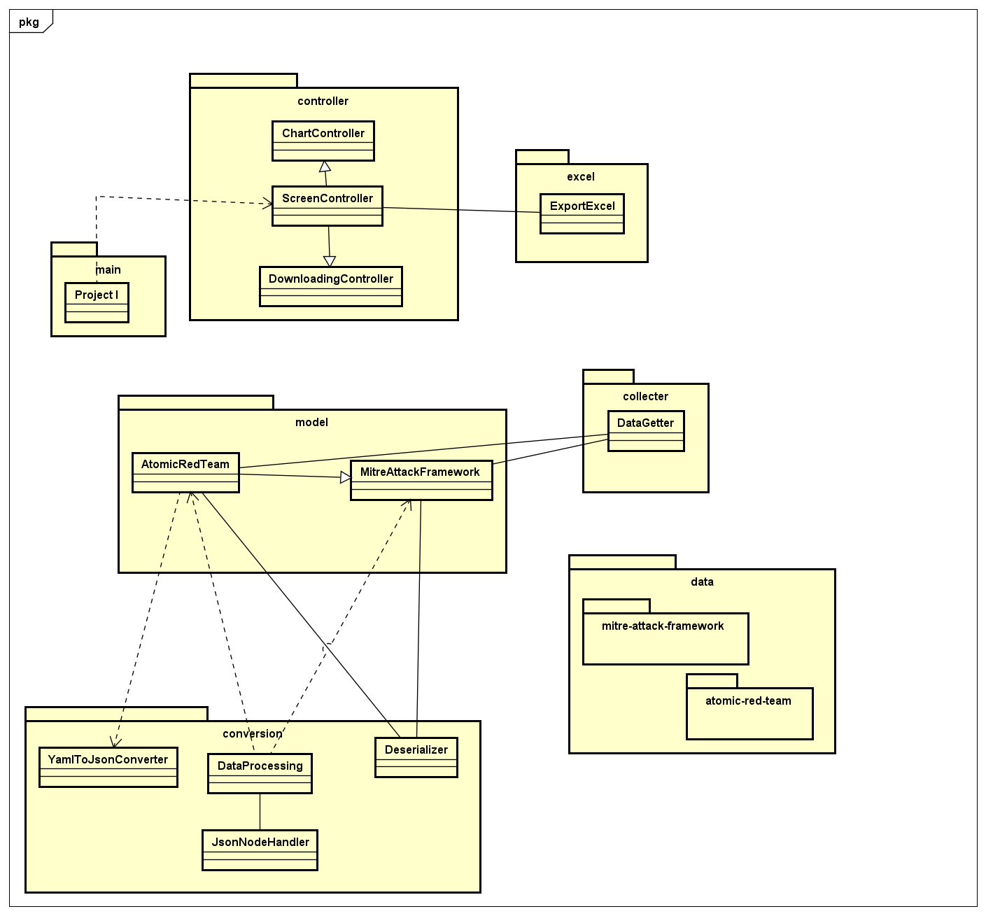
General class diagram

Slide 5
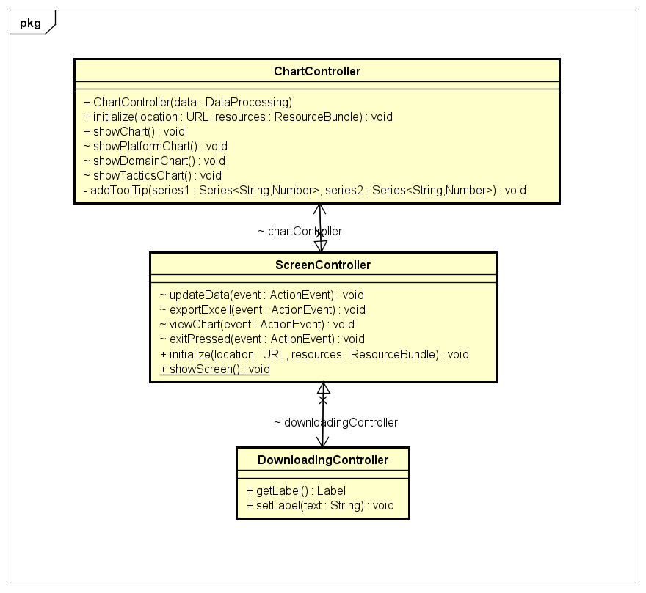
Pakage controller

Slide 6
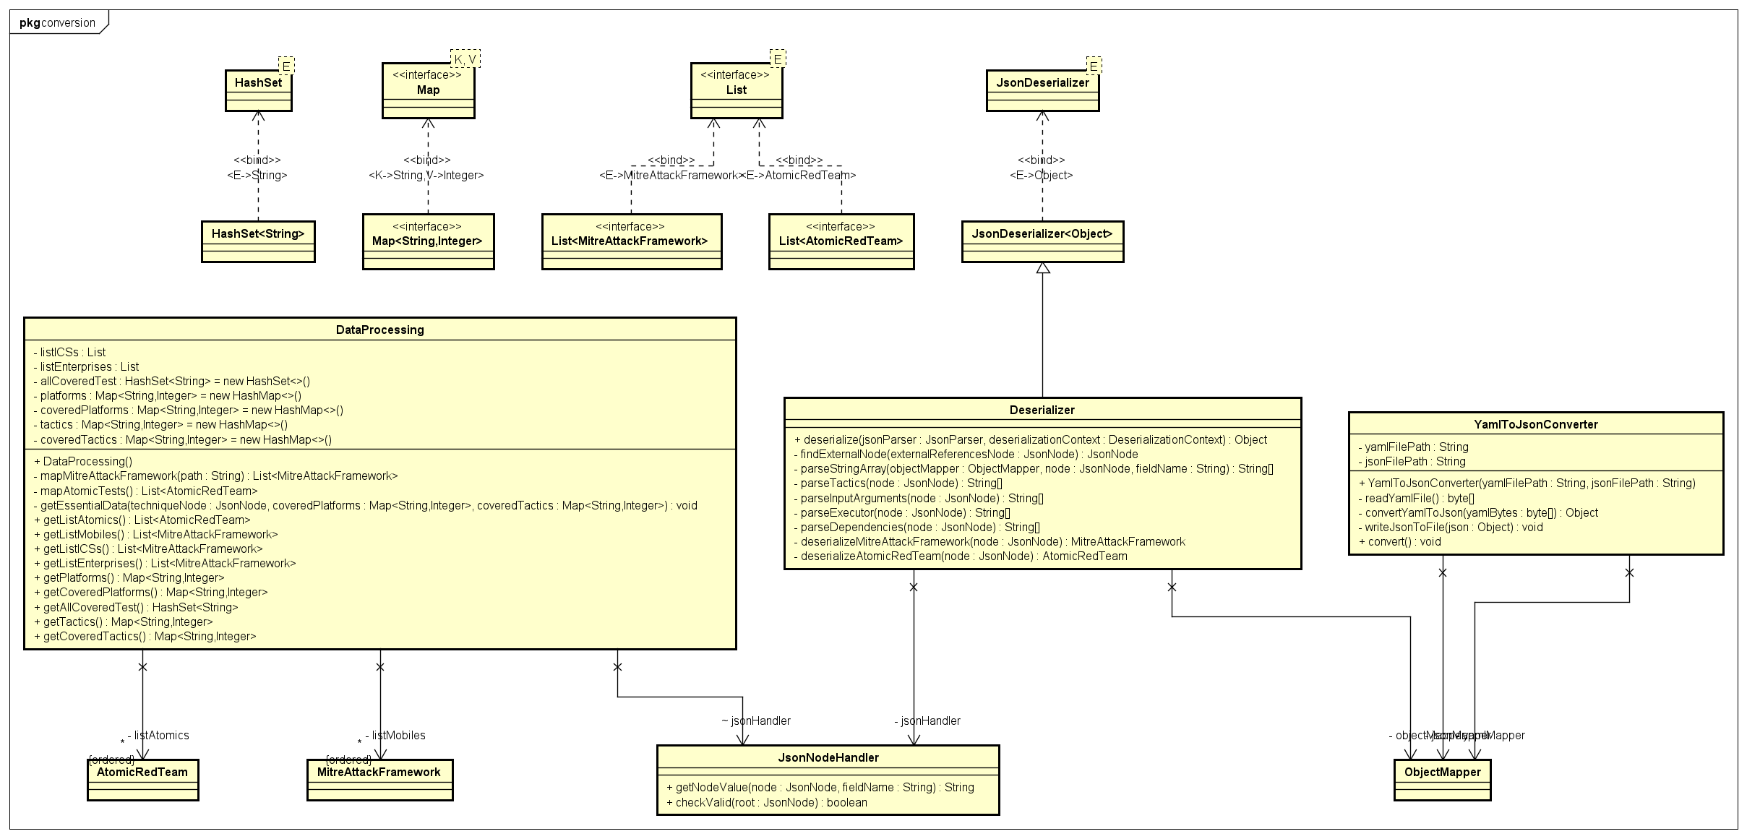
Pakage conversion

Slide 7
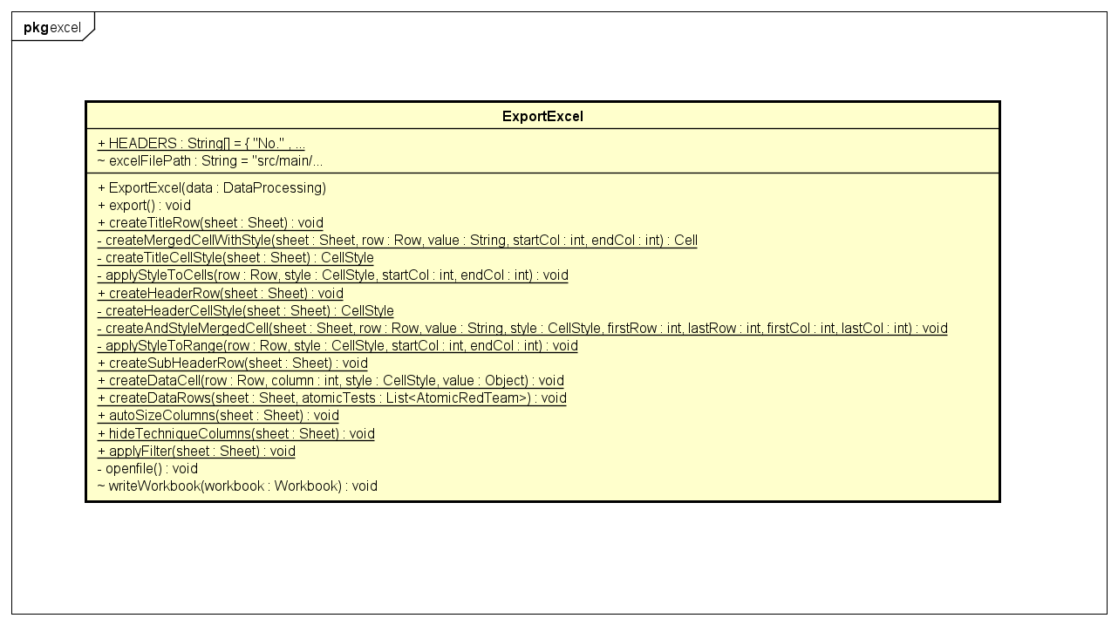
Class MainFrame

Slide 8
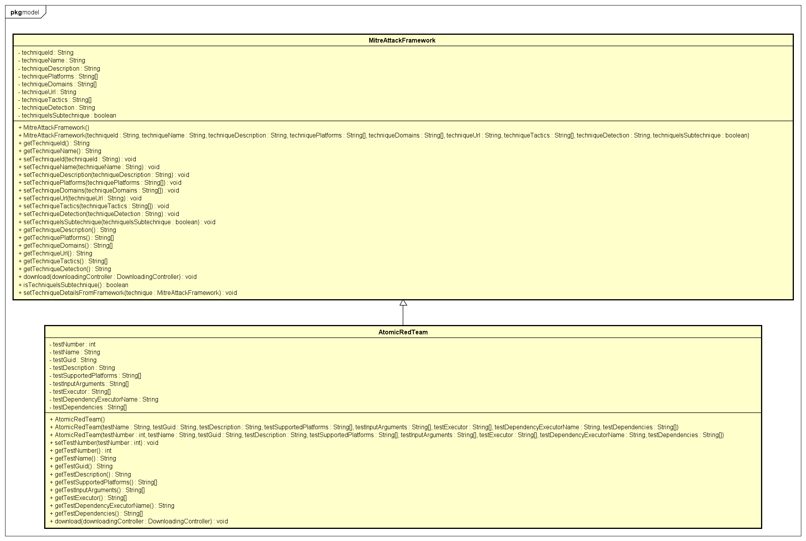
Pakage button

Slide 9
DEMO

