Slide 1

Basic Details of the Team and Problem Statement
Organization : Cyber Crime Unit, Special Cell, Delhi Police, MHA
PS Code : RV1252
Problem Statement Title : ”Develop a Mobile App through which a citizen can check whether an unattended child is a missing child from 'Track the missing child' database of WCD Ministry using Facial Recognition Software of Delhi Police”
Team Name : TEAM-FINDX
Team Leader Name : Chelsi Jain
Institute Code (AISHE) : C-61436
Institute Name : College of Technology and Engineering, Udaipur
Theme Name : Blockchain & Cybersecurity

Slide 2
Idea/Approach Details
Use-Cases
App through which a citizen can check whether an unattended child is a missing child just from Child’s Image.
Idea
“Reverse Image Search based Tracking App with efficient Flex-Search Algorithm on WCD Lost-Child Data”
Flex-Search-Algorithm:
Data-Point: [Missing_ID, Profile_No] Can regenerate all info about person.
Checkpoint-Database: Preserves Data Points with respective Feature-Encoding from Last Search.
Data-pipeline that retrieves new Data Points / Encoding and update Database Checkpoint on New Search.
Filter Top-10 Image with Query-Image Based on KNN-Clustering with Face-encodings (128 Features).
Face Recognition on Top-10 Images with Face-encoding.
Extracts Info of Best Match Data-Point.
Show-Stopper
Highly Efficient Computation time Checkpoint Database omits repetitive Encoding & Clustering reduces Search Span, saving Computation Time & Resources.
REST-API Flexible API integration with Web, App, Surveillance-Cameras, etc.
Handles-Loads Easily With OTP-Auth & Pre Face-Detection along with quota of 1000 Searches per Hour & Task-queue Manager.
Minimalistic UI
Responsive Single Click Search-Mechanism

Slide 3
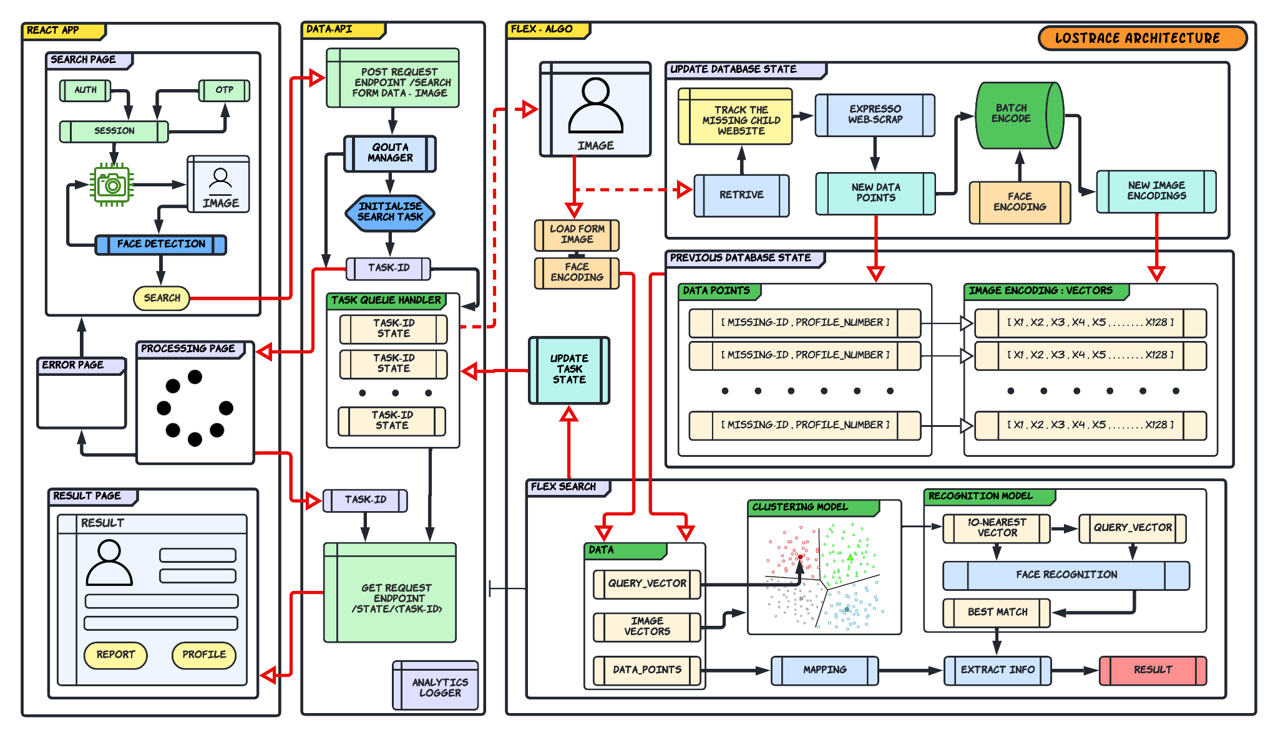
Idea/Approach Details
Tech-Stack
Backend
- Python
- Flask
- Sklearn
- Tensorflow
Frontend
- React
- Javascript
- TailwindCSS
- PostCSS
Database
- MongoDB
Deployment
- Heroku

Slide 4
Team Member Details
Team Leader Name: Chelsi Jain
Branch : B.Tech. Stream : CSE Year : III
Team Member 1 Name: Garvit Chouhan
Branch : B.Tech. Stream : CSE Year : II
Team Member 2 Name: Subin S K
Branch : B.Tech. Stream : CSE Year : II
Team Member 3 Name: Kaustub Dutt Pandey
Branch : B.Tech. Stream : CSE Year : II
Team Member 4 Name: Prateek Garg
Branch : B.Tech. Stream : CSE Year : I
Team Member 5 Name: Ashmita Pandey
Branch : B.Tech. Stream : ECE Year : I

