Slide 1
Implementation of a C to ARM Cortex M4 Compiler
Karthick D(MT2018509)
Karthik S(MT2018510)

Slide 2
Algorithm for generating Assembly from C
The instructions are read from an input text file and processed line by line
If ‘=‘ detected as 2nd argument of string, it is either a data moving instruction(assignment i.e a=35,b=60,etc.) or an arithmetic expression(c=a+b)
If an assignment, it is converted to an MOV, #operand instruction
If an expression, the infix expression following ‘=‘ symbol is converted to postfix expression

Slide 3
Contd…
Stack data structure is used to determine the order of evaluation from the postfix expression and the arithmetic instructions and registers are assigned accordingly
Ternary if else is also supported, with only being ‘>’ and ‘<‘ operators being allowed. If such a an instruction encountered, it is equivalently converted to CMP, MOVGT and MOVLT assembly instructions

Slide 4
Functionalities supported
Assignment Operation
Simple arithmetic operations on integers: addition, subtraction, multiplication and division
Expressions with parenthesis to override the usual precedence is also supported
Ternary if else supported, with only ’>’ and ‘<‘ in comparison operation and assignment as the operation on decision. This can be extended to other comparison operations and other operations upon comparison decision

Slide 5
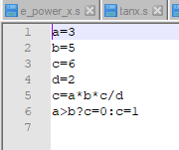
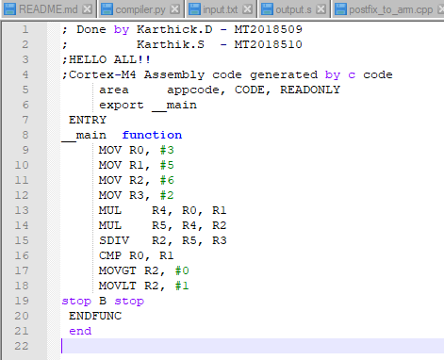
Example Input & Output

Slide 6
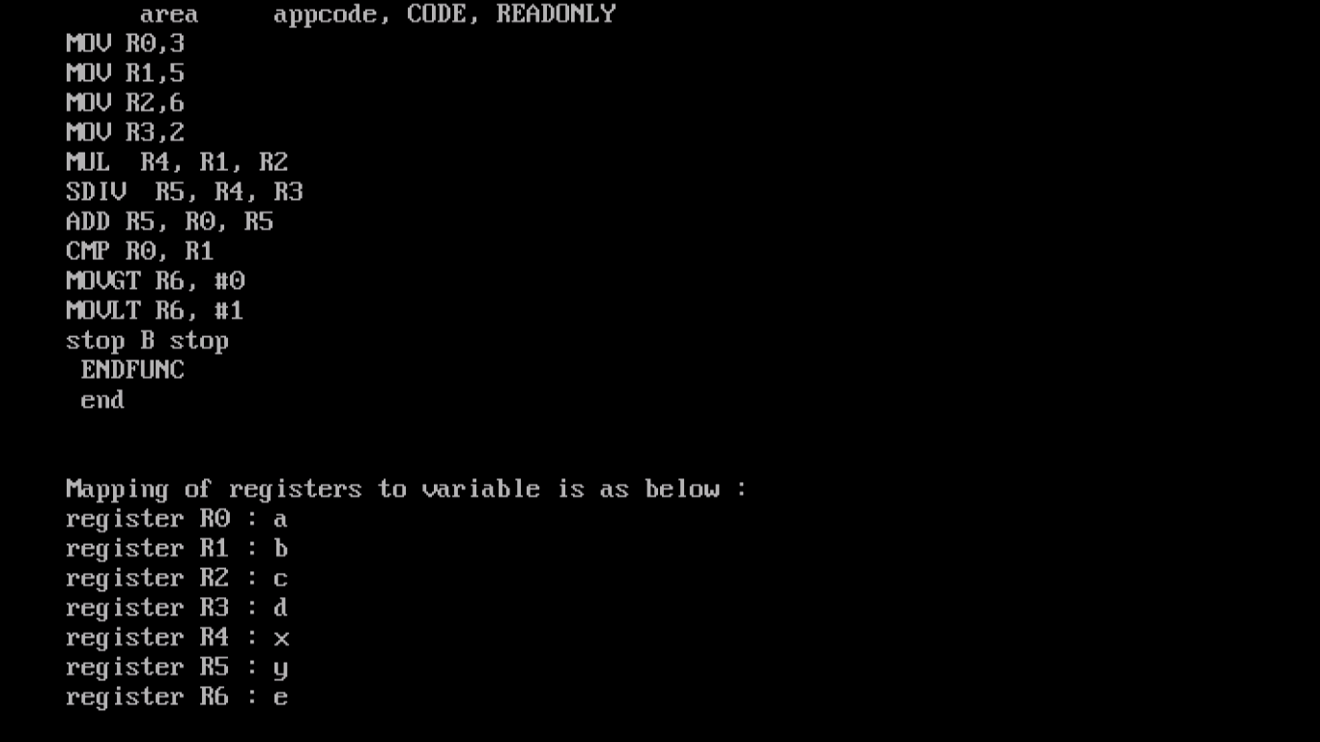
OUTPUT with
register mappings

