Slide 1
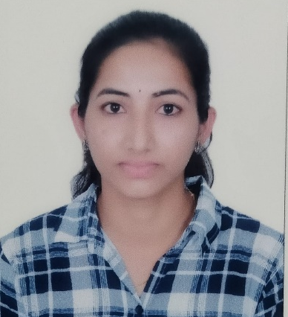
Madiraju Laxmi Prasanna
Analyst/Software Engineer
Bachelor of Technlogy, Electrical and Electronics Engineering : 2017 - 2021
Skills
Java​ | Java Basics, OOPS, Generics,​ Collections, Array, Loops​
Spring | Spring Boot, Spring Rest Services, Spring Restful Services
Angular | Components, Pipes, Services, Dependency Injection, Template-Driven and Reactive Forms, Routing, Authentication
Database​ | Postgre SQL
UI Tech​ | HTML 5 & CSS, Bootstrap 4, JavaScript, ES6
Tools | Eclipse, STS, GitHub, Postman, Swagger, Sonarlint, Visual Studio Code, Pg Admin 4, SQL Shell
Add On skills​ ​ | Immersive Learning​
Banglore
madiraju.laxmi-prasanna@capgemini.com
6281475055
A4
Full Stack Developer
Hands on experience on Core Java, Postgre Sql, Spring Restful Services.
Proficient in creating Single page Web Application in Angular with Authentication with routing.
Hands on experience in developing web pages using HTML5, CSS, Object TypeScript.
Ready to learn new technologies and implement them for the future knowledge improvement.
Online-Advertisement-System
Case study of Online Advertisement System along with API Gateway, Swagger, responsive UI with HTML5, CSS, Bootstrap and Angular used as User Interface.
Degreed :Successfully completed the degreed training in GIT, HTML, CSS, SQL, Angular.

