Slide 1
Combined Lab Meeting 7 October 2016
Meridith L. Bartley

Slide 2
Colony 2 Data

Slide 3
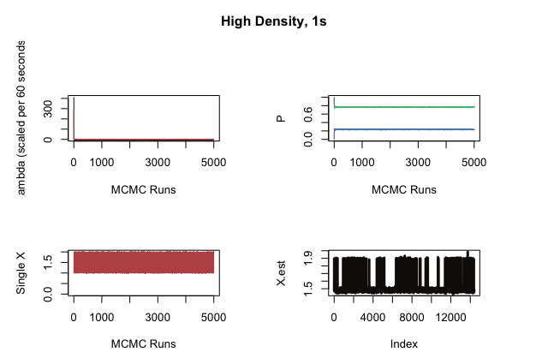
1 Second

Slide 4
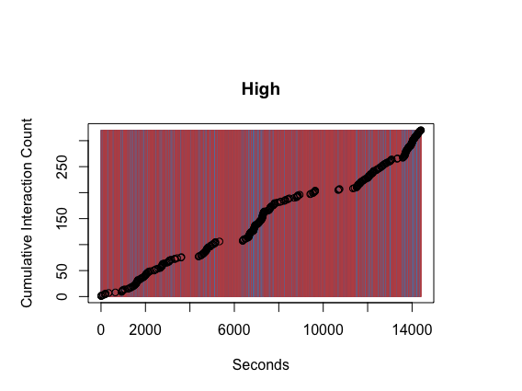

Slide 5
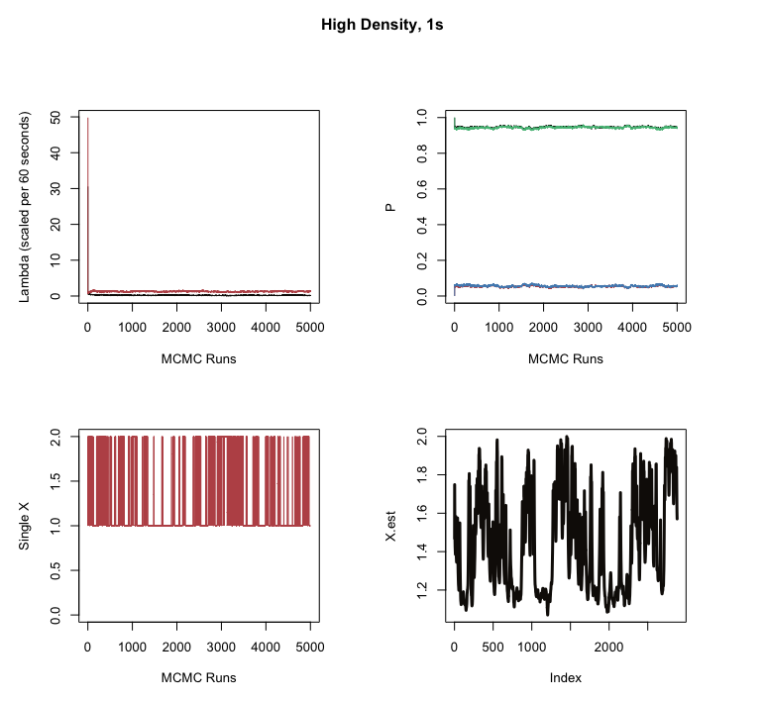
5 seconds

Slide 6
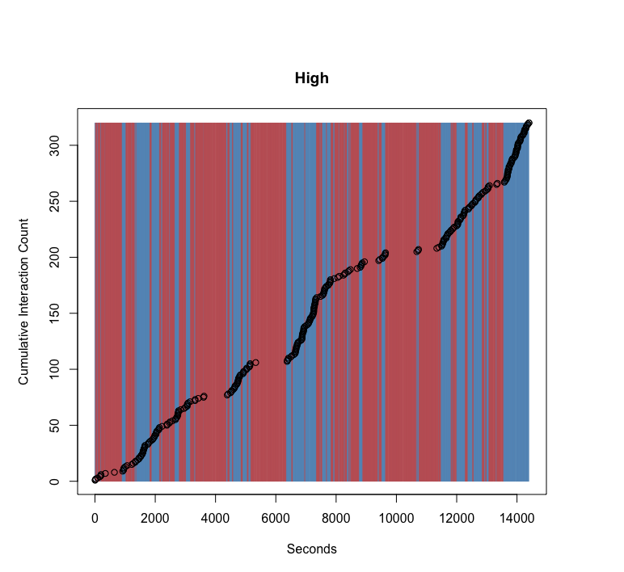

Slide 7
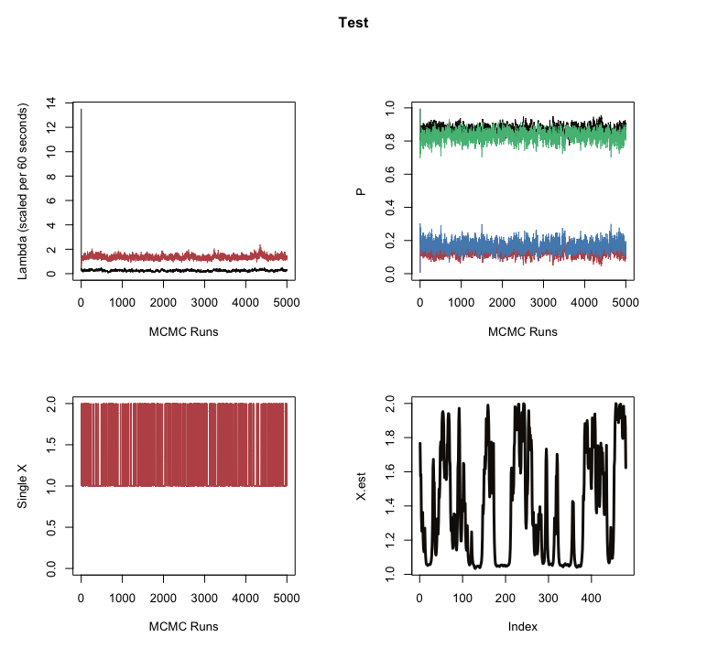
30 seconds

Slide 8
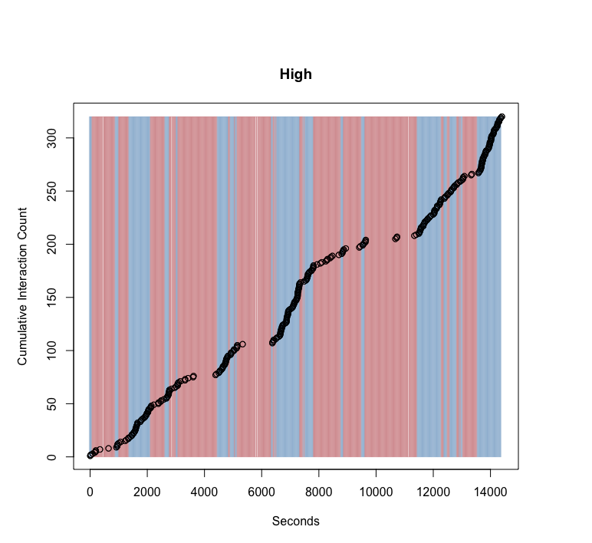

Slide 9
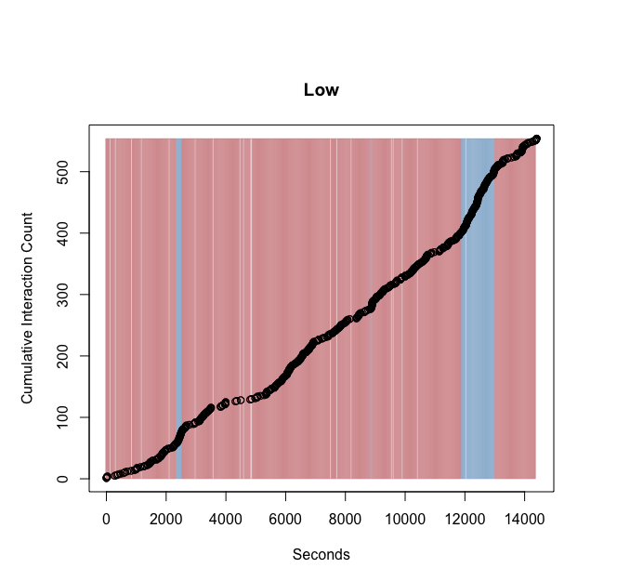
Combined Chambers

Slide 10
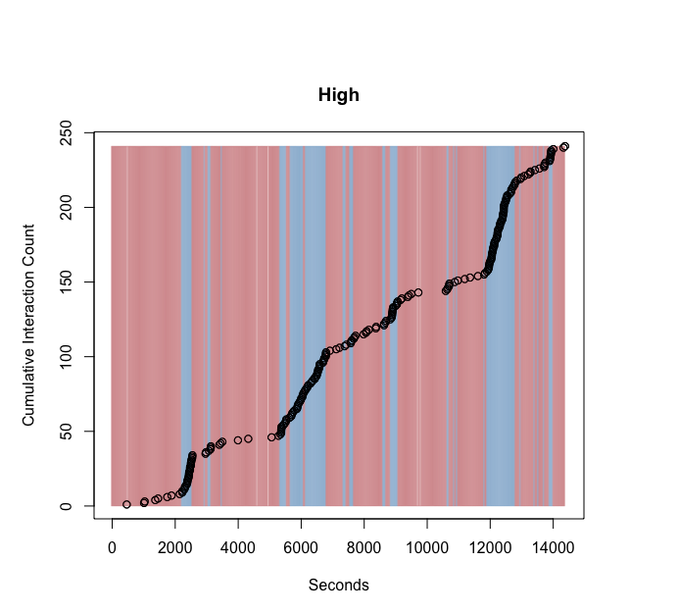
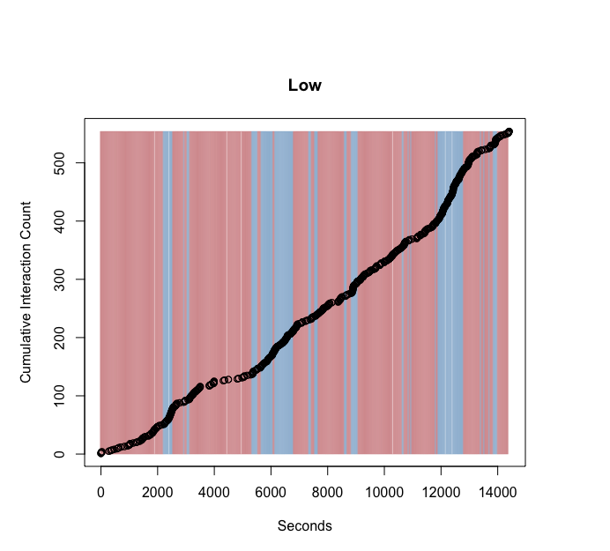
Entrance

Slide 11
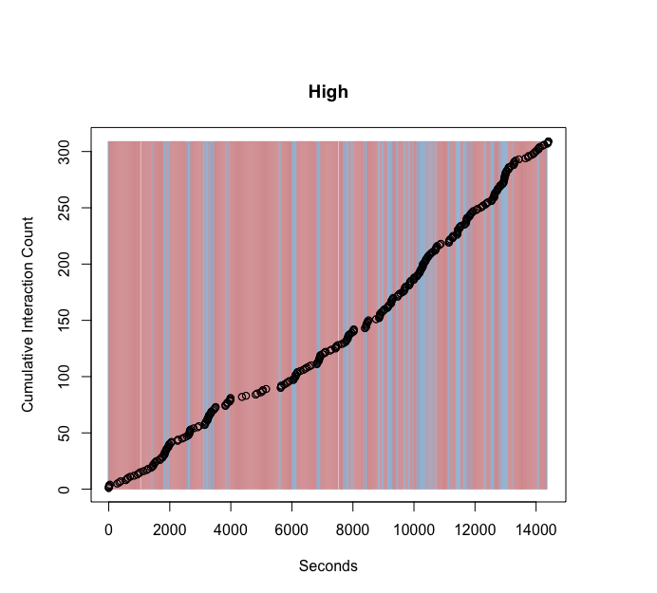
Queen’s Chamber

Slide 12
Current Work
Want to reconcile differences in results when data are used in binned intervals (i.e. 1 second vs 30 second intervals)
New model will incorporate a penalty parameter which will increase ‘smoothness’ of results.
Can penalize based on limiting number of ‘jumps’ between states, or by constraining stationary distribution of X_{t.}

Slide 13
Expectations
Either model will provide similar results.
Want to develop method for taking advantage of full, continuous data
Either methods can go in the paper

