Slide 1
Ant/Stats Lab Meeting
12 January 2018

Slide 2
Current Status
Model for 2-state penalized working
Results for Col 2, Q chamber
Paper writing has begun and will be submitted early this semester.
Forming committee for Comprehensive Exam
Proposed date: Mid- to Late March

Slide 3
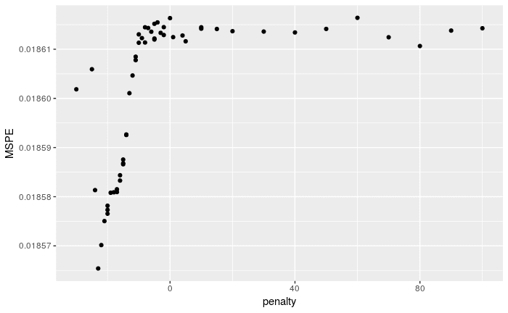

Slide 4
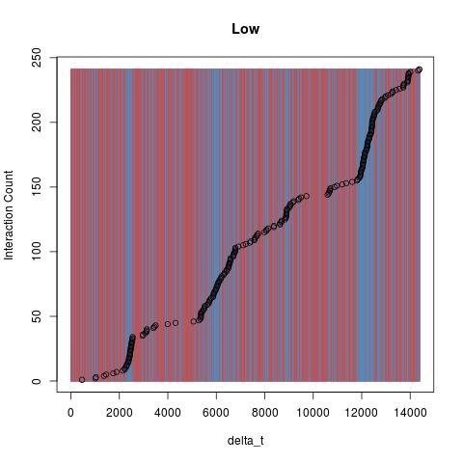

Slide 5
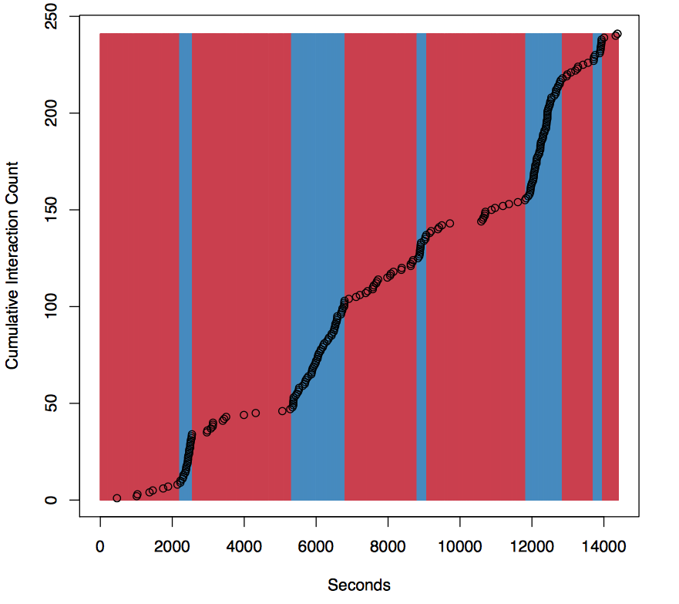

Slide 6
Up Next
Finish code/analysis by end of January
Results for 3 state penalized model on Ant data
Results for 2 state penalized model with covariates
Writing during February
Get write up to committee by early/mid March?
Hoping to present penalized covariate model this summer at the International Statistical Ecology Meeting in St Andrews, Scotland

Slide 7
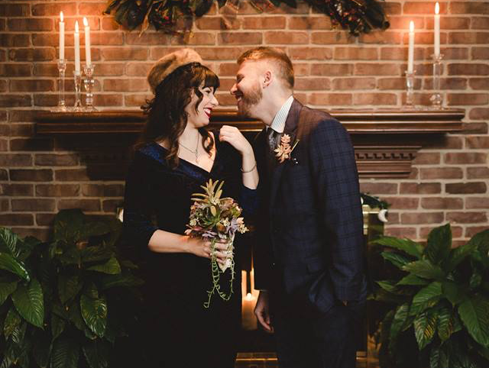
Oh, and I did a thing over winter break!

