Slide 1
LDA, QDA and Log Regression in classifying soil samples
Project1, STAT 557 Spring 2018
Meridith Bartley & Fei jiang

Slide 2
Introduction to dataset
Soil sample data over the US downloaded from Natural Resources Conservation Service (NRCS)
~14,000 records.
Predictors: Physical (sand, silt, clay, organic carbon, and bulk density)and chemical properties (CEC soil, CEC clay, base saturation, and pH) of soil samples
Response Variable: 9 soil classification groups (soil order).

Slide 3
Classification Methodology
Linear Discriminant Analysis (LDA)
Quadratic Discriminant Analysis (QDA)
Multinomial Logistic Regression
Training Data: 80% of entire dataset
Test Data: 20% of entire dataset

Slide 4
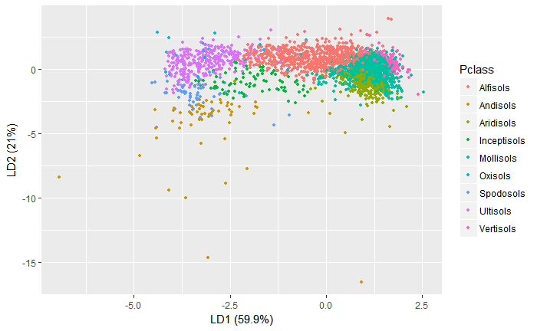
LDA Results
LDA on original database
Soil Order | Prediction correction rate
Alfisols | 0.588
Andisols | 0.486
Aridisols | 0.560
Inceptisols | 0.132
Mollisols | 0.690
Oxisols | 0.529
Spodosols | 0.232
Ultisols | 0.784
Vertisols | 0.612
Overall | 0.583

Slide 5
LDA Results
LDA on reduced- dimension database
 | PC1 | PC2 | PC3 | PC4 | PC5 | PC6 | PC7 | PC8
Standard deviation | 32.638 | 25.633 | 11.000 | 8.588 | 1.539 | 0.745 | 0.647 | 0.186
Proportion of variance | 0.555 | 0.342 | 0.063 | 0.038 | 0.001 | 0.000 | 0.000 | 0.000
Cumulative Proportion | 0.555 | 0.897 | 0.960 | 0.998 | 0.999 | 1.000 | 1.000 | 1.000
PCA Results
 | PC1 | PC2 | PC3 | PC4
Sand | -0.352 | -0.777 | -0.515 | 0.082
Clay | 0.242 | 0.398 | -0.676 | 0.567
Organic.Carbon | -0.005 | 0.005 | -0.017 | -0.058
Bulk.Density | 0.002 | 0.000 | -0.003 | 0.010
CEC.Soil | 0.178 | 0.180 | -0.519 | -0.804
CEC.Clay | -0.011 | -0.006 | -0.025 | -0.142
Base.Saturation | 0.886 | -0.453 | 0.084 | 0.037
pH | 0.031 | -0.023 | 0.006 | -0.003

Slide 6
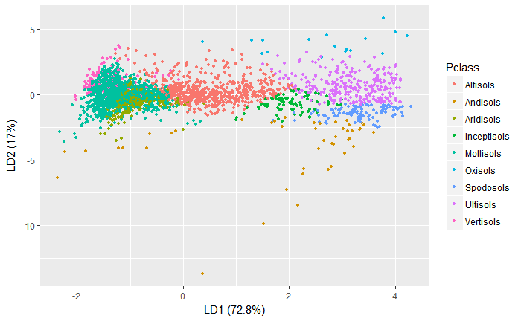
LDA Results
LDA on reduced- dimension database
Soil Order | Prediction correction rate
Alfisols | 0.472
Andisols | 0.338
Aridisols | 0.462
Inceptisols | 0.104
Mollisols | 0.741
Oxisols | 0.353
Spodosols | 0.477
Ultisols | 0.793
Vertisols | 0.345
Overall | 0.537

Slide 7
QDA Results
Results from QDA on original database
Results from QDA on Reduced-dimension database
Soil Order | Prediction correction rate
Alfisols | 0.717
Andisols | 0.324
Aridisols | 0.615
Inceptisols | 0.250
Mollisols | 0.463
Oxisols | 0.941
Spodosols | 0.419
Ultisols | 0.789
Vertisols | 0.732
Overall | 0.580
Soil Order | Prediction correction rate
Alfisols | 0.490
Andisols | 0.270
Aridisols | 0.719
Inceptisols | 0.090
Mollisols | 0.553
Oxisols | 0.235
Spodosols | 0.488
Ultisols | 0.793
Vertisols | 0.641
Overall | 0.538

Slide 8
Multinomial Logistic Regression Results
Original Database
Reduced Dimension Database
Multinomial logistic regression was chosen as the response variable, Soil Order, is comprised of 9 independent (and not ordinal) categories.
Soil Order | Prediction correction rate
Alfisols | 0.66
Andisols | 0.46
Aridisols | 0.57
Inceptisols | 0.22
Mollisols | 0.66
Oxisols | 0.65
Spodosols | 0.50
Ultisols | 0.75
Vertisols | 0.58
Overall | 0.61
Soil Order | Prediction correction rate
Alfisols | 0.62
Andisols | 0.41
Aridisols | 0.53
Inceptisols | 0.14
Mollisols | 0.65
Oxisols | 0.12
Spodosols | 0.52
Ultisols | 0.77
Vertisols | 0.42
Overall | 0.57

Slide 9
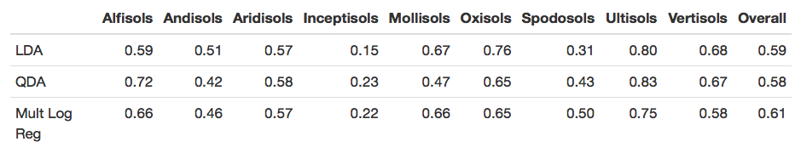
Model Comparison and Conclusion
While individual soil Orders were best predicted by various approaches, the Multinomial Logistic Regression method exhibited the overall highest percentage of correct classifications for these data.
PCA does not improve the prediction accuracy for all three methods.

