Slide 1
LDA, QDA and Log Regression in classifying soil samples
Project1, STAT 557 Spring 2018
Meridith Bartley & Fei jiang

Slide 2
Introduction to dataset
Soil sample data over the US downloaded from Natural Resources Conservation Service (NRCS)
~14,000 records.
Predictors: Physical (sand, silt, clay, organic carbon, and bulk density)and chemical properties (CEC soil, CEC clay, base saturation, and pH) of soil samples
Response Variable: 9 soil classification groups (soil order).

Slide 3
Classification Methodology
Linear Discriminant Analysis (LDA)
Quadratic Discriminant Analysis (QDA)
Multinomial Logistic Regression
Training Data: 80% of entire dataset
Test Data: 20% of entire dataset

Slide 4
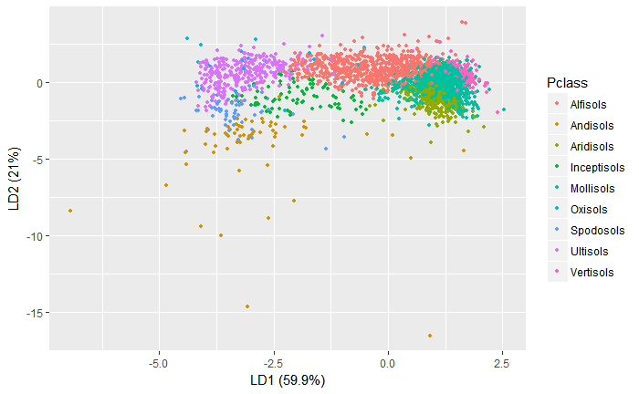
LDA Results w/o PCA
LDA on original database
Soil Order | Prediction correction rate
Alfisols | 0.588
Andisols | 0.486
Aridisols | 0.560
Inceptisols | 0.132
Mollisols | 0.690
Oxisols | 0.529
Spodosols | 0.232
Ultisols | 0.784
Vertisols | 0.612
Overall | 0.583

Slide 5
LDA Results w/o PCA
LDA on reduced- dimension database
 | PC1 | PC2 | PC3 | PC4 | PC5 | PC6 | PC7 | PC8
Standard deviation | 32.638 | 25.633 | 11.000 | 8.588 | 1.539 | 0.745 | 0.647 | 0.186
Proportion of variance | 0.555 | 0.342 | 0.063 | 0.038 | 0.001 | 0.000 | 0.000 | 0.000
Cumulative Proportion | 0.555 | 0.897 | 0.960 | 0.998 | 0.999 | 1.000 | 1.000 | 1.000
PCA Results
 | PC1 | PC2 | PC3 | PC4
Sand | -0.352 | -0.777 | -0.515 | 0.082
Clay | 0.242 | 0.398 | -0.676 | 0.567
Organic.Carbon | -0.005 | 0.005 | -0.017 | -0.058
Bulk.Density | 0.002 | 0.000 | -0.003 | 0.010
CEC.Soil | 0.178 | 0.180 | -0.519 | -0.804
CEC.Clay | -0.011 | -0.006 | -0.025 | -0.142
Base.Saturation | 0.886 | -0.453 | 0.084 | 0.037
pH | 0.031 | -0.023 | 0.006 | -0.003

Slide 6
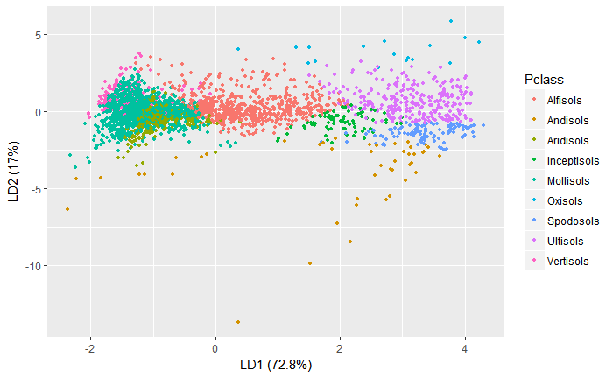
LDA Results w/o PCA
LDA on reduced- dimension database
Soil Order | Prediction correction rate
Alfisols | 0.472
Andisols | 0.338
Aridisols | 0.462
Inceptisols | 0.104
Mollisols | 0.741
Oxisols | 0.353
Spodosols | 0.477
Ultisols | 0.793
Vertisols | 0.345
Overall | 0.537

Slide 7
QDA Results w/o PCA
Results from QDA on original database
Results from QDA on Reduced-dimension database
Soil Order | Prediction correction rate
Alfisols | 0.717
Andisols | 0.324
Aridisols | 0.615
Inceptisols | 0.250
Mollisols | 0.463
Oxisols | 0.941
Spodosols | 0.419
Ultisols | 0.789
Vertisols | 0.732
Overall | 0.580
Soil Order | Prediction correction rate
Alfisols | 0.490
Andisols | 0.270
Aridisols | 0.719
Inceptisols | 0.090
Mollisols | 0.553
Oxisols | 0.235
Spodosols | 0.488
Ultisols | 0.793
Vertisols | 0.641
Overall | 0.538

Slide 8
Multinomial Logistic Regression Results
Soil Order | Prediction correction rate
Alfisols | 0.66
Andisols | 0.46
Aridisols | 0.57
Inceptisols | 0.22
Mollisols | 0.66
Oxisols | 0.65
Spodosols | 0.50
Ultisols | 0.75
Vertisols | 0.58
Overall | 0.61
Multinomial logistic regression was chosen as the response variable, Soil Order, is comprised of 9 independent (and not ordinal) categories.

Slide 9
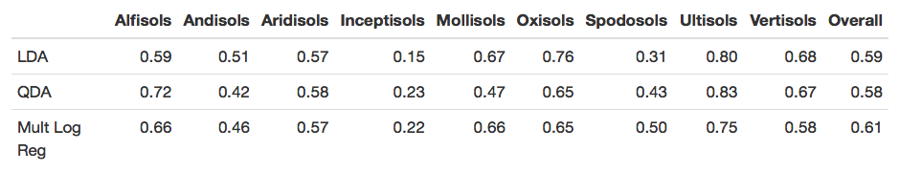
Model Comparison
While individual soil Orders were best predicted by various approaches, the Multinomial Logistic Regression method exhibited the overall highest percentage of correct classifications for these data.

