Slide 1
Decisions Trees for Classifying Car Conditions
Project 3, STAT 557 Spring 2018
Meridith Bartley & Fei jiang

Slide 2
Introduction to dataset
Car evaluation dataset developed by Marko Bohanec and Blaz Zupan (1997)
~1,728 records.
Predictors: buying price, price of the maintenance, number of doors, capacity in terms of persons to carry, the size of luggage storage
Response Variable: 2 car classification groups (car condition)- 30% accepted and 70% unaccepted.

Slide 3
Classification Methodology
Decision Tree
Used rpart package in R to
1. Build the tree
- Splitting Criteria
- Stopping Criteria
2. Prune the tree
- Cross-validation
Training Data: 80% of entire dataset
Test Data: 20% of entire dataset

Slide 4
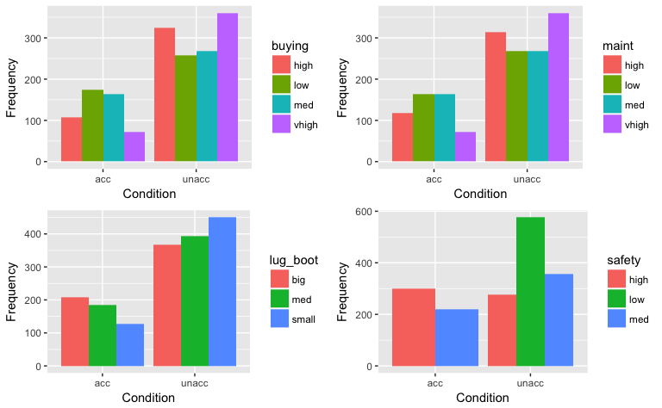
Exploratory Data Analysis

Slide 5
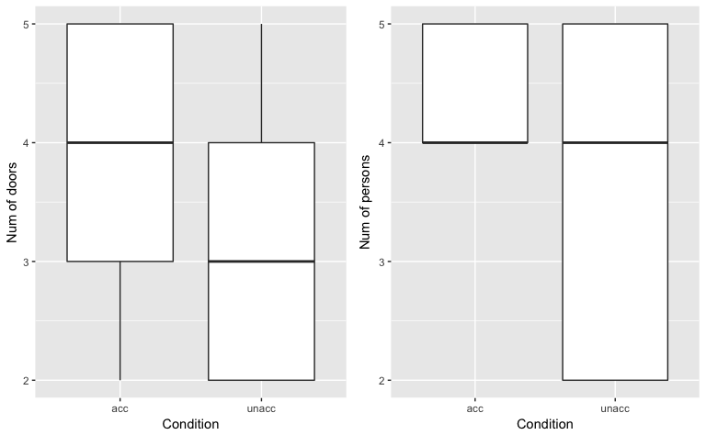
Exploratory Data Analysis

Slide 6
Pseudo-Code
Each tree is grown as follows:
1. A single variable is found which best splits the data into two groups (‘best’ will be defined later).
2. The data is separated, and then this process is applied separately to each sub-group.
3. Continue recursively until the subgroups either reach a minimum size or until no improvement can be made.
4. Pick the tree size that minimizes misclassification rate (i.e. prediction error).
5. Prune the tree using the best complexity parameter.

Slide 7
Complexity Parameter (CP)
CP is specified according to the formula
R_{cp}(T) ≡ R(T) + cp ∗ |T| ∗ R(T₁)
Decision Rule: if any split does not increase the overall R² of the model by at least cp (where R² is the usual linear-models definition) then that split is decreed to be, a priori, not worth pursuing.

Slide 8
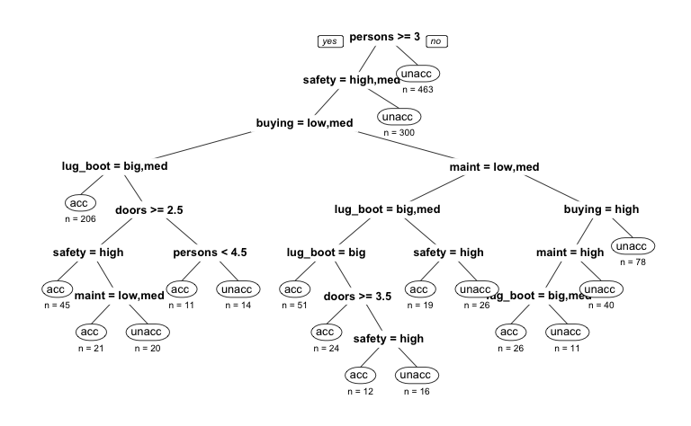
Unpruned Tree

Slide 9
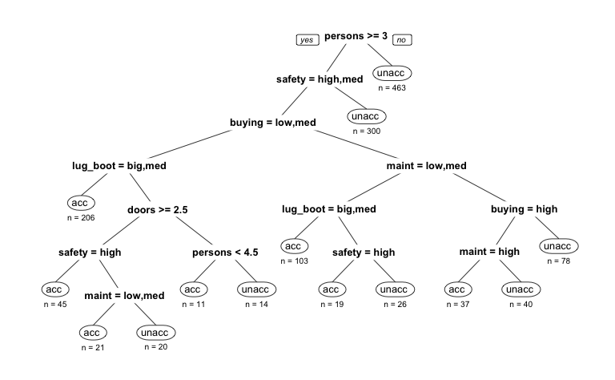
Pruned Tree

Slide 10
Prediction Results – Training VS. Testing Data
Actual/Predicted | Acceptable | Unacceptable
Acceptable | 415 | 0
Unacceptable | 43 | 925
Actual/Predicted | Acceptable | Unacceptable
Acceptable | 91 | 12
Unacceptable | 4 | 238
The tree has a misclassification rate of 2.82% in cross-validation (i.e. 97.18% of prediction accuracy).

Slide 11
Conclusions

