Slide 1
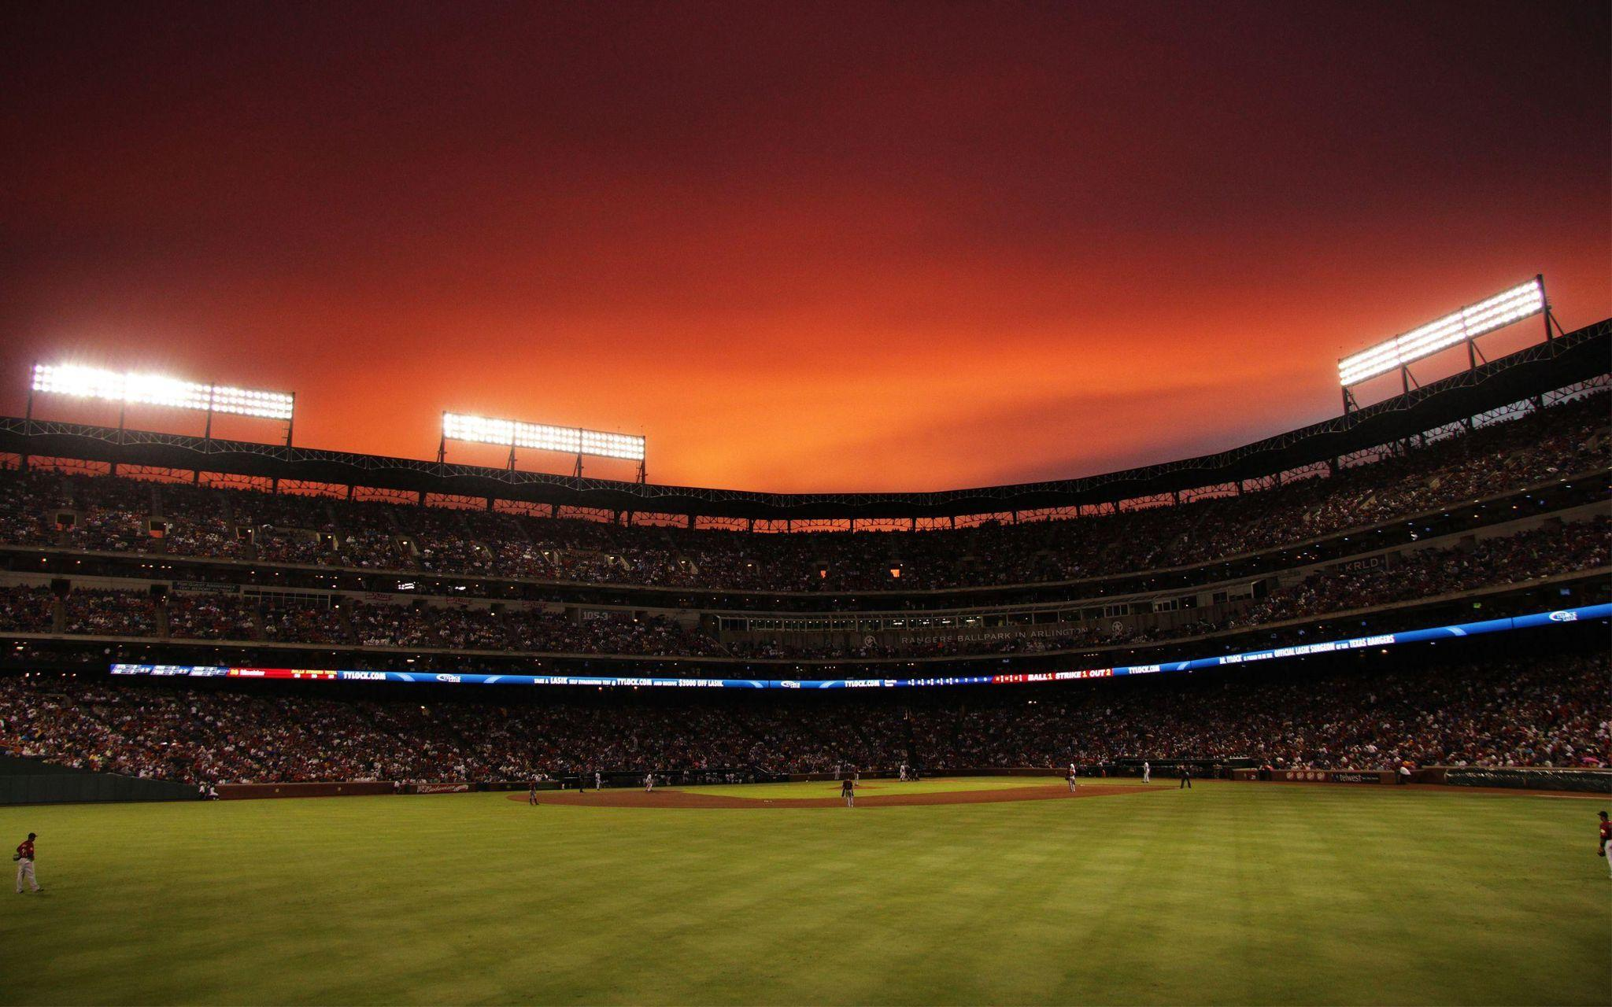
A Home Run of A Proposal
Group 14

Slide 2

Case Overview
Goal: To create a list of potential free agent prospects for the Astros
Why machine learning?
Process: To create various models and feed it different inputs to gather predictions/outputs

Slide 3
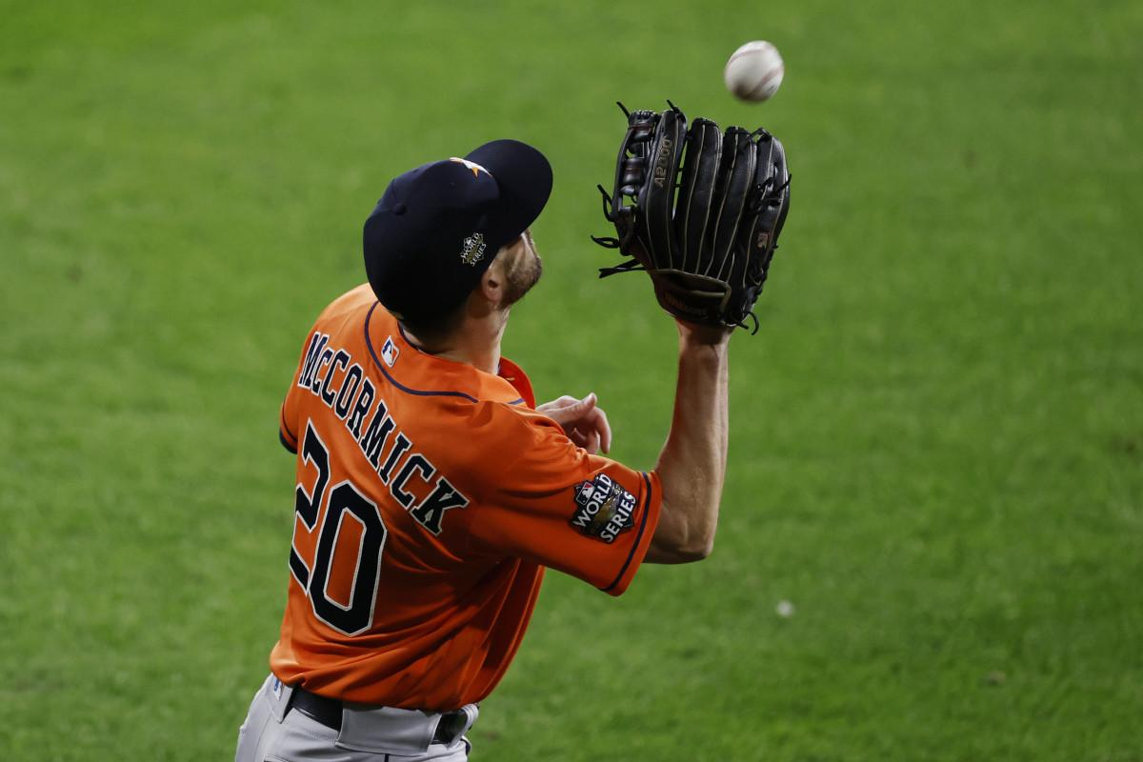
Our free agent targets:
Eric Cyr - 30 year old catcher
Audry Perez - 30 year old shortstop
Dusty Wathan - 36 year old pitcher
Erik Komatsu - 31 year old CF
Graham Taylor - 34 year old pitcher

Slide 4
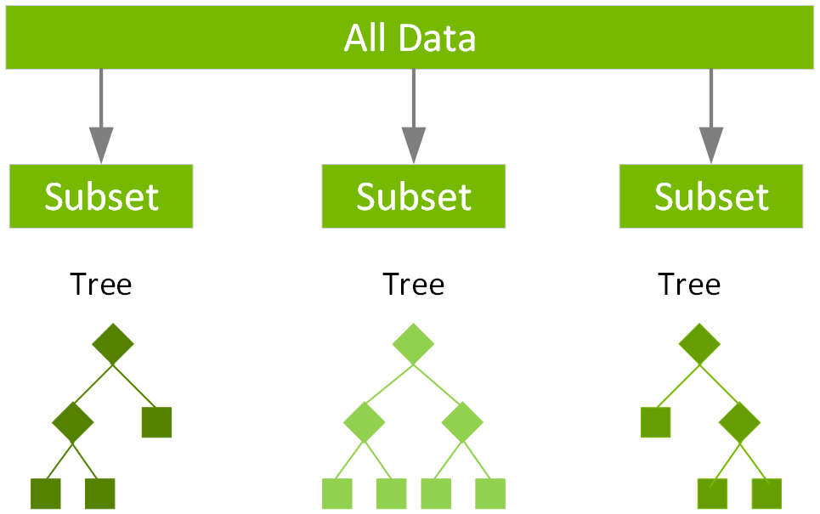
Models, Statistical Parameters, and Metrics
Neural Net Batting Forecast
Regression Model using Batting Summary
Tensorflow Fielding Independent Pitching Metric
Sentiment Analysis using NLP
Random Forest Regressor
XGBoost Regressor (IP)

Slide 5
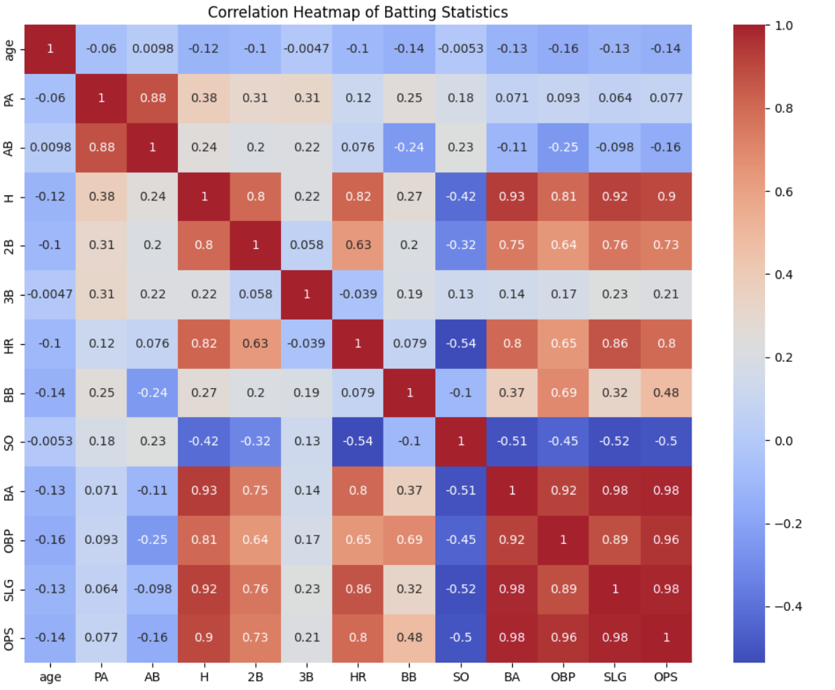

Slide 7
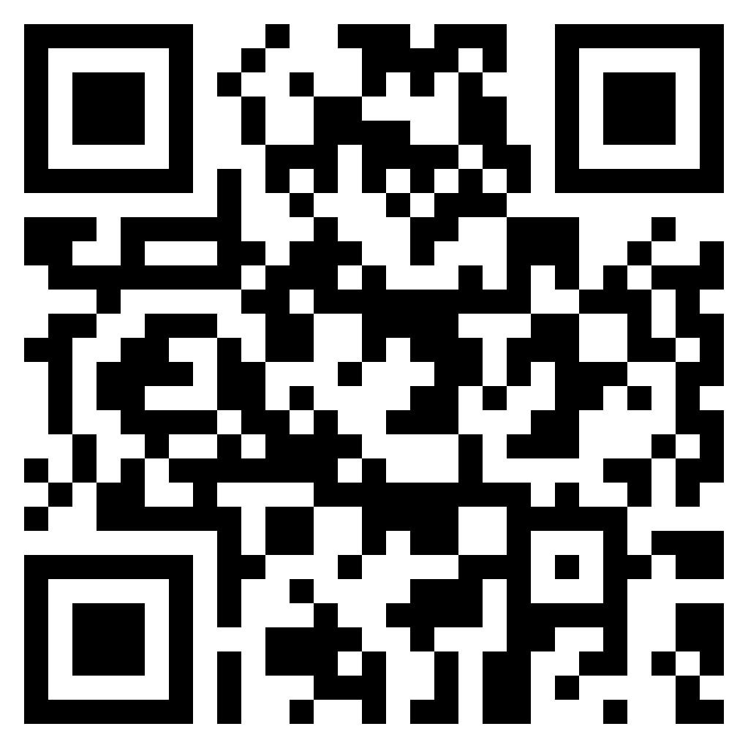
http://datahack.guptadhairya.com/main

Slide 8
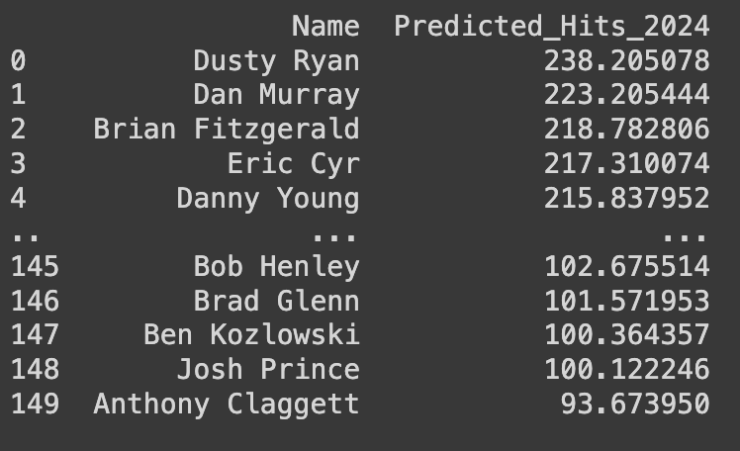
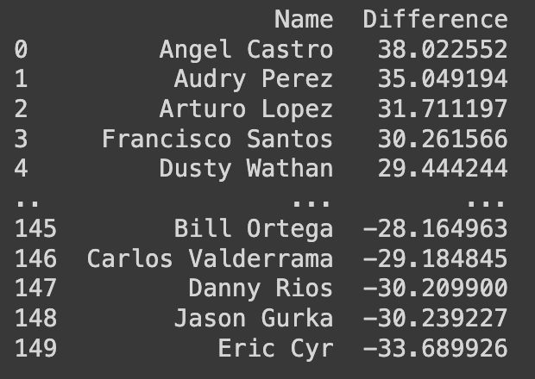
Regression Model Using Batting Summary
Important factors: age, HR, positions
Developed neural net with tensorflow
3) Techniques: emphasize on age, NEAT model, optimizing learning rate, epochs, and batch size

Slide 9
Regression Model using Batting Summary
Verify predictions with other types of models. We tried
Linear Regression
Random Forest Generator
XGBoost

Slide 10
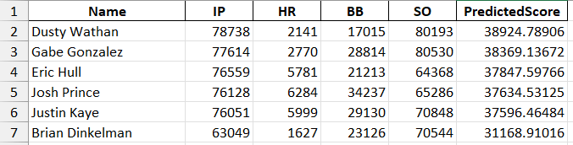
Tensorflow Independent Pitching Metric
Gather data from pitching logs and define the necessary variables
Create the neural network, specifically the hidden layer
Utilize the FIP formula to get a better player score and for ranking

Slide 11
Sentiment Analysis using NLP
Utilized a Sentiment Intensity Analyzer from NLTK
Parsed through structure using a Word Tokenizer and the Vader Lexicon
Developed “Buy Recommendation Metric”: Ranges from -1 to 1 based off sentiment surrounding sentence of mentioned name
Sentiments averaged over whole file as JSON file for a given article is parsed through
Invalid metrics with only a few mentions are removed to preserve data originality

Slide 12
Reasoning Behind Our Top 3 Free Agent Targets
Considering the Astros’ Roster Strength, we are a ‘win-now’ team: reliable experience and proven track record.
Audry Perez
T2 projected improvement
Desired position
Eric Cyr
T4 in both RandomForest and neural networks
Well seasoned player
Dusty Wathan
Top candidate from pitching data
Veteran journeyman
Notes:
Therefore, our process was to target strong assets with reliable experience and a proven track record, since the rest of our roster is relatively younger with an average age of 28.5. Here were our selected win-now assets:

