Slide 1
Predicting Heart Disease
Akeem Wells
Michael Davies
Notes:
Hello and welcome to our presentation on “Predicting Heart Disease”
Our team consists of Akeem Wells and myself, Michael Davies

Slide 2
Problem Statement
Predict the posterior probability that an individual has heart disease given our data and model.
Notes:
Slide 2 – Problem Statement
Broadly speaking, our goal was to Predict the posterior probability that an individual has heart disease given our data and model.

Slide 3
Data
The data comes from Source and Source
Hungarian Institute of Cardiology. Budapest
University Hospital, Zurich, Switzerland
University Hospital, Basel, Switzerland
V.A. Medical Center, Long Beach and Cleveland Clinic Foundation
Variables:
~76 Attributes available
~15 Attributes used (14 features):
Size for this analysis:
920 observations
Notes:
Slide 3 - Data
The data was collected from 4 hospitals across 3 countries.
Once merged, we had 920 observations and focused on 14 features and our response (Heart Disease)
age - age in years
sex - (1 = male; 0 = female)
cp - chest pain type
trestbps - resting blood pressure (in mm Hg on admission to the hospital)
chol - serum cholesterol in mg/dl
fbs - (fasting blood sugar > 120 mg/dl) (1 = true; 0 = false)
restecg - resting electrocardiographic results
thalach - maximum heart rate achieved
exang - exercise induced angina (1 = yes; 0 = no)
oldpeak - ST depression induced by exercise relative to rest
slope - the slope of the peak exercise ST segment
ca - number of major vessels (0-3) colored by flourosopy
thal - 3 = normal; 6 = fixed defect; 7 = reversible defect
target (the predicted attribute) - 0/1

Slide 4
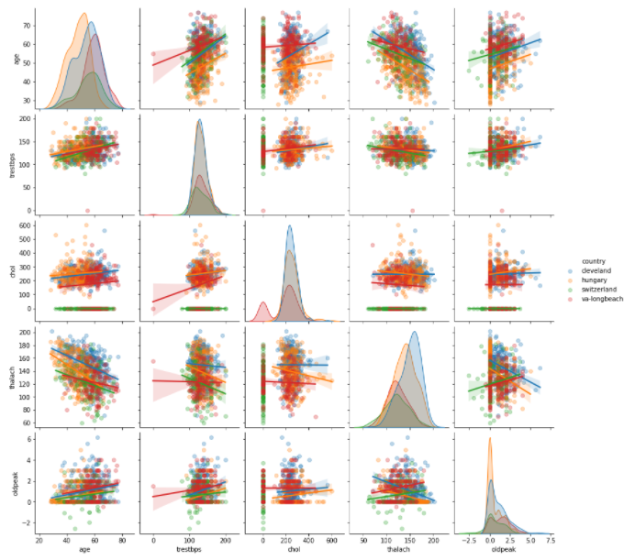
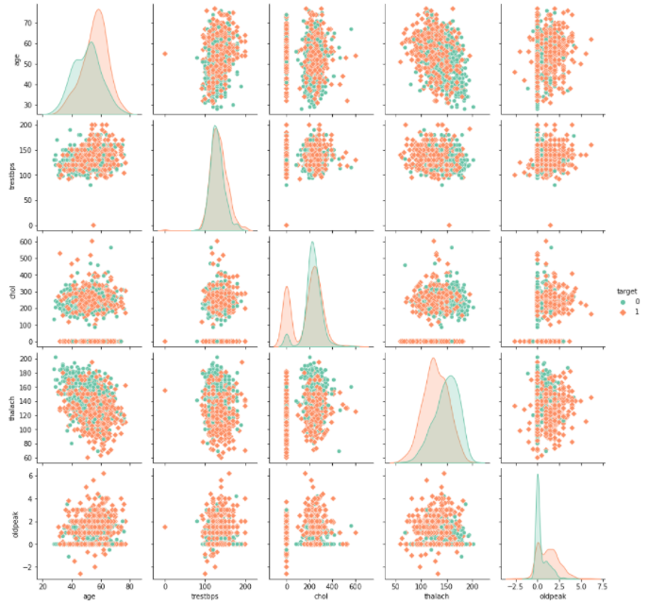
EDA
Pairplot by Country
Pairplot by Response (Heart Disease)
Notes:
Slide 4 – EDA
Here are a couple of plots from our initial exploratory analysis. First, we checked to see if it’s plausible that the data vary differentially by country. Second, of course, we checked that the data vary across classes of the response variable.

Slide 5
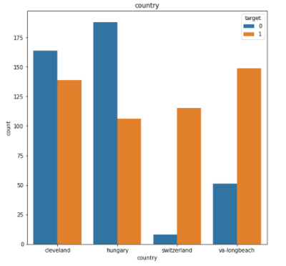
Cleaning, Imputing, Transforming
Imputation
KNN Imputation
Scaling
Z score
Maximum Absolute Scaling (Chosen)
Ugh!
NAs
Notes:
Slide 5 – Data cleaning, imputing, and transformation
During our exploratory phase, we discovered a large number of missing values. Of course, treatment of missing values is fraught with problems, and there is a large discussion about when and how to impute missing variables.
We chose to impute the missing values really for 2 reasons. First, we would lose data if we dropped missing values. And we didn’t want to lose the information – particularly from Switzerland and Long beach. Also, we were really interested in applying a Hierarchical Model and needed the data.
So, we implemented a K Nearest Neighbors method of imputation.
We also need to highlight that we then scaled the data. We explored a few methods.
For instance, we looked at z-score scaling. However, z-score assume a normal distribution. And z-score scaling transforms the variable so that it’s flipped along the axis. We were concerned we would lose the value of variables such as age, which is likely skewed and all positive.
So, we chose Maximum Absolute Scaling, which sets the largest value at one and creates a scale between zero and one.

Slide 6
Approach

Slide 7
Models
Bayesian Logistic Model
Baseline model
Bayesian Model Averaging
Logistic Regression
Bayesian Hierarchical Model
Country Clusters
Notes:
Slide 7 – Approach
We approached this by first running a Bayesian Logical Model to serve as a baseline model.
From there, we implemented a Bayesian Model Averaged Logistic Regression, which learns the parameters for all candidate models and then combine the estimates according to the posterior probabilities of the associated models.
Last, our real goal, Bayesian Hierarchical Model, which allows parameters to vary by group (or in this case, by country)

Slide 8
Prior Rationale
Notes:
Next we’ll discuss our initial priors.

Slide 9
Priors - Model Set Up
“mu’s”
Weakly-informative priors.
Normal distribution with a mean of zero and a very large standard deviation, which gives us a very wide distribution.
Sigma
The variance distribution
Account for the variation and uncertainty at the country-level via sigma.
Half-Cauchy distribution, which is a heavy tailed or weakly informative distribution with a positive scale parameter (sigma greater than or equal to 1).
Notes:
For our priors, we decided that our mu_ parameters will be normal distributions with a mean of zero and a very large standard deviation, which gives us a very wide distribution. For our sigmas, our distributions need to account for the variance and uncertainty at the country-level for this we chose the Half-Cauchy distribution, which is a heavy tailed with a positive scale parameter

Slide 10
Findings
Notes:
Now we will present the findings of our models.

Slide 11
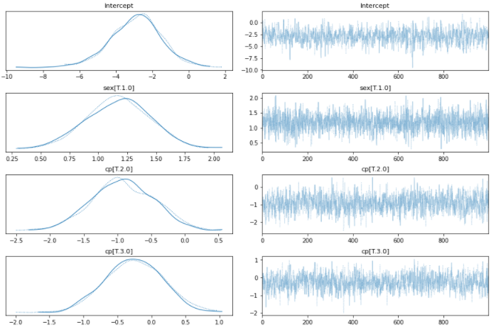
Bayesian Logistic Model - Baseline model
Trace plot:
Sample of the “mu’s”
Families.Binomial()
Initial estimate
Notes:
For our Baseline model which was a Bayesian Logistic Model, we used pm.glm.families.Binomial() since our target was a 0/1 binary response. As you can see from the subset trace on the right from some of the sample, we have convergence and an initial estimate of which variables play a role in our problem.

Slide 12
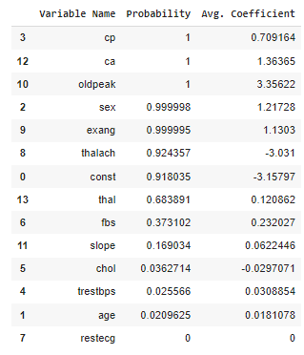
Bayesian Model Averaged Logistic Regression
Learning the parameters for all candidate models and then combine the estimates according to the posterior probabilities of the associated models.
Notes:
Next we opted to do a Bayesian Model Averaged Logistic Regression, this allowed us to see which variables have higher probability to have stronger influences in determining the likelihood of the presence or absence of heart disease.

Slide 13
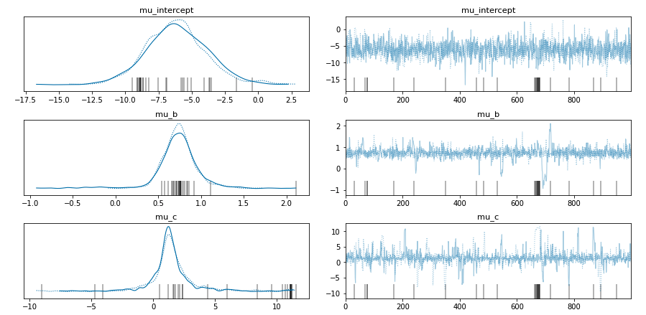
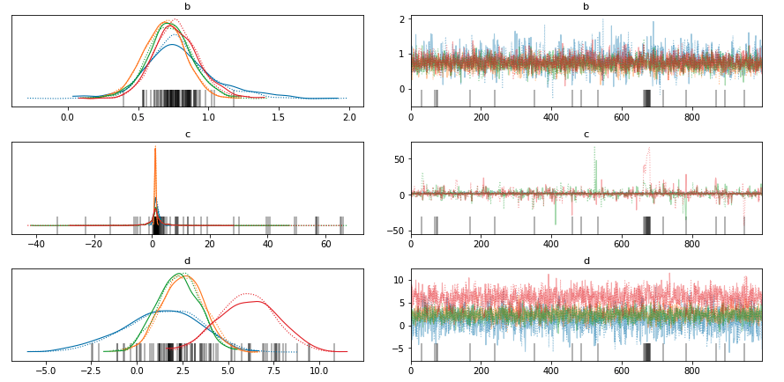
Bayesian Hierarchical Model
Mu parameters normally distributed
Priors
Normal mu
Normal offset with mean 0 sd 1
HalfCauchy sigmas
Link Function
Bernoulli
Notes:
The third model, the Bayesian Hierarchical model, with our mu_ parameters normally distributed, the regression coefficients should range from negative infinity to positive infinity. Since we have hierarchical parameters, we prepared the model as the usual normal mu, normal offset with mean 0 sd 1, halfCauchy sigmas and pymc Deterministic to bring them all together. Our choice of link function was bernoulli since estimating log odds we want a value that ranges between 0 and 1.

Slide 14
Summary
Notes:
In Summary, we have good consistency across all three models on which variables predict strong posterior probabilities on heart disease.

Slide 15
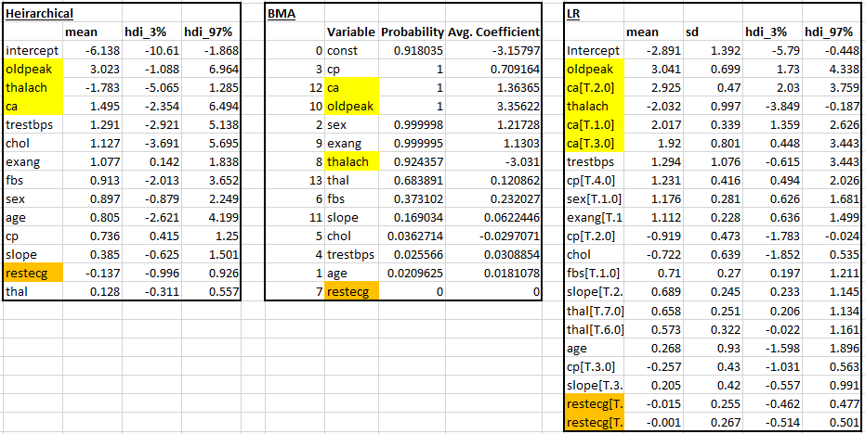
Summary of Model Result
Notes:
From our models we can see that the variables old peak, stress based depression induced by exercise relative to rest; thalach, maximum heart rate achieved; and ca, number of major coronary artery calcification vessels (0-3) colored by fluoroscopy play a larger role in determining the likelihood that a patient has the present or lack of heart disease while variables such as restecg; resting electrocardiographic results play a much smaller role. Variables that are associated with the strength of your heart as determined by a cardiograph and fluoroscopy are better predictors than variables that are associated with physical attributes such as age and sex. We can also see by looking at the marginals for the model to see some differences in likelihood of having heart disease varies for some variables between countries.

