Slide 1
Piano Transcriber
Dec 2024
Mason Galusha
Connor McCall
Jim Carson
Graham Adams
Confidential

Slide 2
Introduction
Piano Transcriber
Project Goal:
Develop a model that can recognize notes played on a piano from audio recordings and convert them into MIDI files. Aim to generate MIDI files from piano audio files using our trained model.
Significance:
Simplifies the process of transcribing piano music.
Allows musicians to capture spontaneous compositions.
Facilitates learning and practicing by providing visual notation.

Slide 3
Introduction
Piano Transcriber
What is automatic music transcription?
Automatic transcription of music for instruments, like that of a piano, involves converting audio recordings into symbolic representations like MIDI files, which can be used for music analysis, education, and interactive applications.

Slide 4
Dataset Overview
Piano Transcriber
MAESTRO Dataset
Dataset Overview
Sourced from the International Piano-e-Competition.
Contains over 200 hours of paired audio and MIDI recordings.
Quality and Precision
Audio: Uncompressed CD-quality (44.1–48 kHz, 16-bit PCM stereo).
MIDI: Includes key strike velocities and pedal positions.
Alignment: Audio and MIDI are aligned with approximately 3 ms accuracy.
Practical Considerations
Dataset size: Over 100GB.
Memory management is crucial due to the large size.
Goal
Extract MIDI metadata from the dataset.
Use the metadata to create relevant labels for training models:
Pitch detection
Onset timings
Other musical features
Notes:
**Dataset Characteristics**
- Key features such as:
- Number of recordings.
- Duration range.
- Diversity in styles and composers.

Slide 5
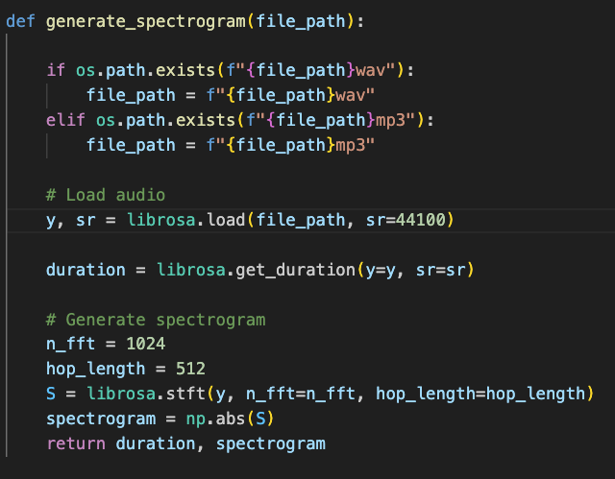
Dataset Overview
Piano Transcriber
Preprocessing Pipeline Part 1
Purpose
Convert audio recordings and corresponding MIDI data into a structured format for model training.
Audio Processing Steps
Load in audio files using librosa
Convert audio to a spectrogram. Represents frequencies over time.
Transpose spectrogram.
Rows represent time intervals (~11 milliseconds each)
This becomes the model input
Notes:
**Dataset Characteristics**
- Key features such as:
- Number of recordings.
- Duration range.
- Diversity in styles and composers.

Slide 6
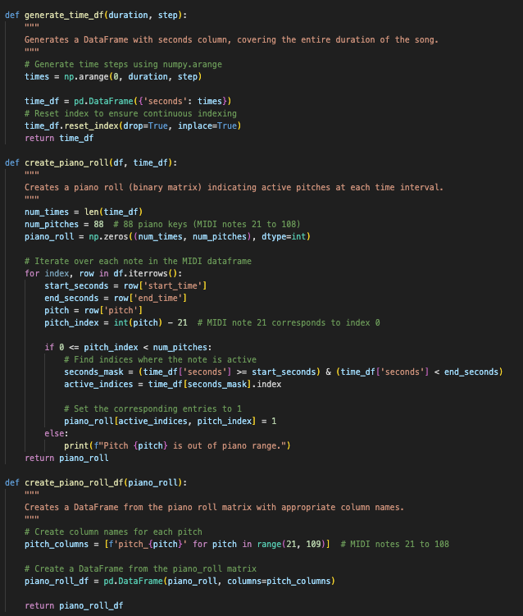
Dataset Overview
Piano Transcriber
Preprocessing Pipeline Part 2
MIDI Processing Steps
Extract note information from MIDI files: Start time, end time, and pitch of each note.
Create a DataFrame from MIDI data.
Alignment
Match time indices of the spectrogram with MIDI notes.
Create a piano roll:
A binary matrix with 88 columns (one for each piano key).
Rows correspond to time intervals.
Entries are 1 if a note is active, 0 otherwise.
Output:
Combined DataFrame of spectrogram data (inputs) and piano roll (labels).
Ready for model training or prediction.
Notes:
**Dataset Characteristics**
- Key features such as:
- Number of recordings.
- Duration range.
- Diversity in styles and composers.

Slide 7
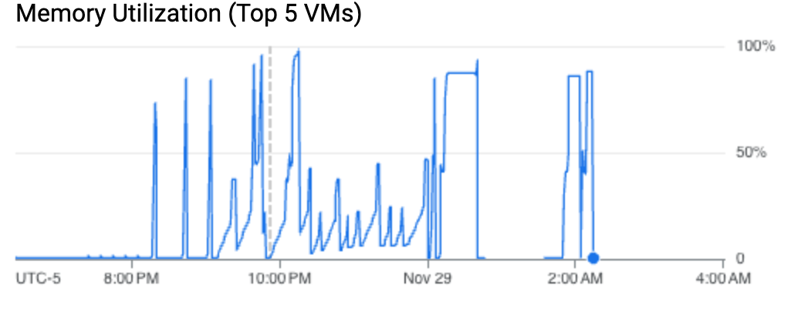
Dataset Overview
Piano Transcriber
Data Concatenation
Purpose of concat_data.py
Process the entire MAESTRO dataset efficiently.
Convert data into manageable chunks due to memory constraints.
Process
Split dataset into 10 parts.
Iterate over 10% of the data at a time.
Use the pipeline to convert each part into DataFrames.
Save each processed chunk to disk.
Memory Management
Virtual machine with 100GB memory used.
Processing all data took approximately 5-8 hours.
Notes:
**Dataset Characteristics**
- Key features such as:
- Number of recordings.
- Duration range.
- Diversity in styles and composers.

Slide 8
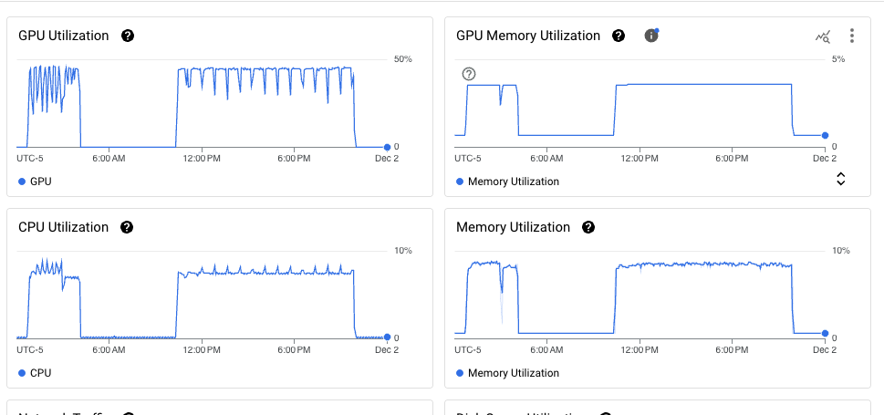
Dataset Overview
Piano Transcriber
Cloud Computing with Google Cloud
Infrastructure
Used Google Cloud’s virtual machines for training.
Machine Specs
GPU: NVIDIA Tesla P100.
CPUs: 16 vCPUs.
Memory: 104GB.
Storage: 500GB disk space.
Cost Management
Cost: Approximately $2 per hour.
Utilized $300 free credits, allowing for 150 hours of free usage.
Setup
Requested a GPU quota increase (approved almost instantly).
Necessary for handling large-scale training tasks.
Training Time
My machine 5 seconds per batch vm 7 seconds per 1000 batch. 1,000,000 batches per epoch
Notes:
**Dataset Characteristics**
- Key features such as:
- Number of recordings.
- Duration range.
- Diversity in styles and composers.

Slide 9
Convolutional Layers
Block 1:
Conv2D: 1 → 32 channels, kernel=(1, 3), padding=(0, 1)
BatchNorm: Normalizes activations.
ReLU: Activation function.
MaxPool2D: Downsample width by 2.
Block 2:
Conv2D: 32 → 64 channels, kernel=(1, 3), padding=(0, 1).
BatchNorm: Normalizes activations.
ReLU: Activation function.
MaxPool2D: Downsample width by 2.
Block 3:
Conv2D: 64 → 128 channels, kernel=(1, 3), padding=(0, 1).
BatchNorm: Normalizes activations.
ReLU: Activation function.
Architecture Overview
Flattened Features
Output Shape After Convolutions:
Channels: 128
Width: 128 (from pooling reductions)
Flattened Size: 128 × 1 × 128 = 16,384 features.
Fully Connected Layers
Layer 1:
Input: 16,384
Output: 256 neurons
Activation: ReLU
Dropout: 50% for regularization.
Layer 2:
Input: 256
Output: 88 (number of pitches)
Activation: Sigmoid (for pitch probabilities).

Slide 10
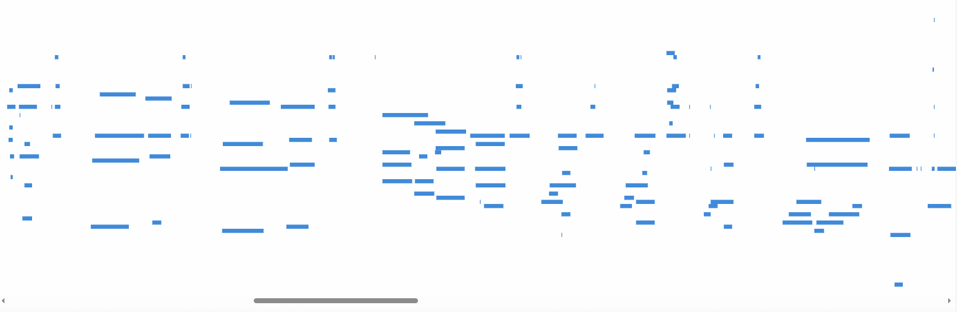
Model Architecture Mk1
Piano Transcriber
Convolutional Neural Network
Challenge Faced: The model plateaued after around 20 epochs and struggled with capturing note duration.
Notes:
**Performance Metrics**
- Show initial results (training loss, validation loss, recall, etc.).
- **Question:** *Do you have specific metrics or graphs from the initial CNN training?*
- *Format:* "Include a line graph showing training and validation loss over epochs for the CNN model."

Slide 11
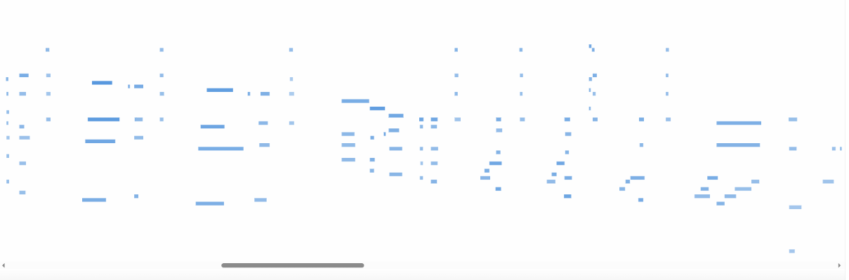
Performance Summary
Piano Transcriber
Performance Summary
Strengths:
The model excelled at pitch identification, accurately recognizing active notes.
Challenges:
Struggled with note duration, leading to difficulty determining when notes end.

Slide 12
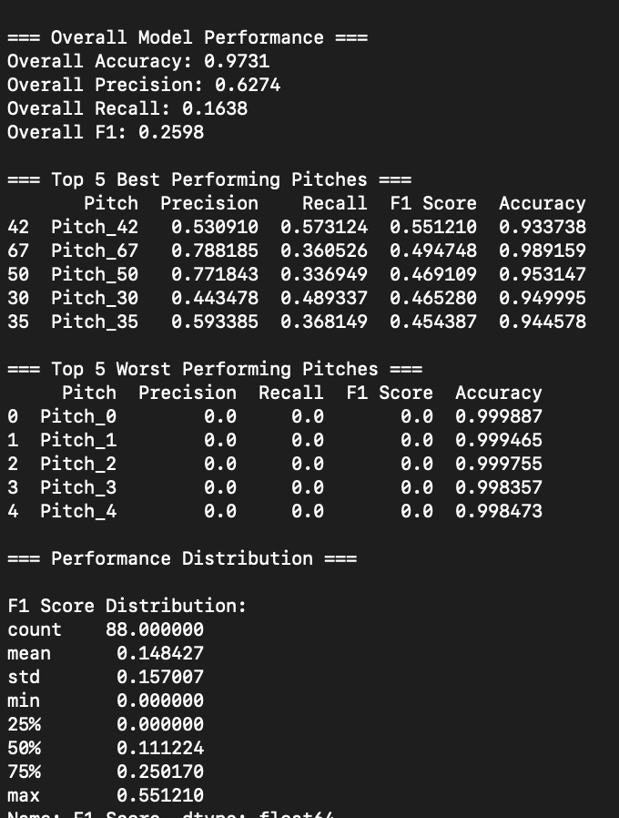
Model Evaluation
Evaluation Insights
Sparse Data Impact:
Piano roll files are highly sparse, with most values being 0.
Accuracy Observation:
Accuracy appears strong, as the model can achieve high performance by predominantly predicting 0s.
Precision Limitation:
A middling precision score reveals the model's struggle to reliably predict positive values.

Slide 13
Future Work
Piano Transcriber
Opportunities to expand
Output conversion: Convert model outputs back to MIDI format
Spectrogram Generation from MIDIs: Use libraries to generate spectrograms from predicted MIDI
Model Improvements: adding attention mechanisms
Deployment: deploy the model as an application or service ($$$)

