Slide 1

Applied Machine Learning Pandas (Series)
MLGeeks
Pre-Requisites:
- Jupyter notebook or Google Collab
- Basic Python Knowledge( not mandatory)

Slide 2
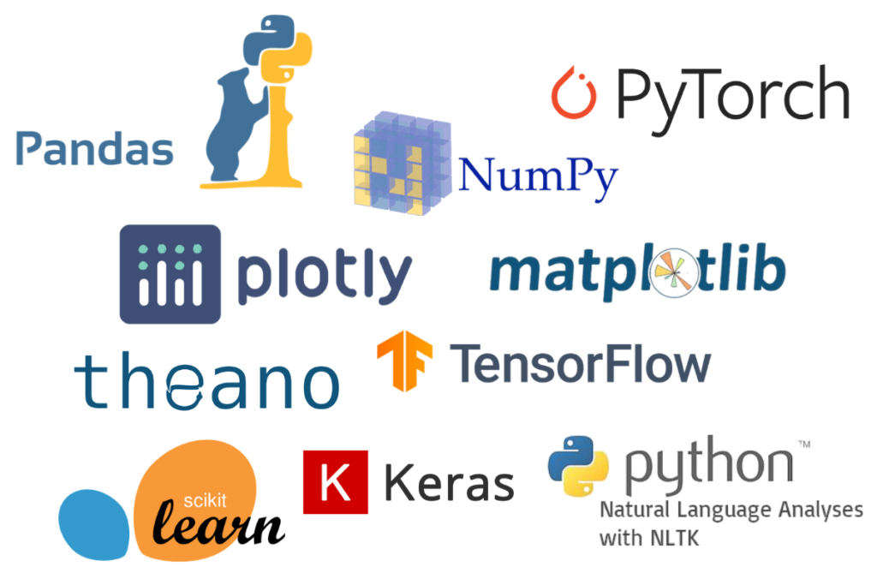

Slide 3

Pandas Role in ML
Collecting Data
Data Cleaning and Data analysis
Transforming and visualizing data
Open source
Built on top of NumPy
Data exploration, Visualization, cleaning
Training Model
Evaluating Model
Testing Model
Install pandas
Pip install pandas
Conda install pandas
!pip install pandas
Prediction

Slide 4
Data Structures – Series(1/3)
Pandas Data Structure
Series
Data Frame
Panel
Creating series:
Empty series
From ndarray
From ndarray(with index)
From Dict
From list
From Scalar
https://github.com/MLGeeks/MasterClass-Topics/blob/main/Pandas/Series/Series(Pandas)_Notebook01.ipynb

Slide 5
Data Structures – Series(2/3)
Pandas Data Structure
Series
Data Frame
Panel
Accessing data from Series:
RTRV based on position
RTRV based on index
RTRV a slice of series
RTRV series in reverse order
RTRV last element of series[-1] index
https://github.com/MLGeeks/MasterClass-Topics/blob/main/Pandas/Series/Series(Pandas)_Notebook01.ipynb

Slide 6
Data Structures – Series(3/3)
Pandas Data Structure
Series
Data Frame
Panel
Basic operations on Series(Part-1)
- Size
- Dimension
- Index
- count(only non null values)
- Name a series
Basic operations on Series(Part-2)
- Object type of Series
- Number of bytes of underlying data
- Return series as ndarray
https://github.com/MLGeeks/MasterClass-Topics/blob/main/Pandas/Series/Series(Pandas)_Notebook01.ipynb

Slide 7
Interesting challenge to solve – Pandas Series
Data Structure
Series
Data Frame
Panel
Properties of a Series
One-Dimensional array like structure - Working
Size is mutable – Not working
Values are mutable
Homogeneous values - Not working
https://stackoverflow.com/questions/54587158/size-immutability-in-pandas-data-structure
Notes:
https://stackoverflow.com/questions/54587158/size-immutability-in-pandas-data-structure#:~:text=It%20means%20we%20can%20add,be%20inserted%20into%20a%20DataFrame.%22

Slide 8
Data Structures – Series Methods
Data Structure
Series
Data Frame
Panel
Basic methods on Series
Concatenate 2 series
Return int position of largest value and smallest value in Series
Cast a pandas series to a specified dtype
Return whether all elements are True, potentially over an axis(all)
Return whether any element is True, potentially over an axis(any)
Make a copy of this object's indices and data.
Detect missing values
Series max, mean, mode
https://pandas.pydata.org/docs/reference/api/pandas.Series.html
Further reading:

Slide 9

Brain Twister Pandas Series

Slide 10

Thank you !
MLGeeks is a crowdsourced ML teaching group.
All the faculty members and professional with DS/ML academic background.
Applied ML program will be 70% hands with numerous implementation examples and assignments.
For registration or any feedback send details to
mlgeeksinfo@gmail.com
Like, share us on LinkedIn, Twitter, Facebook.

Slide 11
Notebook:
https://github.com/MLGeeks/MasterClass-Topics/blob/main/Pandas/Series/Series(Pandas)_Notebook01.ipynb

