Slide 1

Applied Machine Learning Pandas (DataFrame)
MLGeeks
Pre-Requisites:
- Jupyter notebook or Google Collab
- Basic Python Knowledge( not mandatory)

Slide 2
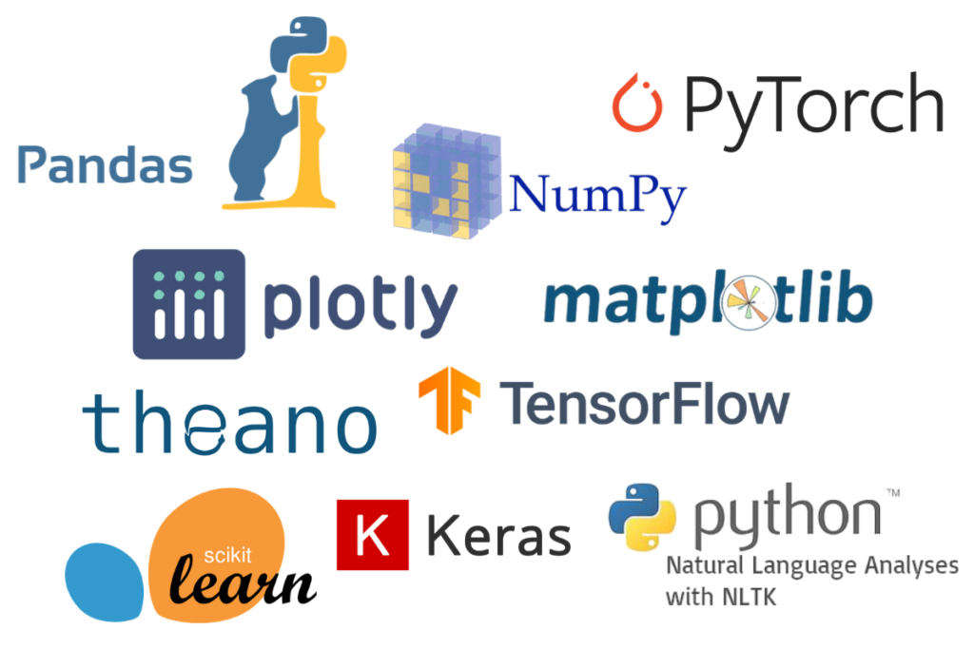

Slide 3

Pandas Role in ML
Collecting Data
Data Cleaning and Data analysis
Transforming and visualizing data
Open source
Built on top of NumPy
Data exploration, Visualization, cleaning
Training Model
Evaluating Model
Testing Model
Install pandas
Pip install pandas
Conda install pandas
!pip install pandas
Prediction

Slide 4
Pandas - DataFrame
Data Structure
Series
Data Frame
Panel
Properties of a DataFrame
DataFrame has 3 different components: data, rows, columns
Two -Dimensional array like structure
Size is mutable
Labelled axes
Values are mutable
Heterogeneous values in different columns
Excel like tables
Notes:
https://stackoverflow.com/questions/54587158/size-immutability-in-pandas-data-structure#:~:text=It%20means%20we%20can%20add,be%20inserted%20into%20a%20DataFrame.%22

Slide 5
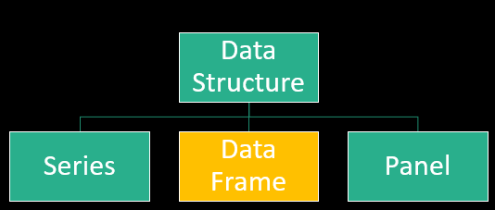
Pandas - DataFrame
Data Frame constructor
pandas.DataFrame( data, index, columns, dtype, copy)
Creating DataFrame(part-1):
Create empty dataframe
From list
From dict of narray/list
Reading from csv file
Creating indexed dataframe
Create DataFrame from list of dicts
Create Dataframe with both row index and column index
Creating DataFrame(advance – not very common):
Create using zip function
From dict of series

Slide 6
Pandas - DataFrame
Importing Datasets in Pandas dataframe:
Importing from csv
Importing from tsv file
Importing from excel file
Reading html file
Many other file formats supported

Slide 7
Pandas - DataFrame
Importing Datasets available options(part-1):
Selecting a single column during import
Rename the columns during Import
Correcting column datatype during Import
Parsing a column as date
Setting the index column
Specify the number of rows to read

Slide 8
Pandas - DataFrame
Importing Datasets available options (part-2):
Handling specific missing values to recognize
Brain Twister : Can you handle both "###" and "\$$$" in one go
Skip blank lines
Skip invalid rows
https://pandas.pydata.org/docs/reference/api/pandas.read_csv.html

Slide 9
Pandas - DataFrame
Analyzing Importing Data:
Checking first 2 and last 4 rows
Check all the headers for the columns
Check the size of the imported data
Check basic statisctical information
Checking the data types for columns

Slide 10
Pandas - DataFrame
Indexing and Selecting data :
Display only selected columns
Selecting a single row using df.loc(by name)
Selecting a single row using iloc(by index)
Select all columns between 2 columns
Selecting some rows and some columns
Select every alternate column
Select columns by index

Slide 11
Pandas - DataFrame
DataFrame Operations:
Load Datasets from sklearn datasets
Add a new column
Rename a column
Assign new columns to a DataFrame. Returns a new object with all original columns in addition to new ones
Pandas - DataFrame Operations (Drop rows)
Drop rows by index number
Drop rows by index range
Pandas - DataFrame Operations (Drop columns)

Slide 12

Thank you !
MLGeeks is a crowdsourced ML teaching group.
All the faculty members and professional with DS/ML academic background.
Applied ML program will be 70% hands with numerous implementation examples and assignments.
For registration or any feedback send details to
mlgeeksinfo@gmail.com
Like, share us on LinkedIn, Twitter, Facebook.

Slide 13

Brain Twister Pandas DataFrame

