Slide 1


Applied Machine Learning
MLGeeks
Pre-Requisites:
- Jupyter notebook or Google Collab
- Basic Python Knowledge( not mandatory)
https://github.com/MLGeeks/MasterClass-Topics/blob/main/Numpy/Numpy_MasterClass_01.ipynb

Slide 2
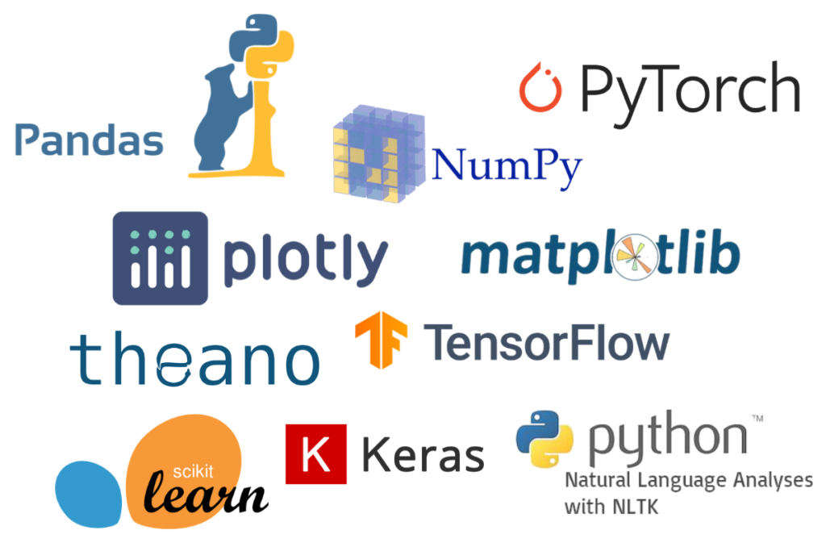

Slide 3
Agenda
Why Numpy ?
Similarity and difference of python list and numpy array
Numpy memory and compute benefits
Numpy array creation
Numpy indexing , array slicing
Numpy datatypes
Numpy array operations
Numpy Copy Vs View
Flattening, join, stacking
Basic match with Numpy
Statistics functions with Numpy
Linear Algebra with Numpy
https://numpy.org/doc/stable/reference/generated/numpy.ndarray.item.html

Slide 4
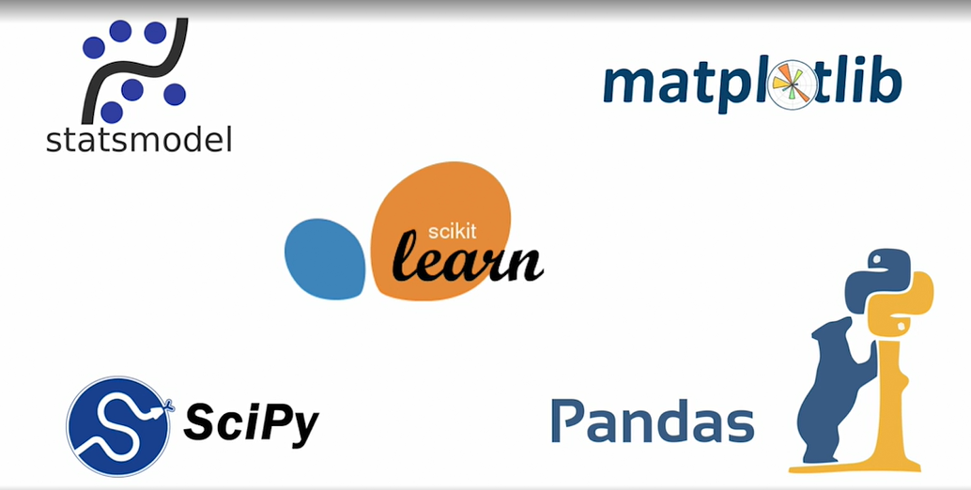
Why Numpy ?
1990 python became popular for programming
Programmers needed faster vector and matrices
Python limitation:
Python list does not support vectorized operations
No fixed type elements(at every iteration data type is checked)
Numpy code is cleaner
Few loops since operations are directly work on vector and matrices
Many ML packages uses numpy as base
Numpy is open source
Numpy basic data structure is “ndarray”
N dimensional array
Notes:
Python was not designed for vector operations

Slide 5
What is Numpy
Numpy = ‘Numerical python’
Array is the central data structure of Numpy library
Numpy uses contiguous memory location

Slide 6
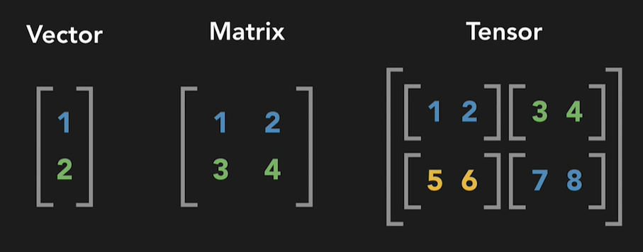
Numpy Multidimensional array

Slide 7
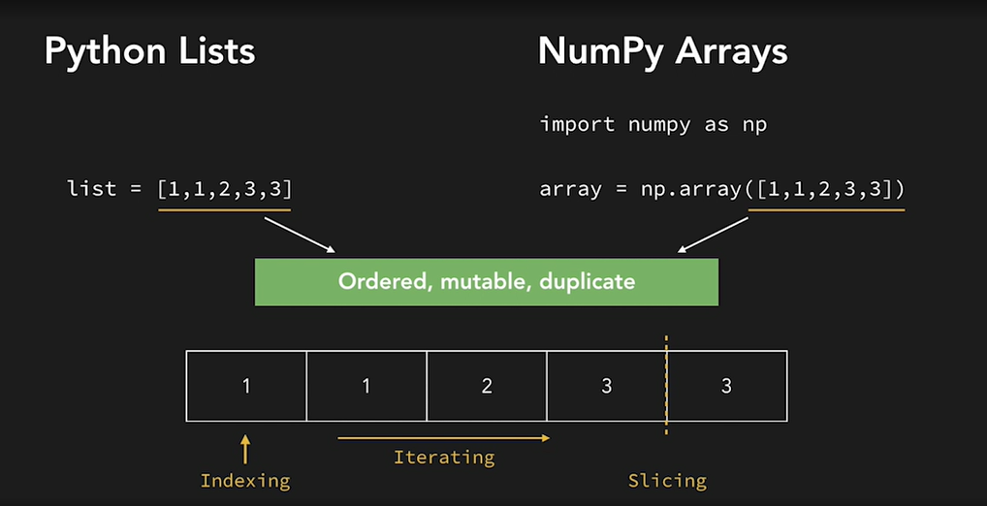
Similarity List and Numpy Array

Slide 8
Difference Python list and numpy array
List is built in data Structure
List can hold elements of different types
List can be expanded
Array must be imported
Import numpy as np
Array can hold elements of same data type
Numpy array cannot be extended once created
Numpy array consume less memory(~6 times less memory than list)
Numpy array are faster
Numpy Arrays are convenient

Slide 9
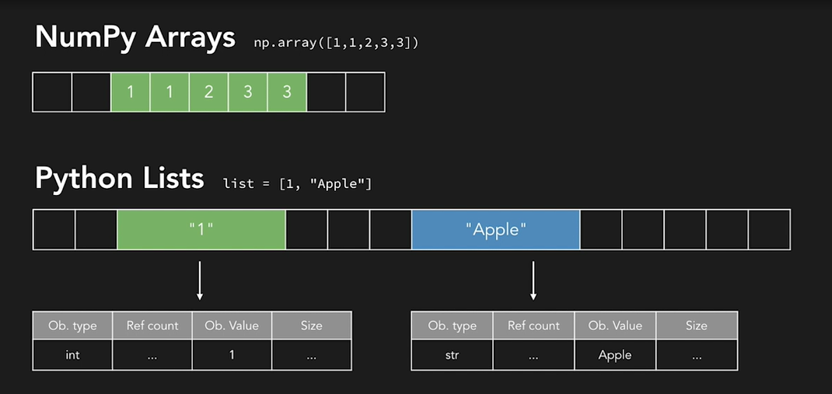
Python list store much more metadata
Backup

Slide 10
Example for faster operations/memory benefits over python list
ToDO
https://github.com/MLGeeks/MasterClass-Topics/blob/main/Numpy/Numpy_MasterClass_01.ipynb
https://github.com/MLGeeks/MasterClass-Topics/blob/main/Numpy/Numpy_PerformanceBenefits(for%20MasterClass).ipynb

Slide 11
Creating numpy arrays
Use a list of tuple to create an array
Check the type after creation of ndarray
Create a 0-D, 1-D, 2-D, 3-D array
Create higher dimensional array(5D)
Numpy array with all
zeros,
ones,
with a constant.
Identity matrix
Creating an array with start value, end value and number of values
With floats
With int
Generate a random int , random float
Array with random values
Array with random int
An array filled with random values(which follows Normal Distribution)
https://github.com/MLGeeks/MasterClass-Topics/blob/main/Numpy/Numpy_MasterClass_01.ipynb

Slide 12
Numpy array indexing
Get first and last element
Accessing last element with -1 index
Access element in 2-D array
Access specific element in 2-D array
Access specific element in 3-D array
https://github.com/MLGeeks/MasterClass-Topics/blob/main/Numpy/Numpy_MasterClass_01.ipynb

Slide 13
Numpy array slicing
We pass slice instead of index : [start:end:step]
Slice elements x to y from array
Slice elements x to <out of index> from array
Slice elements from 2-D array
Slicing from the end of index
Use ‘step” value during slicing
https://github.com/MLGeeks/MasterClass-Topics/blob/main/Numpy/Numpy_MasterClass_01.ipynb

Slide 14
Numpy datatypes
Numpy datatypes
strings - used to represent text data, the text is given under quote marks. e.g. "ABCD"
integer - used to represent integer numbers. e.g. -1, -2, -3
float - used to represent real numbers. e.g. 1.2, 42.42
boolean - used to represent True or False.
complex - used to represent complex numbers. e.g. 1.0 + 2.0j, 1.5 + 2.5j
NumPy array object has a property called dtype that returns the data type of the array
Forcing a datatype during creation
Converting datatype of existing array

Slide 15
Numpy array operations
# of dimension, shape, size
Itemsize, nbytes,
Ndarray.T, asarray, expand_dims,
Reshape, Unknown dimension
Numpy copy vs View
Flattening numpy array

Slide 16
Basic math with Numpy
Adding scalar to numpy array
Adding two numpy arrays (1-D, 2-D)
Subtract two numpy arrays
Multiply two numpy arrays
Sum() for rows and columns
Cumulative sum for rows & columns
Minimum and Maximum value from an array
Logarithmic functions

Slide 17
Statistics functions in Numpy
Mean, median, mode
Variance and Std deviation
Percentile
Co-relation coefficient

Slide 18
Linear Algebra with Numpy
Vector transpose
Vector addition, subtraction
Vector scalar product
Vector dot product
Vector cross product

Slide 19

Thank you !
MLGeeks is a crowdsourced ML teaching group.
All the faculty members and professional with DS/ML academic background.
Applied ML program will be 70% hands with numerous implementation examples and assignments.
For registration or any feedback send details to
mlgeeksinfo@gmail.com
Like, share us on LinkedIn, Twitter, Facebook.

Slide 20
References
Cheat sheet :
https://github.com/MLGeeks/MasterClass-Topics/blob/main/Numpy/Numpy_CheatSheet.pdf
PPT:
https://github.com/MLGeeks/MasterClass-Topics/blob/main/Numpy/Numpy_MasterClass_MLGeeks_v1.pptx
Notebooks:
https://github.com/MLGeeks/MasterClass-Topics/blob/main/Numpy/Numpy_MasterClass_01.ipynb
https://github.com/MLGeeks/MasterClass-Topics/blob/main/Numpy/Numpy_PerformanceBenefits(for%20MasterClass).ipynb

