Slide 1

Applied Machine Learning
MLGeeks
Master Class (Absolutely Free !)

Slide 2

Agenda
Applications & Future of machine learning
Types of machine learning
Build a simple regression model
Build a simple CNN image detection model - Manish
Challenges for Machine Learning
Learning Roadmap for machine learning
What you should know to learn machine learning
Free resources ( you tube playlist, Books, Github profiles, Podcast )
Pitch our classes for registration
70% applied machine learning, lots of assignments and hands-on practice
References
Hands on
Brain Twister/s

Slide 3
QNA
No unmute unless told
Add your question QnA
Later co-Ordinator would pick them

Slide 4
Logistics
Google collabs or download Jupyter
Masterclass will not be recorded; you can attend next session in case you miss it today
Send request to : mlgeeksinfo@gmail.com
Participants create a GitHUB account (optional)
https://github.com/MLGeeks/DS-ML-Repo

Slide 5
Lets start with some motivation (while others join)
https://www.youtube.com/watch?v=d_ahOQIvPLk

Slide 6
Internal – Logistics
We need a coordinator along with host:
Introduce the session and host
Look at the chats and enable any stuck participants
Share the survey link
Close the session
We will do it on google meet (since it is free)
Zoom session :
Send me the zoom
Time: 10.30 -12.00 ( 1 hr + 15 min for QnA )
Evening: 7 – 8.15 PM
Create a survey link right before the meeting end
Create Github link for ML geeks .
Linkedin accounts for ML geeks
Check Facebook account

Slide 7
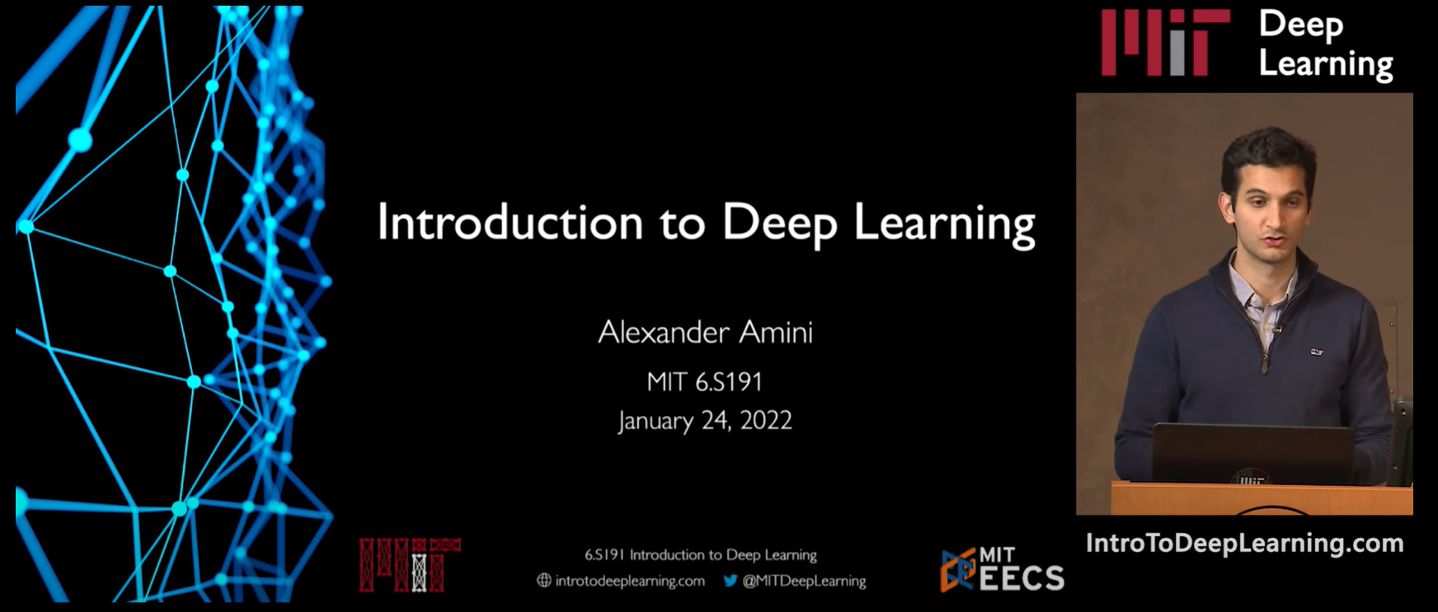
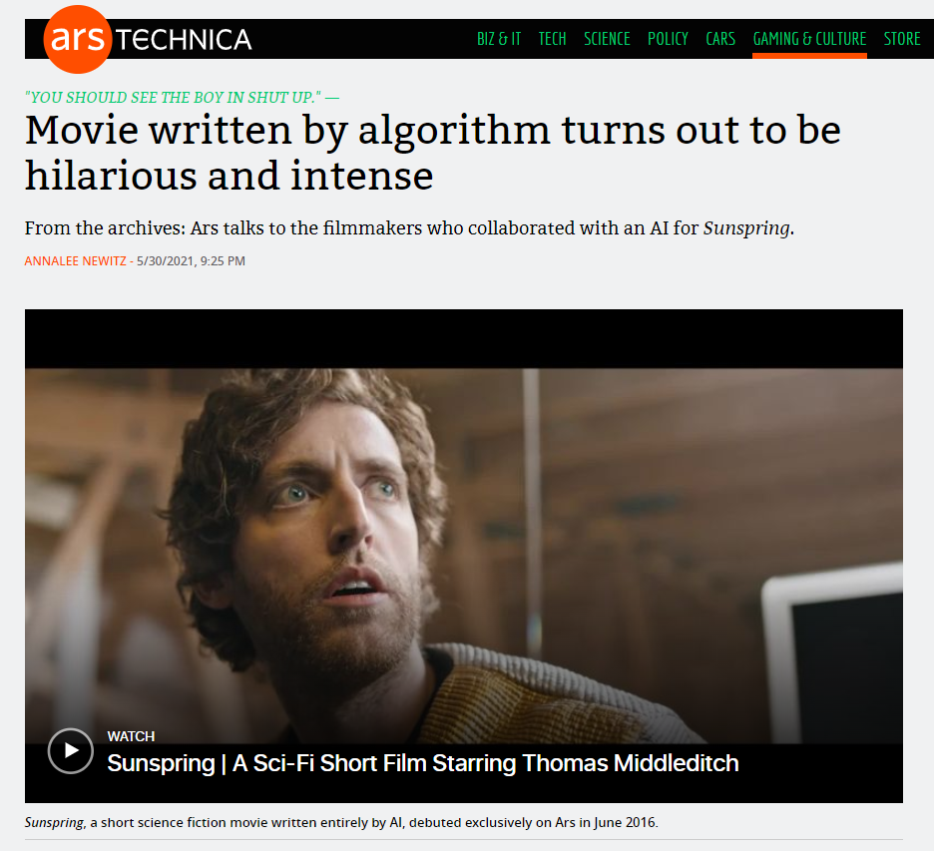
Application of Machine Learning
Let's see some powerful examples
VideoLink
https://teachablemachine.withgoogle.com/v1/
https://www.youtube.com/watch?v=6Mhd8KKHSpo
Movie script written by AI
VideoLink
Notes:
Start @ 1:36 , Stop 2: 27

Slide 8
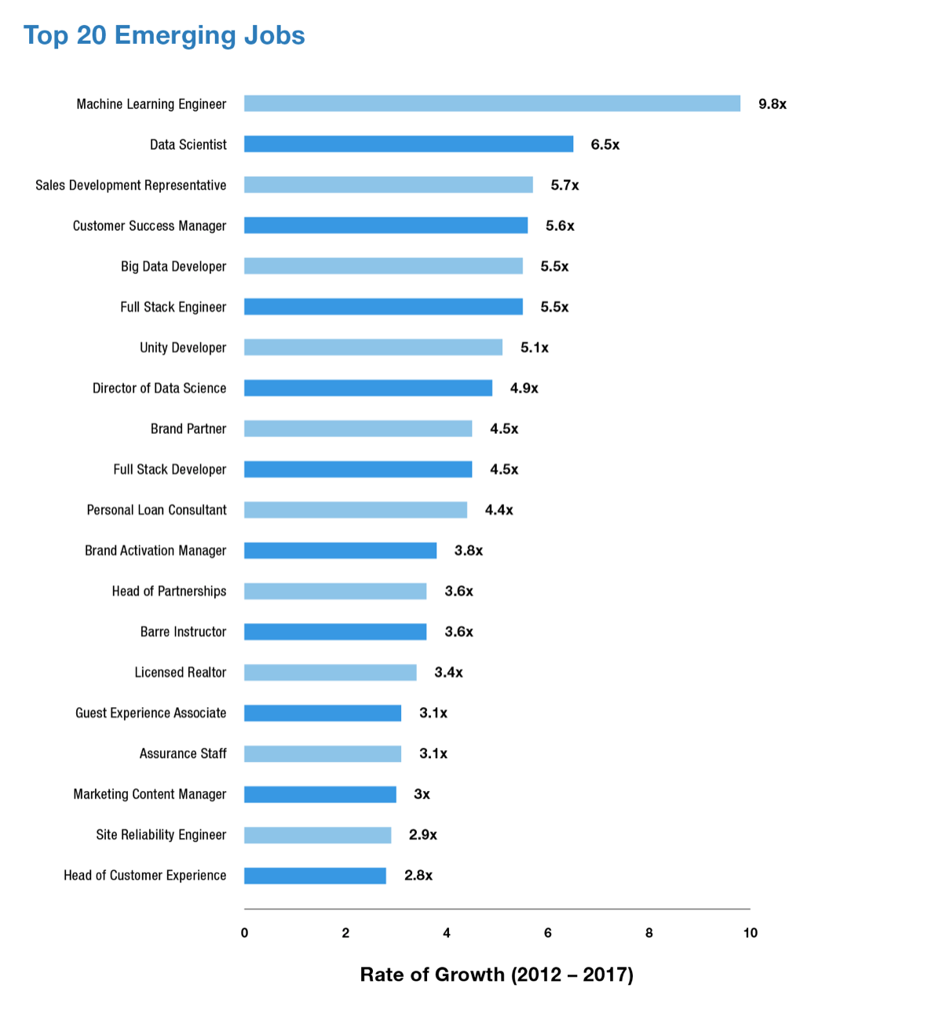
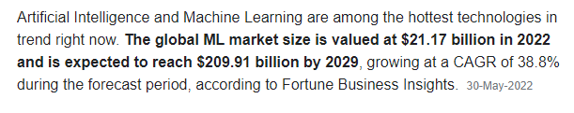
Future of Machine Learning

Slide 9
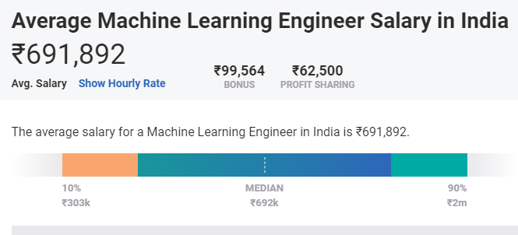
Future of Machine Learning

Slide 10
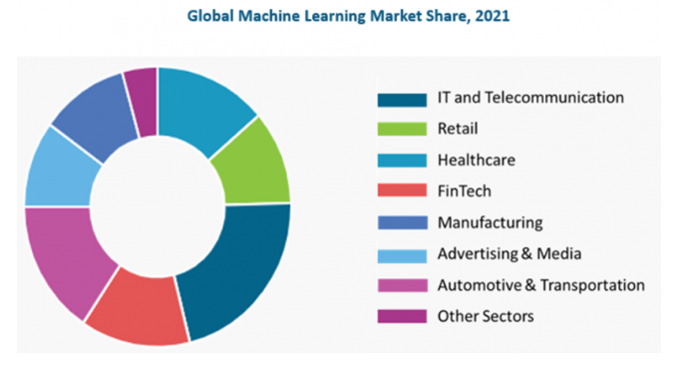
Industries disrupted by Machine Learning
HealthCare:
Disease Prediction : Based on patient's demographics, health records.
Drug Discovery: Speeds up drug testing time.
Medical Image diagnosis: Deep learning and computer vision
FinTech:
Fraud Detection
Loan automation

Slide 11
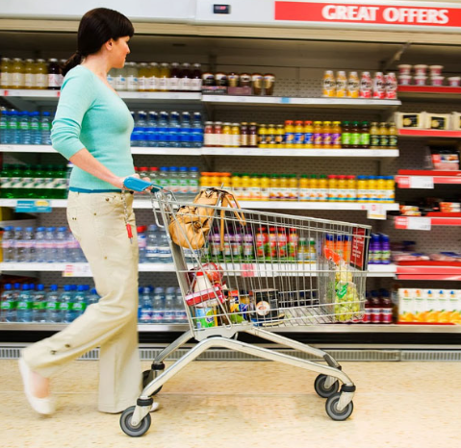
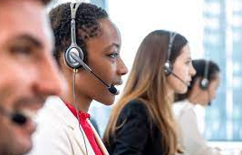
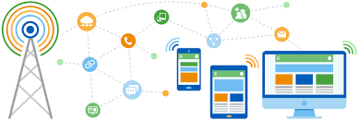
Industries disrupted by Machine Learning
Retail:
Customer Segmentation
Churn Prediction
Customer Service:
Chatbots
IT and Telecom:
Predictive maintenance
Demand prediction
Churn prediction

Slide 12
Can you identify other applications for machine learning?
Notes:
Email spam detection
Loan approvals
Self driving cars

Slide 13
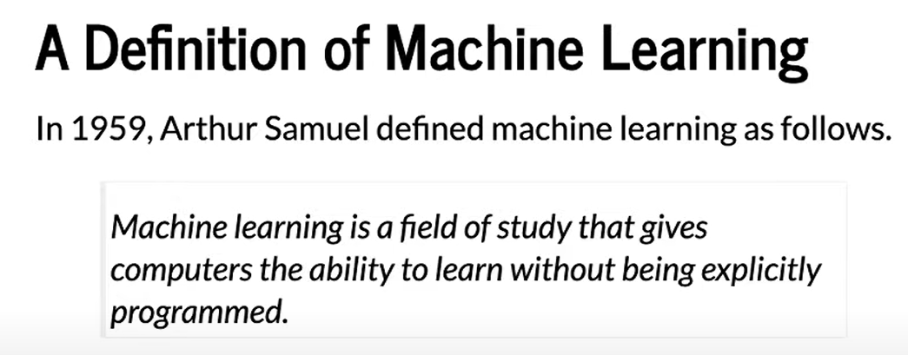
Definition

Slide 14
Machine Learning types : Based on amount of supervision needed
Regression
Supervised
Classification
Clustering
Types of ML
Dimensionality reduction
Unsupervised
Anomaly detection
Semi supervised
Association rule learning
Reinforcement

Slide 15
Supervised Learning
Regression
If you have input and output and the task is to find the relation between input and output.
Simple example:
Supervised
Classification
Clustering
IQ | CGPA | Placement
87 | 7.1 | Y
111 | 8.9 | Y
75 | 6.3 | N
Types of ML
Dimensionality reduction
Unsupervised
Anamoly detection
Semi supervised
Association rule learning
Reinforcement

Slide 16
Classification Vs Regression
IQ | CGPA | Placement
87 | 7.1 | Y
111 | 8.9 | Y
75 | 6.3 | N
Classification
Yes/No
Supervised ML
Regression
Continuous type
IQ | CGPA | Package
87 | 7.1 | 10L
111 | 8.9 | 15L
75 | 6.3 | 17.5L

Slide 17
Side Topic: Data Types
Gender
Nominal
Nation
Categorical
First, second
Ordinal
Data types
High, medium, low
Height
Numerical
Weight
Cost

Slide 18
Brain-twister
How much will it rain today ?
Classification ? Regression?
Will it rain today ?
Classification ? Regression ?
If a dogs is present in an image ?
Classification ? Regression?
How many dogs in an image
Classification ? Regression?
Notes:
If It is a number – Regression, if it is a category – Classification
Classification can have more than 2 classes ( like # detection)

Slide 19
Unsupervised
Regression
Generally, the output is one of these four things:
Clustering
Dimensionality reduction
Anomaly detection
Association rule learning
Supervised
Classification
Clustering
Types of ML
Dimensionality reduction
Unsupervised
Anamoly detection
Semi supervised
Association rule learning
Reinforcement

Slide 20
Unsupervised learning - Clustering
Clustering
Ex1:
Plot the student data on a coordinate system
We can now label the students based on clusters
Other examples:
Customer segmentation
Student data
Notes:
Clustering can take high dimensional data and generate cluster.
Customer segmentation and later come with business plans to retain or on

Slide 21
Unsupervised learning – Dimensionality reduction
T-SNE with MNIST
100s or 1000s of input column
Model performance will be slow
Highly dimensionality data cannot be visualized ?
Eg:
MNIST data set is ~ 784 dimension( 28 X 28)
T-SNE helps to reduce the dimension to 3 dimension which can now be visualized
Youtube:
https://www.youtube.com/watch?v=-bijVUtFCm4
Implementation:
https://github.com/deveshSingh06/t-SNE/blob/master/t-SNE%20Implementation.ipynb
Notes:
Clustering can take high dimensional data and generate cluster.
Customer segmentation and later come with business plans to retain or on

Slide 22
Unsupervised learning – Anomaly detection
Find anomalous pattern
Loan approval
Manufacturing
Software logs
User logins and log out
Security logs etc.
heat
vibration

Slide 23
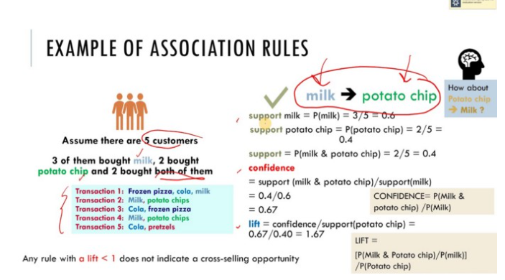
Unsupervised learning – Association rule based learning
Eg: Amazon recommendation of related products
Looks at the bills and identify patterns and may be place these items together or provide discounts together
Interesting case study:
https://medium.com/@kirk.borne/association-rule-mining-not-your-typical-ml-algorithm-97acda6b86c2#:~:text=If%20there%20was%20no%20association,diaper%20purchasers%20also%20buy%20beer.
Notes:
Only machine learning can find such patterns

Slide 24
ML types : Based on amount of supervision needed
Regression
When the cost of labelling the data is high.
The idea is to generate partially labelled data and use it to label other non labelled data.
Eg: Facebook if you label one image al other images with your pics will get labelled.
Google Photos cluster photos (without knowing the label) and once you label one image all other pictures are labelled.
Supervised
Classification
Clustering
Types of ML
Dimensionality reduction
Unsupervised
Anamoly detection
Semi supervised
Association rule learning
Reinforcement

Slide 25
Reinforcement Learning
Regression
No labelled data.
Learn and improve
Maximize the rewards
Robots
Chess game
Self driving cars
Deep mind – Alpha Go
Supervised
Classification
Clustering
Types of ML
Dimensionality reduction
Unsupervised
Anamoly detection
Semi supervised
Association rule learning
Reinforcement

Slide 26
Build a Simple Regression model
Create a model which can predict Salary based on years of experience.
Supervised machine learning
Is it Classification ? Regression ?
Dataset:
Experience and Salary provided for ~30 professionals

Slide 27
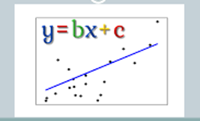
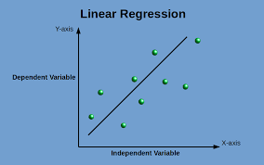
Building Simple Regression model
What is the difference between a “Algorithm” and a “Model”
ML_Training_simple_linear_regression.ipynb
https://github.com/MLGeeks/MasterClass/tree/main/Build_Simple_RegressionModel
Salary_Data.csv

Slide 28
CNN – enabling Computer Vision
Computer Vision had and will transform many applications:
From logistics
Self driving cars
Facebook
Threat control
How does a computer recognize an Image ?

Slide 29
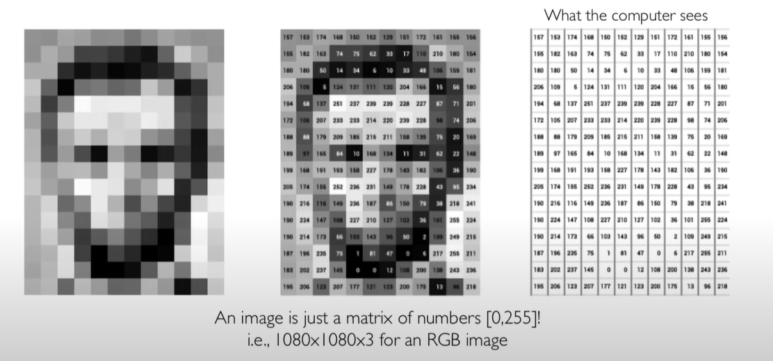
Image representation
RGB

Slide 30
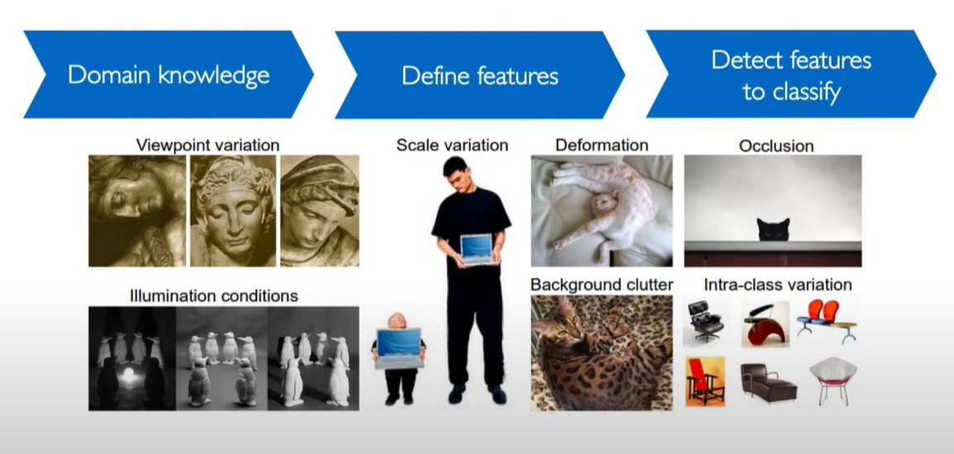
Challenges for Image detection

Slide 31
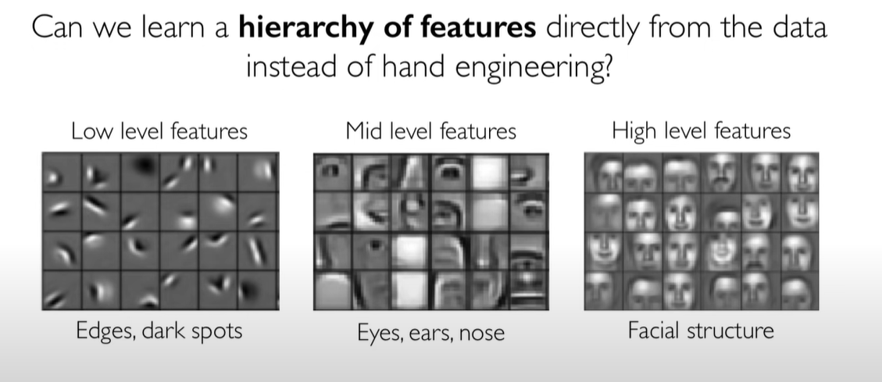
Approach

Slide 32
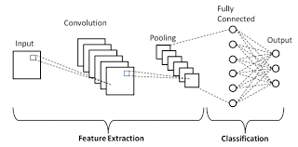
Build an Image detection model
CNN layers (can also be referred as computer vision)

Slide 33
Challenges in Machine Learning
Complexities with Data:
Amount of data for training : often times, there aren't enough data available for building models.
Quality of data: Often while building models, amount of data is not sufficient , has lots of noise, is not clean, has missing values etc. This part consumes about 80% of time.
Model Deployment :
Given the tech stack which a company uses, deploying models built in python/pandas could be challenge too.
Managing and stabilizing Models :
Understanding results, running health checks, monitoring model performance, watching out for data anomalies, and retraining the model
Configuring Environments:
While building models, first and foremost step is to configure suitable environment which takes up another effort of data scientists.
Over the period of time, libraries / environment changes which leads to upgrading all relevant libraries for a model to run successfully.

Slide 34
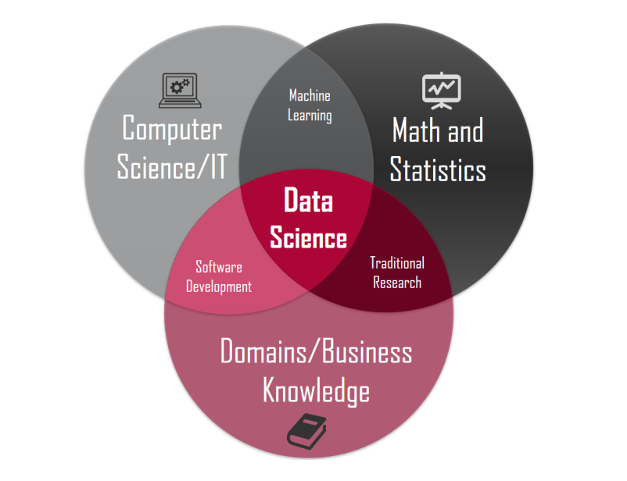
(self)Learning RoadMap
If you want to learn ML or DS concepts on your own, then below the things to focus on:
Maths and Stats
Programming with Python
Database and SQL
Data Analysis and simple Visualization
Supervised Machine Learning
Unsupervised Machine Learning
Advanced ML Concepts
Tensorflow
Deep Learning
NLP
Productionizing
Note : Practice as much as you can . Kaggle is one of the best source to start from.

Slide 35
Feedback survey
How was the content ?
What would you like to see more ?
Would you like to consider joining 3-month sessions( 4hrs/week) on weekends ?
What time will work for you for weekend sessions ?

Slide 36

How can MLGeeks help !
MLGeeks is a crowdsourced Machine learning teaching group.
All the faculty members are professionals with DS/ML academic background.
“Applied ML program” from MLGeeks will be 70% hands-on with numerous implementation examples and assignments.
Sessions to review assignments and quizzes.
Doubts resolution support over Whatsapp or something similar.
Capstone project at the end of the session.

Slide 37
Brain Twister
<add some question>
Create a form on Google forms

Slide 38
References
G drive link for all ML geek resources
Slides, model and input files
Create a Github account with geeksML
Share all the master class collateral
For registration send details to
mlgeeksinfo@gmail.com
Like, share us on LinkedIn, Twitter, Facebook.
Create LinkedIn account for MLGeeks and do one post for master class
Give the link to student, share comments on Linked in

