Slide 1

Applied Machine Learning
MLGeeks
Master Class (Sep 2022)

Slide 2

Agenda
Applications & Future of machine learning
Types of machine learning
Build a simple regression model
Build a simple CNN image detection model
Challenges for Machine Learning
Learning Roadmap for machine learning
What you should know to learn machine learning
Free resources ( you tube playlist, Books, GitHub profiles, Podcast )
Brain Twister (Interesting quiz)
How MLGeeks can help with you ML journey
70% applied machine learning, lots of assignments and hands-on practice
References
Hands on
Brain Twister/s

Slide 3
Logistics
Please keep you line on mute, you can ask questions over chat and our coordinator will pick them up in QnA slot
Please keep your videos off, will save network bandwidth
If any of your question is unanswered, please ask them after the session, another 15 min is dedicated for QnA
For anything else please send a note to mlgeeksinfo@gmail.com
GitHub link for ppt and jupyter notebooks available at :
https://github.com/MLGeeks/MasterClass
Please fill the survey before the end of master class:
https://tinyurl.com/mlclassurvey

Slide 4
Lets start with some motivation (while others join)
https://www.youtube.com/watch?v=d_ahOQIvPLk

Slide 5
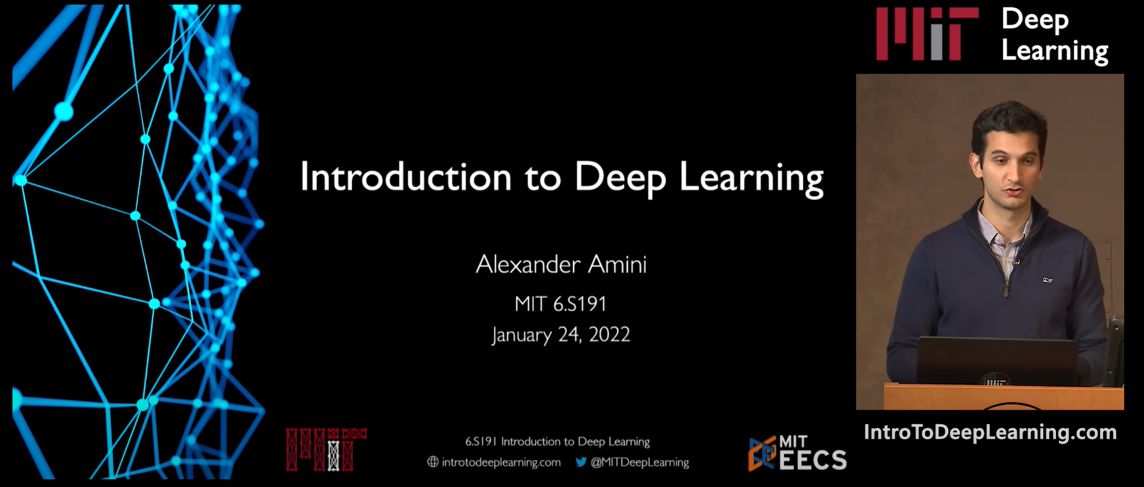
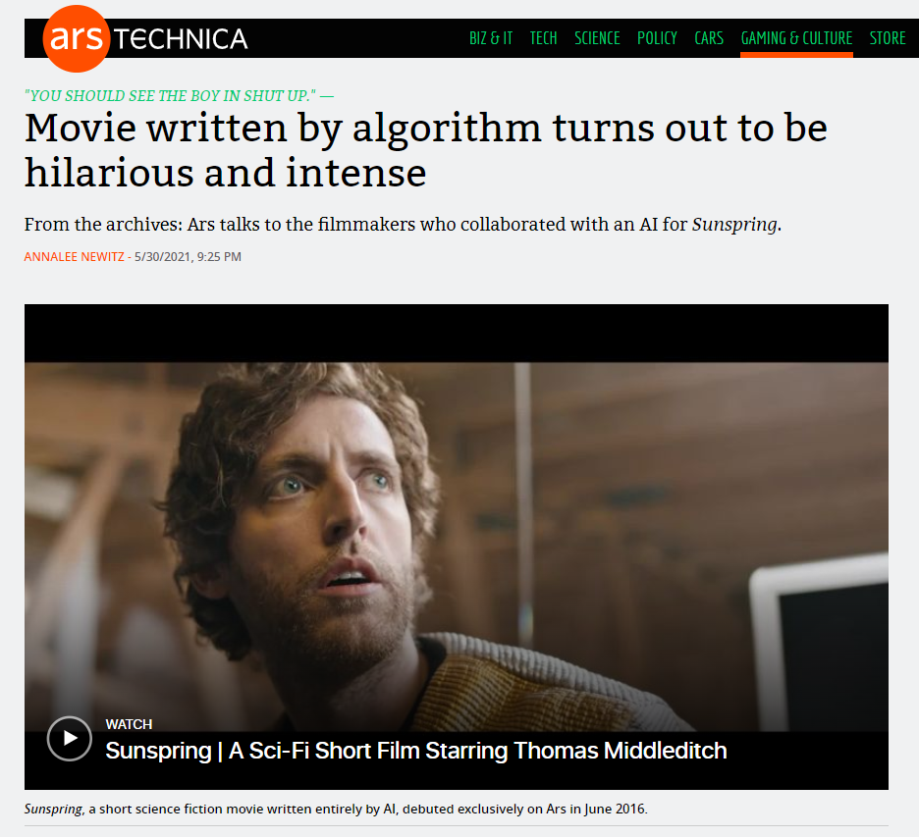
Application of Machine Learning
Let's see some powerful examples:
VideoLink
Movie script written by AI
VideoLink
Try tit yourself:
https://teachablemachine.withgoogle.com/v1/
Notes:
Start @ 1:36 , Stop 2: 27
0:19

Slide 6
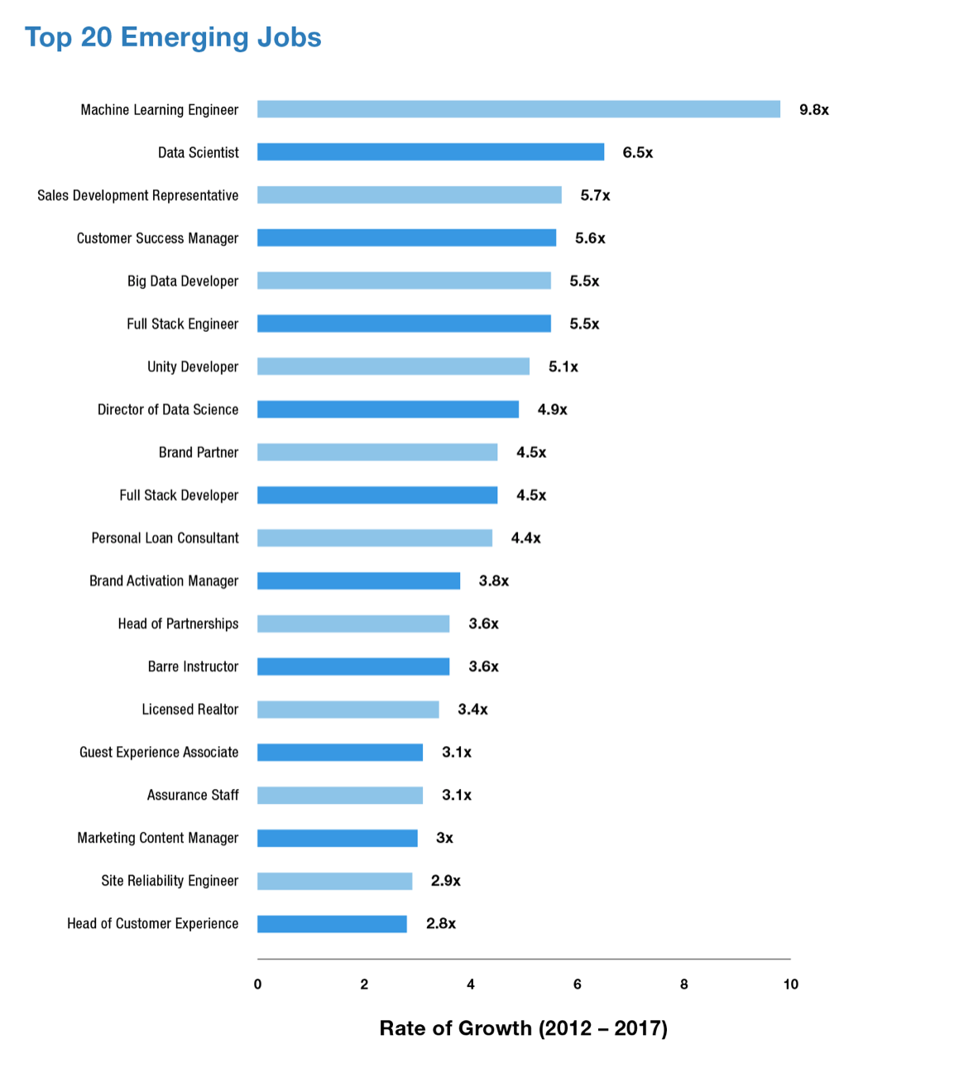
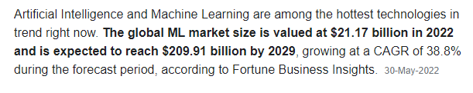
Future of Machine Learning

Slide 7
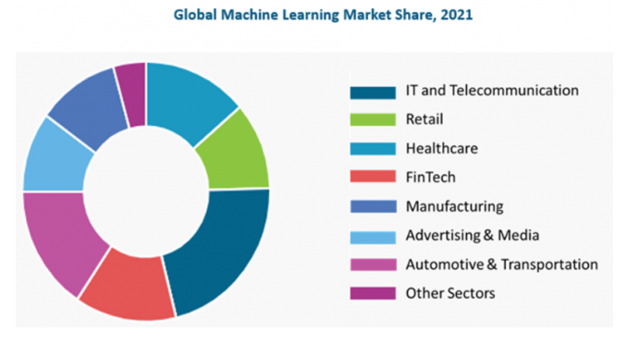
Industries disrupted by Machine Learning
HealthCare:
Disease Prediction : Based on patient's demographics, health records.
Drug Discovery: Speeds up drug testing time.
Medical Image diagnosis: Deep learning and computer vision
FinTech:
Fraud Detection
Loan automation

Slide 8



Industries disrupted by Machine Learning
Retail:
Customer Segmentation
Churn Prediction
Customer Service:
Chatbots
IT and Telecom:
Predictive maintenance
Demand prediction
Churn prediction

Slide 9
Can you identify other applications for machine learning?
Notes:
Email spam detection
Loan approvals
Self driving cars

Slide 10
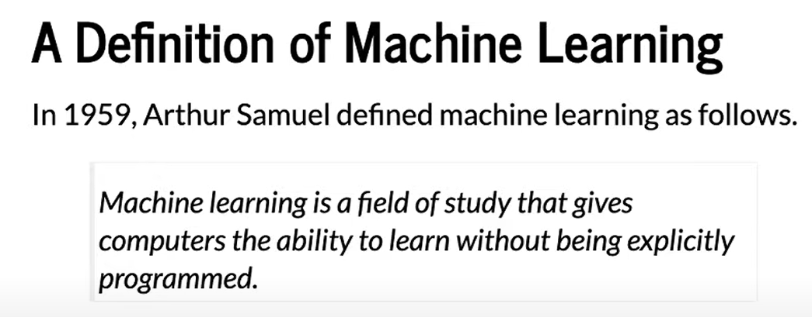
Definition
A computer program is said to learn from experience E with respect to some class of tasks T and performance measure P, if its performance at tasks in T, as measured by P, improves with experience E.

Slide 11
Machine Learning types : Based on amount of supervision needed
Regression
Supervised
Classification
Clustering
Types of ML
Dimensionality reduction
Unsupervised
Anomaly detection
Semi supervised
Association rule learning
Reinforcement

Slide 12
Supervised Learning
Regression
If you have input and output and the task is to find the relation between input and output.
Simple example:
Supervised
Classification
Clustering
IQ | CGPA | Placement
87 | 7.1 | Y
111 | 8.9 | Y
75 | 6.3 | N
Types of ML
Dimensionality reduction
Unsupervised
Anamoly detection
Semi supervised
Association rule learning
Reinforcement

Slide 13
Supervised - Classification Vs Regression
IQ | CGPA | Placement
87 | 7.1 | Y
111 | 8.9 | Y
75 | 6.3 | N
Classification
Yes/No
Supervised o/p
Regression
Continuous type
IQ | CGPA | Package
87 | 7.1 | 10L
111 | 8.9 | 15L
75 | 6.3 | 17.5L

Slide 14
Unsupervised
Regression
Generally, the output is one of these four things:
Clustering
Dimensionality reduction
Anomaly detection
Association rule learning
Supervised
Classification
Clustering
Types of ML
Dimensionality reduction
Unsupervised
Anamoly detection
Semi supervised
Association rule learning
Reinforcement

Slide 15
Unsupervised learning - Clustering
Clustering
Ex1:
Plot the student data on a coordinate system
We can now label the students based on clusters
Other examples:
Customer segmentation
Student data
Notes:
Clustering can take high dimensional data and generate cluster.
Customer segmentation and later come with business plans to retain or on

Slide 16
Unsupervised learning – Dimensionality reduction
T-SNE with MNIST
100s or 1000s of input column
Model performance will be slow
Highly dimensionality data cannot be visualized ?
Eg:
MNIST data set is ~ 784 dimension( 28 X 28)
T-SNE helps to reduce the dimension to 3 dimension which can now be visualized
Youtube:
https://www.youtube.com/watch?v=-bijVUtFCm4
Implementation:
https://github.com/deveshSingh06/t-SNE/blob/master/t-SNE%20Implementation.ipynb
Notes:
Clustering can take high dimensional data and generate cluster.
Customer segmentation and later come with business plans to retain or on

Slide 17
Unsupervised learning – Anomaly detection
Find anomalous pattern
Loan approval
Manufacturing
Software logs
User logins and log out
Security logs etc.
heat
vibration

Slide 18
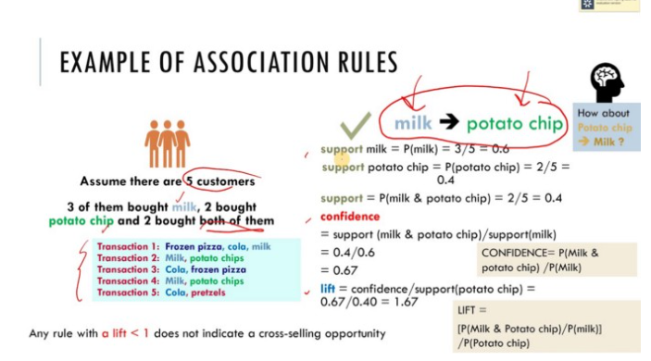
Unsupervised learning – Association rule-based learning
Eg: Amazon recommendation of related products
Looks at the bills and identify patterns and may be place these items together or provide discounts together
Interesting case study:
https://medium.com/@kirk.borne/association-rule-mining-not-your-typical-ml-algorithm-97acda6b86c2#:~:text=If%20there%20was%20no%20association,diaper%20purchasers%20also%20buy%20beer.
Notes:
Only machine learning can find such patterns

Slide 19
ML types : Based on amount of supervision needed
Regression
When the cost of labelling the data is high.
The idea is to generate partially labelled data and use it to label other non labelled data.
Eg: Facebook if you label one image al other images with your pics will get labelled.
Google Photos cluster photos (without knowing the label) and once you label one image all other pictures are labelled.
Supervised
Classification
Clustering
Types of ML
Dimensionality reduction
Unsupervised
Anamoly detection
Semi supervised
Association rule learning
Reinforcement

Slide 20
Side Topic: Data Types
Gender
Nominal
Nation
Categorical
First, second
Ordinal
Data types
High, medium, low
Height
Numerical
Weight
Cost

Slide 21
Reinforcement Learning
Regression
No labelled data.
Learn and improve
Maximize the rewards
Robots
Chess game
Self driving cars
Deep mind – Alpha Go
Supervised
Classification
Clustering
Types of ML
Dimensionality reduction
Unsupervised
Anamoly detection
Semi supervised
Association rule learning
Reinforcement

Slide 22
Brain-twister
How much will it rain today ?
Classification ? Regression?
Will it rain today ?
Classification ? Regression ?
If a dogs is present in an image ?
Classification ? Regression?
How many dogs in an image
Classification ? Regression?
? Any other quick question ?
Notes:
If It is a number – Regression, if it is a category – Classification
Classification can have more than 2 classes ( like # detection)

Slide 23
Build a Simple Regression model
Pre-requisite:
Google Collab
Or Jupyter notebook
Create a model which can predict Salary based on years of experience.
Supervised machine learning
Is it Classification ? Regression ?
Dataset:
Experience and Salary provided for ~30 professionals

Slide 24
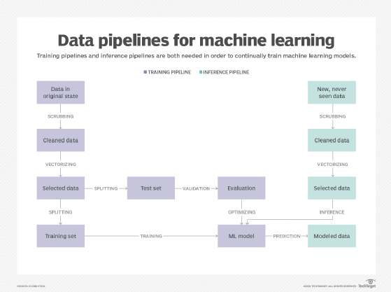
Courtesy: TechTarget

Slide 25
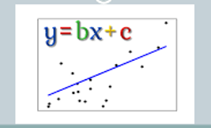
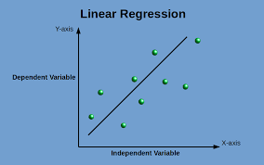
Building Simple Regression model
What is the difference between a “Algorithm” and a “Model”
ML_Training_simple_linear_regression.ipynb
https://github.com/MLGeeks/MasterClass/tree/main/Build_Simple_RegressionModel
Salary_Data.csv

Slide 26
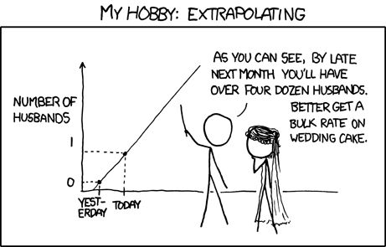
Beware!

Slide 27
CNN – enabling Computer Vision
Computer Vision had and will transform many applications:
Logistics
Self driving cars
Facebook
Threat control
How does a computer recognize an Image ?
https://github.com/MLGeeks/MasterClass/tree/main/CNN_Image_detection

Slide 28
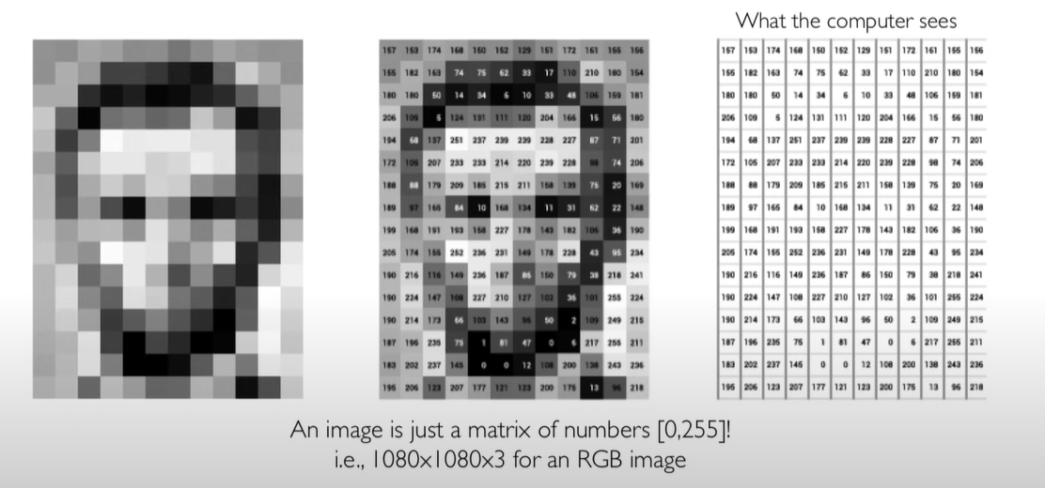
Image representation
RGB

Slide 29
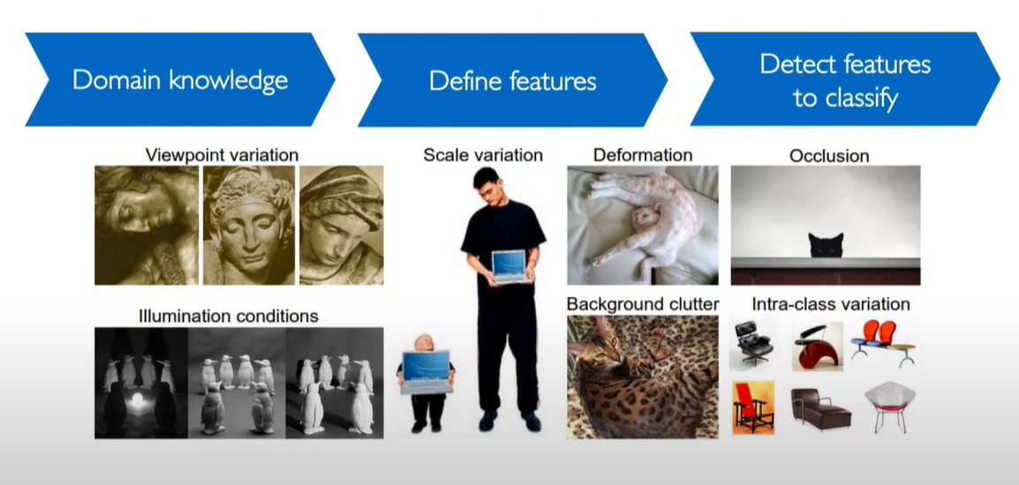
Challenges for Image detection

Slide 30
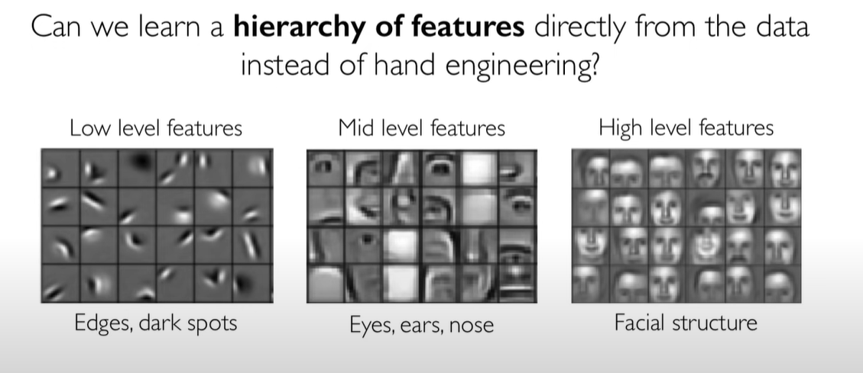
Approach

Slide 31
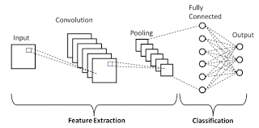
Build an Image detection model
CNN layers (can also be referred as computer vision)

Slide 32
Challenges in Machine Learning
Complexities with Data:
Amount of data for training : often times, there aren't enough data available for building models.
Quality of data: Often while building models, amount of data is not sufficient , has lots of noise, is not clean, has missing values etc. This part consumes about 80% of time.
Model Deployment :
Given the tech stack which a company uses, deploying models built in python/pandas could be challenge too.
Managing and stabilizing Models :
Understanding results, running health checks, monitoring model performance, watching out for data anomalies, and retraining the model
Configuring Environments:
While building models, first and foremost step is to configure suitable environment which takes up another effort of data scientists.
Over the period of time, libraries / environment changes which leads to upgrading all relevant libraries for a model to run successfully.

Slide 33
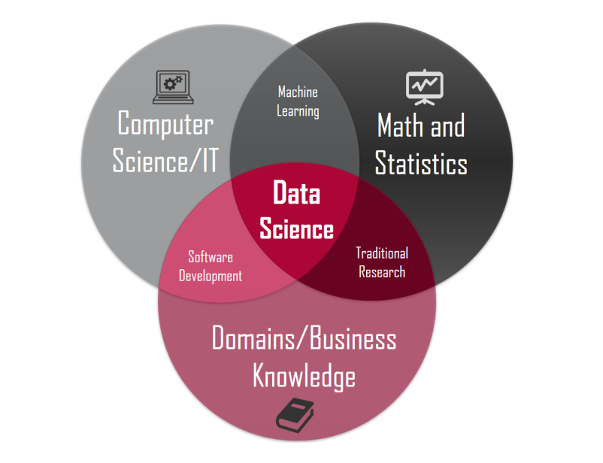
(self)Learning RoadMap
If you want to learn ML or DS concepts on your own, then below the things to focus on:
Math's and Stats
Programming with Python
Database and SQL
Data Analysis and simple Visualization
Supervised Machine Learning
Unsupervised Machine Learning
Advanced ML Concepts
TensorFlow
Deep Learning
NLP
Productionizing
Note : Practice as much as you can . Kaggle is one of the best source to start from.

Slide 34
(free)Learning Resources
Topic | Link
Statistics Fundamental(StatQuest) | Statquest-Youtube
Essentials of Linear Algebra(3Blue1Brown) | 3Blue1Brown-Youtube
Basics of Machine Learning(StatQuest Youtube playlist) | StatQuest-Youtube-ML
Machine lecture by Prof. Kilian Weinberger(University of Cornell) | University of Cornell - YouTube
Introduction to Deep Learning MIT | MIT DeepLearning - YuoTube
Watch out for MLGeeksGitHub Repo

Slide 35
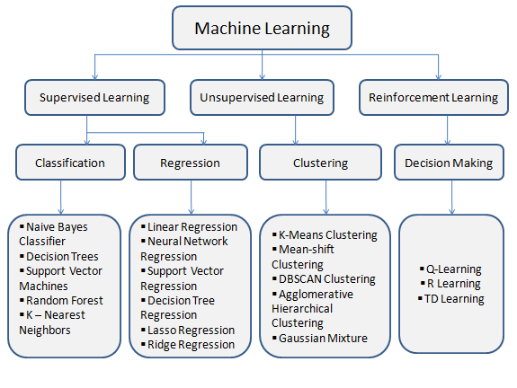
Different Models

Slide 36
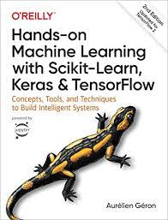
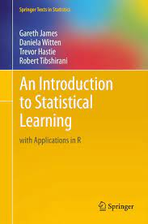
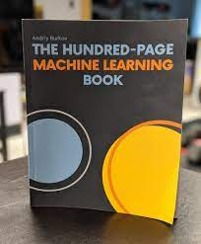
Books

Slide 37
Other thoughts ?
How much time will it take for me to learn ML – Typically 6 – 12 month
How much time/week – Consistently 8-10 hrs
How much Math should I know: Not much, if you refresh basics on linear algebra, you should be good building models.
How much stats should I know : Not much, refresh your basics. Many python and ML libraries abstracts statistical methods

Slide 38
Feedback survey
https://tinyurl.com/mlclassurvey

Slide 39

How can MLGeeks help !
MLGeeks is a crowdsourced Machine learning teaching group.
All the faculty members are professionals with DS/ML academic background.
“Applied ML program” from MLGeeks will be 70% hands-on with numerous implementation examples and assignments.
Sessions to review assignments and quizzes.
Doubts resolution support over WhatsApp or something similar.
Capstone project at the end of the session.

Slide 40
Brain Twister
https://tinyurl.com/mlbraintwister

Slide 41
References
GitHub Link:
https://github.com/MLGeeks/MasterClass
LinkedIn post (Like it, if you enjoyed the session)
LinkedIn Profile
For 3-month program registration send details to
mlgeeksinfo@gmail.com
The program is absolutely FREE

