Slide 1
Data Visualization and Storytelling
Day 1 Exercise Session
Jacob Curran-Sebastian

Slide 2
Getting started in R
If you haven’t already installed R and Rstudio, you need to do this first – follow the installation guide given in the folder ‘Day1’
We won’t stop you if you want to do these exercises in Python or another language!
Open the Rmarkdown file ‘day1_exercises.Rmd’, or you can open ‘day0_exercises.Rmd’ if you want to brush up on your R skills.
Set your working directory to the folder in which you are working.

Slide 3
European Quality of Life Survey Dataset
One of the datasets we will be working with in this course is the European Quality of Life Survey.
This survey asks participants a range of questions about their quality of life, ranging from health to economic status and social integration.
The data that we have comes from two years of the survey, 2007 and 2011.
Information about the responses to the surveys can be found in the text file eqls_2007and2011_ukda_data_dictionary.rtf.

Slide 4
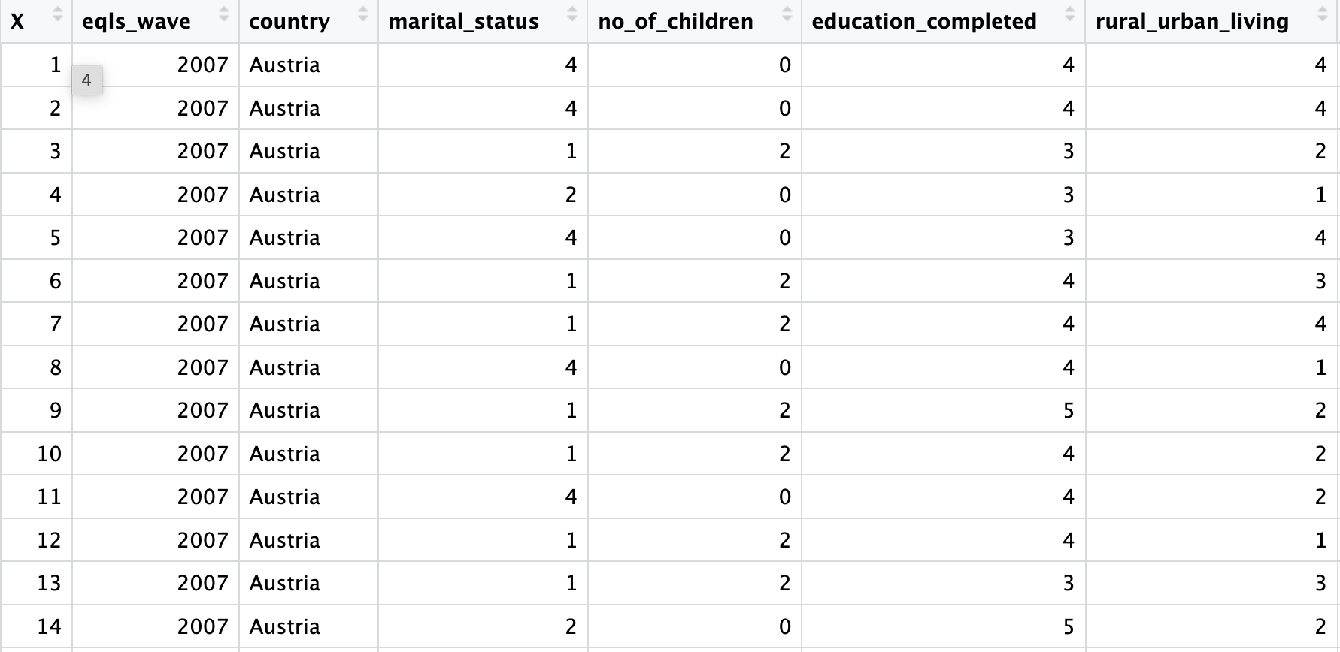

Slide 5
Exercises
Start working through the initial exercises in day1_exercises.rmd. Check that you can run the initial line by setting your working directory.
Then, load all of the libraries that you will be using for these exercises. Certainly we will be using ‘dplyr’ and ‘ggplot2’ – if you are familiar with any other packages and want to use these, go ahead!
Then, you can start working on the exercises in any order. Some have specific solutions, whereas others are more open-ended.

Slide 6
Looking ahead
At the end of the week, we will ask people to present a figure that they are particularly happy with to the group.
This figure may look particularly nice, it may have required an interesting way of visualising the data, or it may tell an intriguing story.
Have a think about this as you go through the exercises – the EQLS may provide a good dataset to present visualisations from!

Slide 7
Over to you!

