Slide 1

Data Visualisation and Storytelling
Exploratory Data Analysis
KC
09.2023
Notes:
##-AccessibilityAssistant: Skip layout check-##

Slide 2
Overview
Exploratory Data Analysis
Mean and Standard Deviation Plots
Outlier Detection
Boxplots, Pair Plots
Distributions

Slide 3
What puts handbrakes in your research?
Notes:
Poll
Answer I am looking for- delays with the data

Slide 5
Delays with the Data
Notes:
First instinct would be to start working with the analysis immediately

Slide 6
Why is Exploratory Data Analysis (EDA) important?
help look at data before making any assumptions
help identify obvious errors
better understand patterns within the data
detect outliers or anomalous events
help answer questions about standard deviations, categorical variables, and confidence intervals
Notes:
##-AccessibilityAssistant: Skip layout check-##

Slide 7
Things that break your analysis

Slide 8
Things that break your analysis
Null values
Incompatible datatypes (1/0 for sex, but some have M/F)
Invalid data value (age = -5)
Class imbalace (1000 males, 87 females)
Unncessary variables (eye colour for predicting COPD)
… and many more
Notes:
##-AccessibilityAssistant: Skip layout check-##

Slide 9
EDA: Steps
LOOK at your data manually
Data cleaning
Plot mean, standard deviation
Plot stratified data (age, sex)
Is your distribution normal? Skewness, kurtosis
Are there obvious outliers?
Notes:
Give example of malaria paper (misclassification of dataset)

Slide 10
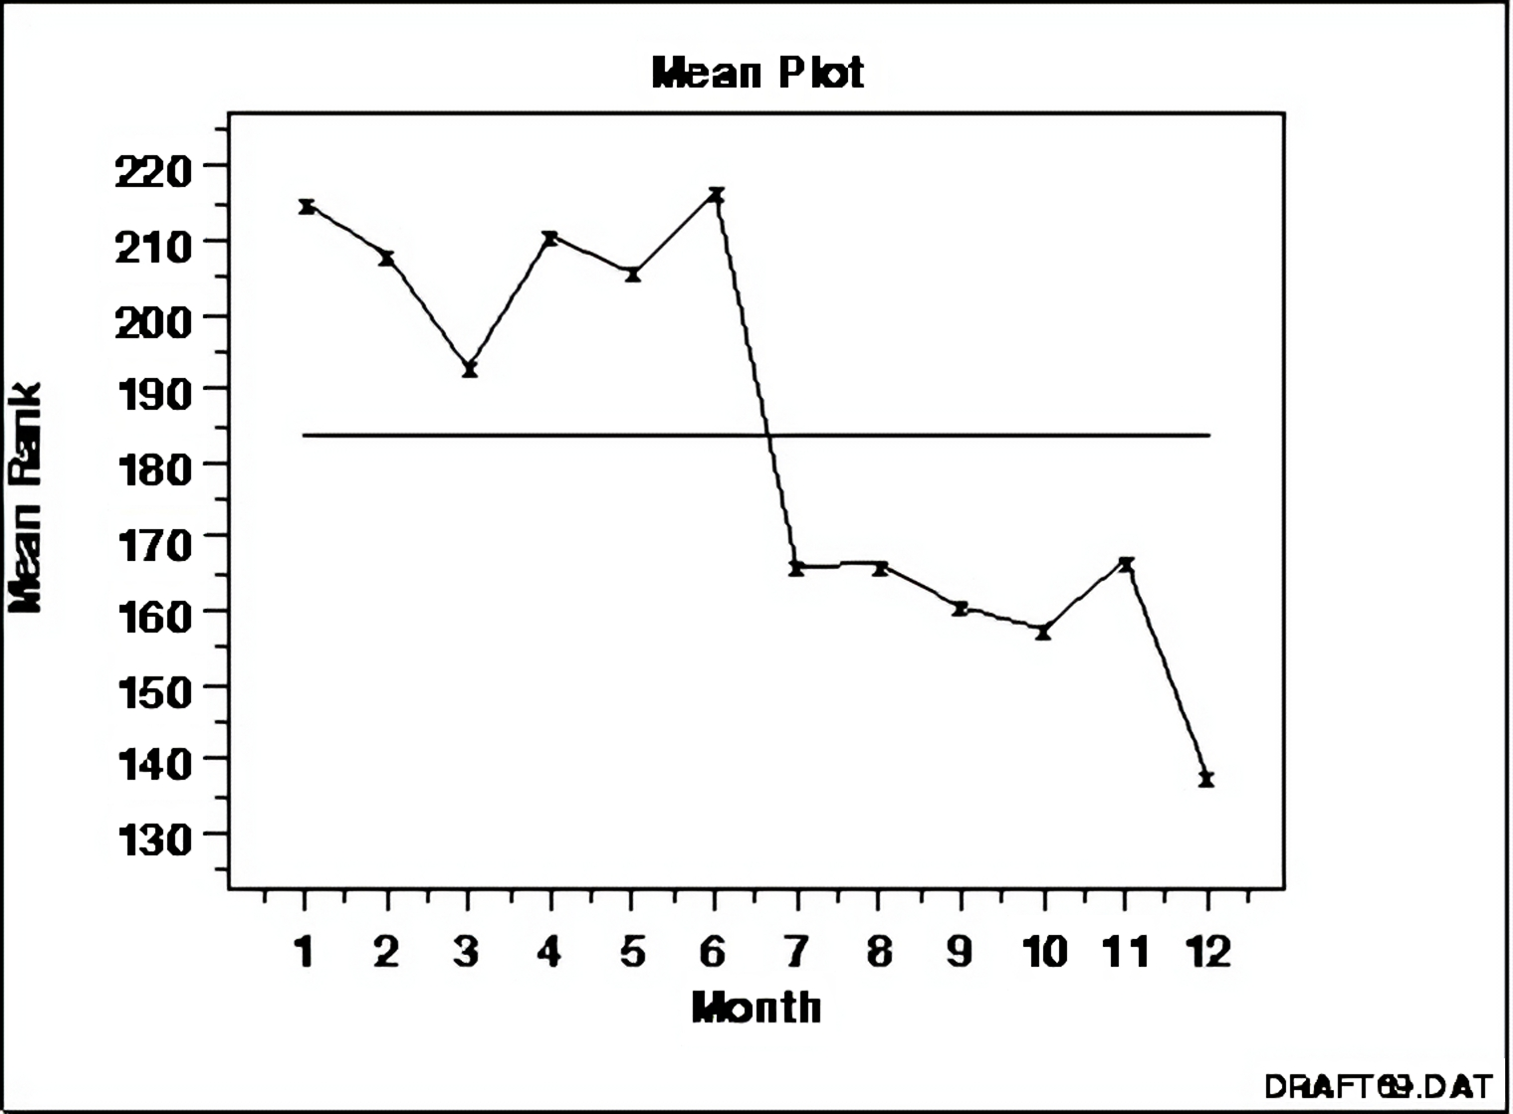
Mean Plot
https://www.itl.nist.gov/div898/handbook/eda/section3/eda33.htm
Notes:
Shifts in location and variation?
Some bad plots, but unfortunately the best ones (from an old handbook): These are the plots that your supervisor used in their PhD

Slide 11
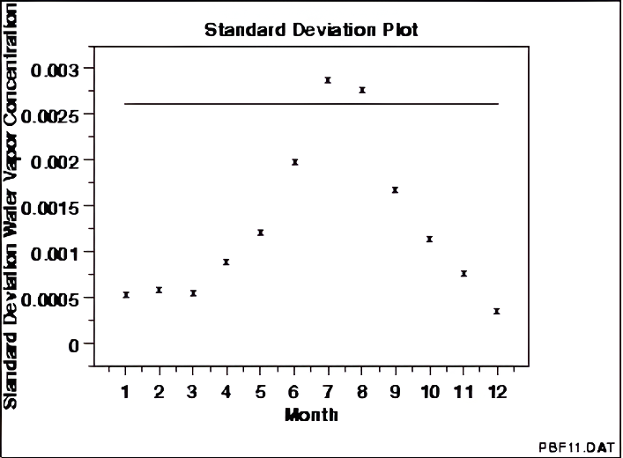
Standard Deviation Plot
https://www.itl.nist.gov/div898/handbook/eda/section3/eda33.htm
Notes:
Magnitude of shifts and variation, patterns in shifts and variation?

Slide 12
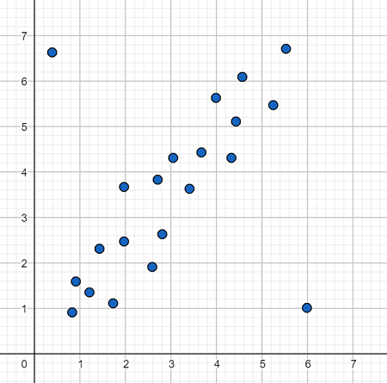
Plotting Outliers using scatter plot
https://www.itl.nist.gov/div898/handbook/eda/section3/eda33.htm

Slide 13
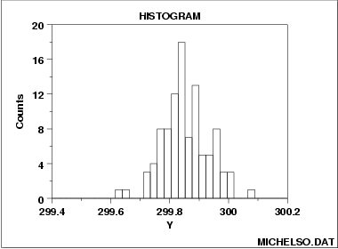
Plotting Distribution using Histogram
Skewness
Is the distribution symmetric?
Kurtosis
Is the tail heavy or light? (outliers)
https://www.itl.nist.gov/div898/handbook/eda/section3/eda33.htm
Notes:
Normal distribution is usually the most common
Also useful for outlier detection!

Slide 14
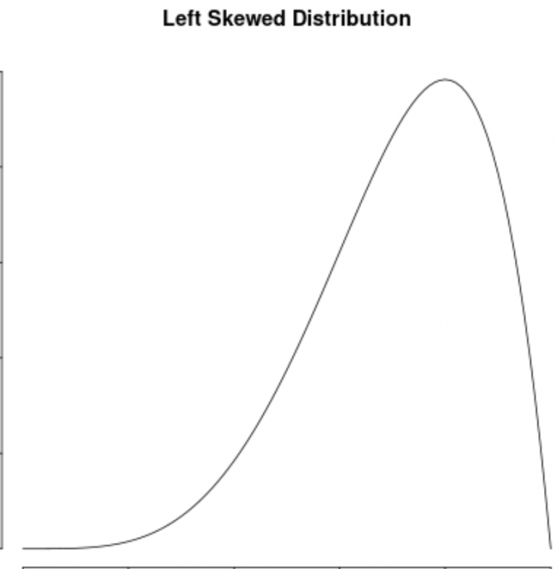
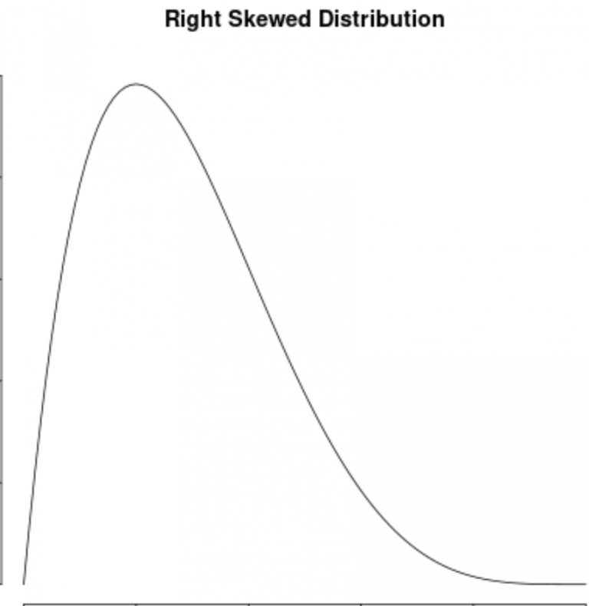
Skewness
https://www.statology.org/left-skewed-vs-right-skewed/
Notes:
Left skewed example: human life
Right skewed example: Salaries

Slide 15
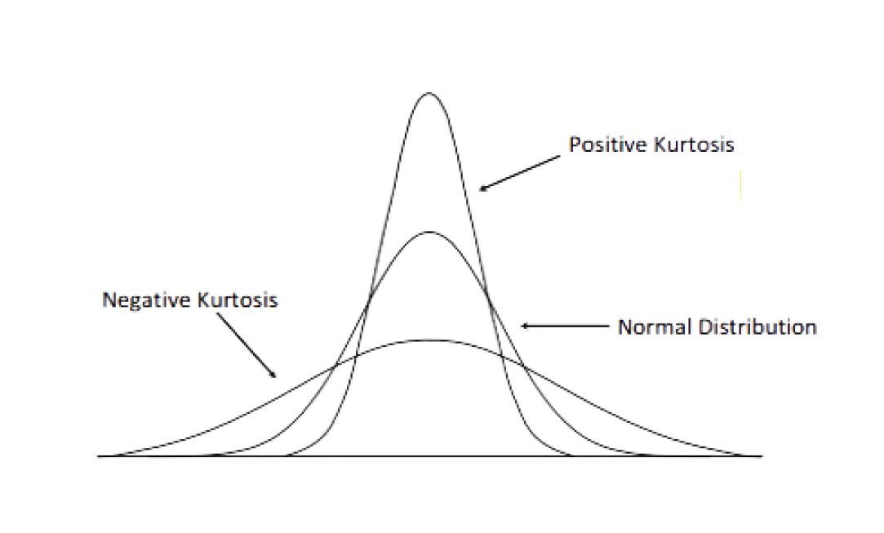
Kurtosis
https://www.freecodecamp.org/news/skewness-and-kurtosis-in-statistics-explained/
Notes:
Positive kurtosis: Higher chance of outliers, distribution along a narrow range
Negative kurtosis: Lower variance, most values are closer to mean

Slide 16
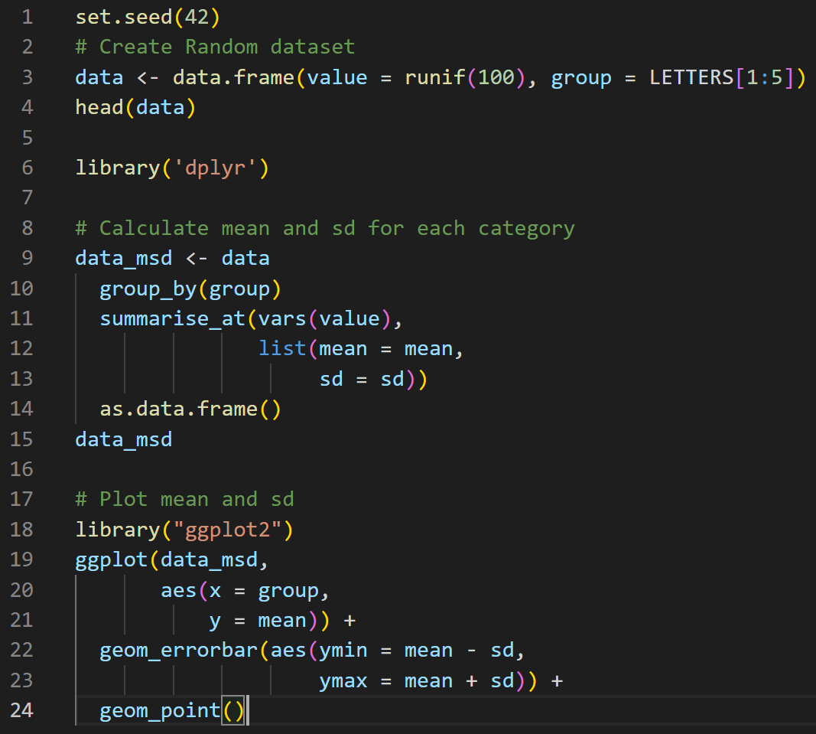
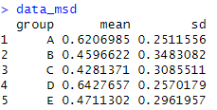
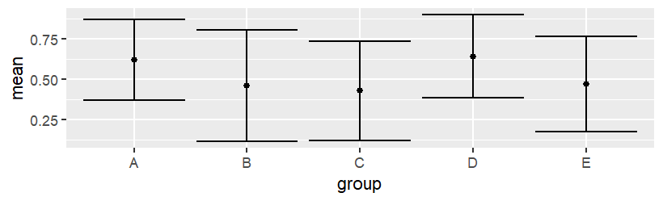
Quick R code for plotting mean and standard deviation

Slide 17
Moving from basic plots (fancy figures for your manuscripts)
Box Plots

Slide 18
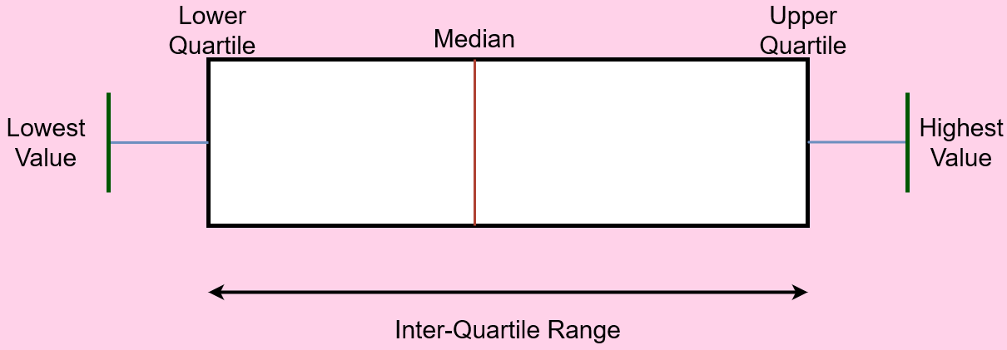
Reading a box plot
Notes:
First 25%, last 25%, middle part is 50%
Can also use violin plots as an alternative!
Box plots still useful for analysis

Slide 19
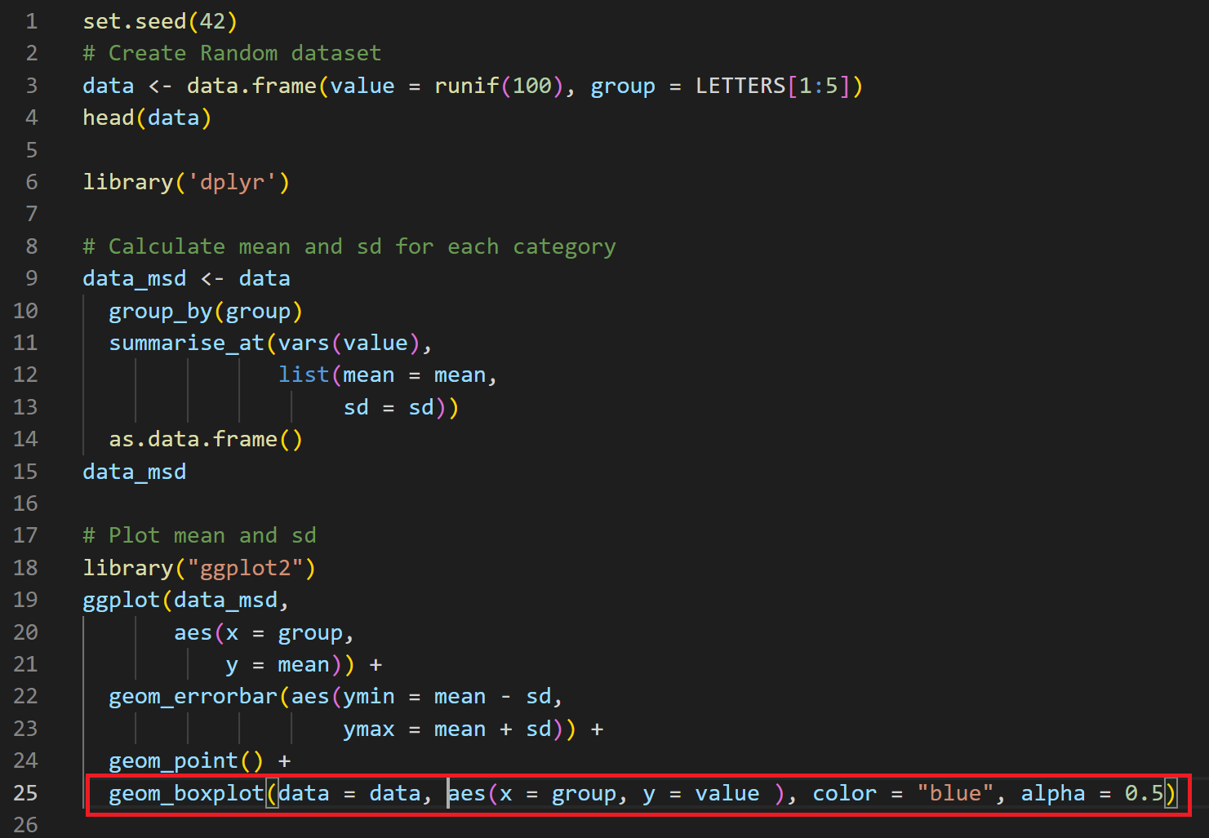
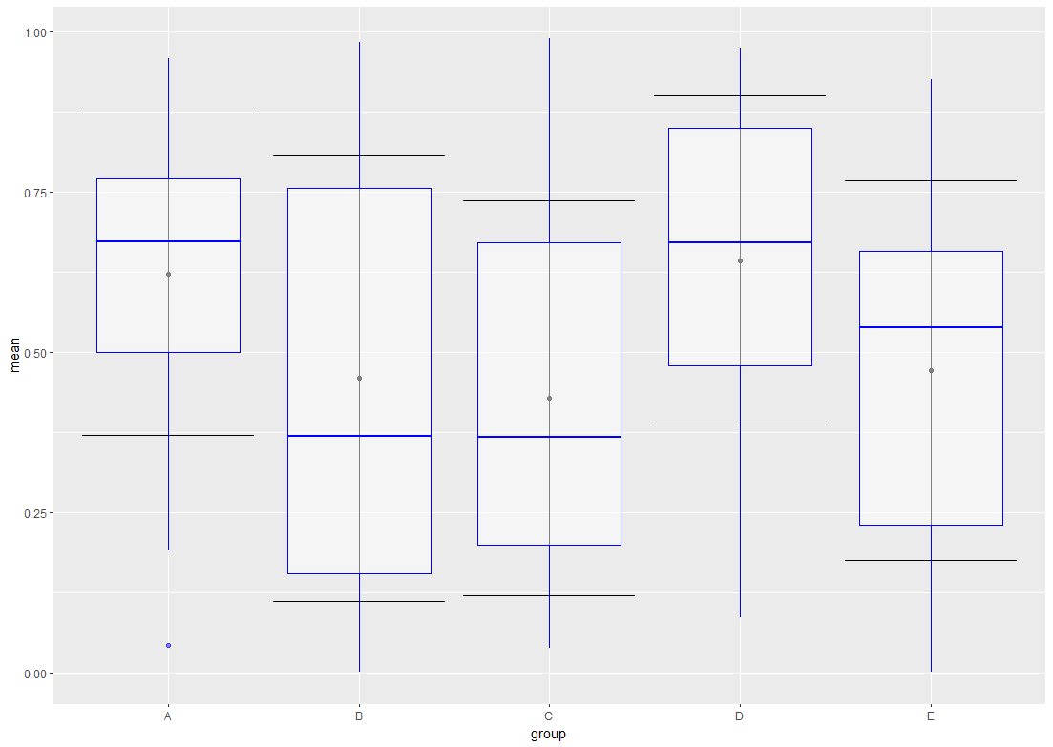
Quick R code for plotting box plots

Slide 20
Use cases for Box Plots

Slide 21
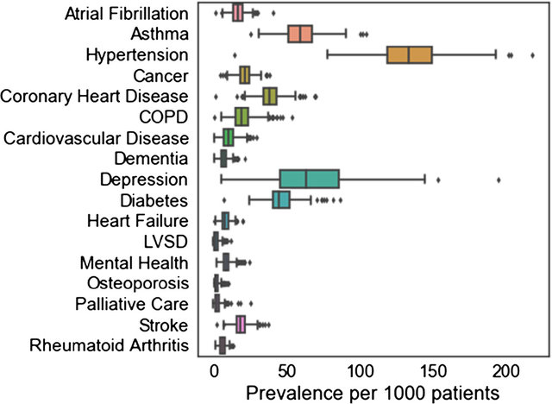
Box Plot Example 1
Cleland, B., Wallace, J., Bond, R., Black, M., Mulvenna, M., Rankin, D., & Tanney, A. (2018). Insights into antidepressant prescribing using open health data. Big data research, 12, 41-48.

Slide 22
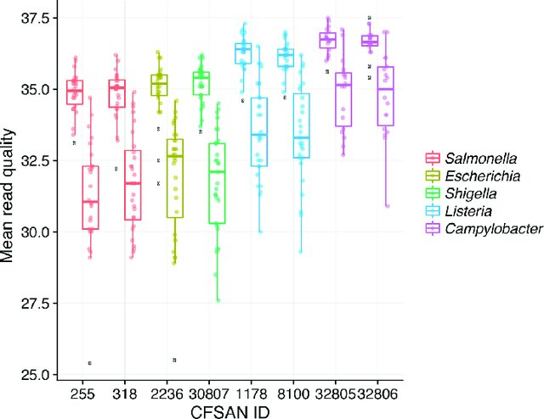
Box Plot Example 2
Timme, R. E., Rand, H., Sanchez Leon, M., Hoffmann, M., Strain, E., Allard, M., ... & Baugher, J. D. (2018). GenomeTrakr proficiency testing for foodborne pathogen surveillance: an exercise from 2015. Microbial genomics, 4(7), e000185.

Slide 23
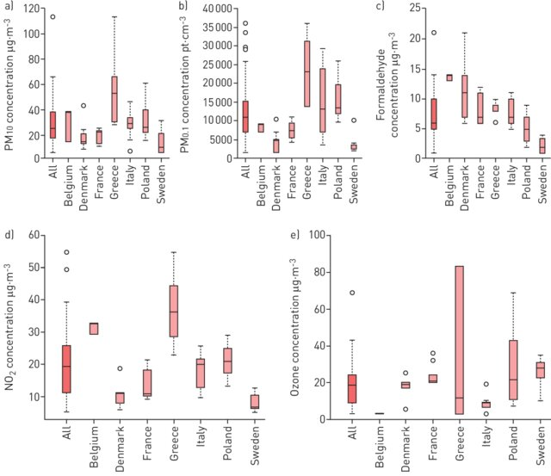
Box Plot Example 3
Bentayeb, M., Norback, D., Bednarek, M., Bernard, A., Cai, G., Cerrai, S., ... & Annesi-Maesano, I. (2015). Indoor air quality, ventilation and respiratory health in elderly residents living in nursing homes in Europe. European Respiratory Journal, 45(5), 1228-1238.

Slide 24
Moving from basic plots (fancy figures for your manuscripts)
Pair Plots

Slide 25
Pair Plots
Allow for exploring relationships between multiple variables simultaneously
Usually for multivariate datasets, quick visual way to identify patterns, correlations, outliers
Each variable plotted against every other variable- grid of scatterplots

Slide 26
Pair Plots- Example
Lets say we have three variables
Blood pressure, cholesterol levels, and age
Questions
How to blood pressure and cholesterol levels relate to each other?
How does blood pressure change with age?
How does cholesterol level change with age?

Slide 27
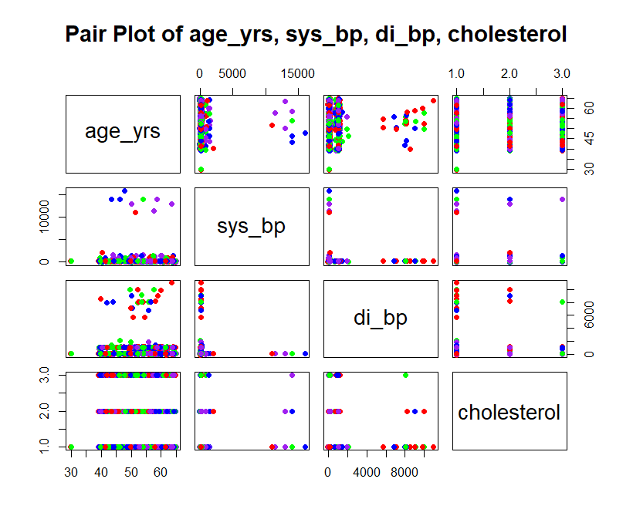
Pair plots- Example
Blood pressure of 15000???!!!

Slide 28
What did we do wrong?
Did not manually check the data
Outlier detection?

Slide 29
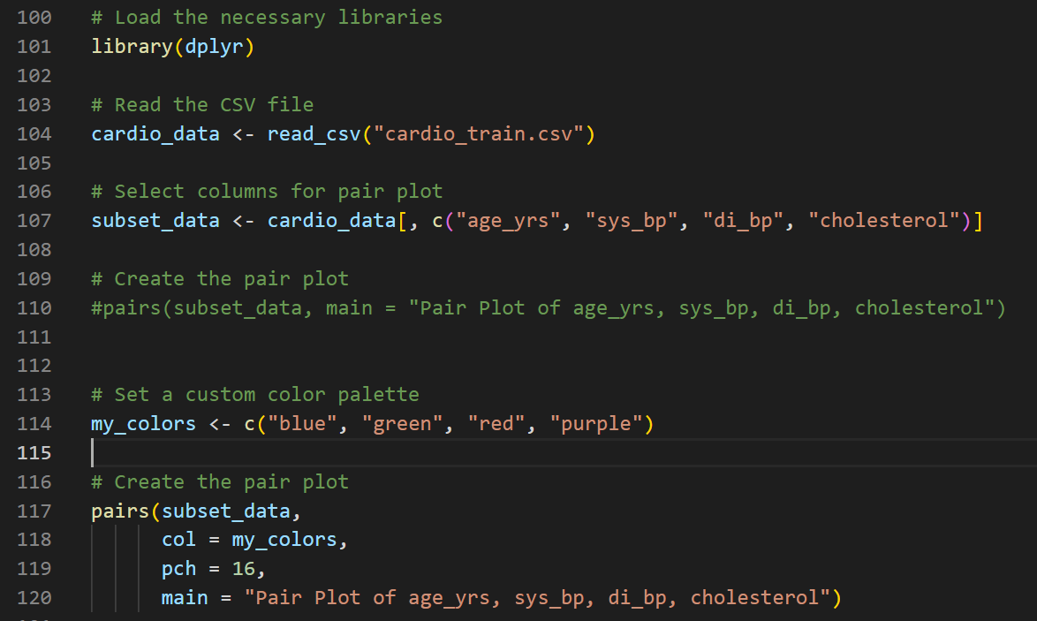
Quick R code for plotting pair plots

Slide 31
Plotting Distrubutions for Outlier detection
What is the range of our variables?
Are they in a normal distribution?
Are there many outliers?
Plot distribution to check!

Slide 32
Normal Distrubution
Also known as Gaussian distribution
Symmetric about mean
Bell curve
Usually, most data is normally distributed
Still good to plot your data!

Slide 33
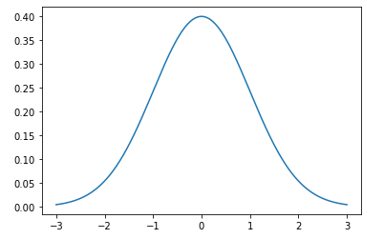
Normal Distrubution
Notes:
Normal distribution with mean 0 and standard deviation 1

Slide 34
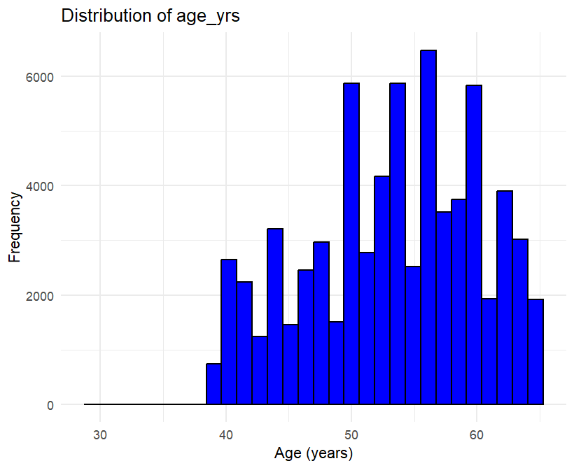
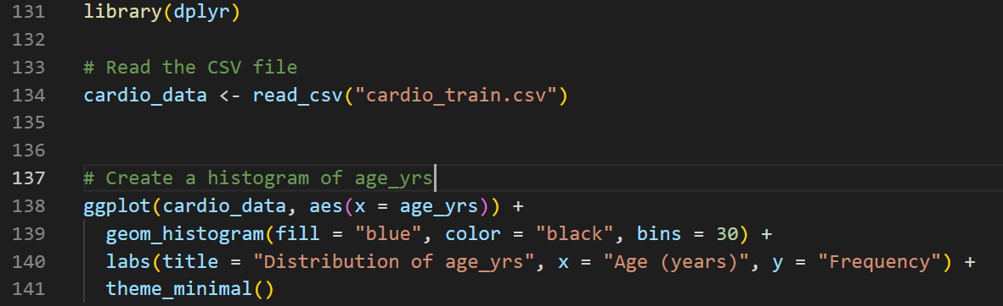
Quick R code for plotting distributions

Slide 35
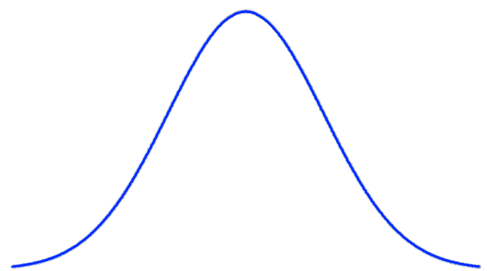
Pssst

Slide 36
Summary
EDA steps
Look at your data, remove null values
Mean, standard deviation
Plot distribution
Plotting target variables
Box plots, pair plots
Outliers

Slide 37
More to follow in practical session

