Slide 1
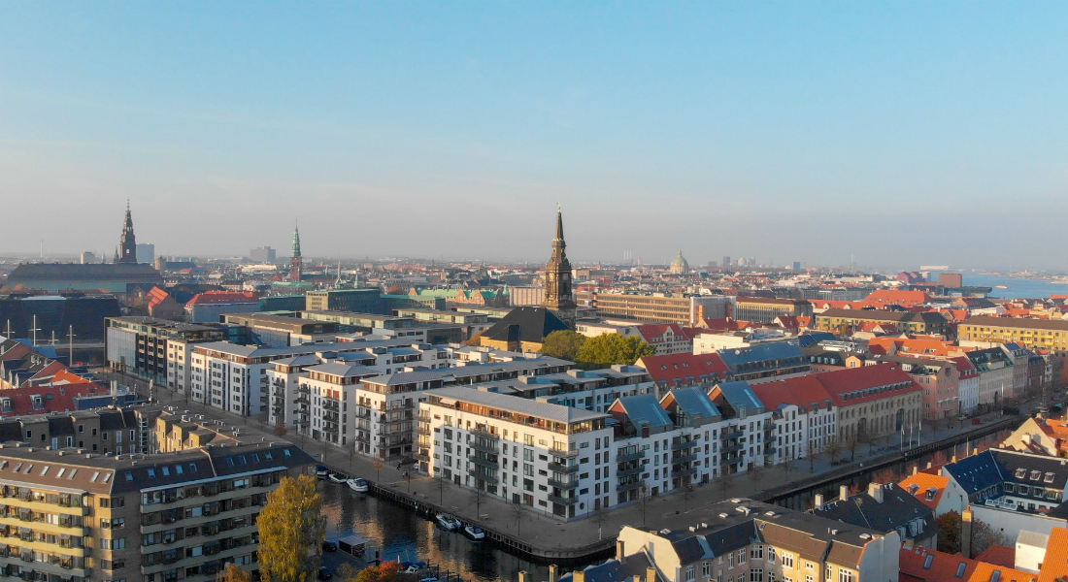

Data Visualisation and Storytelling
Spatial Data
KC
09.2023
Notes:
##-AccessibilityAssistant: Skip layout check-##

Slide 2
Introduction to Spatial Data
Spatial Data- Any data or containing information about a specific location on the Earth’s surface
Useful for
Disease mapping and surveillance
Health impacts of pollution levels
Resource allocation based on population density
Genomics and population studies
Notes:
##-AccessibilityAssistant: Skip layout check-##

Slide 3
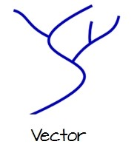
Introduction to Spatial Data- Basic Terms
Vector data
Graphical representations of the real world
lines, polygons, shapes
Notes:
##-AccessibilityAssistant: Skip layout check-##

Slide 4
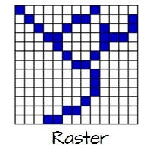
Introduction to Spatial Data- Basic Terms
Raster data
Data presented in a grid of pixels. Each pixel has a value- usually colour, or some unit of measurement
Think of a raster as a layer
Usually satellite images
Notes:
##-AccessibilityAssistant: Skip layout check-##

Slide 5
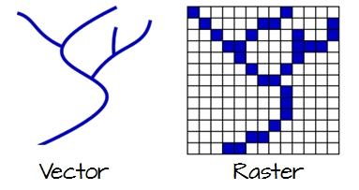
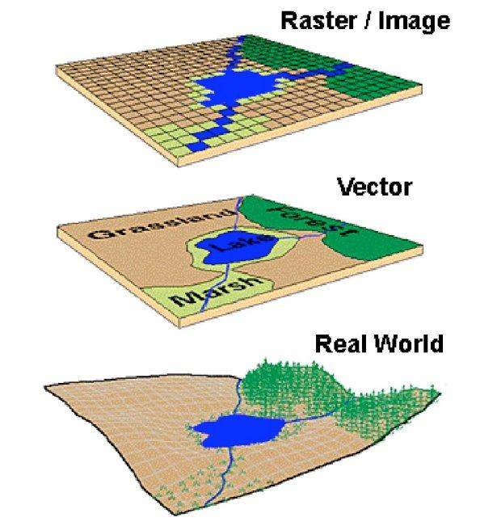
Vector vs Raster
Saab, D. J. (2004). Conceptualizing space: mapping schemas as meaningful representations–Indigenous narratives of place.

Slide 6
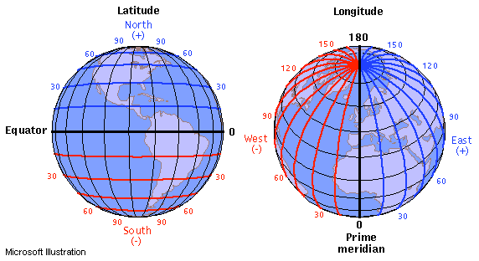
Latitudes and Longitudes
https://journeynorth.org/tm/LongitudeIntro.html

Slide 7
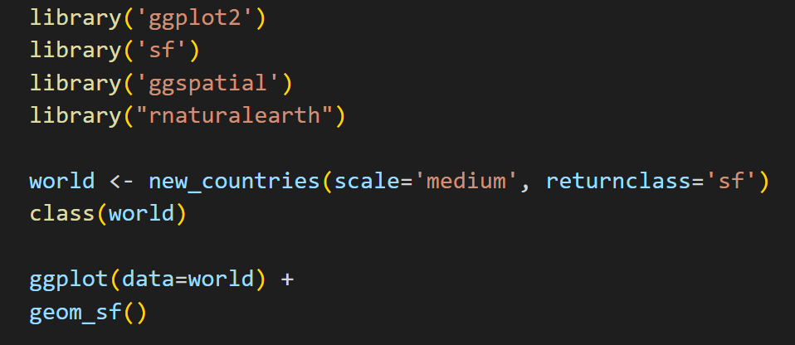
Creating maps in R- plotting basic maps

Slide 8
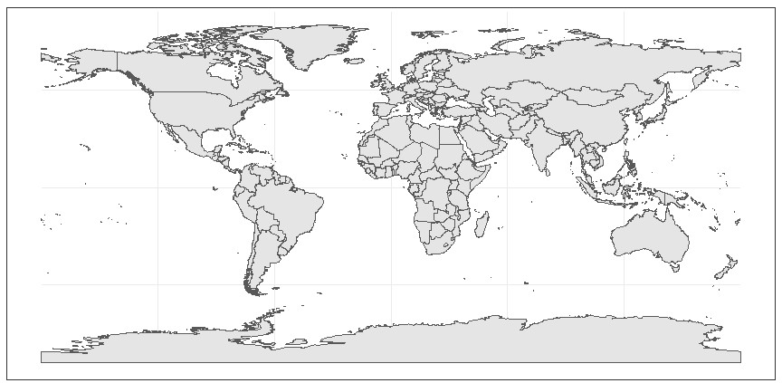
Creating maps in R- basics

Slide 9
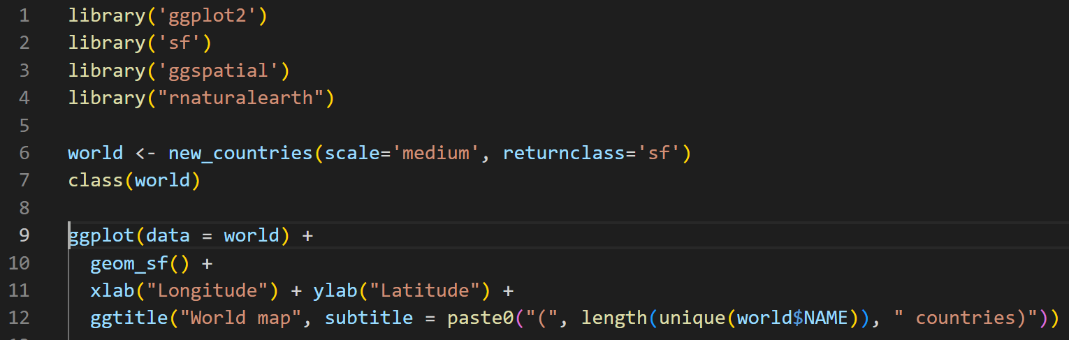
Creating maps in R- add axes, titles

Slide 10
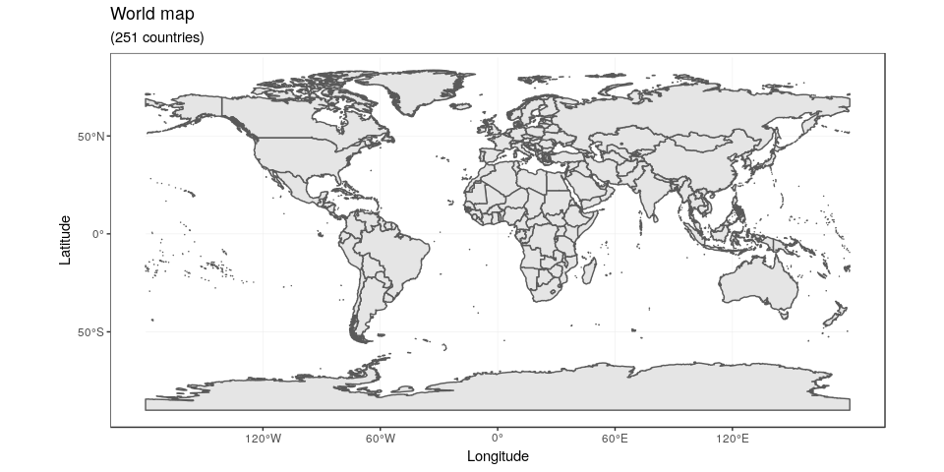
Creating maps in R- basics

Slide 11
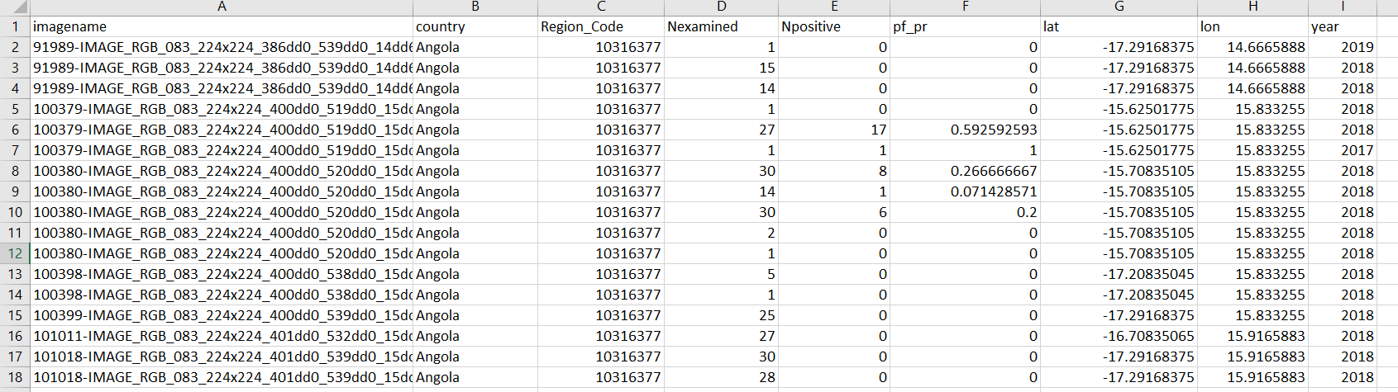
Creating maps in R- Real world example

Slide 12
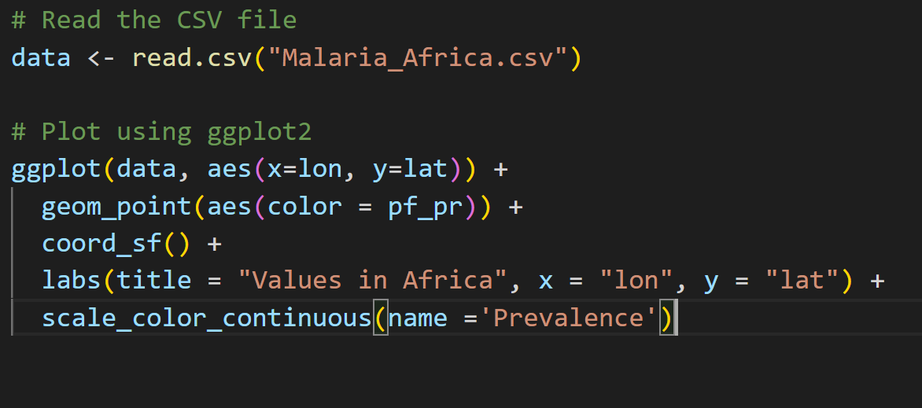
Creating maps in R- Real world example

Slide 13
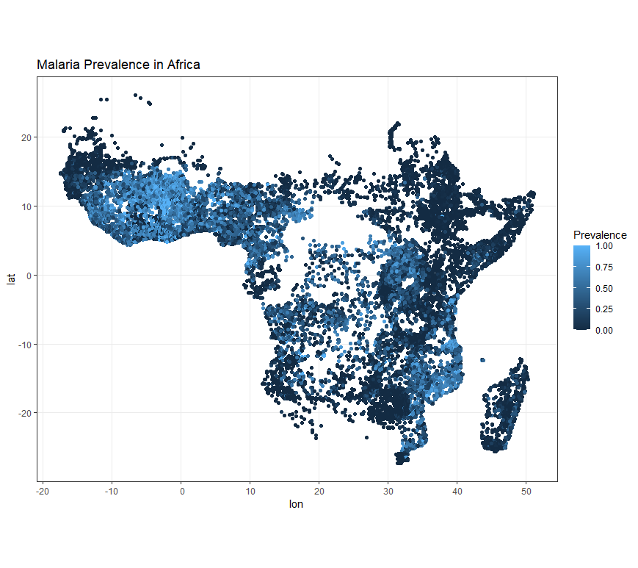
Creating maps in R- real world example

Slide 14
Another example- tmap library
Tmap Thematic maps
Similar to ggplot- specifically geared towards maps. You add subsequent layers-
axes
scales
different layers of topography
Can also create interactive maps (more to come on day 4)

Slide 15
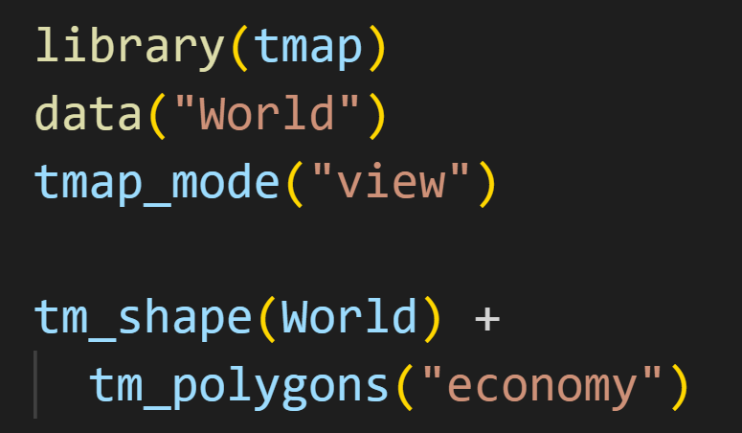
Another example- tmap library
Example- RStudio

Slide 16
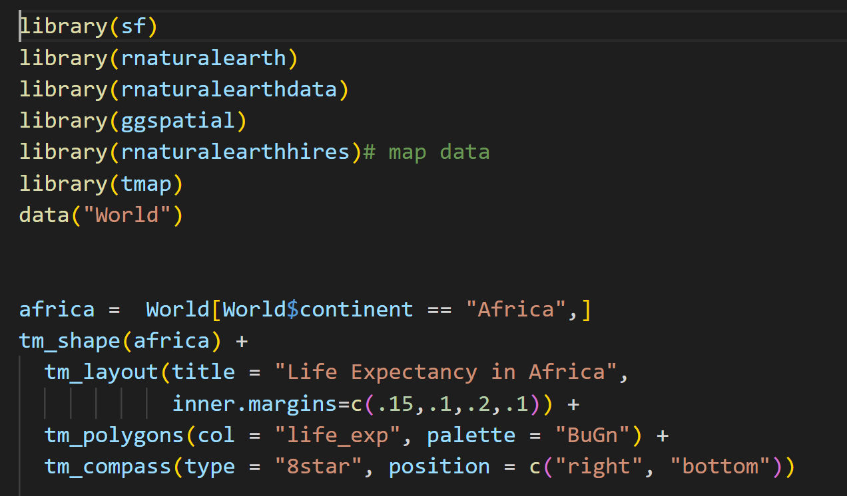
Tmap code- Works similar to ggplot

Slide 17
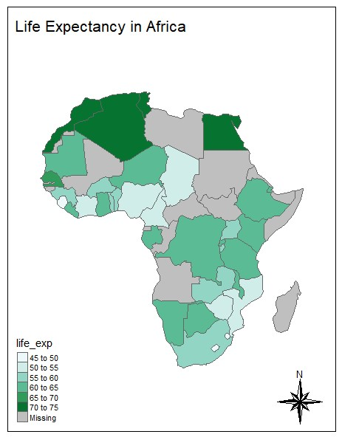
Creating maps using Tmap

Slide 18
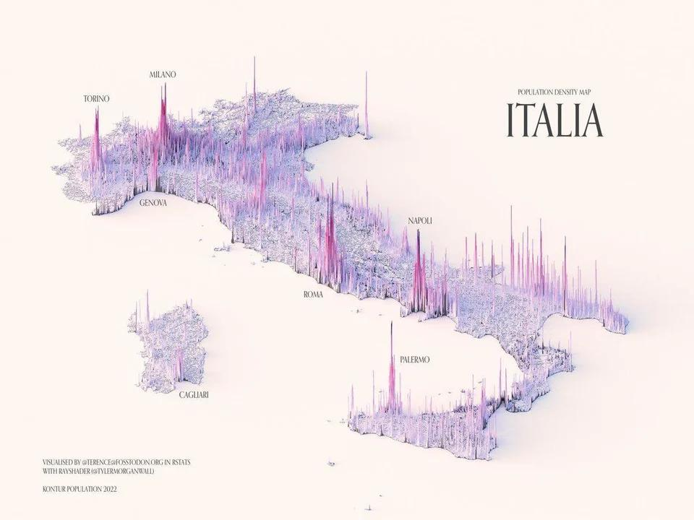
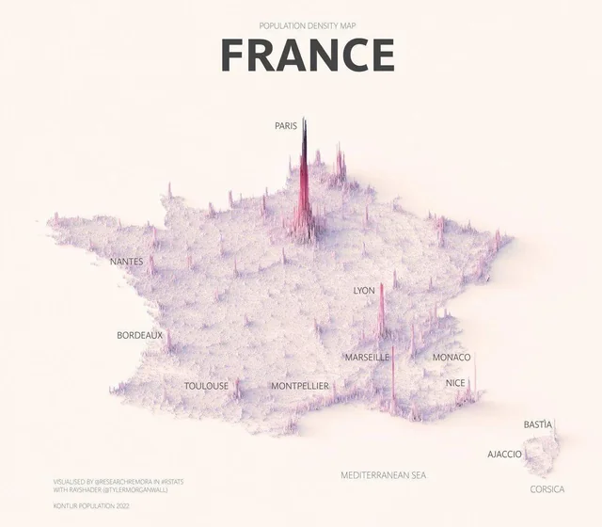
Some fancy looking maps
https://www.visualcapitalist.com/wp-content/uploads/2023/02/Visualizing-Population-Density-in-France-Full-Size.html
https://www.visualcapitalist.com/wp-content/uploads/2023/02/Visualizing-Population-Density-in-Italy-Full-Size.html

Slide 19
Some fancy looking maps
Looks fancy…What is wrong with the map? (Day1)
https://www.visualcapitalist.com/wp-content/uploads/2023/02/Visualizing-Population-Density-in-France-Full-Size.html
https://www.visualcapitalist.com/wp-content/uploads/2023/02/Visualizing-Population-Density-in-Italy-Full-Size.html

Slide 20
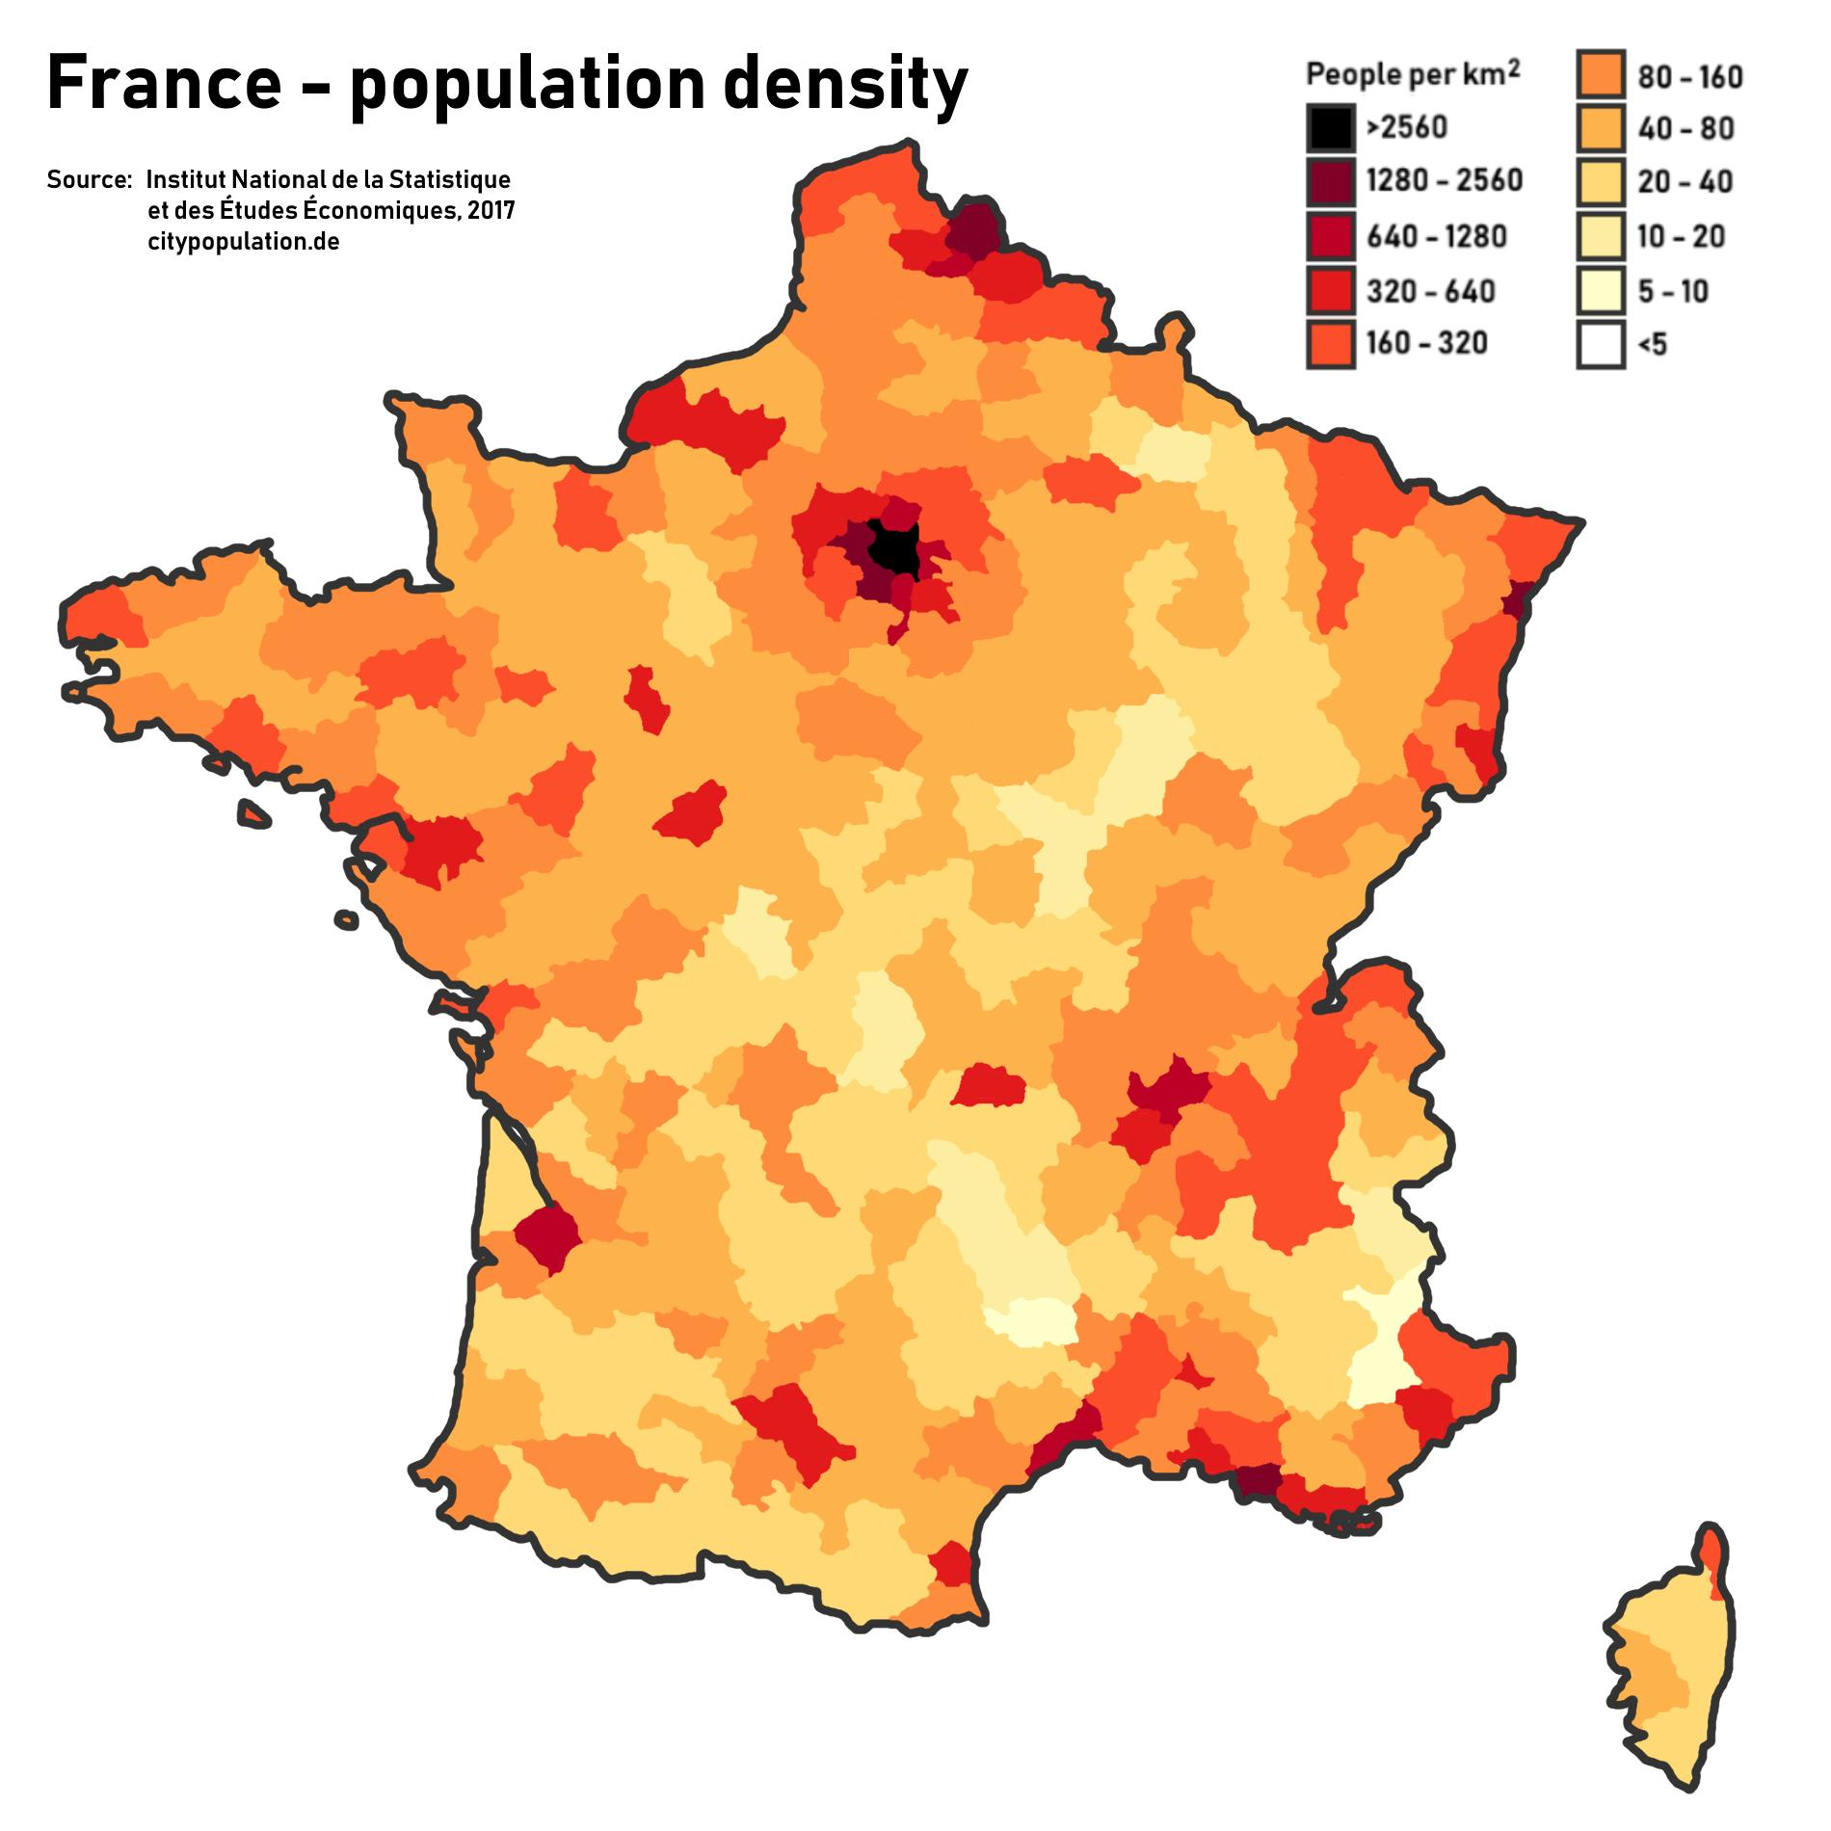
Functional vs Fancy
VS
https://maps-france.com/maps-france-geography/france-population-map
https://www.visualcapitalist.com/wp-content/uploads/2023/02/Visualizing-Population-Density-in-France-Full-Size.html

Slide 21
Continued in Practical Session
Installing Libraries
Basic Plots
Adding Scales, Directions, Coordinates
Adding points based on coordinates
Thematic Maps
Interactive Maps
Layers
Shading and Facets

