Slide 1
Data Visualization and Storytelling
3.1 Visualizing Networks and DAGs
Jacob Curran-Sebastian

Slide 2

Introduction to Networks
Networks are constructed by taking a set of vertices (V), sometimes called nodes, and a set of edges (E) that connects them.
They can be used for connecting datapoints, for example, we might think about individuals in a population being connected by social contact.
In R, the main package for visualising networks and for analysing their structure is called igraph.

Slide 3
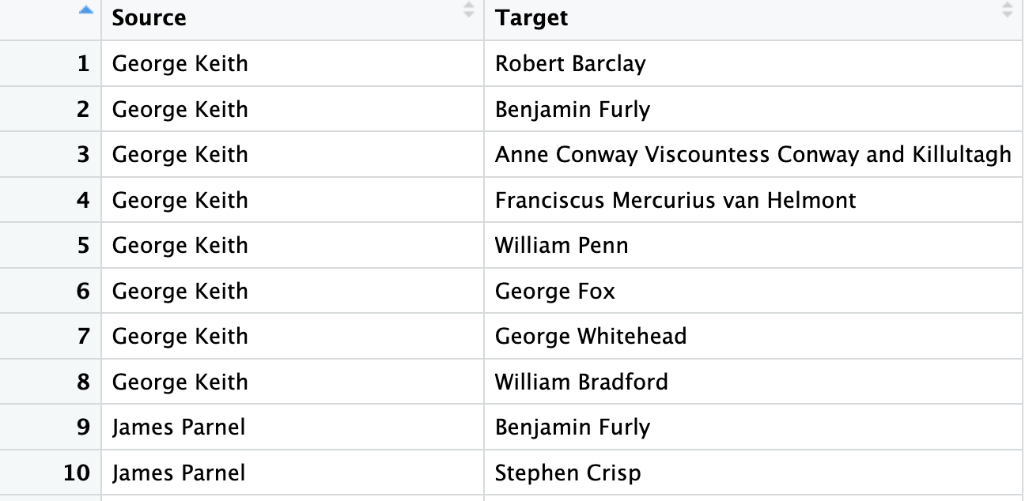
Reading in network data
There are several ways to store network data that can be read into R using igraph.
One of the most common is as an edgelist file, which is a table consisting of two columns. Edges are drawn connecting vertices in the first column to the second column.
For example, the file quakers_edgelist.csv is shown on the right.

Slide 4
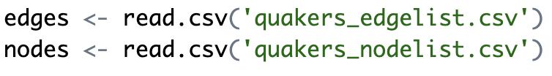
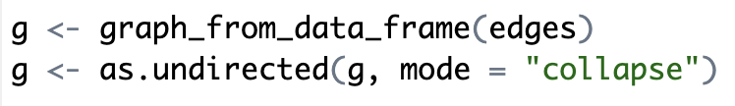
Reading in Network Data
We read in the file as a csv – we also read in quakers_nodelist.csv, which contains additional data about each of the nodes. These are called node attributes.
We then use igraph to create a network object out of this dataframe.
We could keep this graph directed if we wanted to.

Slide 5
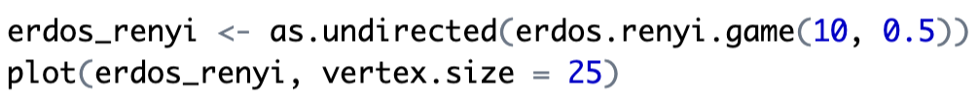
Visualising Networks using igraph
Let’s create a random graph in igraph and plot it.
To plot igraph objects, you can just use the plot function (from base R).

Slide 6
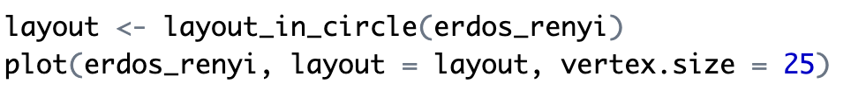
Visualising Networks using igraph
Let’s create a random graph in igraph and plot it.
We can also specify the layout of the nodes, e.g.

Slide 7
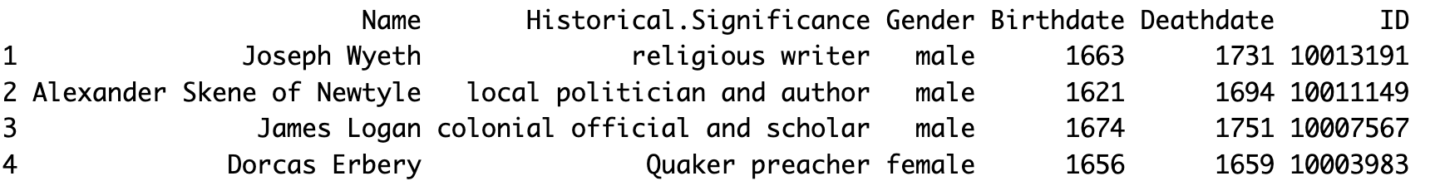
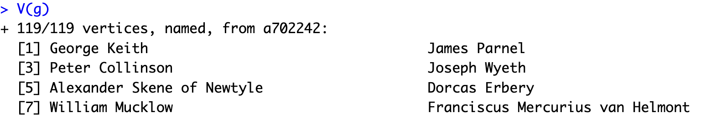
Node attributes
We can attach metadata about the nodes to the nodes themselves within an igraph object.
The vertices of a graph can be called using V(g):

Slide 8
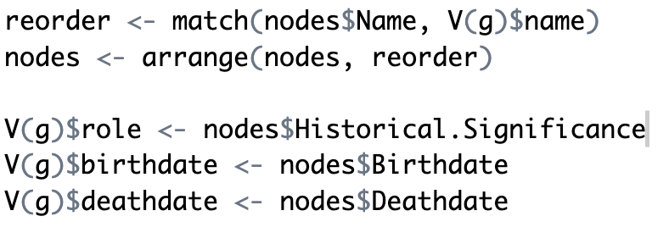
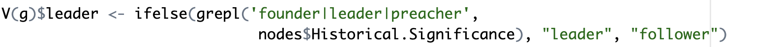
Node attributes
Now we can set the node attributes in a similar way to setting columns for data.frame objects, using the $ sign.
We can also create some slightly more complicated attributes:

Slide 9
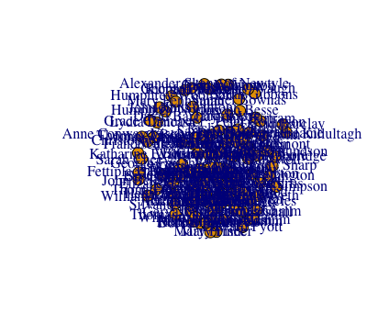

Plotting

Slide 10
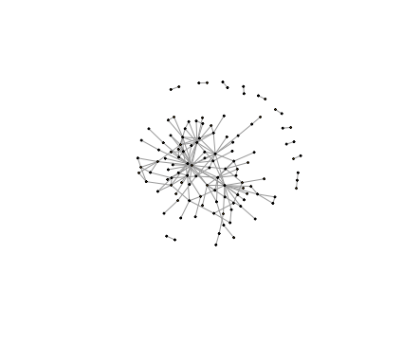
Plotting

Slide 11
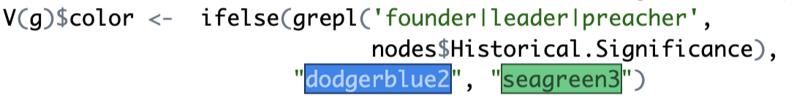
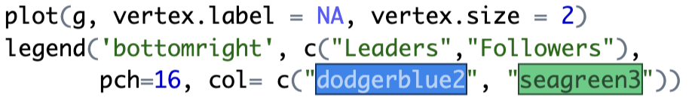
Plotting
We can also color the nodes

Slide 12
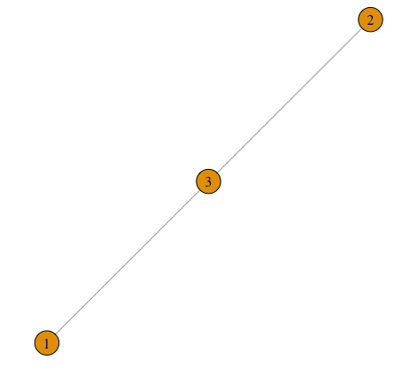
Node degree
The degree of a node is the number of other nodes that it is connected to.
We can also scale the size of a vertex in the plot by its degree to show this in the graph.

Slide 13
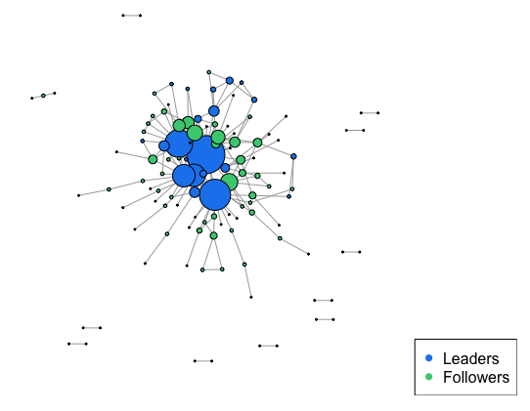

Plotting
If we specify the function to be

Slide 14
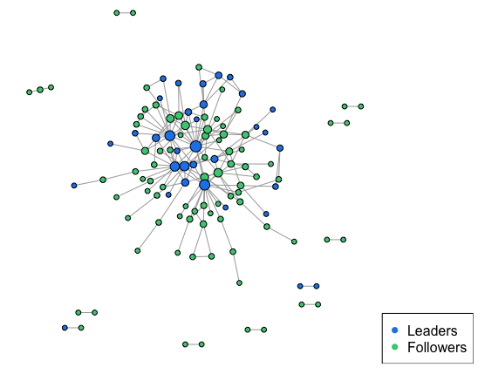

Plotting
Just specifying the vertex size to be the degree is not super nice (at least, in this case).
It’s often worth having a play around to see what works!

Slide 15
Degree distributions
Sometimes, a network can be too large to plot nicely, and if there are many edges it can be hard to see the structure of a graph.
Instead of plotting the full graph, it can be nice instead to visualise the degree distribution of all of the nodes.
This displays information about how many people are well connected in a graph.

Slide 16
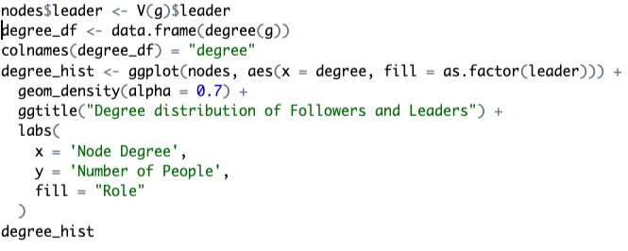
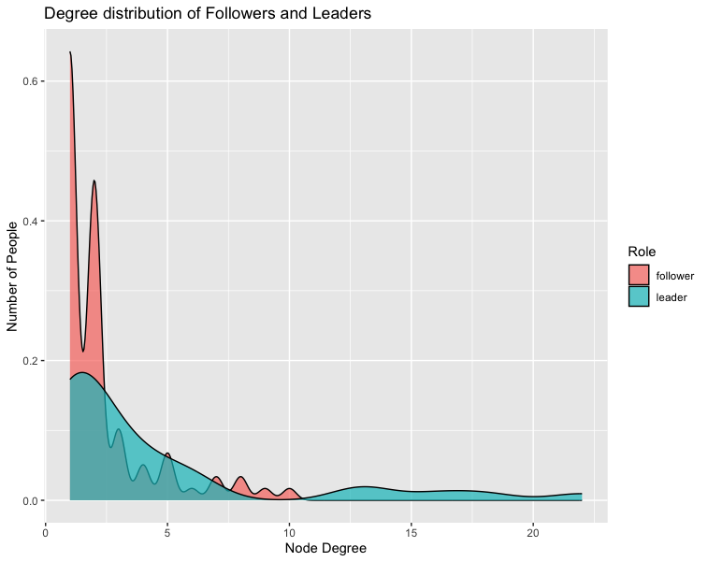
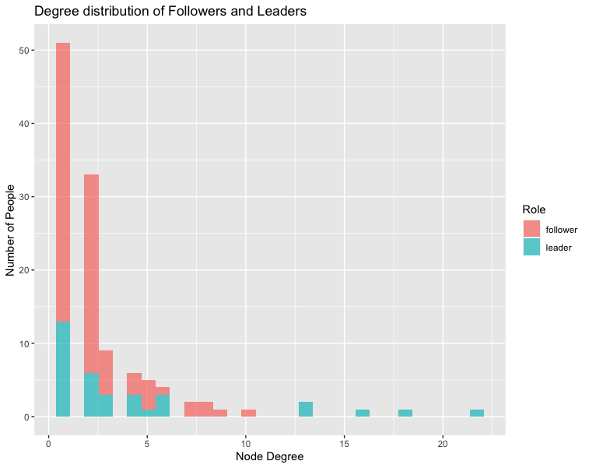
Plotting a degree distribution

Slide 17
DAGs
We can also plot DAGs (Directed Acyclic Graphs) to show the causal relationship between groups of variables.
We could do this in igraph, by reading in source and target nodes without using the function as.undirected().
However, R has a nice package called dagitty that is useful for plotting DAGs quickly and easily.

Slide 18
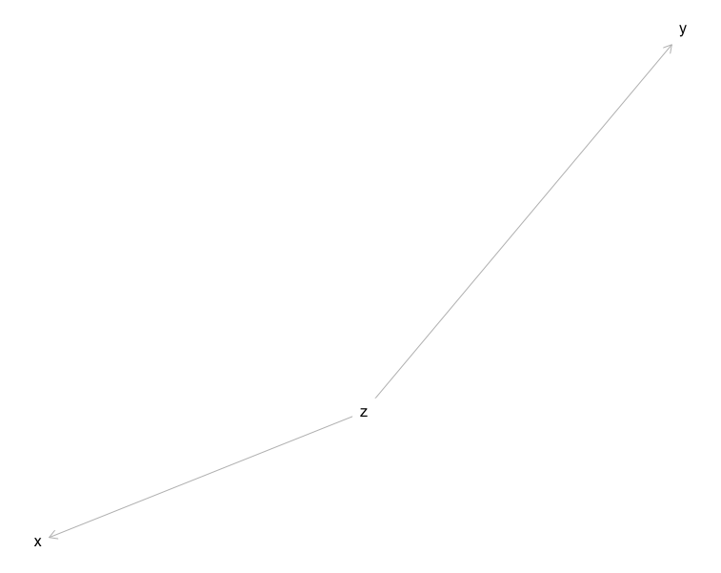
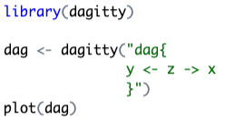
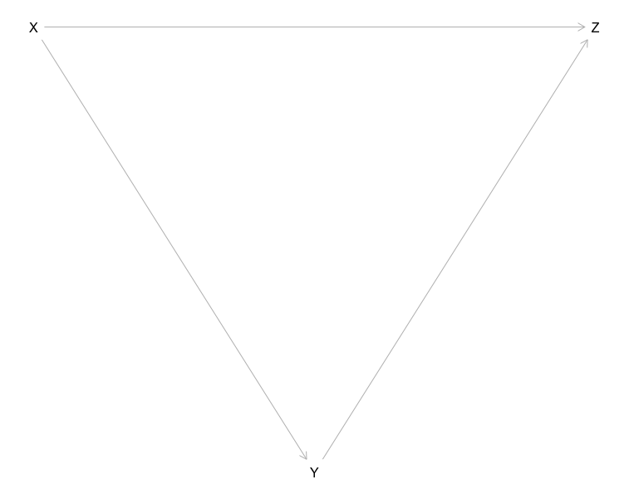
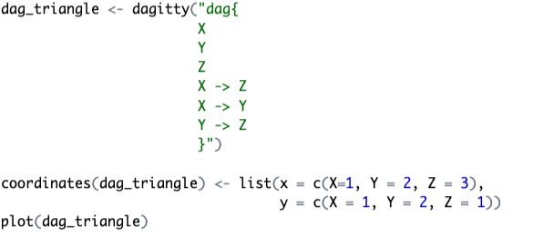
Creating a DAG object

Slide 19
Extension – Plotting using ggdag
The plots from dagitty are quite basic – we can convert dagitty objects to more tidyverse-like objects that can be plotted in a ggplot style.
For this, you need to use the function dagify() – this is not super easy, and requires some knowledge of DAGs.
I’ll show a basic plot here, but for those that are interested, I recommend exploring the ggdag package a bit more (e.g. in the exercise session).

Slide 20
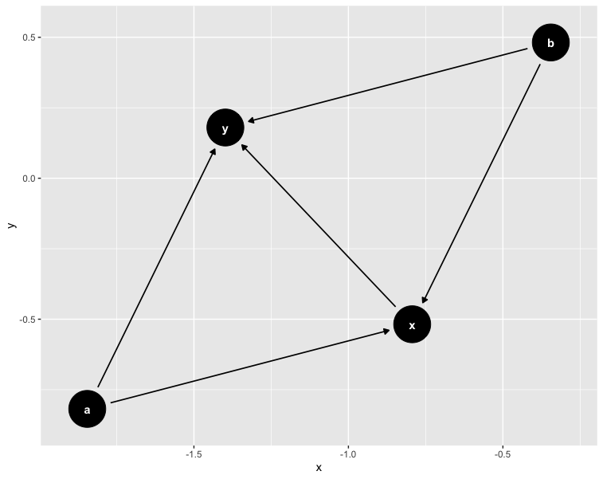
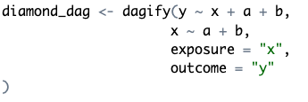
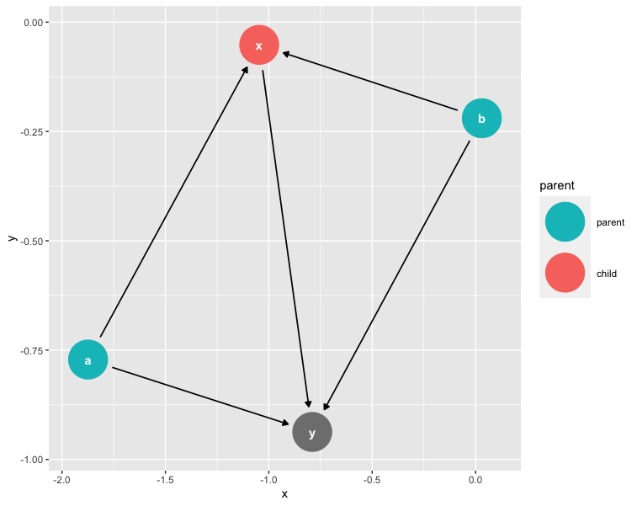
Extension – Plotting using ggdag

