Slide 1
Computational Thinking and the Design Process

Slide 2
What is computational thinking?

Slide 3
Computational Thinking
real-world problems
computational solutions
… the thought processes involved in formulating problems and their solutions
so that solutions are represented in a form that can be effectively carried out by an information-processing agent.
humans, machines, or both
Cuny, Snyder, Wing. Demystifying Computational Thinking for Non-Computer Scientists.
Notes:
CT is primarily a thought process for problem solving.

Slide 4
Computational Thinking
… is essentially a problem-solving process that involves designing solutions that capitalize on the power of computers.
K-12 Computer Science Framework, 2017.

Slide 5
CSTA / ACM / ISTE Operational Definition of CT
https://cdn.iste.org/www-root/Computational_Thinking_Operational_Definition_ISTE.pdf

Slide 6
Design Thinking Process

Slide 7
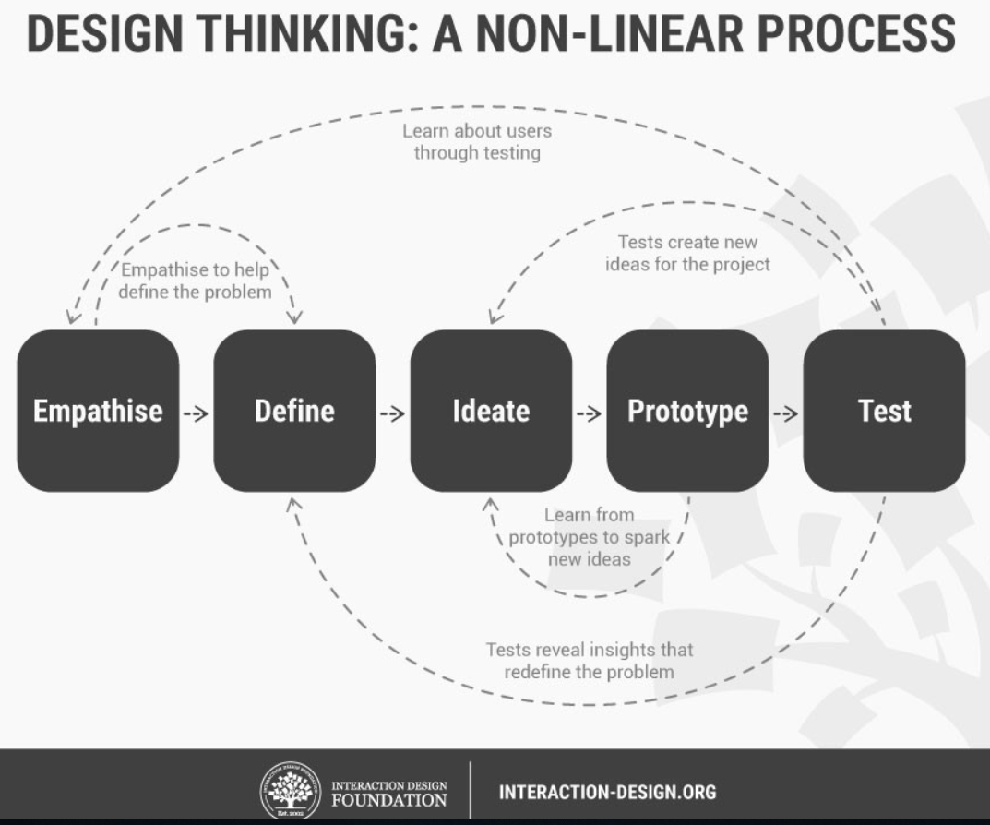

Slide 8
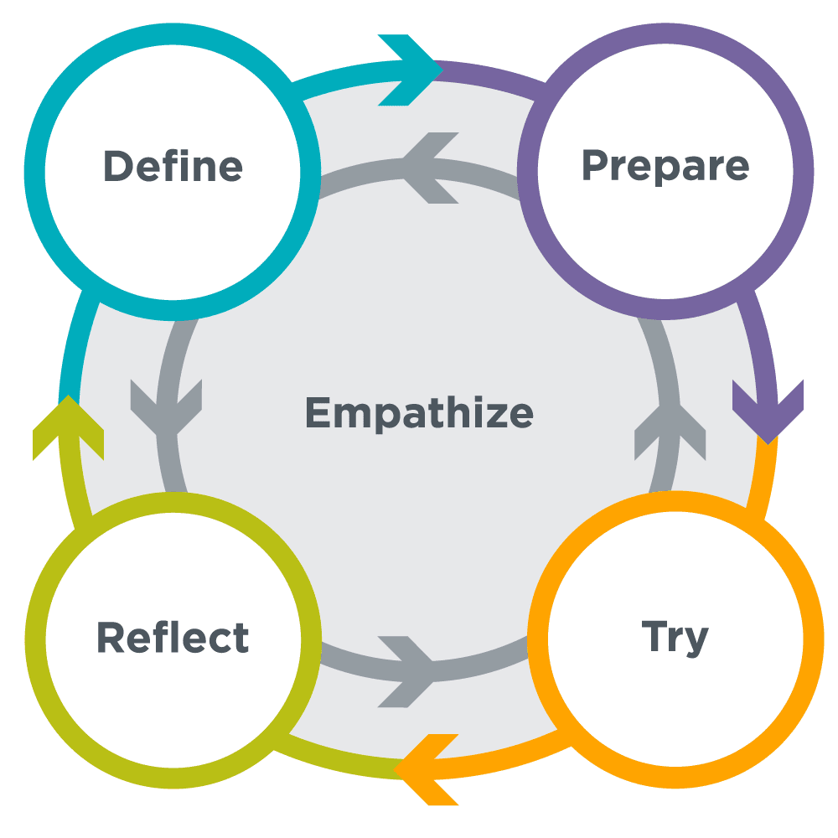
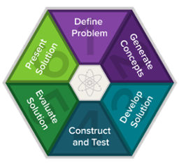
Six of one, half dozen of another...
Code.org CS Discoveries Design Process
PLTW Engineering Design Process

Slide 9
A sample challenge to think with...
Design an Internet of Things device for older adults (50+) to enhance their quality of life in one or more ways.

Slide 10


Empathize
For whom are you designing?
What are their needs, knowledge, and abilities?
What other stakeholders have an interest in this?
How will you learn about them?
Who’s left out?
Let’s challenge your assumptions!
Image credit: AARP
http://tiny.cc/6wg2uz

Slide 11
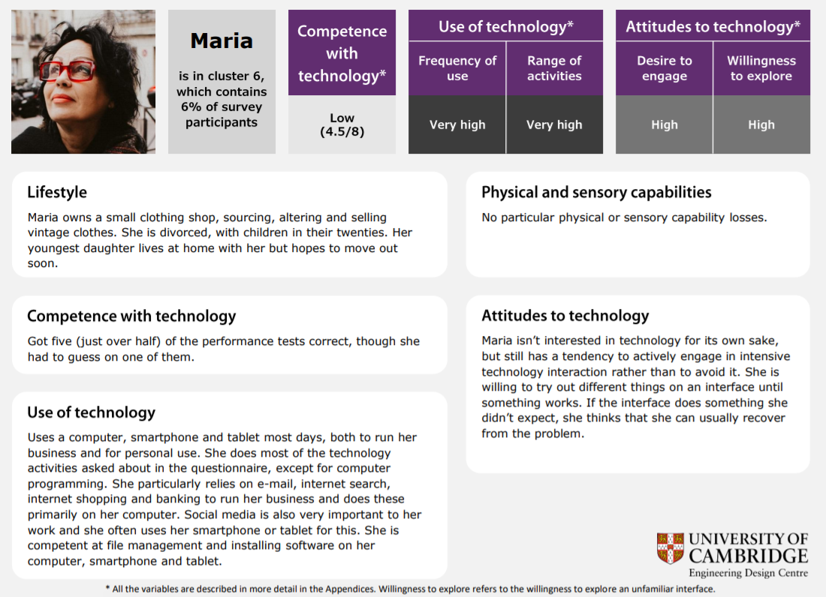
Documenting What You Learn with Personas
http://www.inclusivedesigntoolkit.com/digitalpersonas/

Slide 12
Define
What problem are you really trying to solve?
What are your constraints?
What does success look like?
User Stories allow us to articulate the requirements of the system we are designing
As a type of user, I want to some action, so that I can rationale.

Slide 13
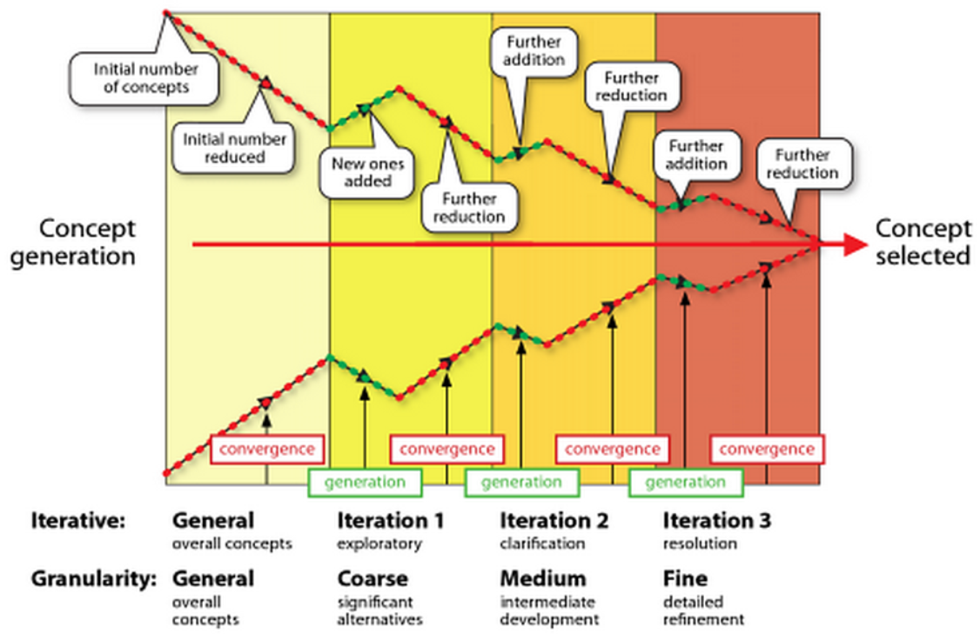
Ideate
Image Credit: Greenberg, S., Carpendale, S., Marquardt, N., & Buxton, B. (2011). Sketching user experiences: The workbook. Elsevier.
Brainstorm alternative solutions
10 + 10 Method
Compare and contrast the possible solutions

Slide 14
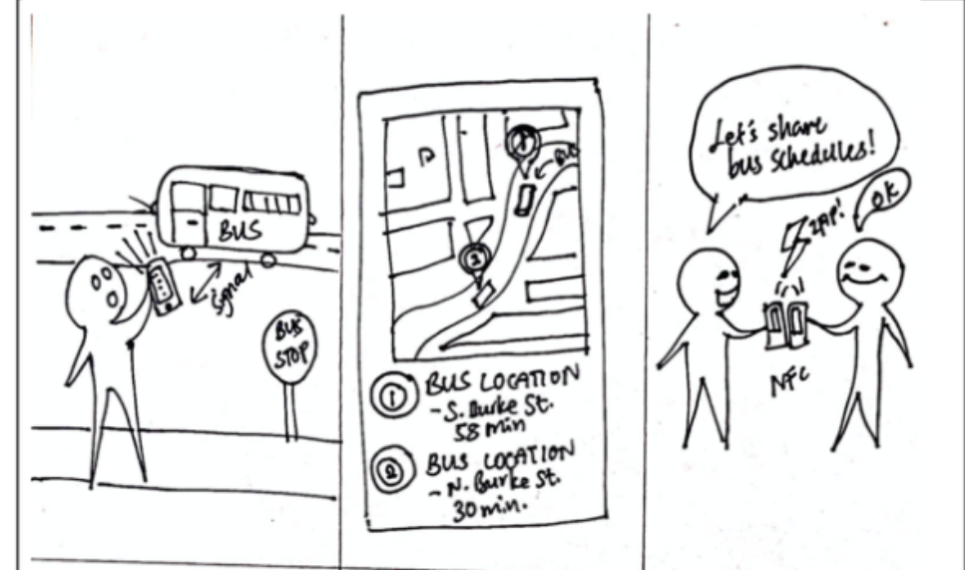
Storyboard Your Ideas

Slide 15
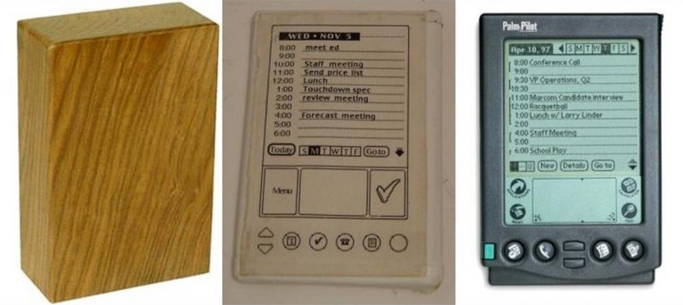
Prototype
Select aspects from your potential designs for further exploration
A prototype allows you to explore limited aspects of a design without building the whole thing
Image reprinted from https://medium.com/@UCDBristol/using-prototypes-to-see-into-the-future-901c449c408

Slide 16
Test
Try out the prototype and gather empirical evidence about its success
Is it “usable”?
Is it “simple”?

