Slide 1
CT Bins: Cryptography

Slide 2
What’s a CT Bin?
Self contained, unplugged, hands-on activities for students to explore an idea in computing that requires no pre-teaching.
Each box contains:
Student instructions
Handouts/worksheets (as needed)
Answer sheet
Teacher materials
Howto Videos for Teachers: https://app.vidgrid.com/content/PWZqTOUmVWfd

Slide 3


Slide 4
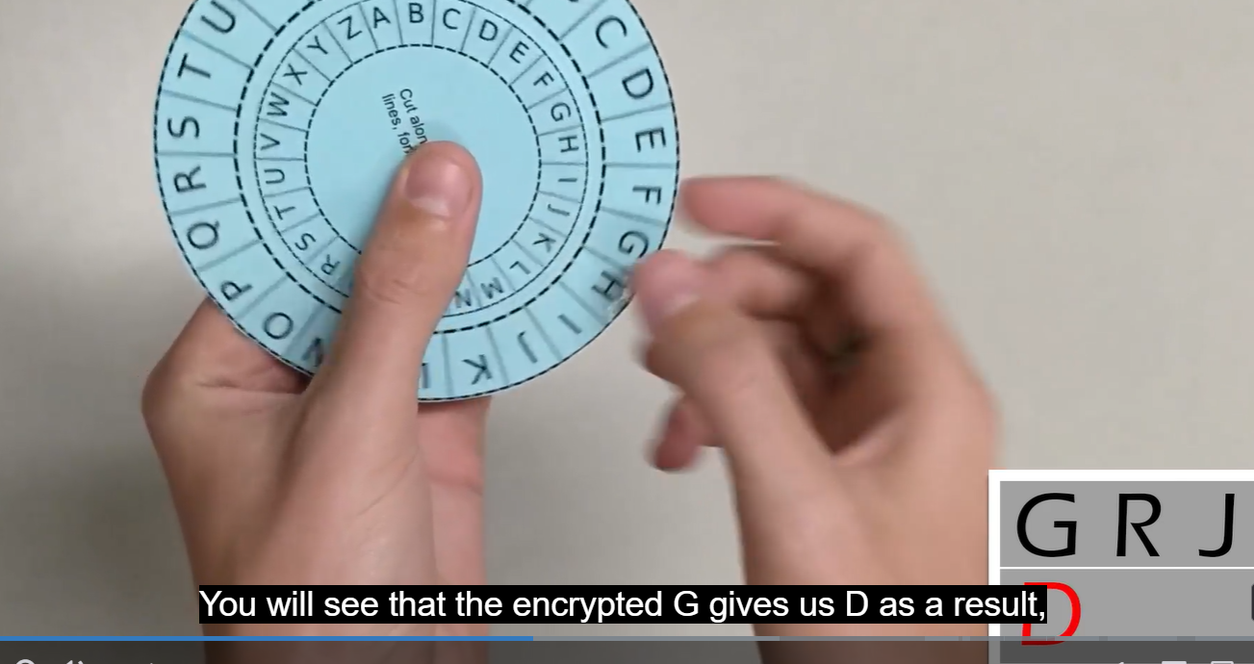
Teacher Prep Materials
Background materials for Caesar Cipher CT Bin
https://app.vidgrid.com/view/MgQHrybiEF3V

Slide 5
Now you do...
Open your CT bin and work in pairs to try and decode at least three of the five “Challenge 1” messages.
Once you get done with that, move on to “Extension 2” and try encoding some of your own messages.

Slide 6
Applicable First Principles
TTYP: What first principles do you see at work here?

Slide 7
TTYP: Think like a Cryptanalyst
In these examples you were a trusted recipient of messages, and you knew the shift key needed to decode the message.
But what about an untrusted party who happens to be listening in as the message travels through the network?
How might they be able to reliably break this encryption approach? Brainstorm potential weaknesses they might be able to use.

Slide 8
Hmmm…..what are they saying?
OZGG HZ J HPNZ JA OCVO DIBZIDJPN CZMJ RCJ OMVQZGGZY AVM VIY RDYZ VAOZM CZ CVY NVXFZY OCZ AVHJPN OJRI JA OMJT HVIT XDODZN YDY CZ QDNDO VIY HVIT RZMZ OCZ IVODJIN RDOC RCJNZ HVIIZMN VIY XPNOJHN CZ RVN VXLPVDIOZY HJMZJQZM CZ NPAAZMZY HPXC WT NZV RCDGZ OMTDIB OJ NVQZ CDN JRI GDAZ VIY WMDIB CDN HZI NVAZGT CJHZ WPO YJ RCVO CZ HDBCO CZ XJPGY IJO NVQZ CDN HZI AJM OCZT KZMDNCZY OCMJPBC OCZDM JRI NCZZM AJGGT DI ZVODIB OCZ XVOOGZ JA OCZ NPIBJY CTKZMDJI NJ OCZ BJY KMZQZIOZY OCZH AMJH ZQZM MZVXCDIB CJHZ OZGG HZ OJJ VWJPO VGG OCZNZ OCDIBN JC YVPBCOZM JA EJQZ AMJH RCVONJZQZM NJPMXZ TJP HVT FIJR OCZH
NJ IJR VGG RCJ ZNXVKZY YZVOC DI WVOOGZ JM WT NCDKRMZXF CVY BJO NVAZGT CJHZ ZSXZKO PGTNNZN VIY CZ OCJPBC CZ RVN GJIBDIB OJ MZOPMI OJ CDN RDAZ VIY XJPIOMT RVN YZOVDIZY WT OCZ BJYYZNN XVGTKNJ RCJ CVY BJO CDH DIOJ V GVMBZ XVQZ VIY RVIOZY OJ HVMMT CDH WPO VN TZVMN RZIO WT OCZMZ XVHZ V ODHZ RCZI OCZ BJYN NZOOGZY OCVO CZ NCJPGY BJ WVXF OJ DOCVXV ZQZI OCZI CJRZQZM RCZI CZ RVN VHJIB CDN JRI KZJKGZ CDN OMJPWGZN RZMZ IJO TZO JQZM IZQZMOCZGZNN VGG OCZ BJYN CVY IJR WZBPI OJ KDOT CDH ZSXZKO IZKOPIZ RCJ NODGG KZMNZXPOZY CDH RDOCJPO XZVNDIB VIY RJPGY IJO GZO CDH BZO CJHZ
CDN DIOZIYZY QJTVBZ VIY JA OCZ XJPINZG OCVO HDIZMQV CVY BDQZI CDH

Slide 9
Let’s try out some of your ideas...

Slide 10
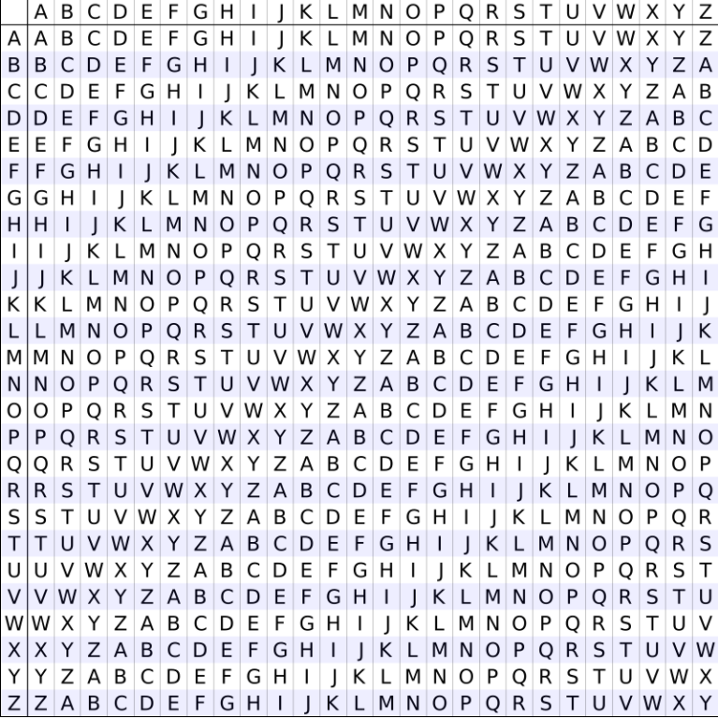

Possible Improvements on Monoalphabetic Substitution?
Vigenere

Slide 11
CT Bin: Vigenere
Teacher prep: https://app.vidgrid.com/view/EPueqKZbbmgj

Slide 12
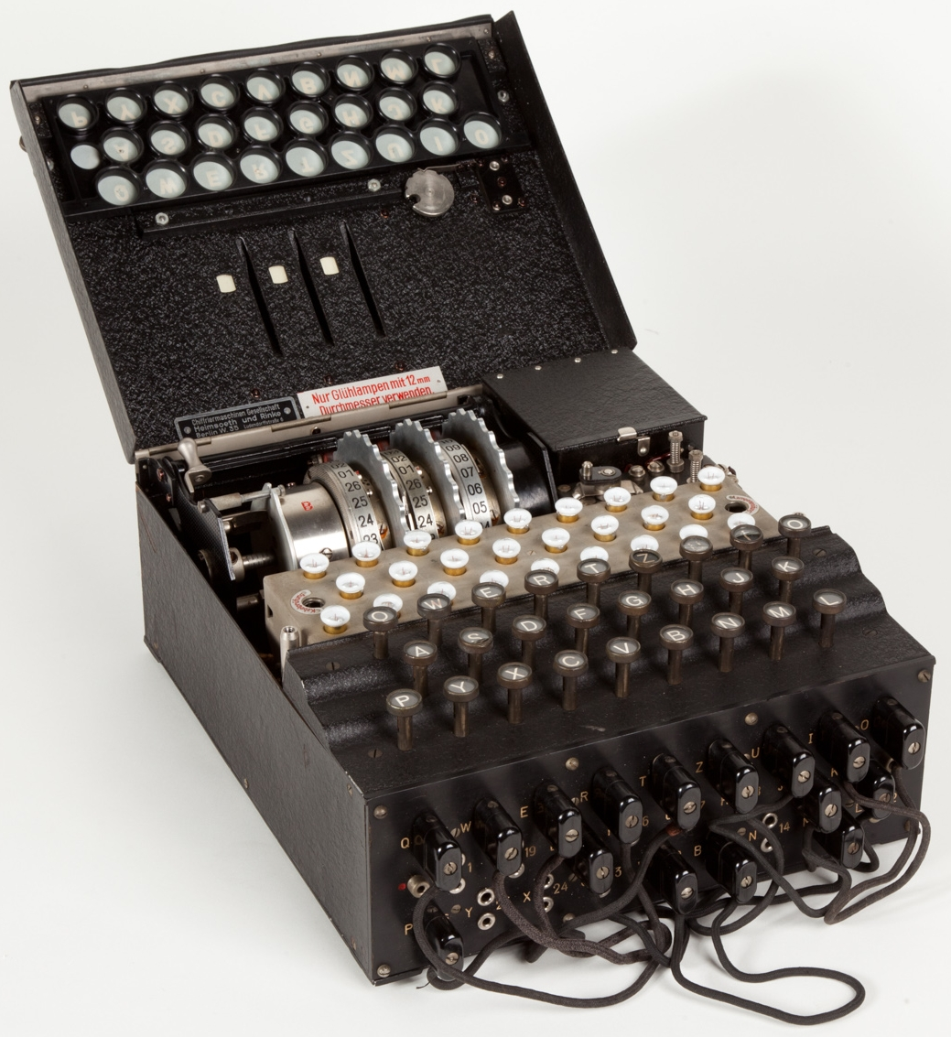
Can we go further?
Enigma

Slide 13
Recap and Related Resources
Vocab Review
Cryptography
Encryption / Decryption
Cipher algorithms / substitution ciphers
Caesar Cipher
Vigenere
Engima
Cryptanalysis
Frequency Analysis
Brute Force
Related Resources
https://studio.code.org/s/hoc-encryption

