Slide 1
Curriculum Standard Alignment
Briana Morrison
(bbmorrison@unomaha.edu)

Slide 2
Plans for the week
We are asking you to create a new cybersecurity lesson:
For your classroom
To share with others (this and future years)
You can do this alone or in small groups (2-3).
You will be able to have a “dry run” of the lesson by teaching it to this group.

Slide 3
Lesson Documentation
You will write up your new lesson in a prescribed format:
Title
Summary
Targeted grade/age level
Time requirement
First principles addressed
Learning objectives
Standards Addressed
Material list

Slide 4
Continued...
Lesson Plan (warm-up, focused, closure, reflection)
Assessment
Accommodations
Extensions
Authorship
Creative Commons License

Slide 5
Dry Runs
We have allocated time for you to “practice” your lesson once and update any lesson documentation based on experience and feedback from the group.
Notes:
We all know that lessons don’t always go as planned...

Slide 6
Timing
Research and Prep
Friday morning
Monday morning
Monday afternoon
Tuesday afternoon
Feedback
Tuesday morning (circle share)
Friday – dry runs

Slide 7
Curriculum Standards
K-12 Computer Science Framework
CSTA CS Standards
ISTE Standards for Students
ISTE Computational Thinking Competencies
Nebraska CS Standards

Slide 8
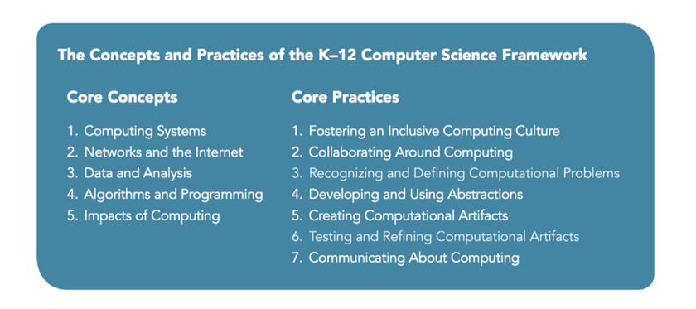
K-12 Computer Science Framework
https://k12cs.org/

Slide 9
CSTA CS Standards
https://www.csteachers.org/page/standards
Ages 5 – 16
Computing Systems (devices, hardware & software, troubleshooting)
Networks & the Internet (network communication & organization, cybersecurity)
Data & Analysis (storage, collection, visualization & transformation, inference & models)
Algorithms & Programming (algorithms, variables, control, modularity, program development)
Impacts of Computing (culture, social interactions, safety, law, & ethics

Slide 10
ISTE Standards for Students
https://www.iste.org/standards/iste-standards-for-students
Empowered Learner
Digital Citizen
Knowledge Constructor
Innovative Designer
Computational Thinker
Creative Communicator
Global Collaborator

Slide 11
ISTE Computational Thinking Competencies
https://www.iste.org/standards/iste-standards-for-computational-thinking
Computational Thinking (Learner)
Equity Leader (Leader)
Collaborating Around Computing (Collaborator)
Creativity & Design (Designer)
Integrating Computational Thinking (Facilitator)
Also CT Competencies for Educators

Slide 12
Nebraska CS Standards
https://www.education.ne.gov/nce/cis/
Computational Thinking Standards
Programming Standards
Classes
Foundations of Computing
Computer Science Principles
AP CS A
Software Development
Cybersecurity
K-12 Technology Scope and Sequence

Slide 13
Support
Know that we are available for support during the week.
Also available is Kristeen - another teacher!
Questions?

