Slide 1
System Components Overview (Python)

Slide 2
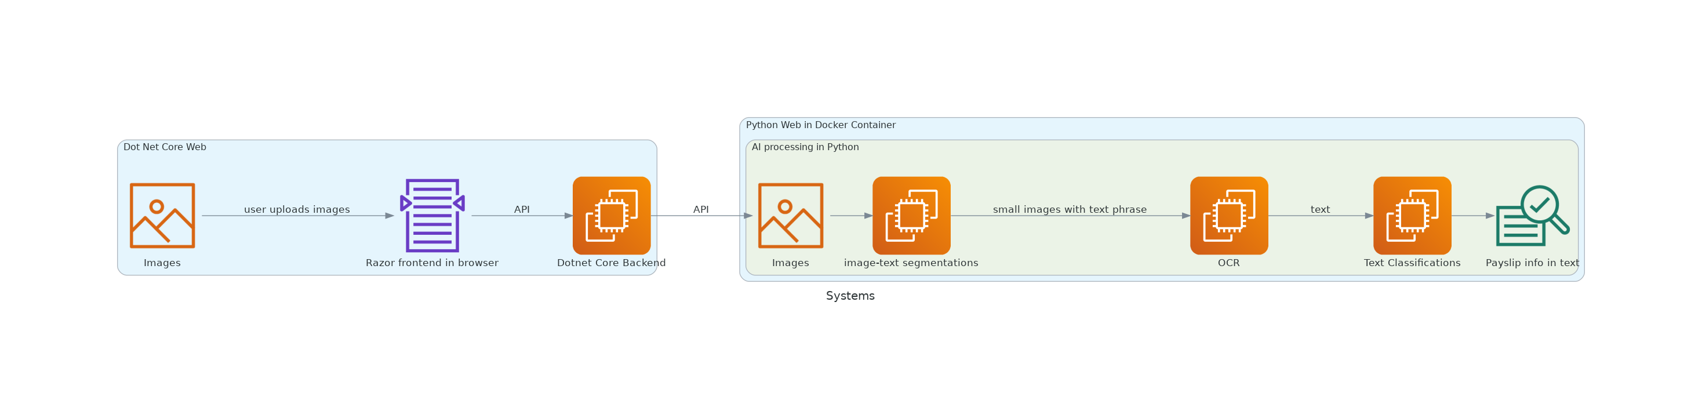
Systems Overview

Slide 3
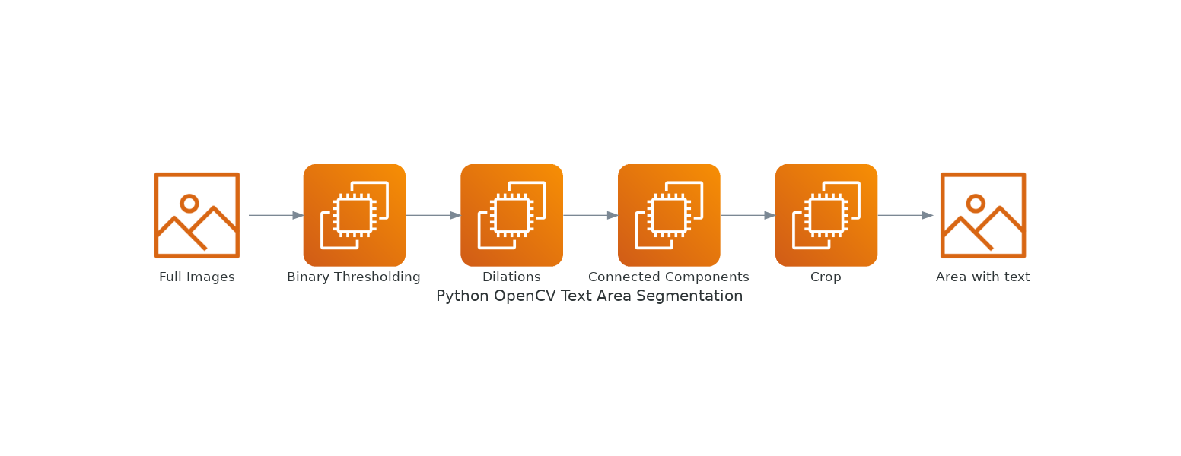
Text Area Image Segmentation

Slide 4
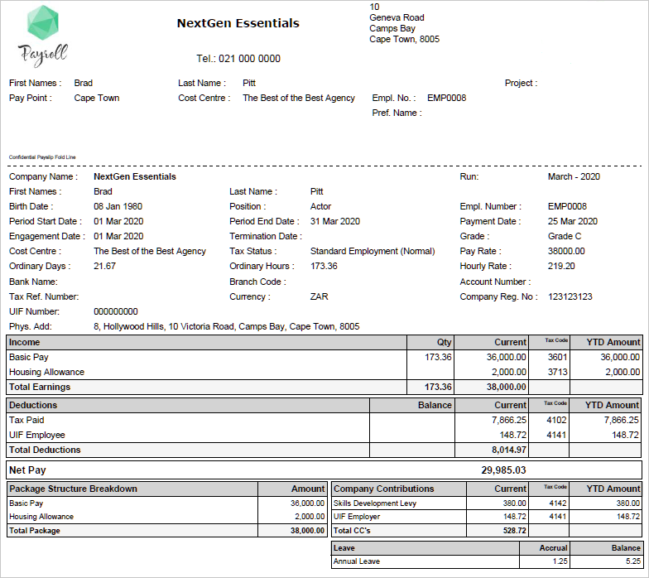
Sample Payslip images

Slide 5
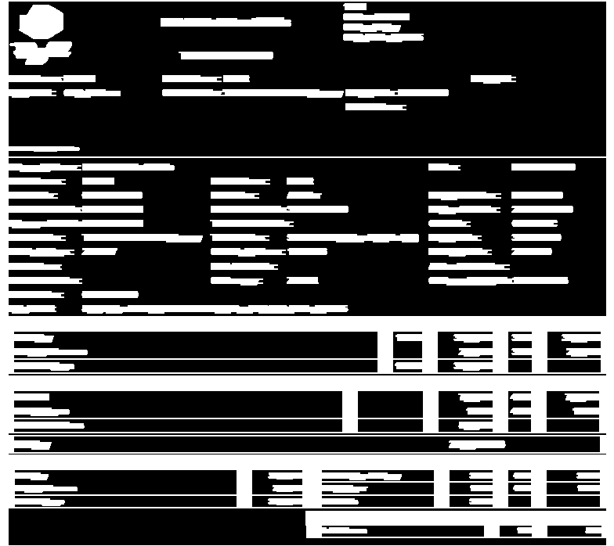
Example Intermediate Processing Images

Slide 6
Example segmented outputs

Slide 7
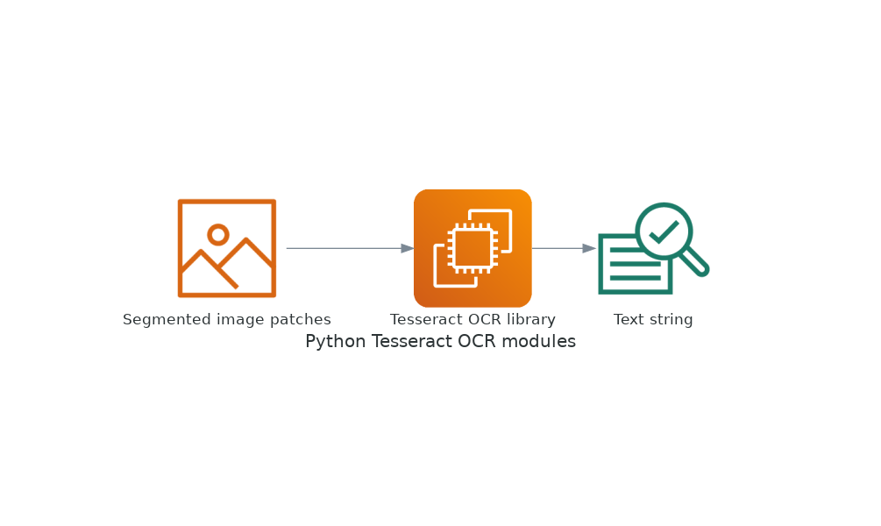
Python tesseract OCR module

Slide 8
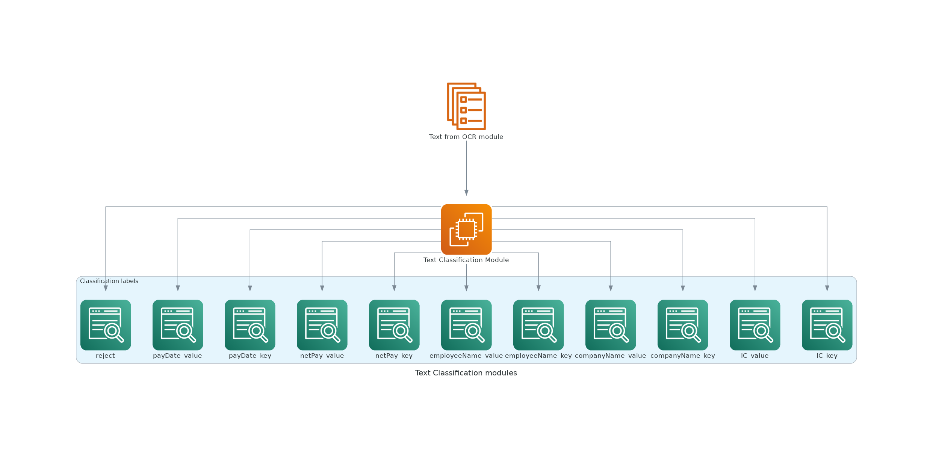
Neural Network Text Clasification Module

Slide 9
Text Classification Neural Network Training Process Overview

Slide 10
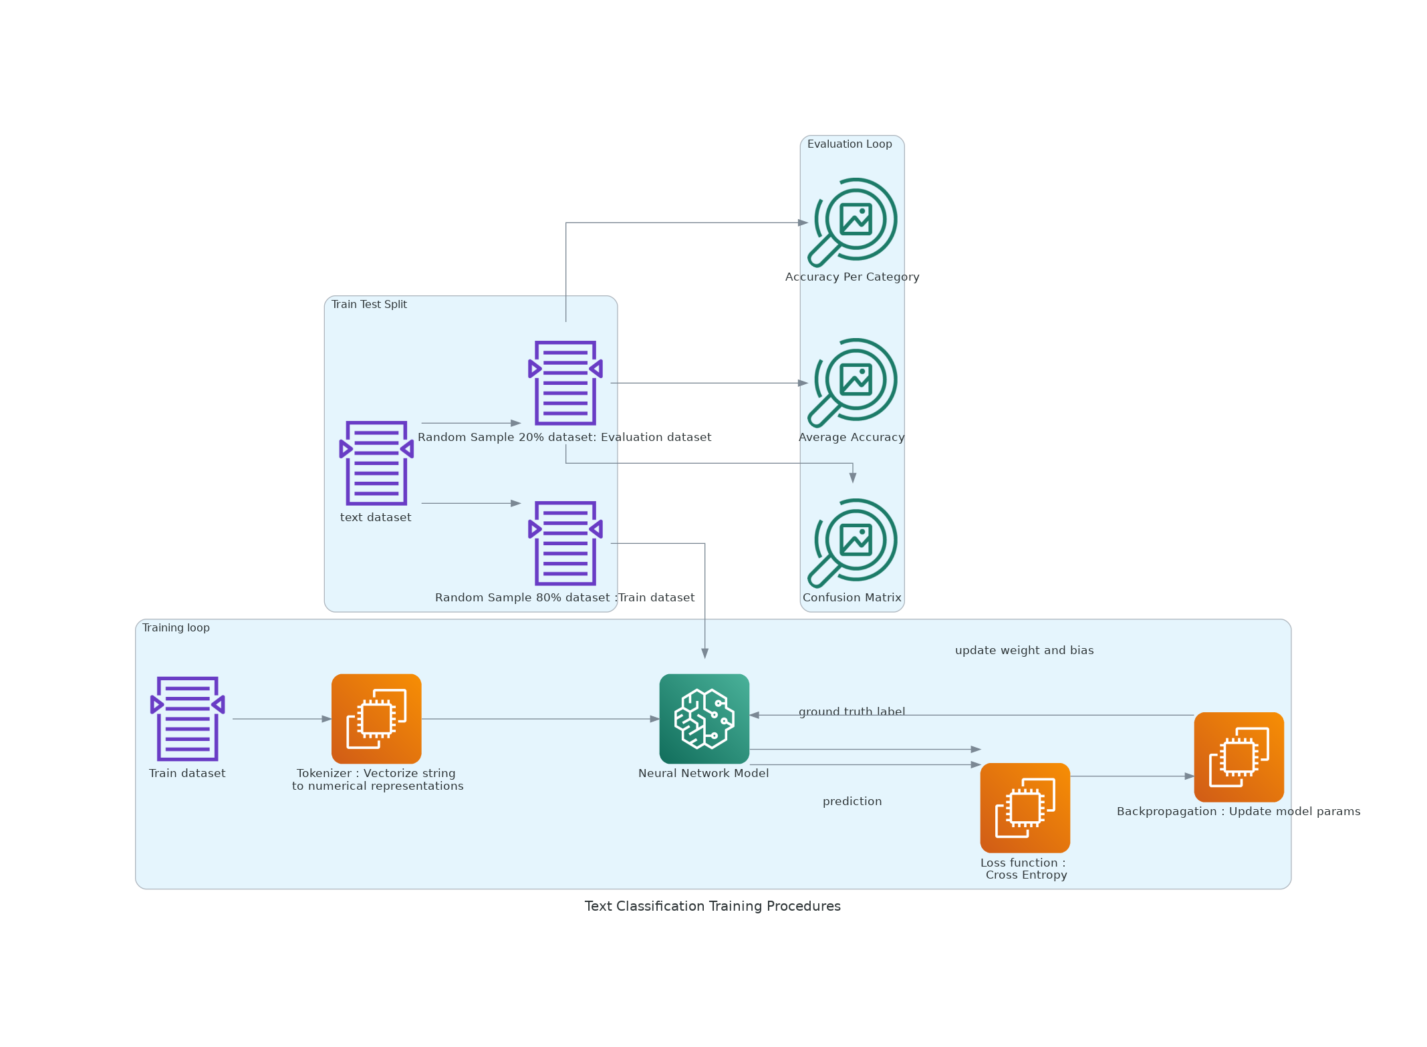
Training-Evaluation Process

Slide 11
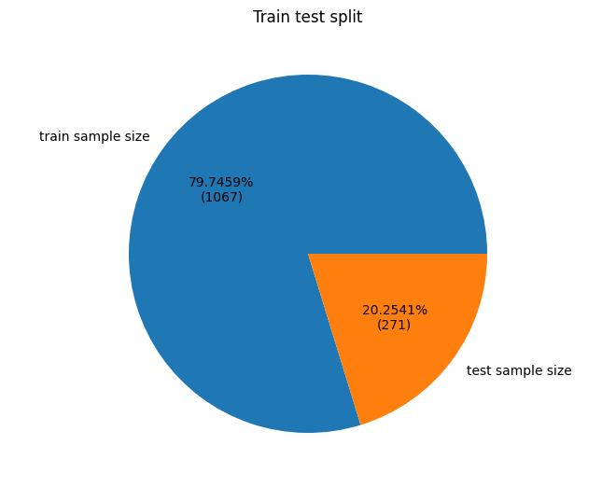
Text Classification Train Test Split

Slide 12
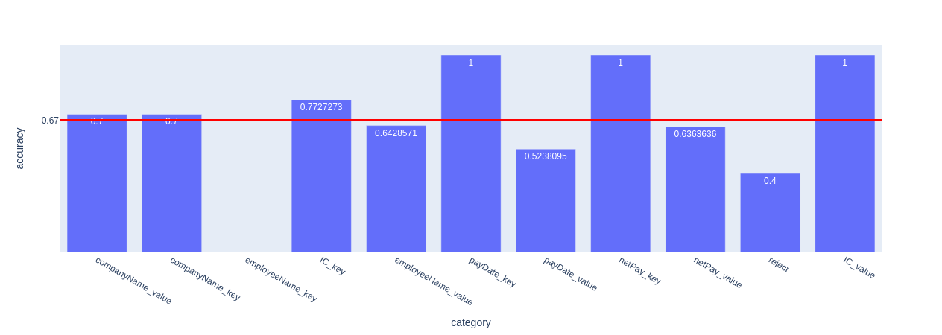
Text Classification Performance : Accuracy Per Category

Slide 13
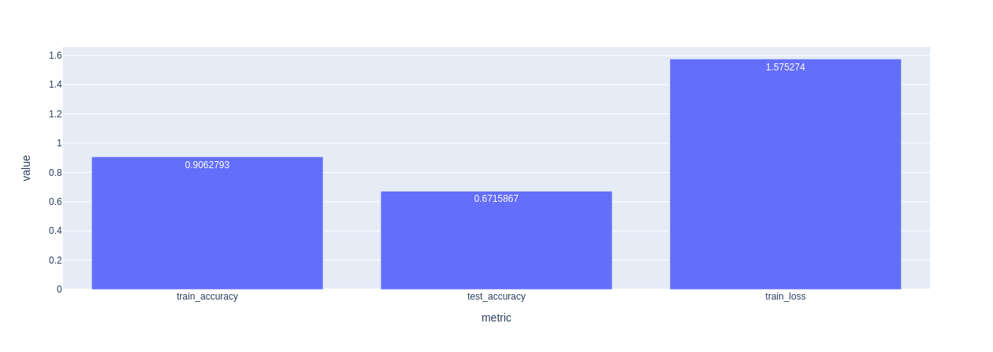
Text Classification Performance : Average Train set Accuracy, Average Test set Accuracy, Train Cross Entropy Loss

Slide 14
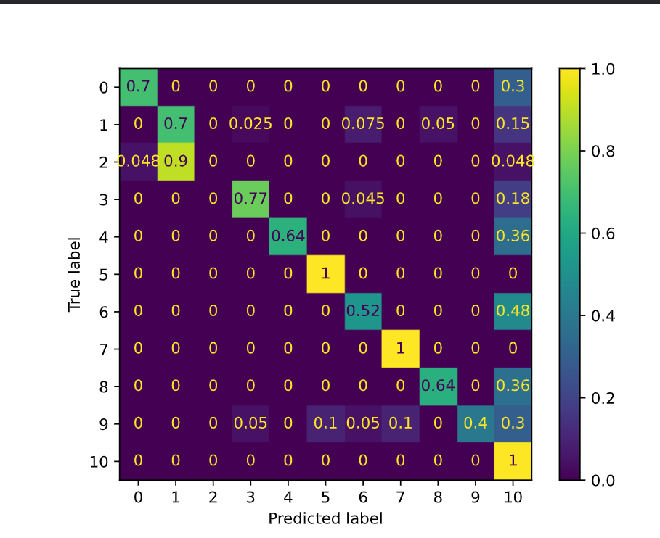
Text Classification Performance : Test set Confusion Matrix

Slide 15
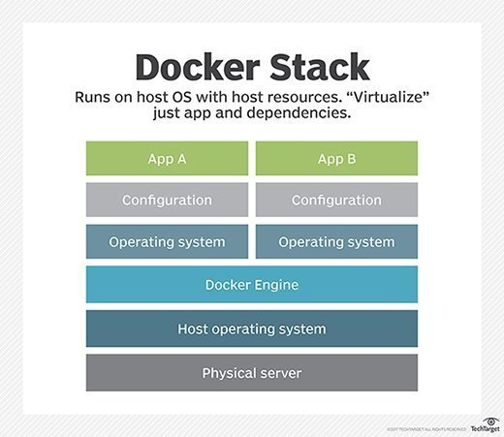
Containerisation : Docker

Slide 16
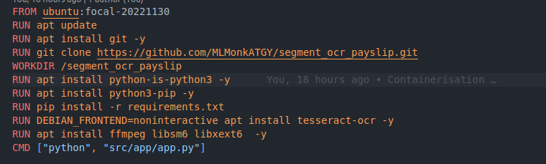
Containerisation : Dockerfile

