Slide 1

Using Machine Learning to Address the Opioid Crisis
Megan Skrobacz, Matthew Menzi, Yoselyn Cervantes, Adithya Chundailthodi

Slide 2
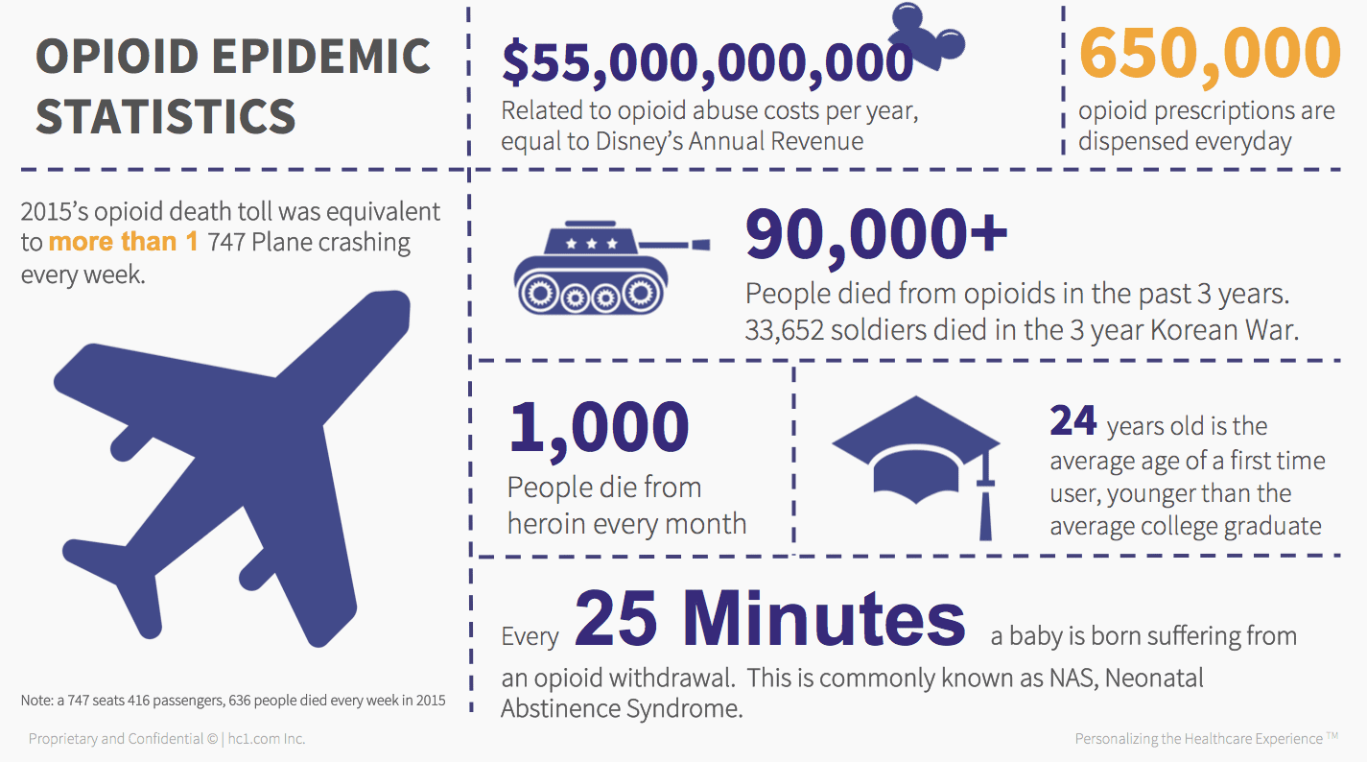
Background & Motivation
We wanted to study a topic which would involve a social problem to potentially use ML to help solve it
The opioid crisis is one which is agnostic of borders and endemic to many countries
We chose to focus on the US due to the availability of public datasets
Image source: Virgil, Sarah. “The Opioid Crisis Is Now Officially A National Emergency. Now What?” Hc1.com Inc, https://www.hc1.com/blog/the-opioid-crisis-is-now-officially-a-national-emergency-now-what/

Slide 3
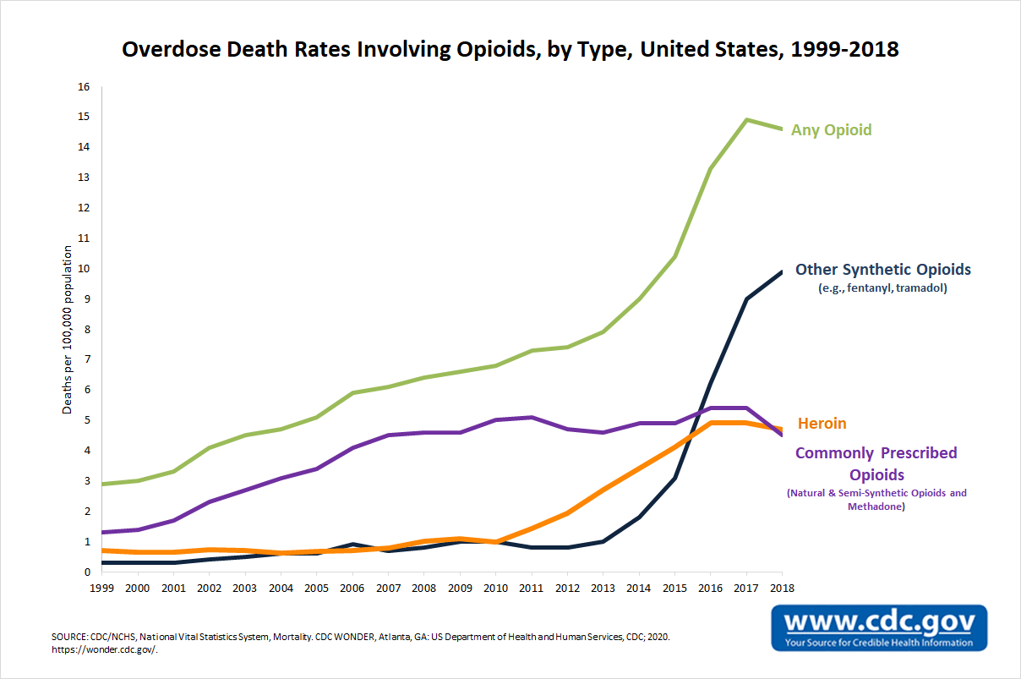
The Opioid Crisis in the United states
1803 → morphine distributed to soldiers in Civil War for pain relief, many became addicted
Overdose deaths increased from 2,000 deaths a year in the 1970s to 93,000 a year in 2020 ^{[1]}
The scale of the crisis has been enough to reduce life expectancy in the United States below its peak in 2014 to today ^{[2]}
The CDC estimates that the total "economic burden" of prescription opioid misuse alone in the United States is $78.5 billion a year, including the costs of healthcare, lost productivity, addiction treatment, and criminal justice involvement ^{[3]}

Slide 4

Previous/Related Works
Machine Learning scholarly research is primarily focused on users of opioids, specifically predicting opioid misuse (scholars like Huinker ^{[4]} analyze these possible models)
Northeastern’s Angela Kilby ^{[5]} and Lo-Ciganic W et al ^{[6]} investigate issues with algorithmic methods currently being used in locales such as medical offices and police departments.
Critique of machine learning algorithms predicting one’s chances of opioid abuse is so prevalent that even mainstream journalistic sources cover the topic, as in Szalavitz’s expose in Wired ^{[7]}

Slide 5
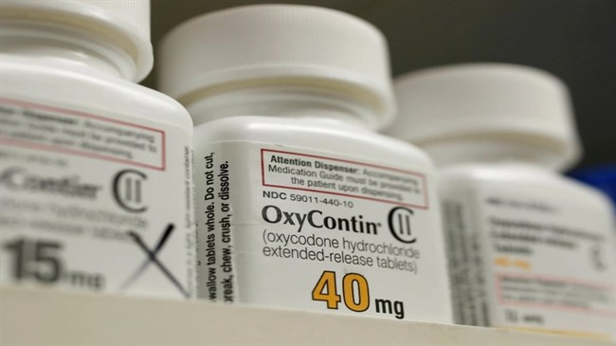
Our approach
We focus more on opioid prescribers rather than opioid users
We use federal datasets to do broad analysis, state-level ones to see how well those predictors fare
We are broad in our analysis, focusing on 3 specific concepts:
Studying the impact of lobbying groups on opioid prescriber rates
Using federal data to build a classifier which can identify doctors who prescribe opioids
Using that classifier to gain state-level insights, specifically for the state of Connecticut
Image source: https://irandaily.ir/content/imgcache/file/291108/0/image_650_365.jpg

Slide 6
Analysis 1 → Studying the impact of lobbying groups on opioid prescriber rates (Yoselyn)

Slide 7

Analysis 2 → Using Federal data to classify doctors who prescribe opioids (Adithya)
Unnecessary prescriptions potentially play a significant role in the increase in opioid overdoses.
Patients who do not truly need the medication run the risk of becoming addicted themselves
Find the likelihood that a provider would prescribe an opioid.

Slide 8

Understanding the Dataset
Summaries of prescription records for 250 common opioid and non-opioid drugs written by 25,000 unique licensed medical professionals.
Features – Gender, State, Credentials, Specialty, Opioid-Prescriber Label & List of Drugs.

Slide 9
OBSERVATIONS
Most widely prescribed opioid - hydrocodone(Vicodin)
Most Common Prescribers - Surgeons
California had significantly more deaths than any other states.
West Virginia had the highest death per capita.

Slide 10

Prediction – classification algorithms
The Perceptron
K-Nearest Neighbors
Gaussian Naïve Bayes
Decision Trees
Gradient Boosting

Slide 11
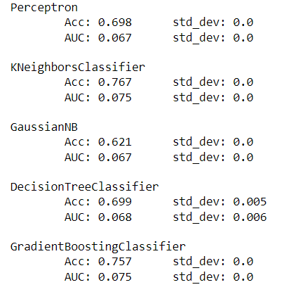
MODEL EVALUATION - 1
TRAIN-TEST SPLITS

Slide 12
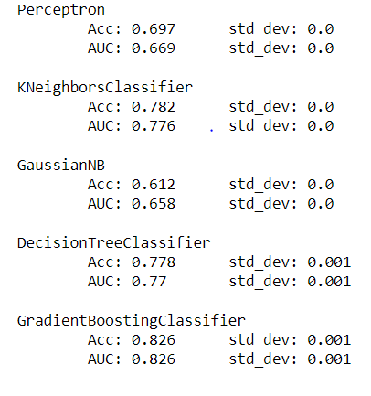
MODEL EVALUATION - 2
5 – CROSS VALIDATION

Slide 13
Analysis 3 → using the classifier to gain state-level insights (Matthew)

Slide 14

Overall findings
Lobbying didn’t have as much of an impact as we thought on opioid distribution rates (no significant correlation)
Regression didn’t work best for this analysis
For the prediction model, gradient boosting classifier worked best, followed by KNN
For the state model, gradient boosting also worked well, but we worry about potentially overfitting – with more time we would like to verify with other data, etc
Model efficacy is hard to determine without other state data
We think our contributions can certainly lead to future work around this topic
Image source: https://i1.wp.com/www.studentdoctor.net/wp-content/uploads/2018/07/20180726_opioid_783935359.png?resize=800%2C445&ssl=1

Slide 15
Sources Referenced
[1] “Unintentional Drug Poisoning in the United States”, Center for Disease Control, https://www.cdc.gov/medicationsafety/pdfs/cdc_5538_ds1.pdf
[2] Dowell D, Arias E, Kochanek K, et al. Contribution of Opioid-Involved Poisoning to the Change in Life Expectancy in the United States, 2000-2015. JAMA. 2017;318(11):1065–1067. doi:10.1001/jama.2017.9308
[3] Florence CS, Zhou C, Luo F, Xu L. The Economic Burden of Prescription Opioid Overdose, Abuse, and Dependence in the United States, 2013. Med Care. 2016;54(10):901-906. doi:10.1097/MLR.0000000000000625.
[4] J. Huinker. Using machine learning to predict prescription opioid misuse in patients. Iowa State University Digital Repository, 194, 2019.
[5] A. E. Kilby. Algorithmic fairness in predicting opioid use disorder using machine learning. In Proceedings of the 2021 ACM Conference on Fairness, Accountability, and Transparency, FAccT ’21, page 272, New York, NY, USA, 2021. Association for Computing Machinery.
[6] W.-H. Lo-Ciganic, J. L. Huang, H. H. Zhang, J. C. Weiss, Y. Wu, C. K. Kwoh, J. M. Donohue, G. Cochran, A. J. Gordon, D. C. Malone, C. C. Kuza, and W. F. Gellad. Evaluation of machine-learning algorithms for predicting opioid overdose risk among medicare beneficiaries with opioid prescriptions. JAMA Network Open, 2(3):e190968–e190968, 03 2019.
[7] M. Szalavitz. A drug addiction risk algorithm and its grim toll on chronic pain sufferers, Wired, 08 2021.

Slide 16
Questions?

