Slide 1
Computer Vision JSON Python and JSON
Anwesh Budhathoki

Slide 2



Anwesh Budhathoki
CSIT student at MBMC
Microsoft Student Partner
Community Member at techWebinarNepal
Socials
@4nweshb
anweshb

Slide 3
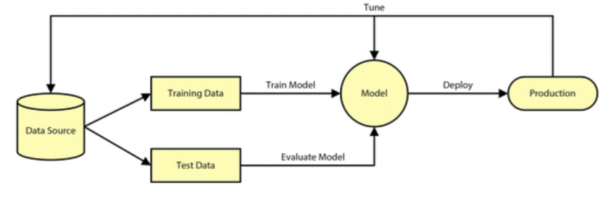
Artificial Intelligence

Slide 4

Azure Cognitive Services
Powerful and convenient tool
Easy Access
Use as per your need
No expertise on AI/ML

Slide 5
JSON
JavaScript Object Notation
Collection of Key-Value pair
Language independent
Objects => { “key1”: “value”, “key2”: “value”}
Arrays => [ obj1, obj2, obj3, …… ]

Slide 6
JSON via. Python
x = {“menu”:{
“value”: “File”,
“popup”:[
{“value”: “New”, “onclick”: “Create”},
{“value”: “Open”, “onclick”: “OpenFile”},
{“value”: “Close”, “onclick”: “CloseFile”},
]
}}
Access via. Python:
> x['menu']["popup"][1]["onclick"]

Slide 7
Let’s see the CODE

Slide 8
Queries???
Good Luck!!! Have Fun!!!

Slide 9
AI Gaming

