Slide 1
AGRICULTURE YIELD PREDICTION
by Data Pirates:
Kashish Shah - AU1841014
Harsh Patel - AU1841015
Hriday Nagrani - AU1841042
Yugamsinh Chavda - AU1841090

Slide 2
Introduction
Agriculture sector is one of the most important sector in Indian economy. With the continuing expansion of the human population and urbanization, understanding agricultural yield is central to addressing food security challenges
Studying the impacts of climatic change on crop yield has become one of the most important topics to look forward as our surroundings are changing due to the impact of global warming.
The Agricultural yield mainly depends on weather conditions like temperature and rainfall , type and quantity of pesticides used,and the soil type.

Slide 3
Problem Statement
We want to predict the agricultural yield production for a variety of crops by taking into consideration the various parameters which significantly affect the production . The parameters include types of soils used for agriculture, average rainfall in a region throughout the year,types of fertilizers used and many others.
After predicting the yield, we want to analyze the effect of climatic change in crop yield over the range of many years.

Slide 4
Approach
Studying the problem and exploring various official government sources like annual reports,articles etc related to the crop production.
Preparing the list of parameters which affect the crop yield.
Collecting the data for various factors like rainfall, temperature, soil types, types of fertilizers etc for India.
Data cleaning and Preprocessing for different datasets collected for different affecting parameters.

Slide 5
Approach
Merging the data from different tables into one.
Data Normalization.
Splitting data into train and test sets.
Creating a basic linear regression model.
Observing the results generated for the linear model.We observed the MSE and r2_score values.
Then we tried to fit a polynomial regression model trying different degrees.

Slide 6
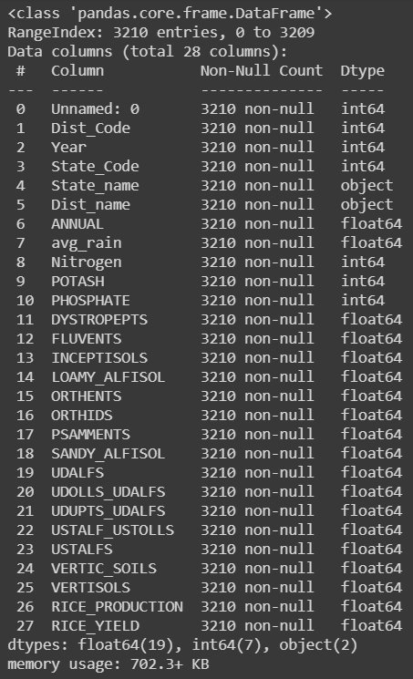
Initial Results
Complete processing of the data has been done. The image on the right is the information of our final dataset( for yield prediction of rice).
Different regression techniques implemented and their results.
We applied Linear Regression, Polynomial Regression, Ridge Regression and Lasso Regression

Slide 7
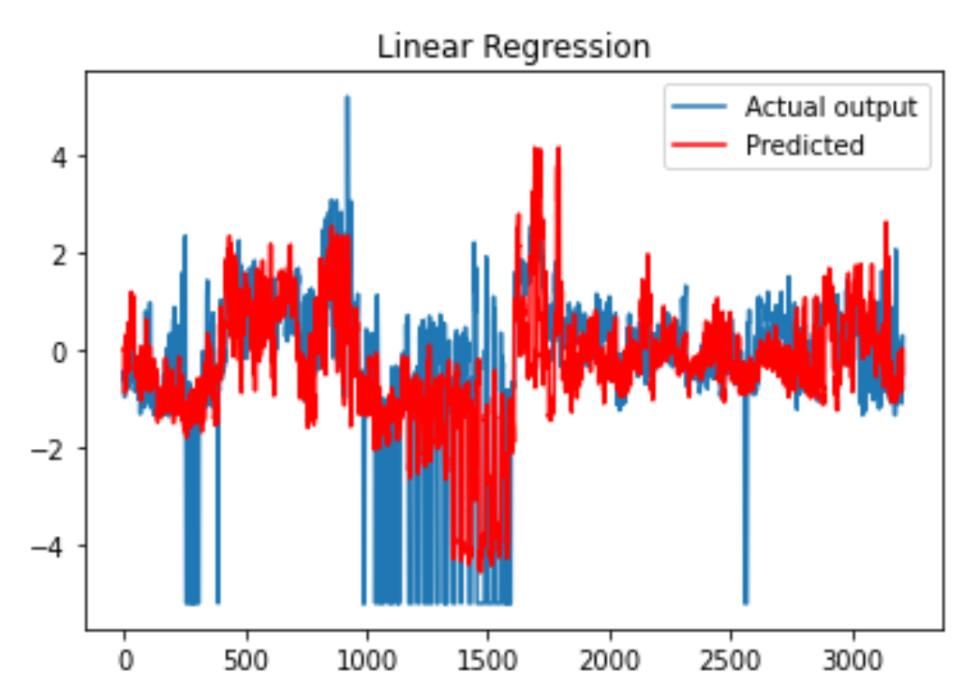
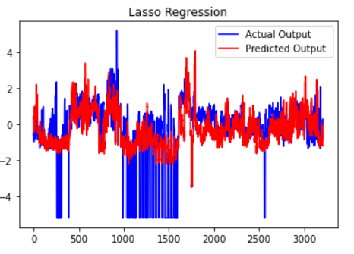
Initial Results
Above are the two outputs for Linear Regression and for Lasso Regression.

Slide 8
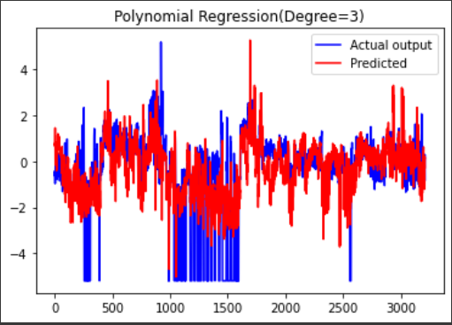
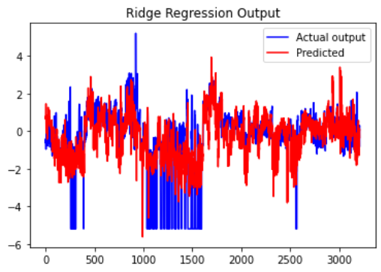
Initial Results
Above are the two outputs for Polynomial Regression(Degree=3) and for Ridge Regression.

Slide 9
Role of Group Members
Future Work
Hriday : Soil Data Fetching and Preprocessing , coding part(Linear Regression)
Harsh and Kashish : Outlier Treatment, Missing value treatment and other preprocessing for Rainfall, crop production and fertilizers data, coding part(Ridge Regression, Lasso Regression and Polynomial Regression) .
Yugamsinh : Contribution in all basic coding parts like helping everyone in basics numpy transformations etc .
Hyper Parameters Tuning and will implement different regression techniques
Adding more factors like temperature and water deficit.
Implementing regularization to improve the accuracy of the model.

Slide 10
References
https://iasri.icar.gov.in/
http://data.icrisat.org/dld/src/crops.html
https://data.gov.in/
https://scikit-learn.org/stable/modules/linear_model.html
Effect of transforming the targets in regression model — scikit-learn 0.24.1 documentation (scikit-learn.org)

