Slide 1
Blackwell Electronics:
Predicting Customer
Preference
ANALYSIS CURATED BY TEAM ALPHA
James, Matt, Monika, Sharon, Yanhua

Slide 2
Objective & Resources
Objective:
Provide benefits of data mining
Customer brand preference
Prediction of sales
Effects of customer reviews
Should Blackwell Electronics acquire Electronidex?
Resources:
Survey data of customer brand preferences
Historical sales data
One month of Electronidex’s transaction data
Comparison of frequently purchased items of both companies
Notes:
Recently, our team has been tasked with providing Blackwell Electronics valuable information about their customers’ purchasing habits. Today, we are going to illustrate the benefits of data mining by sharing the results of our research.
Data mining allowed us to discover which brand of electronics Blackwell customers prefer along with ideas to streamline inventory control. In addition, We will provide a tool to predict the sales rankings and volumes of several items currently sold by Blackwell as well as any expected effect of customer reviews provided by Blackwell’s customers.
We will also answer the question on everybody’s mind: Should Blackwell Electronics acquire online competitor, Electronidex?
We were able to generate this information from surveys sent to Blackwell’s customers regarding 2 computer products. We also gathered historical Blackwell sales data to assist with our prediction of 4 new product types. One month of Electronidex’s transaction data was used to determine their customers’ buying patterns which was compared with Blackwell’s customers to make a final determination of the acquisition proposal.
First up is Sharon to discuss customer brand preferences.

Slide 3
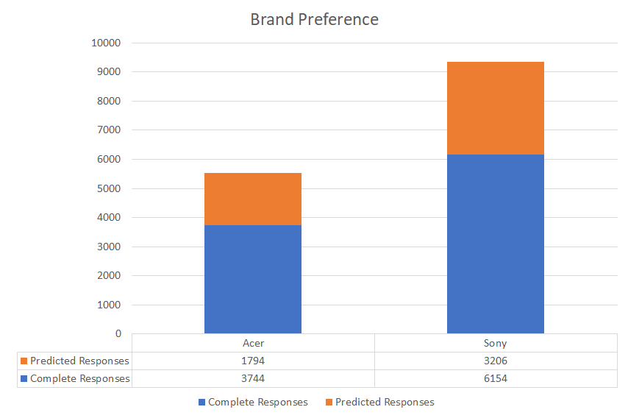
Predicting Customer Preference
Customer Brand Preferences
Using existing customer survey data we were able to apply a model to determine brand preference for incomplete surveys.
62 % of customers prefer Sony
Recommendations:
Use this information to influence inventory control.
Increase discount from vendors with bulk purchasing.
Replicate this type of survey for additional products to improve inventory and purchasing.
Notes:
C3T2 -- Classification: Predict which Brand of Products Customers Prefer
Problem we are trying to solve: Can we use existing customer surveys to predict which brand customers prefer, and how can we leverage this from a business perspective? Problem we are trying to solve: Can we use existing customer survey data to predict which brand customers prefer, and how can we leverage this information?Problem we are trying to solve: Can we use existing customer survey data to predict which brand customers prefer, and how can we leverage this information?

Slide 4
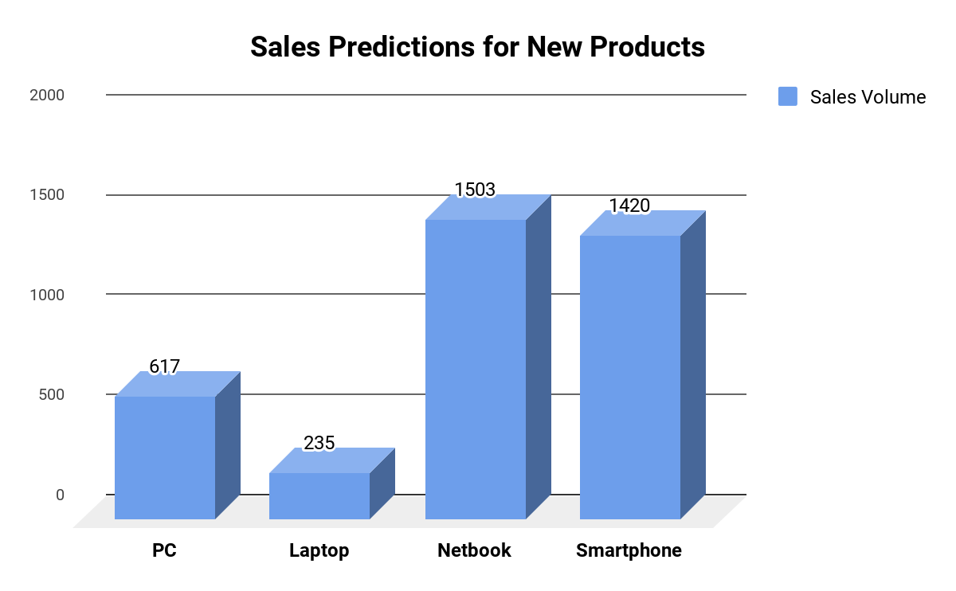
Predicting Customer Preference
Predicting Sales
 | Predicted Sales Volume | Predicted Revenue | Predicted Profit
PC | 617 | $458,975 | $107,347
Laptop | 235 | $289,765 | $33,073
Netbook | 1,503 | $516,910 | $47,566
Smartphone | 1,420 | $179,091 | $20,566
The New Netbook Products have the Highest Predicted Sales Volume but the Lowest Profit Margin
The New PC Products are by far the Most Profitable
The New Smartphone Products have the Lowest Predicted Revenue & Profit
Notes:
C3T3 -- Multiple Regression in R
Predicting sales of four different product types: PC, Laptops, Netbooks and Smartphones

Slide 5
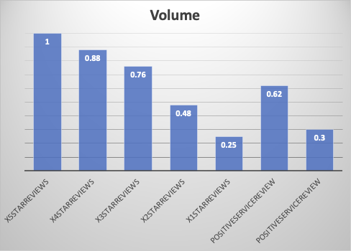
Predicting Customer Preference
Accessing Customer Reviews
Customer and service reviews have a great impact on sales volumes.
More products with high service and customer reviews should be made and put in the inventory.
Notes:
C3T3 -- Multiple Regression in R
Assessing the impact services reviews and customer reviews have on sales of different product types
The Service Reviews appeared to be manipulated as all 5 Star Reviews were exactly 25% of the Total Sales Volume

Slide 6
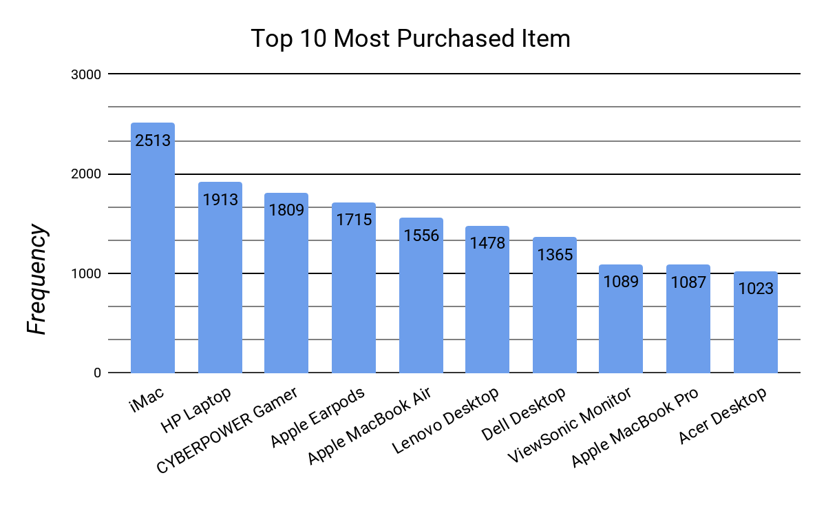
Predicting Customer Preference
Electronidex: Transaction Observations
Top 10 Electronidex Purchases:
5 of the top 10 items were Desktops 3 of the 10 items were Laptops Top ten list includes 4 Apple products
22% of the transactions are single item purchases. The top 3 products purchased individually include:
Apple MacBook Air – 380 Apple EarPods - 156 iMac – 121
Notes:
Most purchased products
Products purchased most individually
Products purchased most together

Slide 7



Predicting Customer Preference
Electronidex: Associations Between Products
Buying Pattern Observations:
Customers purchase multiple Desktops and Laptops of different types in a single transaction
The Dell Desktop & iMac were purchased together 537 times
The Acer Aspire, ViewSonic Monitor and HP Laptop were purchased together 106 times
Based on our findings, Electronidex seems to be a B2B company.
Acer Aspire
ViewSonic Monitor
HP Laptop
Dell Desktop
iMac

Slide 8
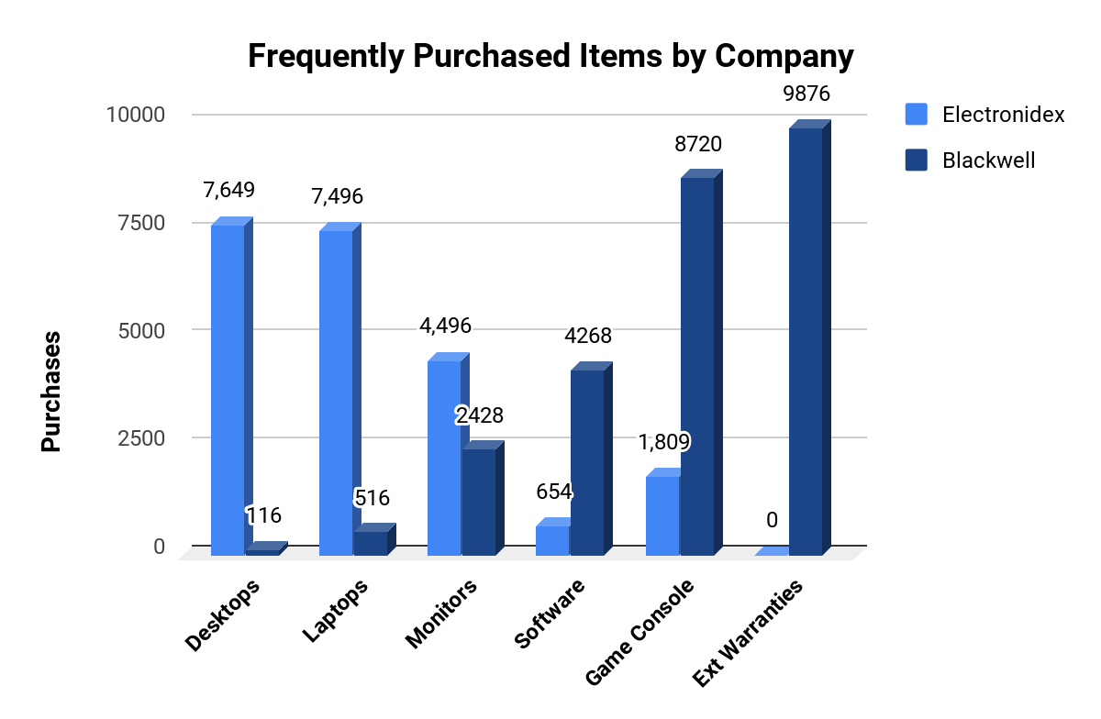
Predicting Customer Preference
Should Blackwell Acquire Electronidex?
Good Fit for Blackwell:
Over 15,000 Desktop & Laptop Purchases
28 Desktop, Laptop & Monitor Products
9 Gaming Products
Benefits From the Acquisition:
Increase Sales Volume & Product Variety
More Business Clientele
Cross-Selling Items
Experience In eCommerce
Notes:
C3T4-- market basket analysis: Discover Associations Between Products
Are there any interesting patterns or item relationships within Electronidex's transactions?
Would Blackwell benefit from selling any of Electronidex's items?
In your opinion, should Blackwell acquire Electronidex?
If Blackwell does acquire Electronidex, do you have any recommendations for Blackwell? (Ex: cross-selling items, sale promotions, should they remove items, etc.)

Slide 9
Predicting Customer Preference
Overview
Outline of Data Mining Analysis:
Predicted Customer Brand Preferences for 2 Computer Products
Predicted Sales Volume, Revenue & Profit for 4 New Product Types
Discovered Electronidex’s Customer Buying Patterns
Determined the Acquisition of Electronidex would be Beneficial to Blackwell
Recommendations:
Pursue Sony over Acer (Preferred Almost 2 to 1)
Consider Removing the New Netbook Products (Lowest Profit Margin)
Cross-Selling Desktop & Laptop Products and Recommend the Acer Aspire & ViewSonic Monitor when Purchasing an HP Laptop
Acquire Electronidex
Notes:
C3T4-- market basket analysis: Discover Associations Between Products
Are there any interesting patterns or item relationships within Electronidex's transactions?
Would Blackwell benefit from selling any of Electronidex's items?
In your opinion, should Blackwell acquire Electronidex?
If Blackwell does acquire Electronidex, do you have any recommendations for Blackwell? (Ex: cross-selling items, sale promotions, should they remove items, etc.)

Slide 10






Leveraging data mining in the future
Marketing Analytics
Sales Analytics
Quality Assurance Analytics
Finance Analytics
Customer Service Analytics
Operational Analytics
Notes:
Churn Predictions
Understand how often individuals buy a new device
Brand loyalty
Retention rates
With retention data we could calculate how many new customers are needed to hit sales goals.
With transaction dates, we could investigate seasonality of transactions.
With product information, we could examine if certain products are purchased in a certain region.
With product information, we could explore correlations between customer age and products being purchased.
With product & transaction date information, we could help accurately stock inventory.
With specific store data, we could analyze which stores were performing better than others. This could help determine if a store should be closed or if a new store could thrive.
With data around transaction time we could better determine the optimal hours of operation for a store. This could also aid with proper staffing of the store.

