Slide 1
fiskaltrust.Middleware
our solution for POS Creators

Slide 2


Agenda
Challenges for POS Creators
ft.Middleware as a solution
Functionality
Interface & data flow
Portal und configuration
Demo
Integration phases
Rollout scenarios
The portal as a rollout management tool
Getting started & documentation

Slide 3
The challenge of fiscalisation
Implement compliance with national law
Nevertheless, the costs of the POS System for the POS Operators should not increase

Slide 4
Challenge in Germany
New obligations for POS Systems (01 Jan. 2020)
Individual recordings
A certified TSE (technical security device) must be used
Archiving
Obligation to issue receipts
Obligation to notify the tax authorities
Integration of one or more TSE solutions
Adjustments for DSFinV-K (standardized format for data handover to tax authorities)
Notes:
Since 1.1.2020, new regulations apply to electronic recording systems that have a cash register functionality:
The data recorded with these systems must be protected against subsequent changes by a certified technical security device (TSE).
During tax audits, the recorded data must be handed over in a standardized format - the "Digital Interface of the Financial Administration for POS Systems" (DSFinV-K) describes that format.
The new obligations
The essential requirements result directly from the law (§146a of the German Fiscal Code) and the “Kassensicherungsverordnung” (KassenSichV - which regulates the technical requirements for cash register systems):
Individual recording: The business action and other processes must be recorded individually, completely, correctly, on time and in an orderly manner.
Obligation to use a certified TSE: The digital recordings must be protected by a certified technical security device.
Data backup / archiving: The digital records must be backed up and kept available for cash register checks and external audits from the tax authorities (at least 10 years).
Obligation to issue receipts: A receipt for the business action must be issued and made available to the parties involved in the business action.
Obligation to report: The responsible tax authorities must be notified of the acquisition and decommissioning of electronic recording systems and TSEs within one month.

Slide 5
ft.Middleware as a solution
Offers Compliance-As-A-Service by integration into your POS System
Advantages:
Internationally the same interface (DE, AT, FR)
In Germany: Connection to any certified TSE solution of your choice
Export of data in the legally prescribed formats
"As-A-Service", means always automatically conforming to the current requirements of the corresponding market
Can be operated locally or in a data center
Free of charge

Slide 6
ft.Middleware as a solution
Why is the ft.Middleware free of charge?
facilitates the "make or buy" decision
fiskaltrust offers fiscalisation products for POS Operators through POS Dealers. For example:
Audit-proof archiving of data
Automated notifications to the tax authorities
Carefree packages with and without TSE As-A service

Slide 7
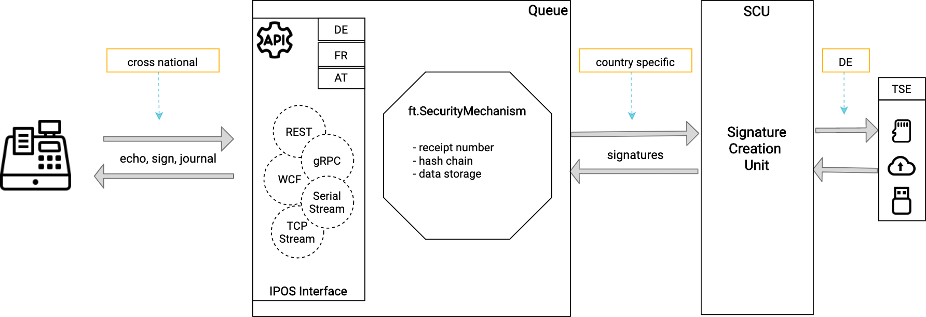
Functionality
Notes:
The cash register communicates with the Queue (component of the ft.Middleware) via the IPOS interface.
The IPOS interface is identical for all supported countries (cross national).
The iPOS Interface is accessible via REST, gRPC, WCF, TCP stream and serial stream.
The iPOS Interface offers 3 interface methods: echo (check availability), sign (sign receipt data, send special receipts), journal (export data)
The requests are processed in the ft.SecurityMechanism. This mechanism takes care of the creation of the unique, consecutive receipt number, the chaining and the persistence of the data.
The SCU handles the country-specific implementation of the security solution and is responsible for the signatures (e.g. in Germany with the help of a certified TSE of your choice)

Slide 8
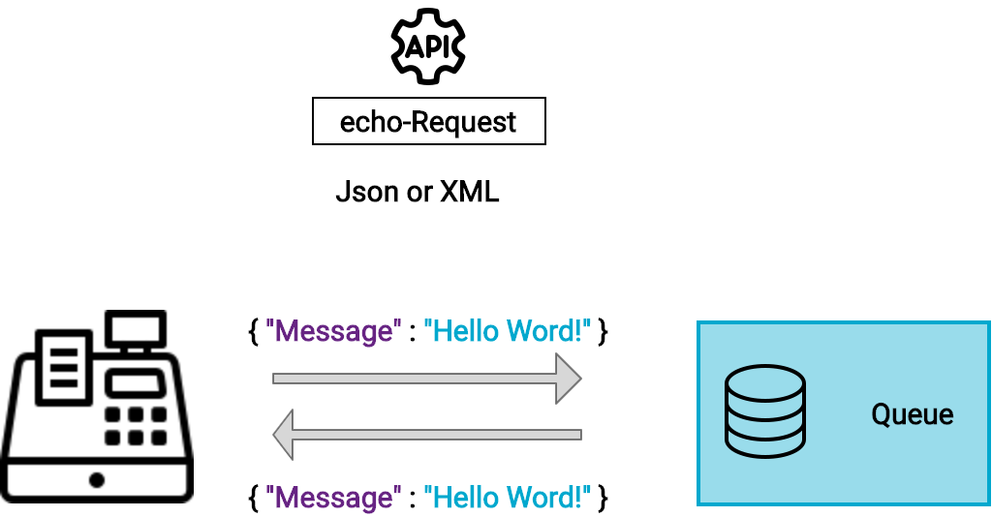
Echo
Notes:
Explanation of the echo method of the IPOS interface.
The POS system sends a message formatted with XML or JSON as a request to the Queue via the echo method of the IPOS Interface. If the Queue is reachable, it sends the same message back in the response.

Slide 9
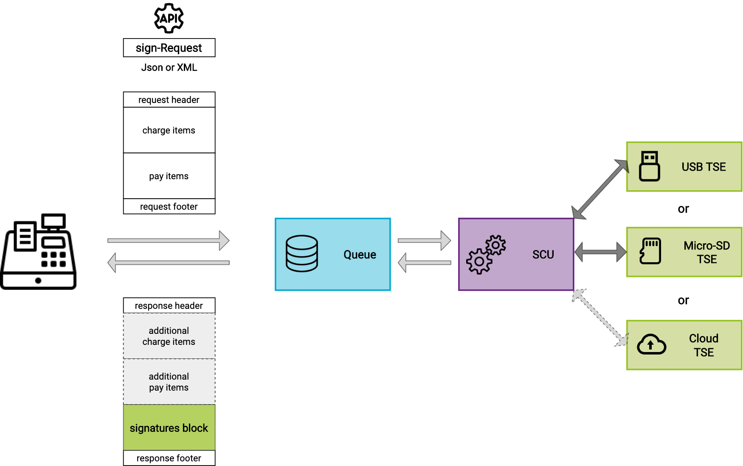
Sign
Notes:
Explanation of the sign method of the IPOS interface.
The POS system sends data formatted with XML or JSON to the Queue via the sign method of the IPOS interface.
The request data is divided into 4 blocks: request header data, catch items, pay items, and request footer data.
Example request header data: identification number of the POS System, identification number of the used terminal, reference number of the request, etc.
Example charge item: 1 beer, 19% VAT - quantity, amount, charge item case (delivery normal, 19%), moment of order, etc.
Example pay item: amount, pay item case (cash payment), moment of payment, etc.
Example request footer data: username, receipt case (e.g. "pos-receipt" or "zero-receipt"), reference to the previous - related receipt (e.g. in case of cancellation), additional individual data, etc.
The middleware processes the data and sends response data back to the POS System. The most important block in the response is the ”signatures" block. The data contained here must be printed on the receipt to ensure compliance.
The charge and pay item blocks initially sent to the Queue are not returned in the response! Optionally, only additional charge and pay item blocks may be returned (but this functionality is currently not used).
Example response header data: identification of the processing chain (queue), identification number of the used terminal, reference number of the request, moment of processing by the Queue, and so on
Example signatures: QR code, TSE process-type, TSE process-data, transaction number, signature counter, cash register serial number etc. (the QR code is optional, all other data must be printed on the receipt)
Example response footer data: status (status, e.g. ok or TSE not reachable, etc.), detailed data on the status (error message, info, etc.)

Slide 10
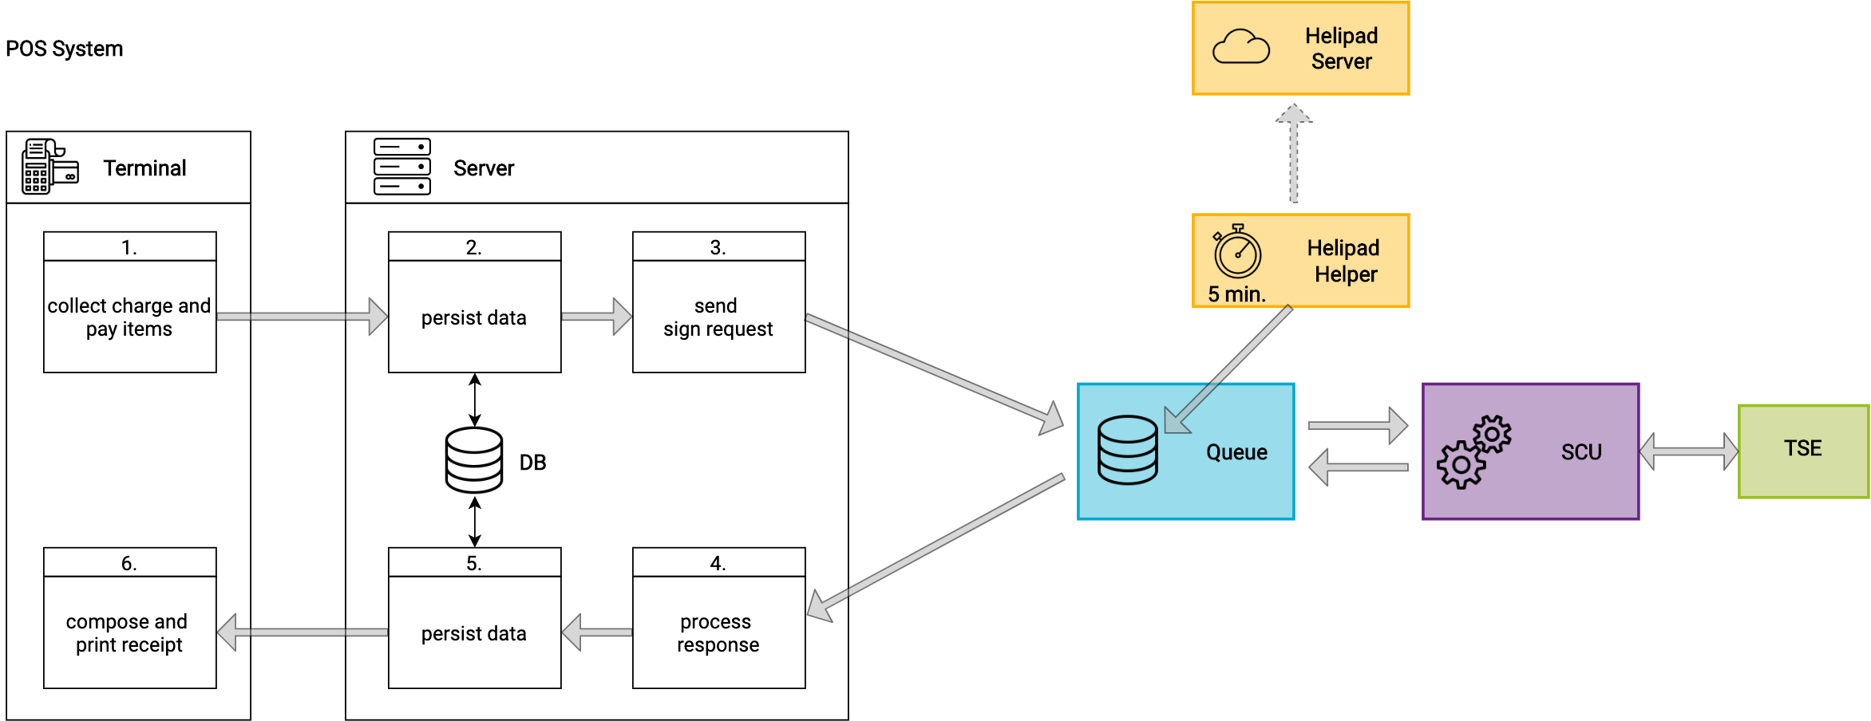
Sign data flow
Notes:
The Terminal of the POS System collects the charge and pay items for the request.
The Server of the POS System should persist the data locally. Data persistence is important because the request data is not returned by the Queue. Local archiving is also essential if fiskaltrust archiving is not available.
The Server of the POS System builds the request and sends the data to the sign method provided by the Queue. The ft.Middleware processes the received data and is taking care of chaining, persisting, signing and archiving the data.
The Server of the POS System receives the response and processes the data it contains.
The received data is persisted locally by the Server of the POS System (see also point 2)
The receipt is composed and printed by the Terminal (it contains the data from the signature block of the response)

Slide 11
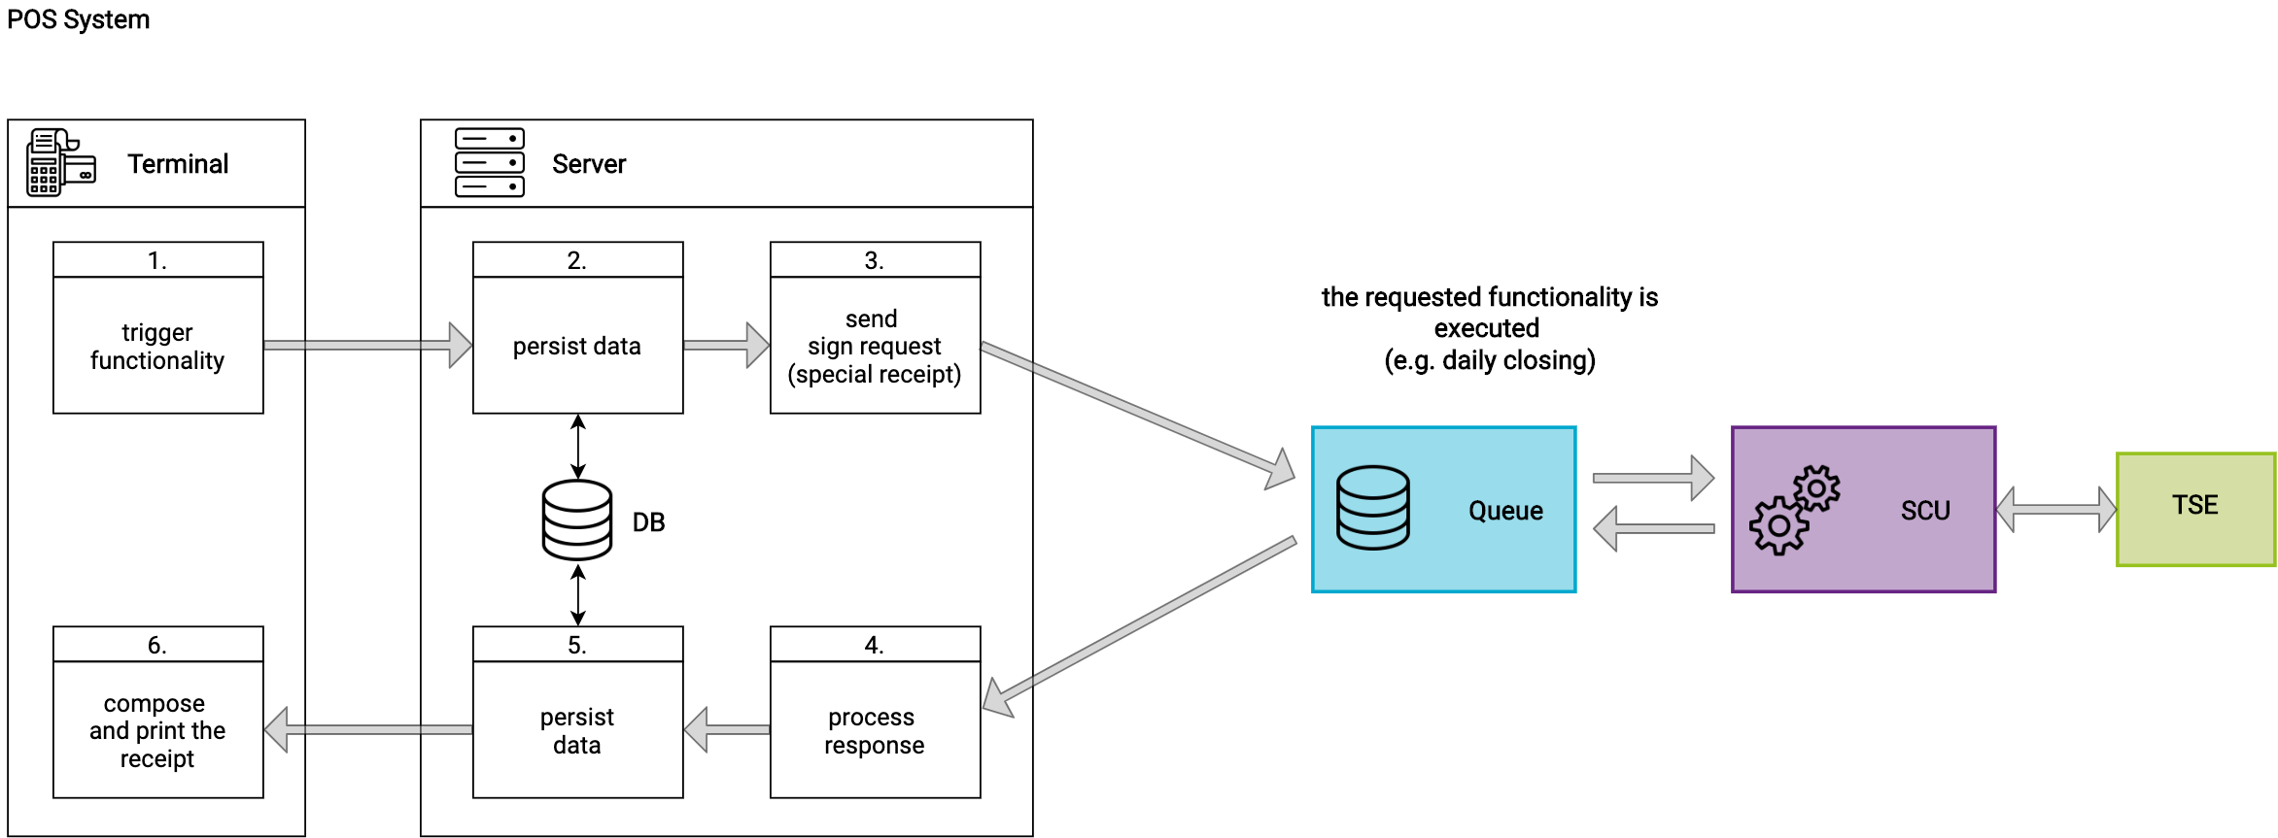
Sign data flow: special receipts (execution of functionality: zero receipt, initial operation receipt, daily closing…)
Notes:
Special receipt requests execute functionality. For example, the initialization of the TSE, daily closing closing, monthly closing, and so on.
The Terminal of the POS System triggers the functionality to be executed.
The Server of the POS System persists the data locally.
The Server of the POS system composes the request (setting the special receipt case - depending on the functionality to be executed) and sends the data to the sign method of the Queue. The ft.Middleware then executes the requested functionality
The Server of the POS system receives the response and processes the data it contains
The received data is persisted locally by the Server of the POS System
The receipt is composed and printed by the Terminal (it contains data from the signature block of the response)

Slide 12
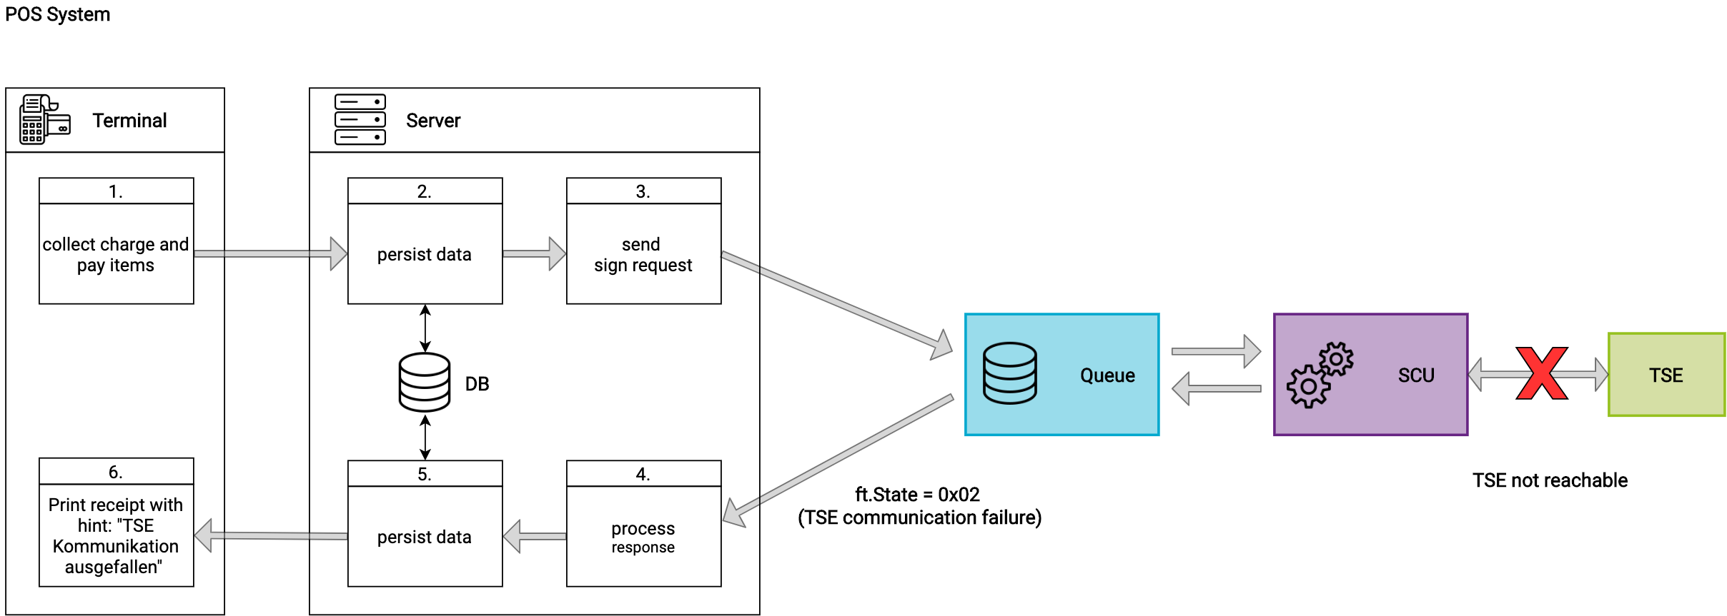
Sign data flow: failure case (TSE not reachable)
Notes:
If the communication with the TSE fails, the POS System can continue to operate until the TSE is accessible again. In this case, the POS System continues to send requests to the Queue as usual.
The Terminal of the POS System collects the charge and pay items for the request.
The Server of the POS System should persist the data locally. Data persistence is important because the request data is not returned by the ft.Middleware. Local archiving is also essential if fiskaltrust archiving is not available.
The Server of the POS System builds the request and sends the data to the sign method provided by the Queue. Because the TSE can not be reached, the Queue sends back the ft.Status = 0x02 (error: TSE communication failure).
The POS System receives the response and processes the data it contains.
The received data is persisted locally by the POS System
The receipt is created and printed by the Terminal (it contains the data from the signature block of the response including the note that the TSE communication has failed)
Important:
If communication with the TSE cannot be re-established, for example because the TSE is broken or has been stolen, the incident must be documented and a new setup with a new TSE must be set up. The ft.Middleware must be reconfigured and rolled out via the portal. A corresponding report to the tax authorities must be made.

Slide 13
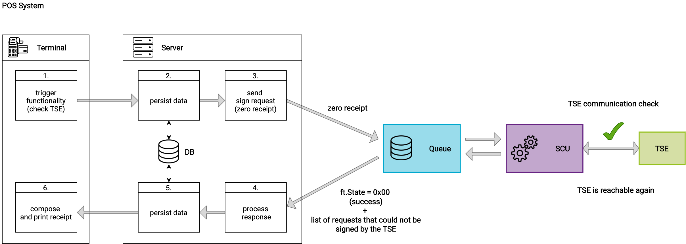
Sign data flow: failure case (TSE is reachable again)
Notes:
As soon as the TSE is reachable again, the POS System has to send a zero receipt to the Queue. This is important because the ft.Middleware does not itself try to find out whether the TSE is reachable again, so as not to disturb the operative business by timeouts. If a zero receipt is sent to the Queue, the SCU will try to restore the communication with the TSE. If the communication still fails, the ftState = 0x02 (TSE communication failed) is still returned in the response. If the communication works again, the ftState = 0x00 (ok) is returned to the POS system via the response and the ft.Middleware is ready for normal operation again. Furthermore, the response contains a listing of the requests that were not signed by the TSE. The requests affected by the failure of the communication with the TSE do not have to be sent to the Queue again after the problem has been resolved.

Slide 14
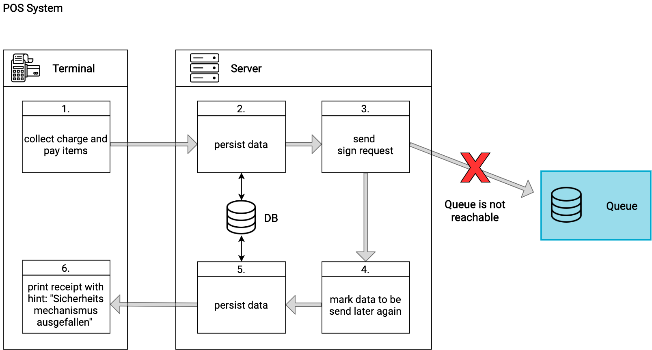
Sign data flow: failure case (ft.Middleware is not reachable)
Notes:
For the case that the Queue is not reachable:
4. The requests are marked by the Server of the POS System to be sent later again to the Queue
5. The printed receipt must contain the hint that the security mechanism is not reachable

Slide 15

Sign data flow: failure case (ft.Middleware is reachable again)
Notes:
At a later point in time, when the Queue is reachable again, the POS System sends the requests previously marked for repetition to the middleware in the so-called “late signing mode". Each request is marked with a flag (ftReceiptCase + "failed receipt" flag - 0x000000000000010000).
As soon as the middleware receives the first marked request, it switches to the “late signing mode". The POS System can now send further requests in this mode. The Queue answers with the ftState 0x08 which means that it is in “late signing mode". To leave the “late signing mode" the POS System must send a zero receipt to the Queue (see next slide)

Slide 16

Sign data flow: failure case (ft.Middleware – end late signing mode)
Notes:
To end the “late signing mode", the POS System must send a zero receipt to the Queue. The Queue responds with the ftState = 0x00, which means that it has left the “late signing mode" and is available for normal operation.

Slide 17
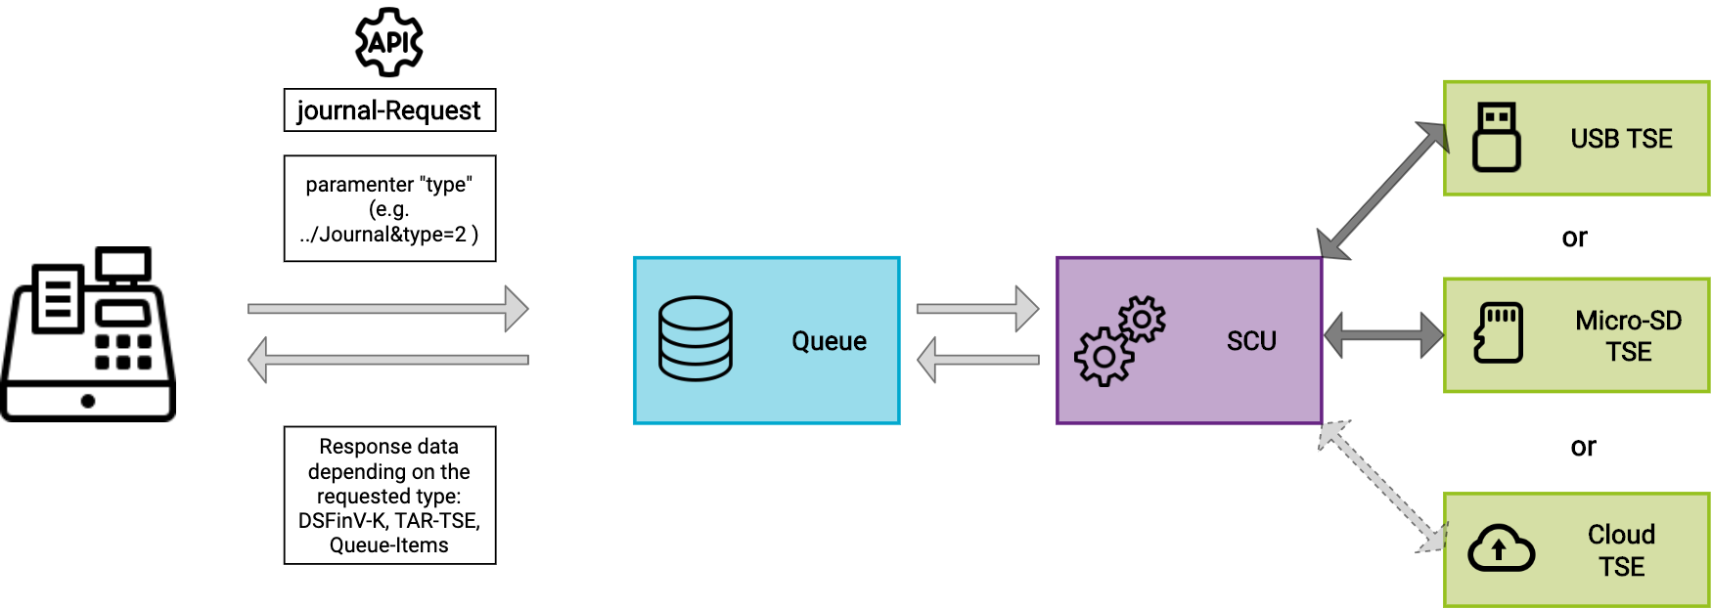
Journal
Notes:
Explanation of the journal method of the IPOS Interface.
The POS System calls the journal method with the parameter "type". Depending on the passed value, the requested data is returned. Via WCF the data is returned as stream.
Types are country specific. Examples for Germany:
1 = TAR file from TSE
2 = DSFinV-K-File

Slide 18
Portal
Recording of your POS System
Configuration and testing of your ft.Middleware integration
Recording and inviting your POS Dealers
Preparation of the rollout with the help of templates for your POS Dealers
Supporting materials for your POS Dealers

Slide 19
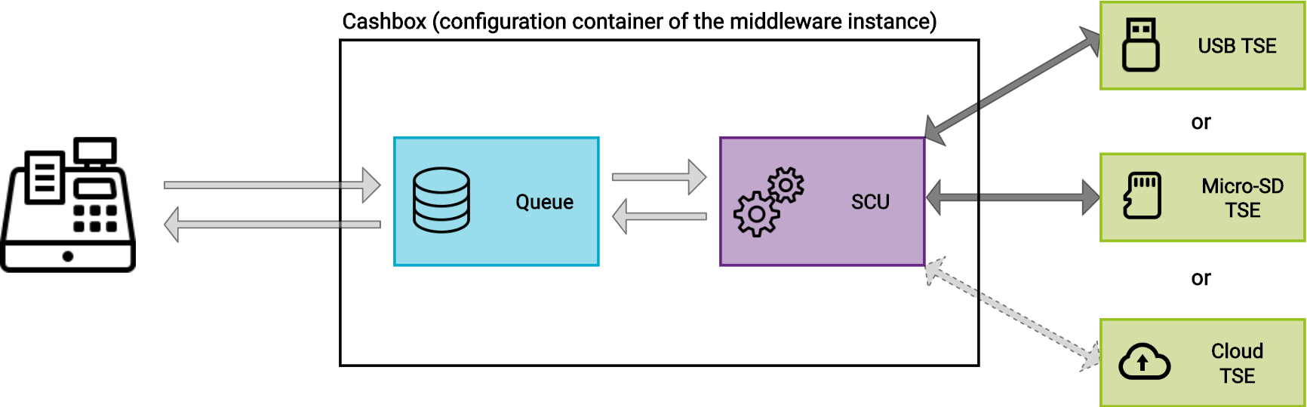
Configuration of a middleware instance (Cashbox)
Notes:
The configuration of a middleware instance is done via a so-called cashbox in the portal.
The cashbox is a configuration container that contains the configuration of the individual components of the ft.Middleware. This configurations can be connected to each other via the cashbox. The cashbox can contain the configuration of the queue, SCU and various helpers and connect them with each other.
The queue is a component of the ft.Middleware that collects the receipt requests and is responsible for creating and persisting the receipt request chain. The queue is the component of the ft.Middleware with which your POS System communicates. You send your receipt data via a request to it and receive signatures and other data back.
The SCU (Security Creation Unit) is a component of the ft.Middleware that is responsible for signatures. In Germany, it takes over the communication with the TSE, which finally carries out the signing. Depending on which TSE you want to use, the SCU needs a corresponding configuration to access it.
The cashbox contains the required configurations and connects them together. Each middleware instance needs a cashbox to be able to start operating.

Slide 20
Integration of middleware and testing
Test environment: „Sandbox“
Getting started guide (integration steps)
Support will be provided after signature of the partner contract in the live portal
Notes:
Getting started guide:https://docs.fiskaltrust.cloud/doc/productdescription-de-doc/for-poscreators/getting-started-en.html

Slide 21
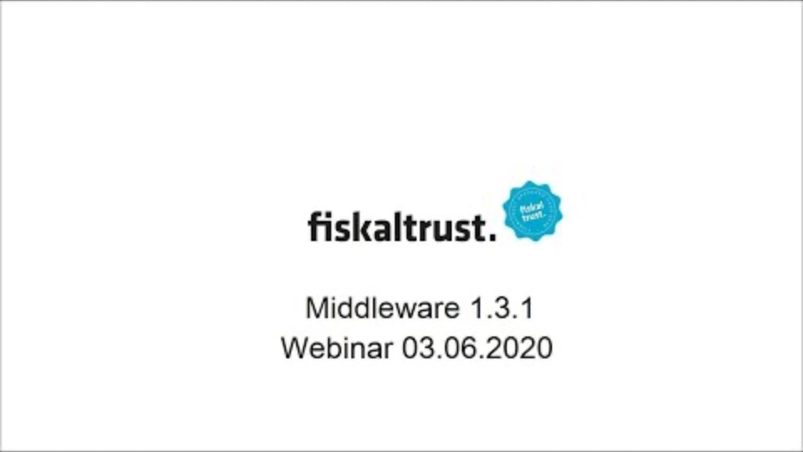
Middleware - Demo
Notes:
Temporary and german, starts from minute 18:30

Slide 22
Phases of integration (recommendation)
Connecting to the local ft.Middleware
Sending of data and processing of responses (pos receipt, zero receipt, own business cases, cash balance, daily closing, etc.)
Invitation of the POS Dealers, prepare rollout/templating
Industry-specific discussion of complex business cases with the fiskaltrust support team
Pilot installation
Handover for rollout to your POS Dealers

Slide 23
Rollout scenarios using Germany as an example
Options for connecting a TSE
One TSE per POS System
Hardware TSE on the local server or main POS System
Cloud-TSE for multiple cash registers
Several terminals per cash register
Bring your own datacenter
=> Presentation based on the documentation in docs.fiskaltrust.cloud
Notes:
https://docs.fiskaltrust.cloud/doc/productdescription-de-doc/for-posdealers/02-pre-sales/rollout-scenarios.html

Slide 24
The portal as a rollout management tool
Roles structure (POS Creator, POS Dealer, POS Operator)
Invitation management
Rollout preparation and execution
Notes:
Overview, the execution is shown on the following slides.

Slide 25
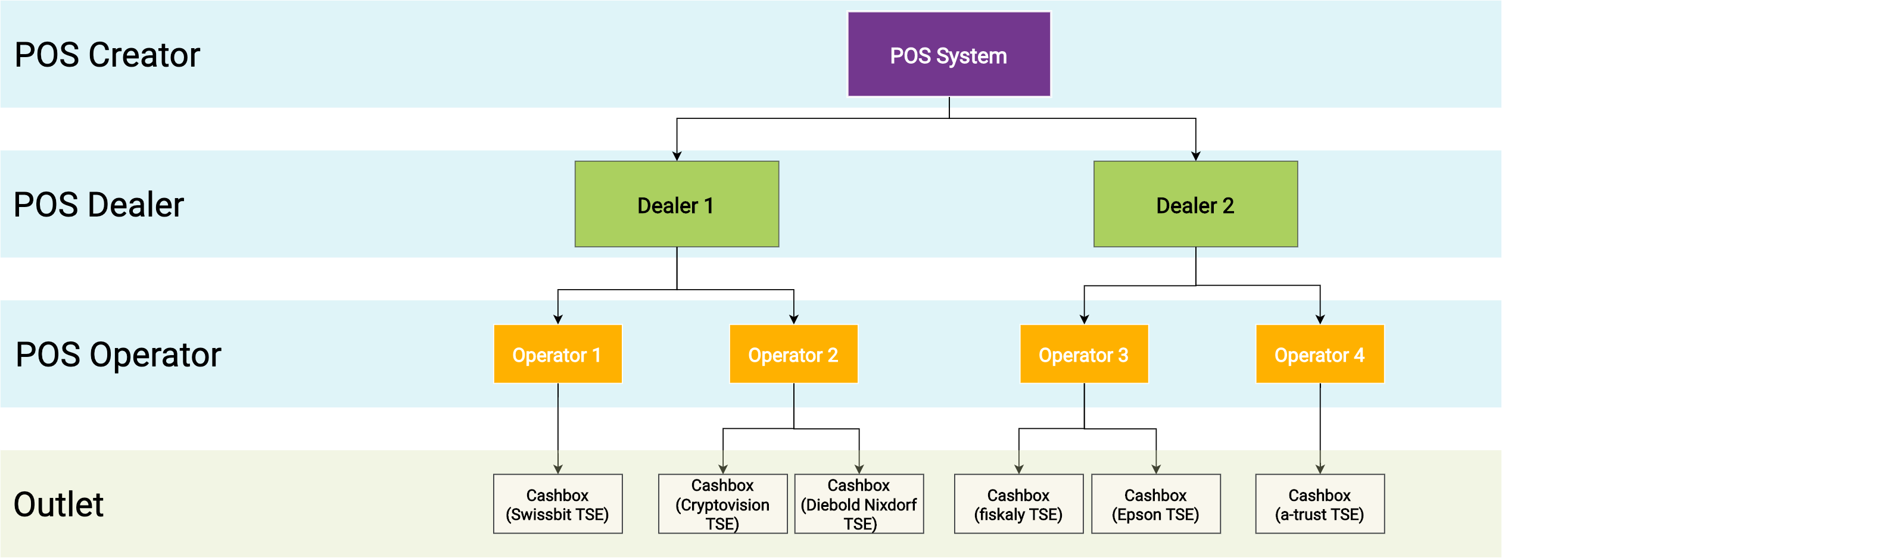
The portal as rollout management tool (role structure)

Slide 26
The portal as rollout management tool (invitation process)
Creator
Invitation E-Mail to the dealers
Operator
Set password
Dealer
Access options to the operator account (surrogating)
E-Mail link
Sign contract
Dealer
Create csv-file (for mass invitation of operators)
Invitation E-Mail to the operators
Dealer
E-Mail link
Set password
Sign contract
Sign contract
Master data capture
Register POS System

Slide 27
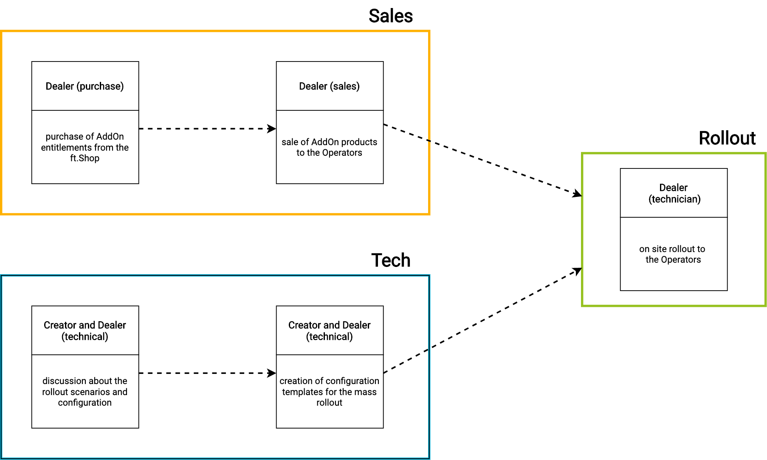
The portal as rollout management tool (rollout preparation)
Notes:
Dealers (purchasing) buy Addon entitlements in the ft.Shop
Dealers (sales) sell Addon products (e.g. carefree package) to the operators. These can be assigned to the operators via the entitlements.
Creator and dealers (technicians) discuss rollout scenarios, create configuration templates for the mass rollout in the ft.Portal and release them. They then appear in the ft.Shop of the POS operator.
Dealers (technicians) install at the operator's site using the templates created previously. When checking out the template in the operator's ft.Shop, a configuration container (cashbox) is automatically created by the ft.Portal.
Sales and technical preparation can be carried out independently by the POS dealer.

Slide 28
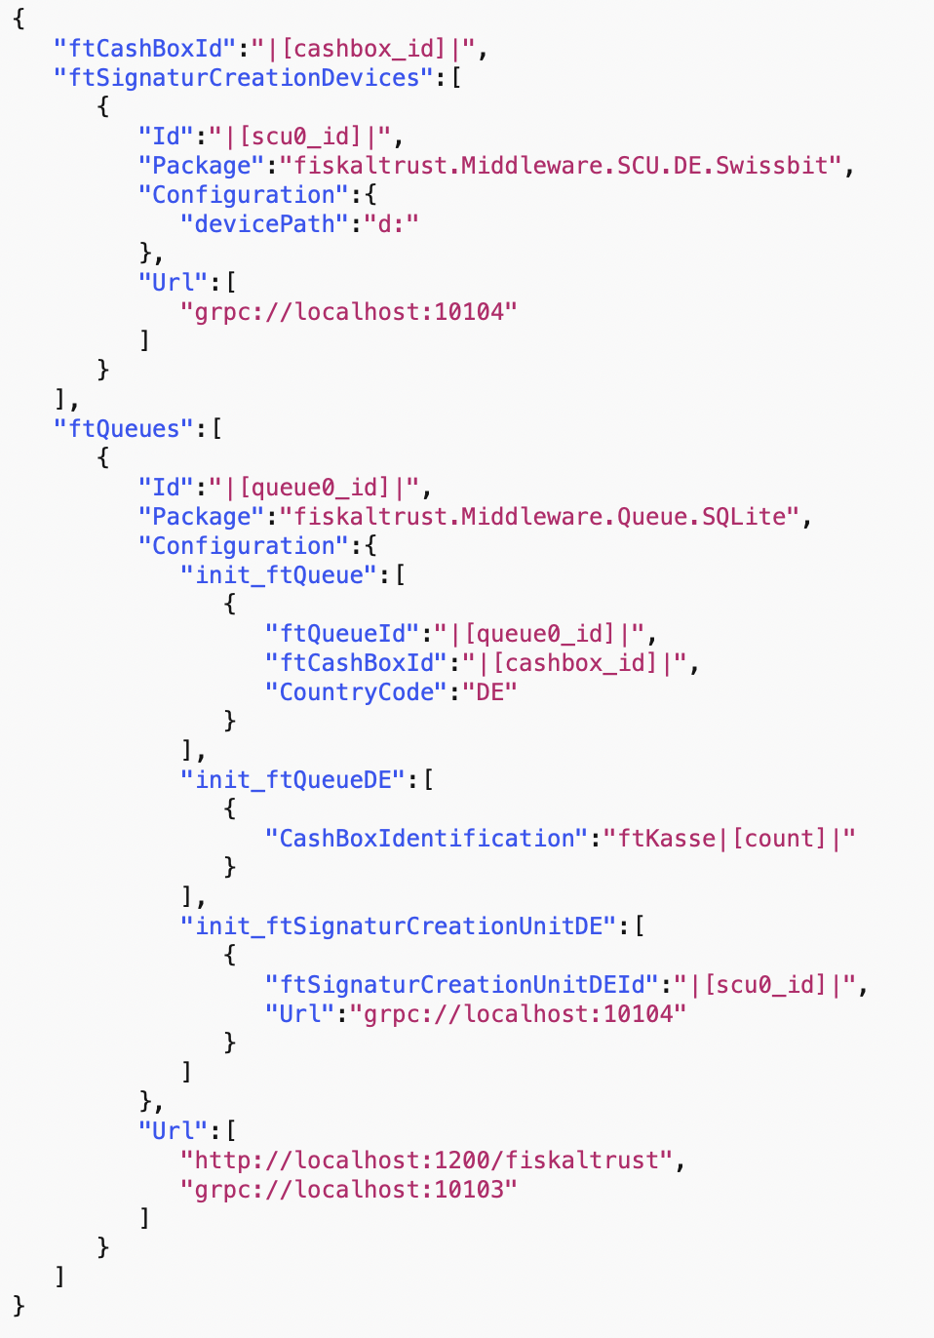
Example of a configuration template
Use of variables (e.g.| [cashbox_id]|)
Example: Configuration of the SCU
TSE package
Path to the TSE
Endpoint of the SCU
Example: Configuration of the Queue
Persistence
Cash register serial number/TSE Client-Id
Link to SCU
Endpoint of the Queue
Notes:
The variables are automatically filled by the ft.Portal when the template is checked out in the operator's ft.Shop

Slide 29
The portal as a rollout management tool (rollout execution with template)
Manual with the ft.Portal
Add in ft.Portal
Checkout in ft.Shop
Automated via API
Notes:
https://docs.fiskaltrust.cloud/doc/productdescription-de-doc/for-posdealers/02-pre-sales/automatisierter-rollout.html

Slide 30
Getting started & documentation
Getting started guide english
Getting started guide german
Product description
docs.fiskaltrust.cloud
Github repos

