Slide 1

LLM Background and Journey
Notes:
Replace image placeholder: Click on image -> Click on ‘Replace image’ -> Choose your image.
Send image placeholder to back: Right click on image -> Order -> Bring to Back

Slide 2
LLM Inputs
M
Model (e.g., GPT-4o, GPT-4.1)
S
System Instructions: A set of detailed (and formatted - e.g., markdown) instructions detailing how to respond, how to think and reason, and how to interpret, utilize, and even read in data (e.g., RAG, write code to read in csv, etc.)
D
Data: A collection of data files to be added to a vectorstore and retrieved based on the context of the prompt/query.
T
Tooling: E.g., access to file_search and code_interpreter (easy via custom GPT and Assistant API), or adding functions for the assistant to call (advanced)
R
Response Format: Control the format of the response. Default is a text string (e.g., chatGPT), but you can also have it perform computations and return a JSON of numbers and text for example.
F
Fine Tuning (Advanced): Top k documents/Max num results, score threshold, etc.

Slide 3
How LLMs Think (simplified)
Text Prediction: LLMs don't "know" — they calculate the most likely next word (token) using probabilistic modeling of language patterns, based on your prompt and their training data.
Pattern Matching: They model language structure, semantics, syntax, and context based on statistical patterns seen during training. Each LLM behaves a bit differently depending on their core training. Providing context and/or data will change the decision tree.
No Grounded Knowledge: Without access to external data, they can only "guess" (and likely will) based on what sounds correct.
Why Hallucinations Happen: Since LLMs predict plausible text rather than verify facts, they may confidently generate incorrect or invented information — especially:
Without clear instructions ("hallucination by ambiguity")
Without access to relevant data ("hallucination by missing context")
Example:
> If asked for internal company metrics, without access to real data, the model may invent numbers that fit the pattern of a report.
I personally verified this when I was working on the testing framework - take care to ensure the data is actually being utilized

Slide 4
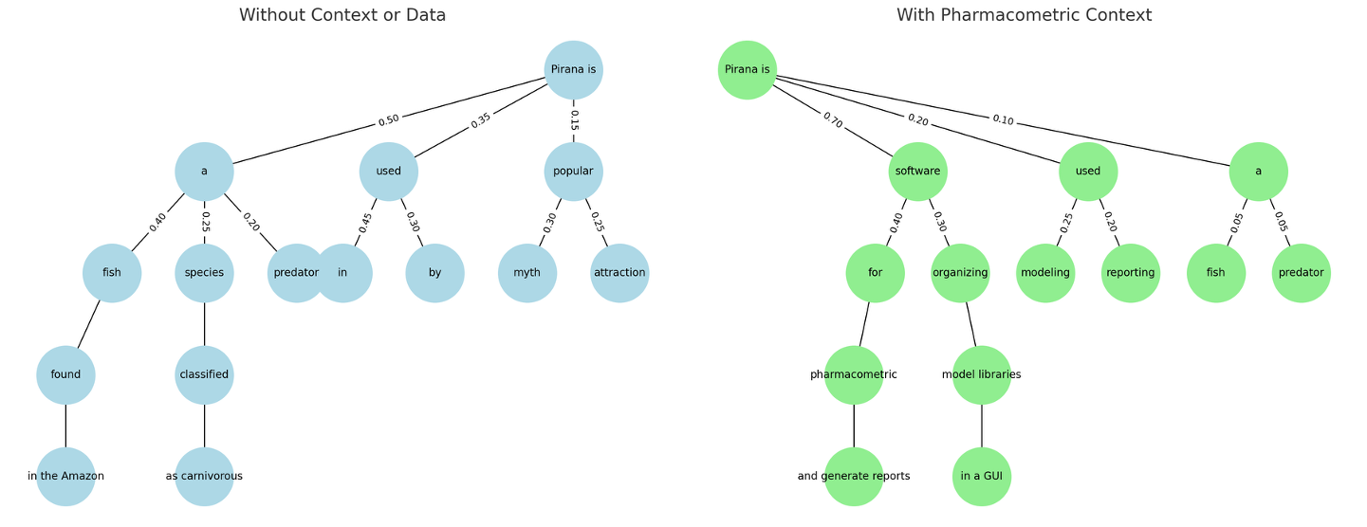
LLM Decision tree
LLMs account for misspellings, and would likely assume you meant “piranha” without proper context…
…code is generated in the same way

Slide 5
Some Definitions
Vectorstore: A database that stores documents as embeddings (numerical representations of meaning). When you send a query/prompt, it’s embedded too, and the vectorstore finds the most semantically similar documents to retrieve.
Context Window: The space where GPT "reads" both your input and any retrieved data before generating a response. The larger the context window, the more information GPT can consider at once - though this will also slow down the response time at a certain point. Your system instructions are part of this.
Retrieval Augmented Generation (RAG): RAG lets GPT access external knowledge at query time without retraining the model, acting as an integration layer that retrieves relevant data when needed (via internal reasoning).
Your prompt/query is embedded (turned into numbers), and the vectorstore is scanned for relevant information via a semantic search.
That relevant information is returned, and added to the context window for additional reasoning.
Note: You can actually force this with custom GPTs by saying “use file_search to find…then do this..”. Other named tools work the same way (e.g., code_interpreter).

Slide 6
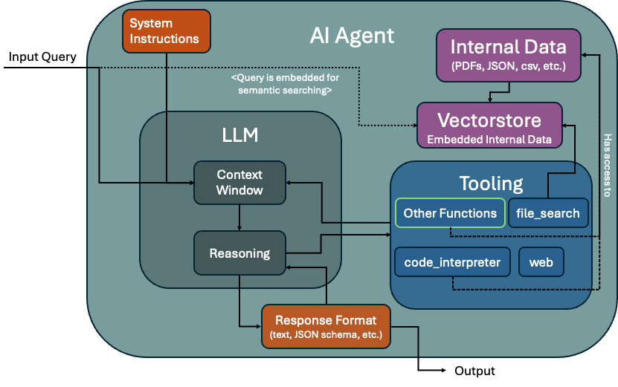
AI Agent Workflow

Slide 7
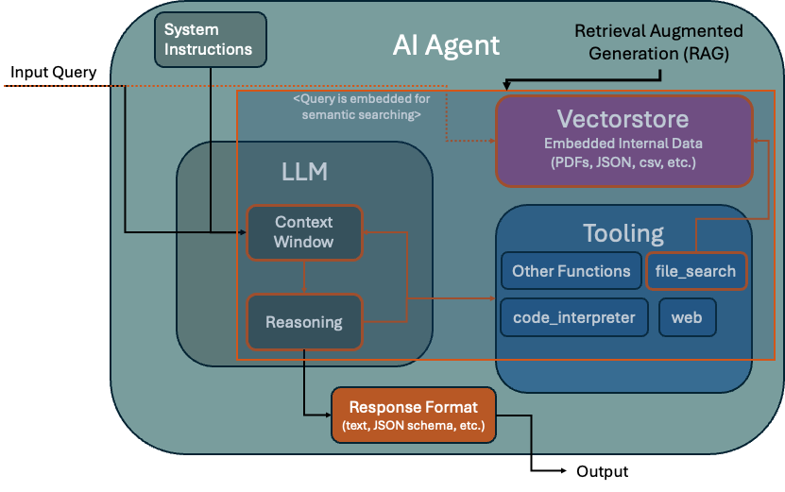
AI Agent Workflow

Slide 8
When to add internal data?
Approach | Description | Data Integration | When to Use
No internal data | GPT uses only its pretrained knowledge | No real-time access to private or dynamic data | General reasoning, public knowledge, brainstorming, coding using open source knowledge
With internal data | GPT retrieves relevant documents from external data before generating answers | External data sources (DBs, files, APIs) are indexed & retrieved on demand | When answers require private, dynamic, or up-to-date information
Fully Integrated (APIs/Functions/Assistants) | GPT uses functions or APIs to query live systems during conversation | Structured integration via APIs, functions, tools | Complex workflows, transactional queries, decision support. File searching could be part of this workflow.

Slide 9
Comparing LLMs and their use case
Option | Description | Use Case
Open Source LLMs (e.g. Llama, deepseek) | Fully open models you host & fine-tune | Full control over data (and how it gets added to the vectorstore (chunking)), model behavior, deployment, function calling, research
Custom GPT (OpenAI ChatGPT Custom GPTs) | Prebuilt GPT model with customized instructions, knowledge, tools, and behaviors | No-code customization for internal tools, workflows, or domain-specific tasks
GPT Assistants (OpenAI Assistants API) | API to build agent-like applications with memory, tools, and functions. This is faster since we aren’t running the model, but costs a little $. | Developers build dynamic chat-based apps with complex flows, but worry less about fine tuning. Each assistant can be maintained separately (data, model, instructions, etc.)
GPT Chat Completion API | Raw model endpoint via API. Single chats or remember conversation. | Flexible integration into apps, chatbots, automation, pipelines. Not recommended if you need to maintain multiple agents with different data.

Slide 10
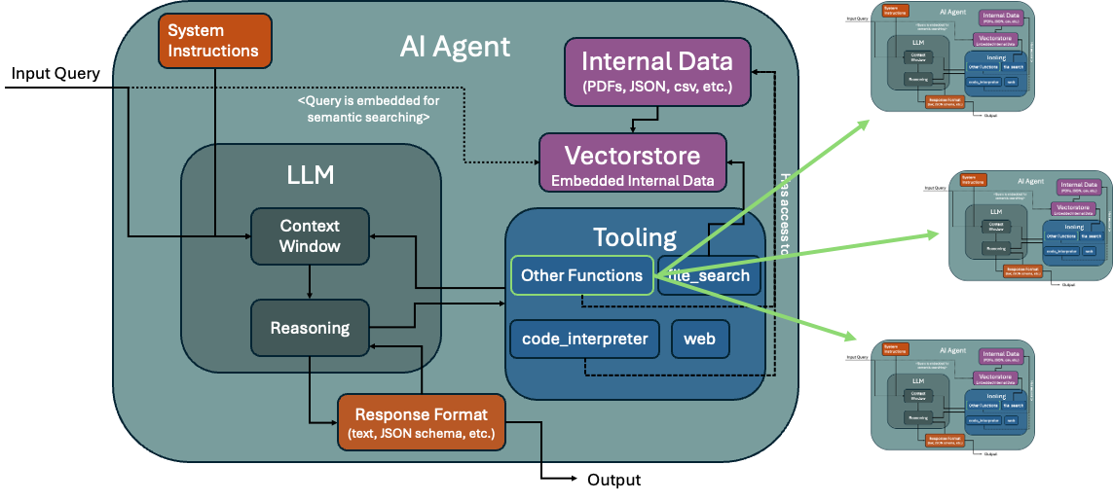
Where we’re headed

Slide 11
References
Open Source Investigation:
Open Source model running
Open Source model vectorstore creation
Evaluation Presentation
Metworx Assist Agent (custom GPT)
Where we store and format all the data fed into custom GPT, assistants, and open source models. Also includes the test framework:
This is where we are managing everything fed into the LLMs we have been testing
Manage GPT Assistants

