Slide 1
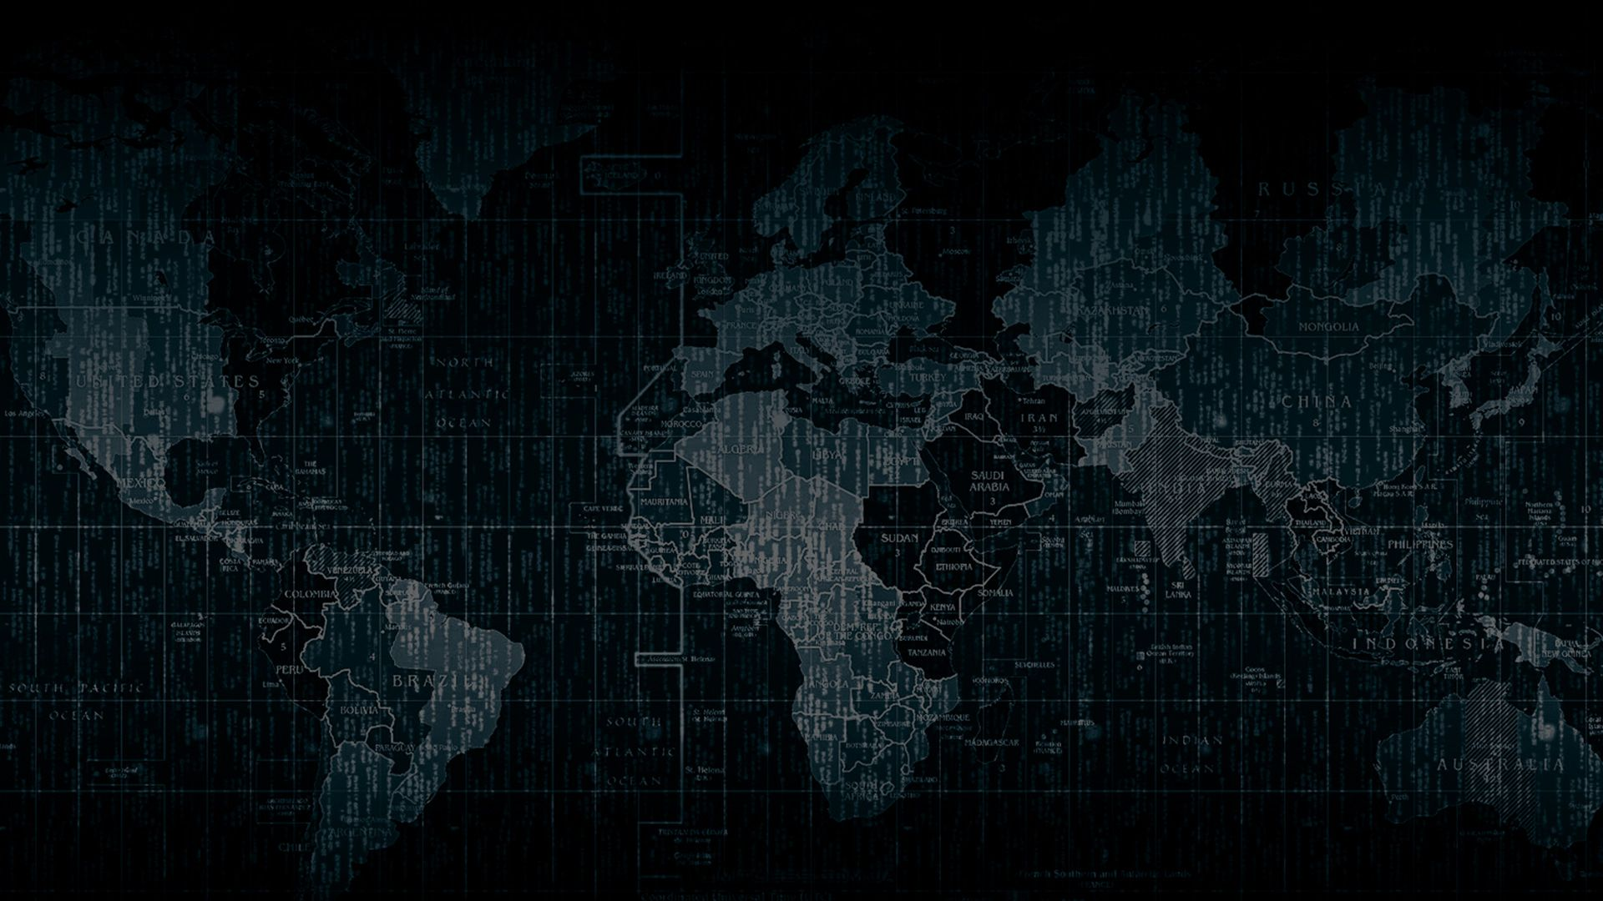

Solution By: CODE DEV
PSID: INTL-xxx-xxx
Team Leader Name: Farhan Hai Khan

Slide 2

Idea Introduction
IDEA TITLE- ADVANCED OBJECT DETECTION
Tech Stack
1. Python
2. PixelLib
3. Flask
Resources Used
1.
2.
3.
Any Third Party API/Services used ----NO
IDEA-OUTCOME – HEADLINE-
An object detection and recognition model which can accurately identify objects such as vehicles (truck, bus, boat, airplane), roads signage (zebra crossing, traffic light), buildings and bridges.
.

Slide 3


Your Approach Towards Idea
Approach in Brief
We are going to use Deep Learning approach. If we choose our model to perform accurately we will use PointRend but somewhere it will not be faster and if we use Custom Unet model then it will perform faster but it will not be much accurate. We need a model that will be both faster and accurate.
Innovation added:
-Customised unit architecture.
-Light weight.
-Reduced depth of up-sampling and down-sampling by a factor of 1.
-Deployable for mobile devices.
-Original unit weight of 160mb.
-Original unit size.
-Reduced storage space by 400%
-Fastest speed of inference(real time object detection)
3D Modelling in Deep Learning
Notes:
Use any image of your proposed solution here instead of this macbook image

Slide 4


Team Slide
Farhan Hai Khan
(Team Leader)
Shivam Aranya
(Mentor)
Sayantan Dasgupta
(Member)
Tandrima Singha
(Member)
Shubham Kumar Singh
(Member)

Slide 5
Development Pipeline
Documents To be prepared for installation and evaluation
1.
2.
3.
4.
Any Third party API used, if yes please specify
Kaggle
Google Colab
Proposed Development Plan in pointers
1. Dataset Formation
2. Select Model
3. Train-Test-Split
4. Training Model
5. Refining Model
6. Testing the model
Proposed UI and functional flow in pointers
1.
2.
3.
4.
5.
Repository Link or Any refrences link of folders
https://github.com/MLXTREME/Objectify
Step A
Step B
Step C
Step D
Step E

Slide 6
Vision of Innovation/Idea/Solution
The current Deep Learning approaches are some that gives high accuracy whether some performs faster but could not give high accuracy. So needed a model that is both accurate and performs faster
How you idea is different and innovative form other ideas- a default comparison
It will take approximately one week
The model should be both faster and accurate & fastest speed of inference(real time object detection).

