Slide 1
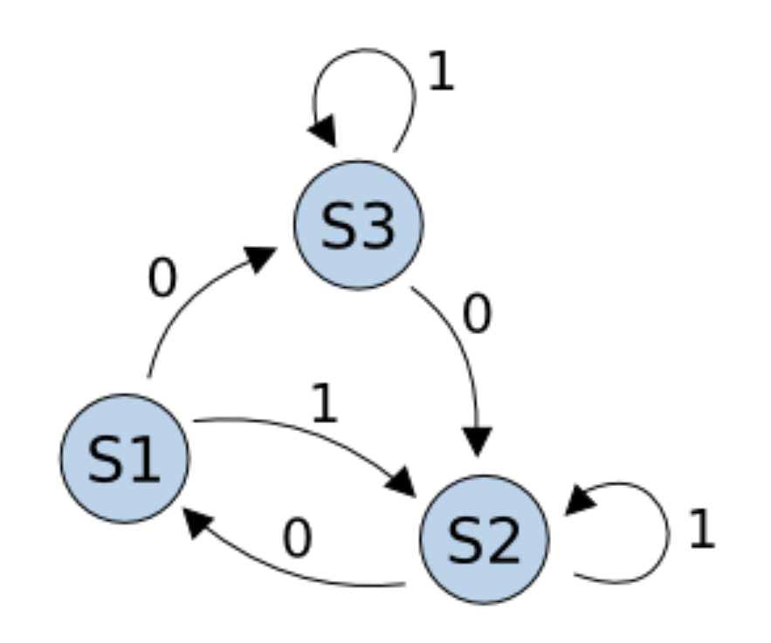

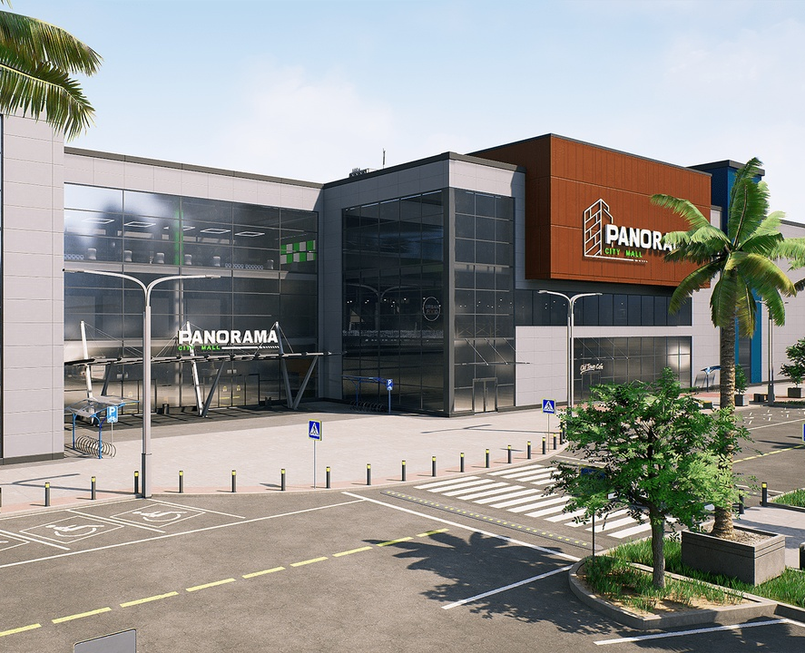
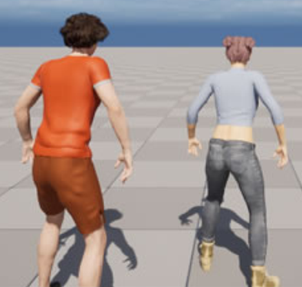
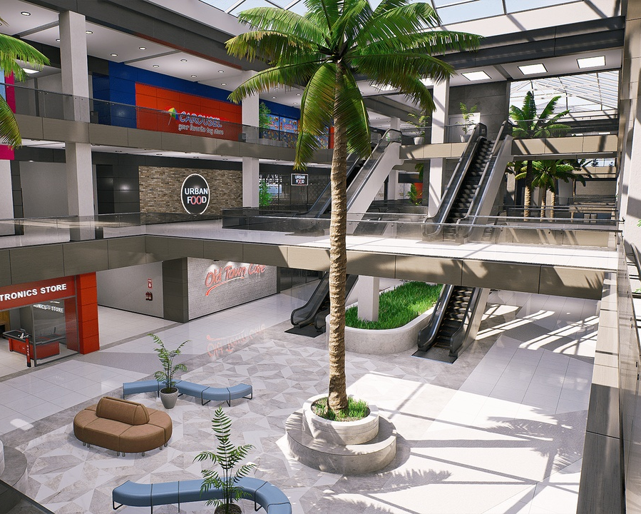
Maintain all fixed data and dynamic information during simulation;
Semantic related records and reasoning;
Decision maker;
Planner
Scenario (A simulation case)
Preliminary information
Prompt
States
Characters
Entities
All states
Fixed params
Dynamic params
Attributes
Dynamic params (memory, add ts, ..)
Scenario information
Context
Generator
Context
Environment
Actions
Scenario params:
- Date
- Holiday
- …
e.g., memory, observation, …
Query
Characters
All supported actions
Extensible structure
LLM
Feedback
Initialized
Decision
Update
Update
Add Character
(pre-defined time)
Provide Feedback
Make Query
(1 agent)
Perform Action
(action sequence,
one character)
Simulator
Actions
3D models
3-D Character Generator
Action Performer
Generate and initialize a 3D character in simulation.
Feedback Generator
Perform a whole action sequence in 3D simulation.
3D scene
Only do simulation: adding and controlling 3D characters (according to commands from planner);
Provide simulation-related real-time feedback for information synchronization in the planner, also as a part of context to guide LLM;
Most content is pre-defined;

