Slide 1
SFDC Security Model Org
Part 1 –Profiles and permission sets

Slide 2
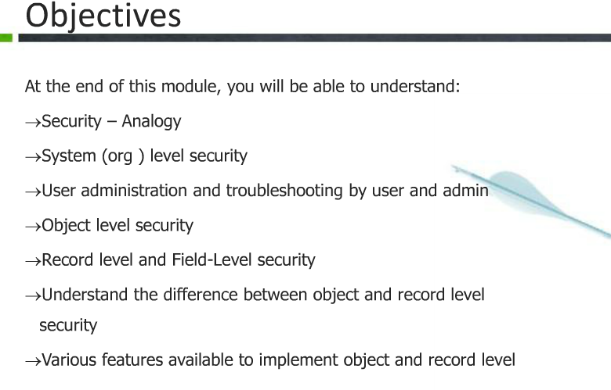

Slide 3
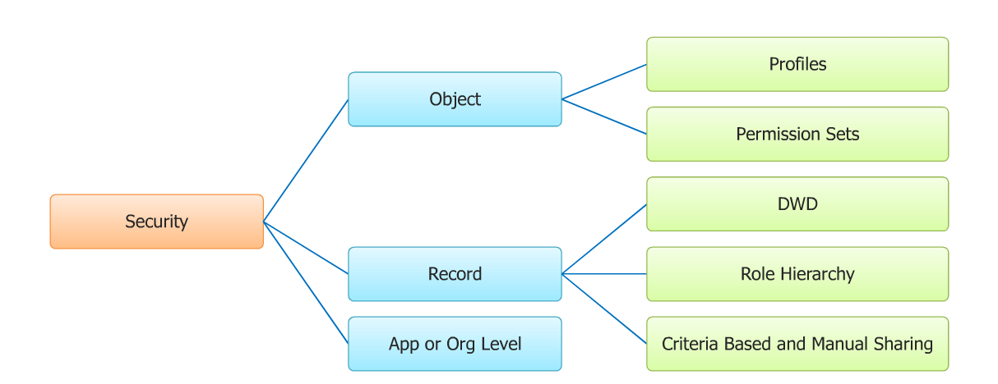
Security –Object Level and Record Level

Slide 4
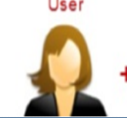
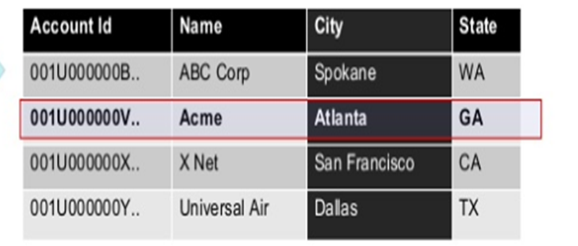
Profile and object access
Create
Read
Update
Delete
Profile
Access to sobject
Visible and readonly
Visible and readonly
FLS Controls field level access

Slide 5
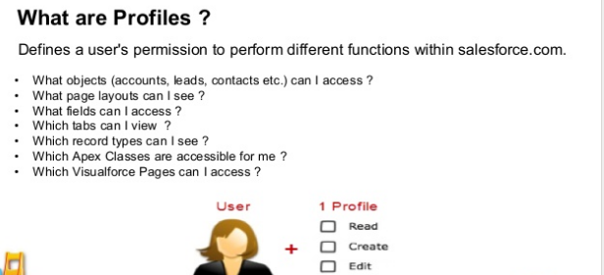

Slide 6
Creating Profiles
Salesforce ships with default system admin profile and some additionally
One user can be linked only to one profile
Create new profile by cloning the system admin profile and then reducing access as system admin has all accees
Ensure that new profiles don’t have view all ,modify all disabled at object level
Ensure that new profiles also have edit readonly fields permission disabled

Slide 7
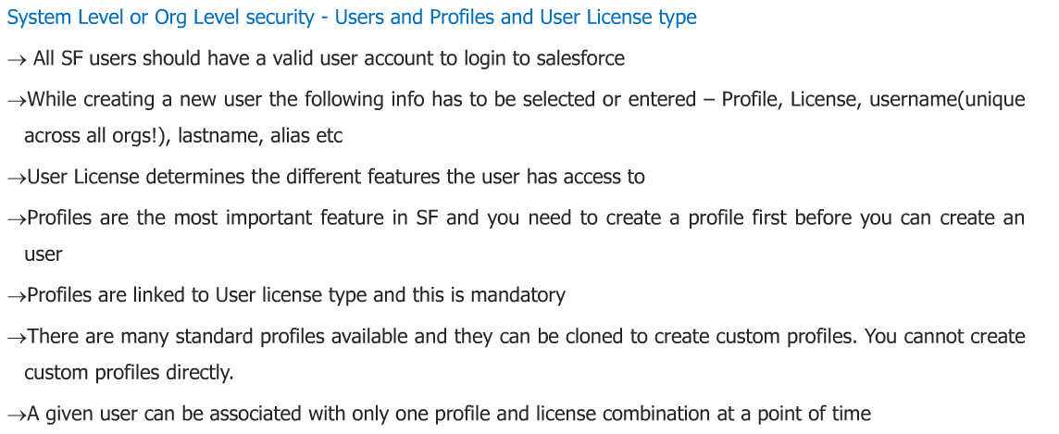
User creation in salesforce

Slide 8
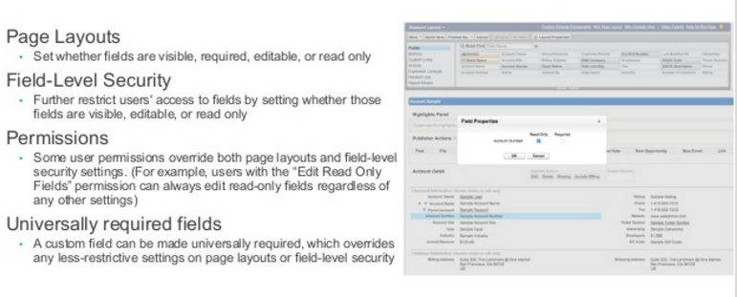
Field Access Security settings

Slide 9
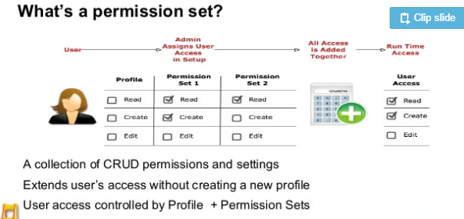

Slide 10
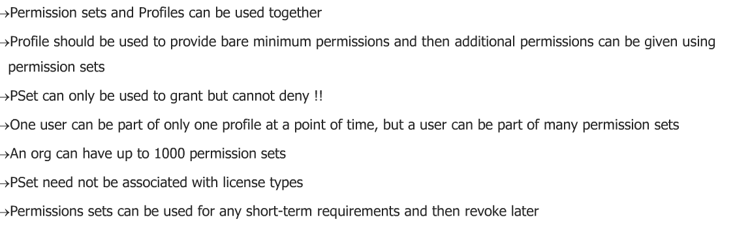
Object Level security:Permission sets

