Slide 1
SFDC security model – Part 2
Object level (Covered in previous slide)
Record Level
Field level security

Slide 2
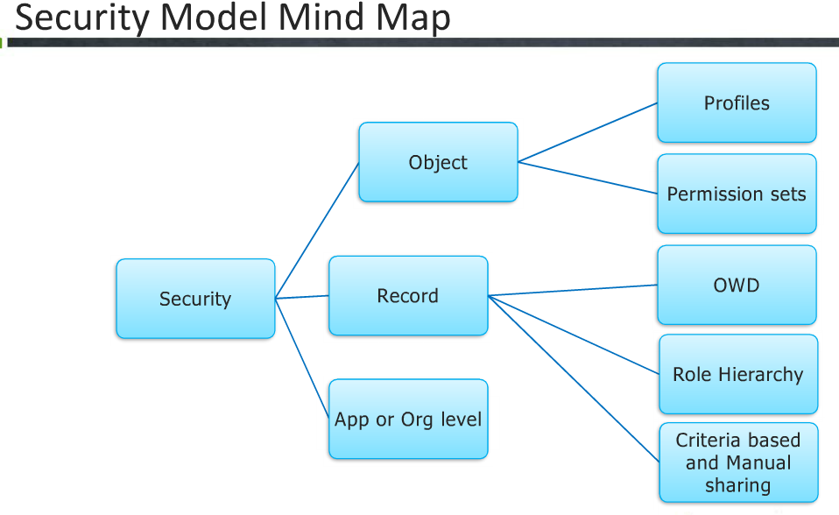

Slide 3
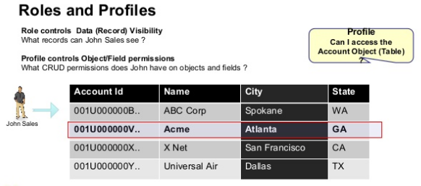

Slide 4
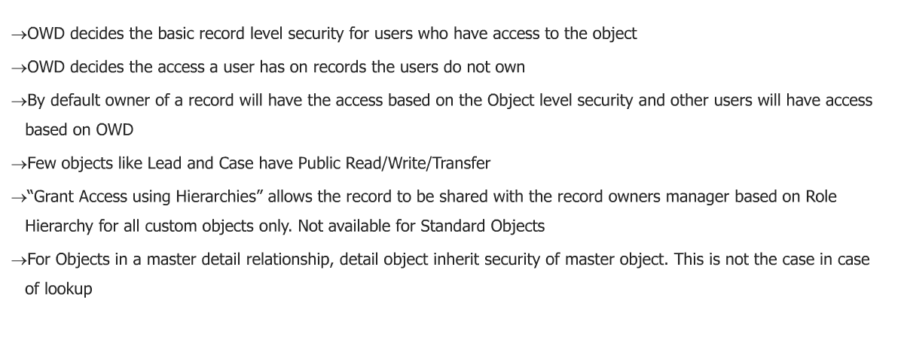
Organisation wide defaults

Slide 5
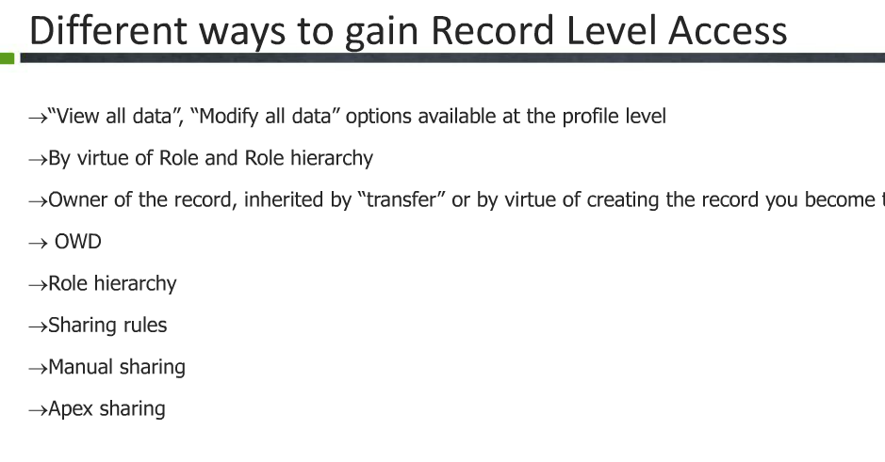
Who Owns a Record (Basic record Access Access)

Slide 6
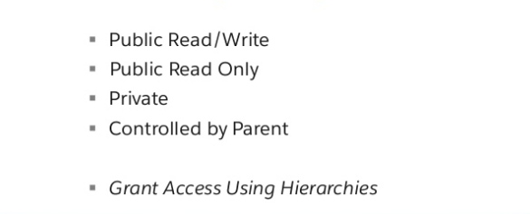
OWD setting for objects

Slide 7
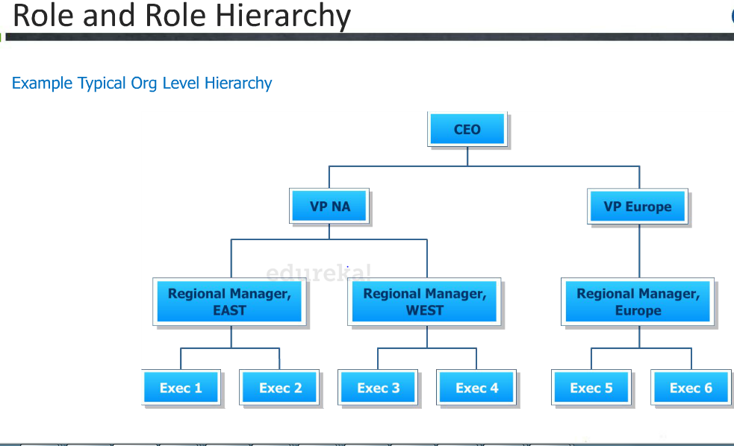

Slide 8
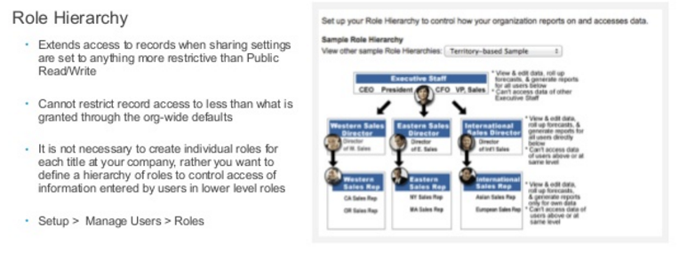
Roles

Slide 9
How OWD affects record visibility
IF OWD on an object is set to Public read write,all users in the role can RW records of that object irrespective of the role heirarchy provided their profile gives them access to the Object.
IF OWD on an object is set to Public read ,all users in the role can read the records .
IF OWD on an object is to private ,only owners of records or their manages in role herirachy and above can r/w the records. Others in he

Slide 10
Sharing Rule
Suppose OWD of Lead is set to Private
Only users who created the record and their managers/users in the rolehierarchy can view it in such a case,peers cannot view the record
If you want to open access to other users parallel and across org,use Sharing rules
There are 3 tyes of sharing Rule
Manual
Criteria based
APEX

Slide 11
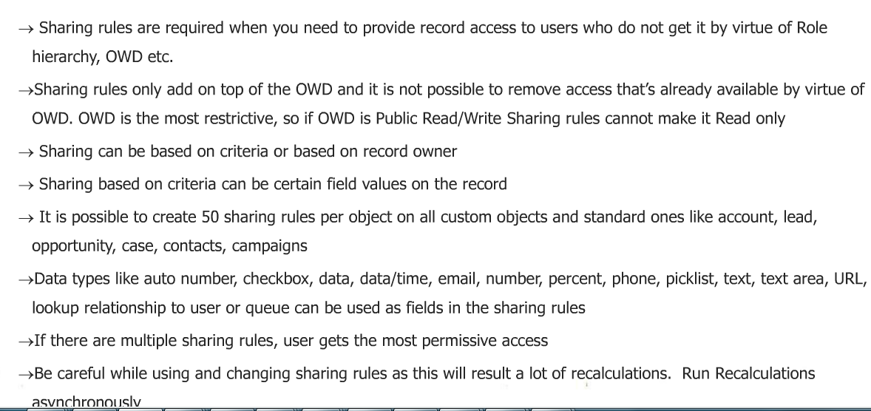
Criteria based sharing rules

Slide 12
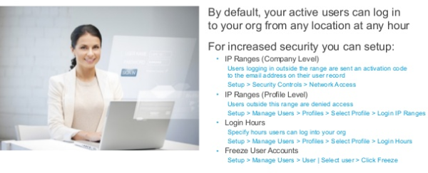
Additonal Security settings

Slide 13
