Slide 1

Community implementation
Presented by: Jared Hechler
Lawrence Mamaliga

Slide 2


Table of contents
1
Project Overview
2
Find and edit user account information
3
Past and Current Deliveries
4
Tracking Code
5
Service Cloud
6
Process Automation
7
Summary

Slide 3


Project Overview
Marketing Manager, Client Retention
30% Client Attrition Rate
$15M in Profit Lost
Project Overview
User Information
Past & current
deliveries
Tracking
Code
Service
Cloud
Process
Automation
Summary

Slide 4
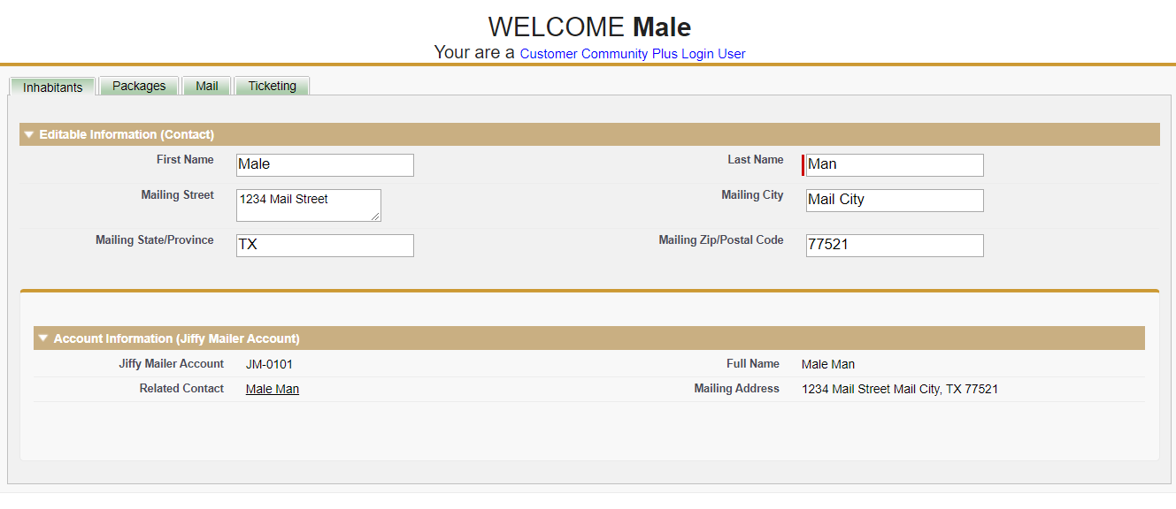
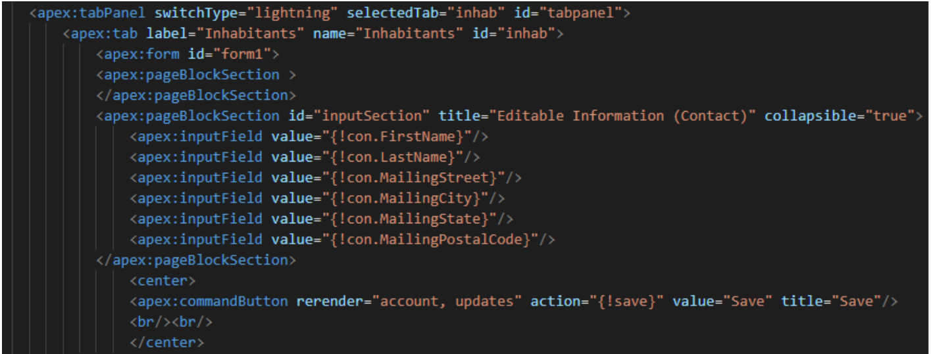
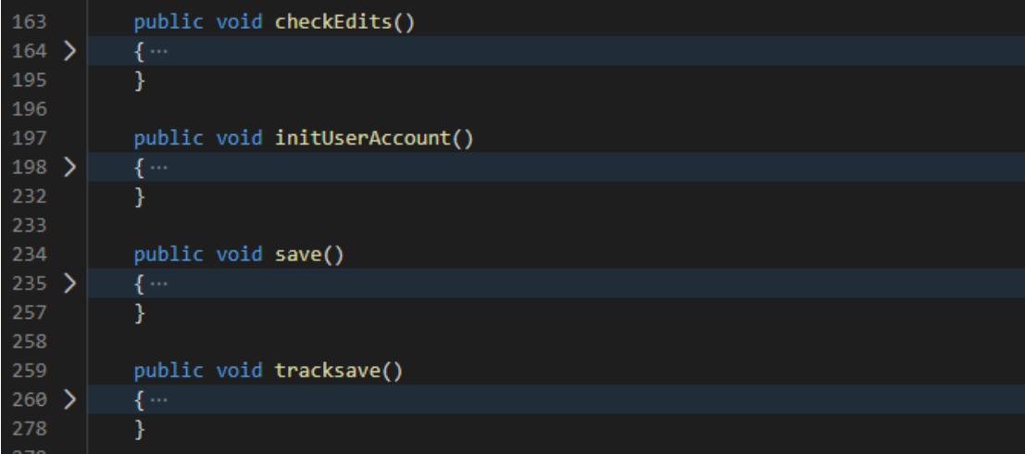
User Information
Project Overview
User Information
Past & current
deliveries
Tracking
Code
Service
Cloud
Process
Automation
Summary

Slide 5
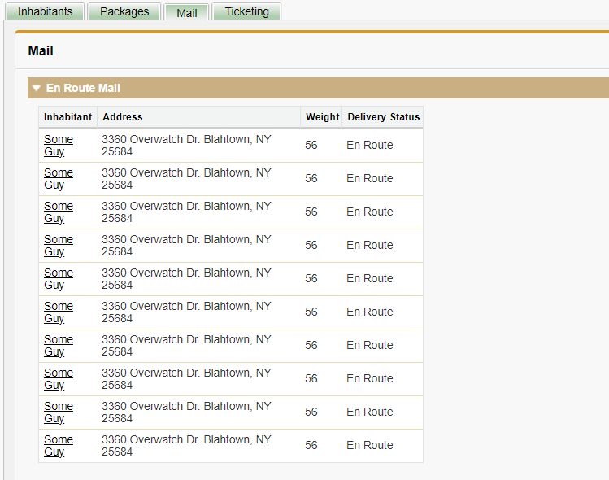
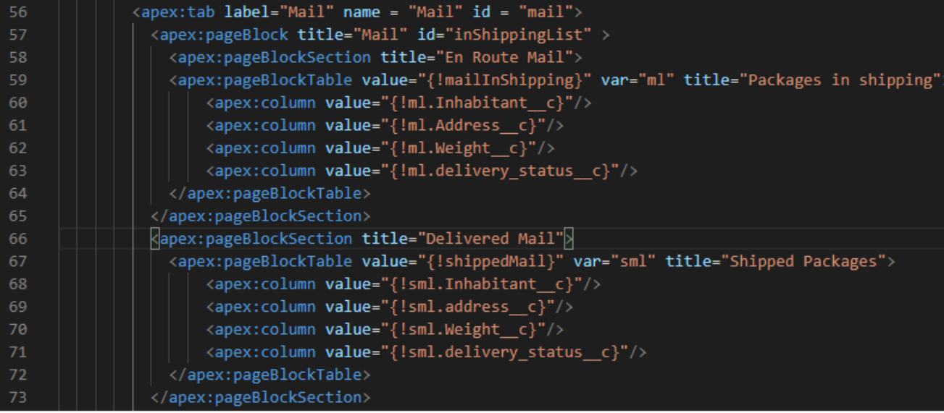
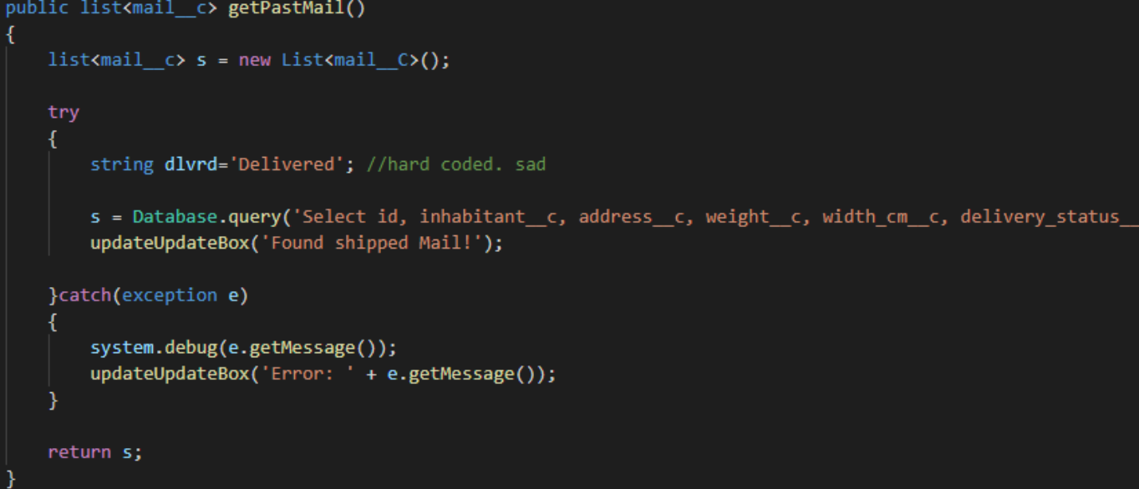
Past & current deliveries
Project Overview
User Information
Past & current
deliveries
Tracking
Code
Service
Cloud
Process
Automation
Summary

Slide 6
Past & current deliveries
Project Overview
User Information
Past & current
deliveries
Tracking
Code
Service
Cloud
Process
Automation
Summary

Slide 7
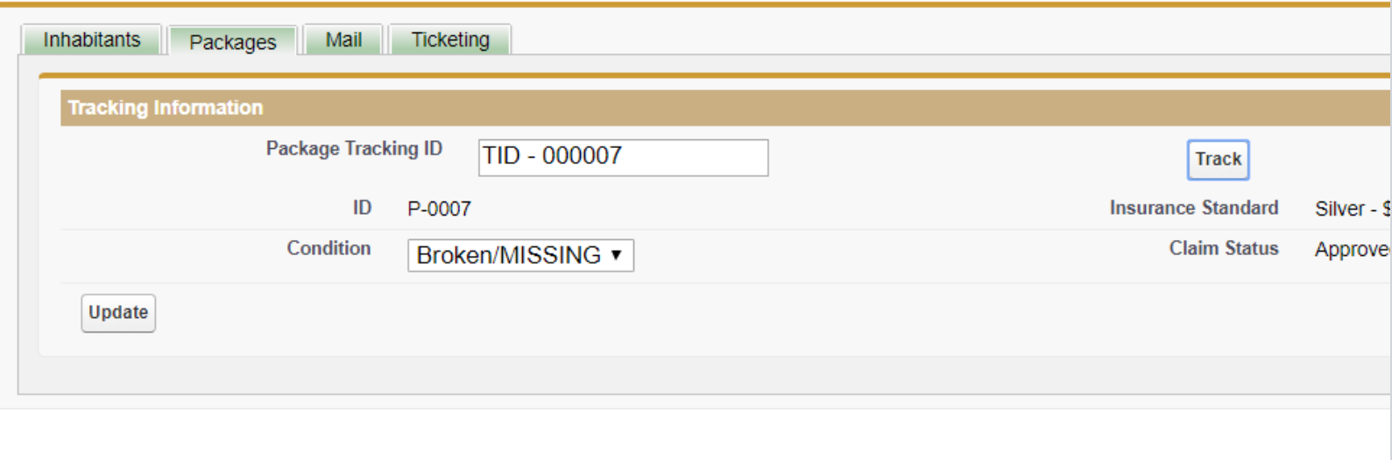
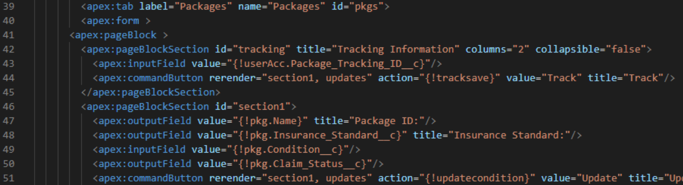
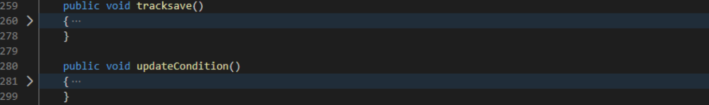
Tracking Code
Project Overview
User Information
Past & current
deliveries
Tracking
Code
Service
Cloud
Process
Automation
Summary

Slide 8
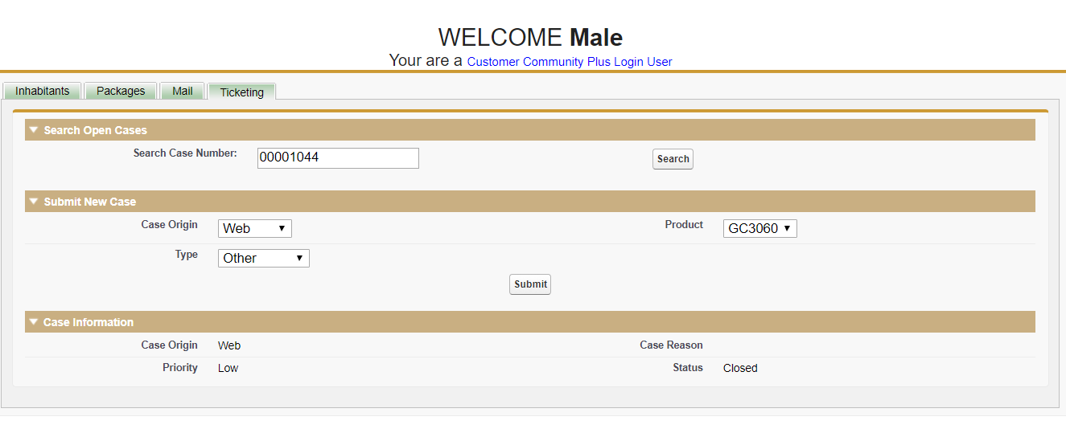
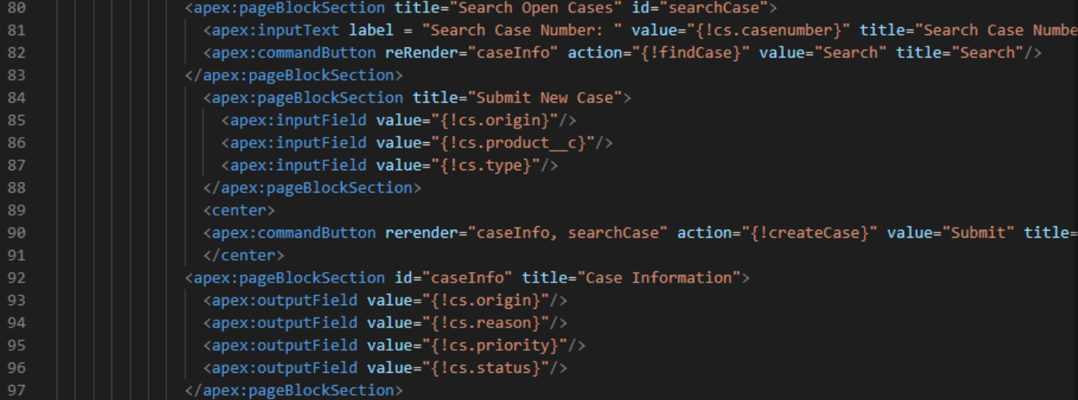
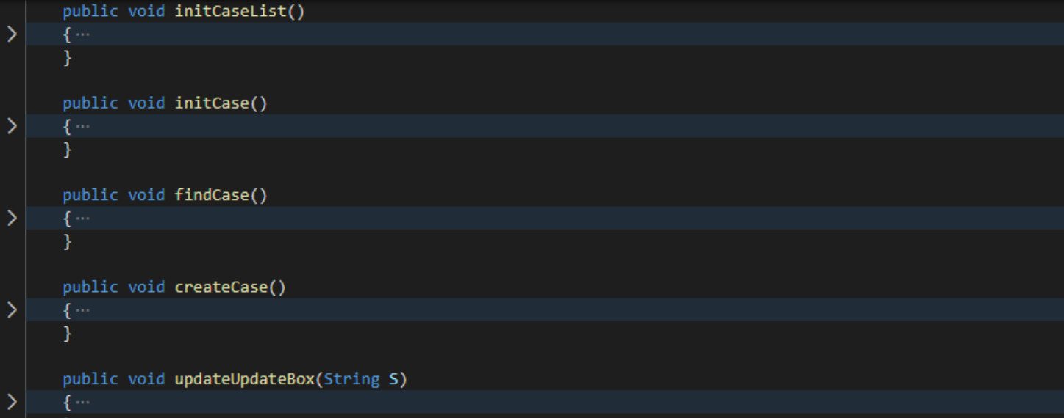
Service Cloud
Project Overview
User Information
Past & current
deliveries
Tracking
Code
Service
Cloud
Process
Automation
Summary

Slide 9
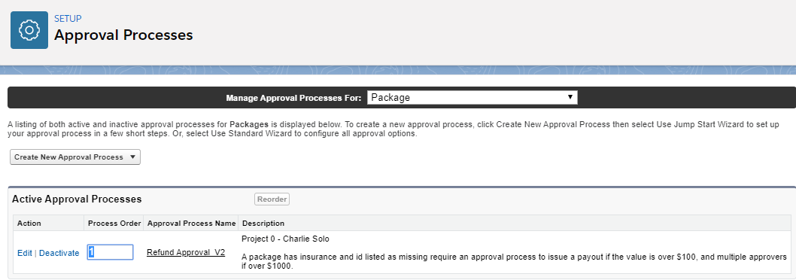
Approval process
Project Overview
User Information
Past & current
deliveries
Tracking
Code
Service
Cloud
Process
Automation
Summary

Slide 10
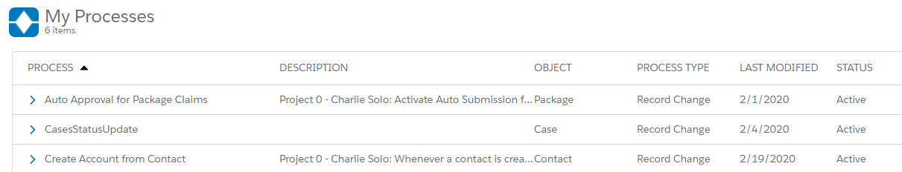
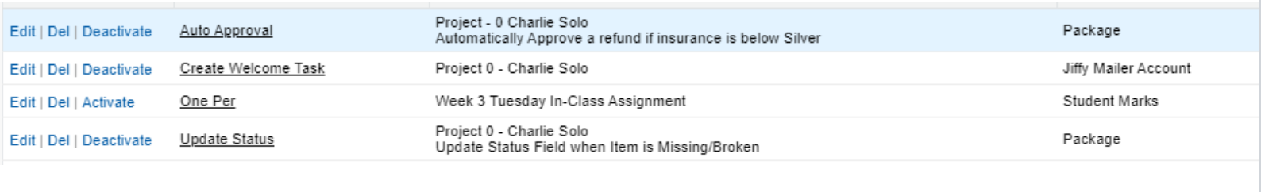
Process BUILDer
Project Overview
User Information
Past & current
deliveries
Tracking
Code
Service
Cloud
Process
Automation
Summary

Slide 11
summary
Code integration
Bugs
Time
Responsibility Balancing
Project Overview
User Information
Past & current
deliveries
Tracking
Code
Service
Cloud
Process
Automation
Summary

Slide 12
Questions?

